Slide 1
Inherent safety on legacy high-hazard plant
Peter Hunt FIChemE & Dr Malcolm Toft, Axiom Engineering Associates Ltd.

Slide 2
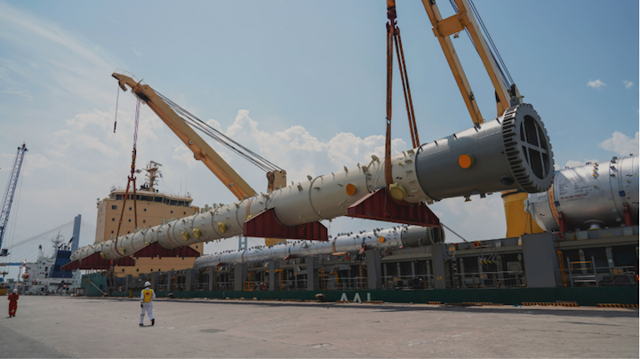
Contents
Introduction/background – the story of some vessel defects found in service
Legal and codal guidance
Risk assessment
Project and design
Procurement
Inspection
Verification
Themes
Conclusions

Slide 3
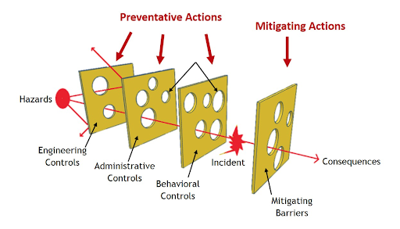
1. Introduction
What are we talking about – critical vessels where unusual defects have been found: what went wrong? Occasioned by move to non-invasive
Structure of this paper – the story of the vessels and their defects

Slide 4
2. Legal and codal guidance
COMAH – the governing legislation… or is it?
PSSR – the driver of many procedures onsite
PD 5500 – a Cat. 2 vessel? Can we specify additional inspection?
“For each pressure-containing component of the vessel, the manufacturer shall select a construction category in accordance with Table 3.4-1. The purchaser may require a minimum construction category in which case it shall be specified in the purchase specification. A component is defined as a part of pressure equipment which can be considered as an individual item for the purpose of calculation e.g. flange, end, cylindrical strake.”
“NOTE 1 ...The justification for any special precautions (e.g. additional inspection and/or test requirements, secondary containment) to reduce external risks in the postulated event of an escape of hazardous vessel contents involves consideration of matters by the purchaser (and Regulating Authority) which are beyond the scope of this specification...”
“NOTE 2 Construction categories, as defined in Table 3.4-1 are intended to apply to components of a vessel and not necessarily only to complete vessels which may therefore comprise components in two or more categories…”

Slide 5
(background to (2) – PD5500 construction categories

Slide 6
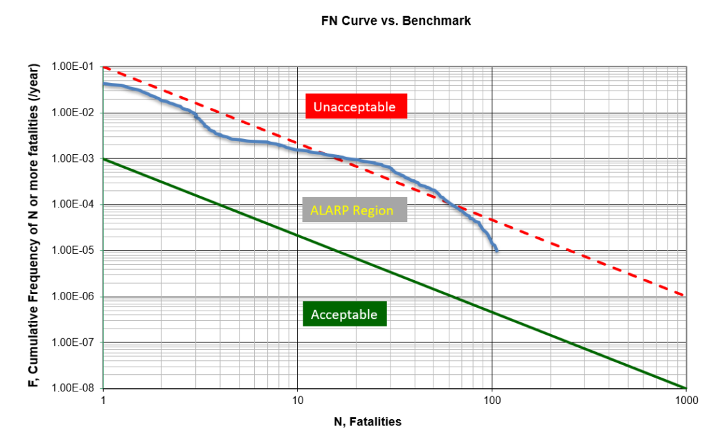
3. Risk assessment – COMAH reports
Vessel itemisation
Basis of safety (philosophy)
Worst-case and unmitigated QRA
Demonstration of risk reduction
Demonstration of ALARP
Quality of mitigations e.g. reliability of equipment

Slide 7
4. Project and design
New procedures, old vessels…?
Procedural integration (e.g. corporate/site)
Process safety integration or mention?
COMAH “vs” PSSR?
Follow-through of categorisation
Dossiers and discussion of detail

Slide 8
5. Procurement
Structure of process, differentiation
Prioritisation for procurement
ITP and/or Mechanical Data Sheet

Slide 9
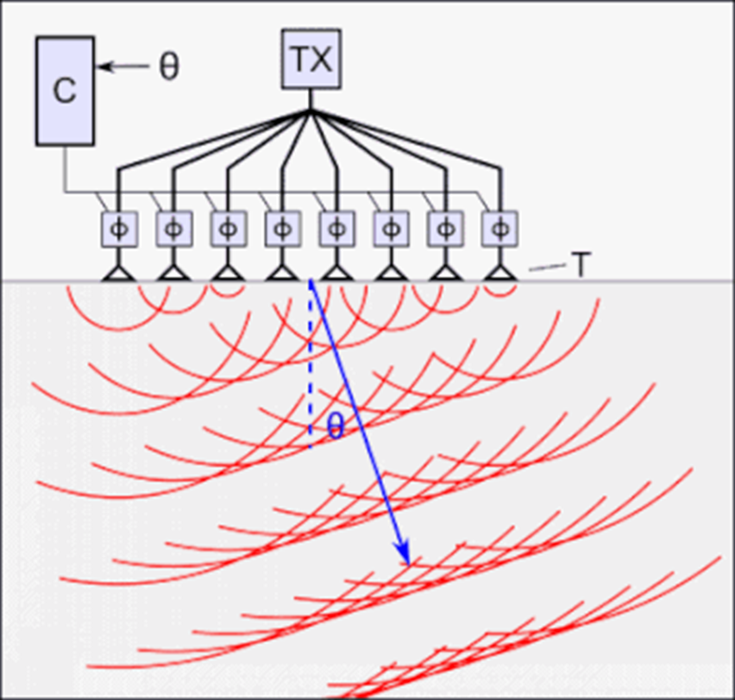
6. Inspection
Prescription from design
Based on what prioritisation?
Risk assessment (RBI-WSE): design for integrity/inspection – are initial inspections risk-based, specific, aligned with conceptual risk design?
Dossier review input?
Feedback on weldability, access etc.?

Slide 10
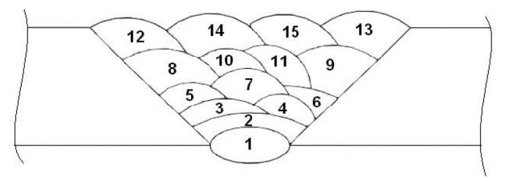
7. Verification
Tickbox or genuine review?
“open” or “closed” questioning?
HSE “intelligent customer”
Engagement with fabricator

Slide 11
8. Themes
HASWA hierarchy of control – elimination or substitution unavailable for existing vessels, or late in design phases – PPE in a COMAH report? Engineering & admin. control/mitigation critical
Process safety principles – operation or design? “Inherent” safety for legacy assets?
Need for Process Safety integration with mechanical integrity in each aspect of asset lifecycle to avoid gaps in barriers aligning
Cascade of potential issues from initial concept and risk thinking
Silos and continuity

Slide 12
9. Conclusions
PSSR vs COMAH
PD 5500 on critical components of vessels
COMAH report improvement scope – ALARP, mitigation, reduction
Multidisciplinary design HAZOPs
Inherent safety embedment in each stage of asset lifecycle
Legacy assets
Data dossiers/verification – missed opportunities for reflection?

Slide 13
Thank you
Peter.Hunt@ax-ea.co.uk
Malcolm.Toft@ax-ea.co.uk

