Slide 1
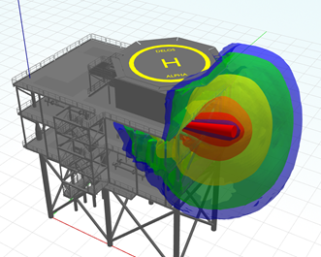
A Shielded Thermal Flux and Impacted Jet Fire Model
Andrew Lawson
Notes:
Welcome to this paper on A Shielded Thermal Flux and Impacted Jet Fire Model
My name is Andrew Lawson, I am a principal consultant at ESR Technology.
The accompany paper to this presentations provides further detail and supporting references to the work presented today.

Slide 2
TORCH Jet Fire Model
Empirical jet fire model
Predicts the jet fire size, shape, orientation and the subsequent radiative heat flux.
Originates from the work of Chamberlain (1987).
Improved to include modelling of horizontal jets (Johnson et al. 1994).
Validated against a range of experimental tests.
Notes:
TORCH is an empirical model developed by ESR technology for predicting the jet fire flame properties – flame shape, lift off distance, orientation and the subsequent radiative heat flux.
It is based on the work of chamberlain who developed a model for the prediction of the flame shape based on vertical flares
It has been further improved to include the work of Johnson et al on the modelling of horizontal jet fires.
It has been validated against a range of experimental tests, including the tests in the original chamberlain and Johnson papers.

Slide 3
Limitations with Empirical Modelling
Inability to account for the complex 3D geometry which may potentially shield regions from the thermal radiation produced by a jet fire and may also distort the jet fire flame because of the impaction on large surfaces.
This limitation can be overcome with the use of CFD fire codes; however, this can often require large computational times, which limits the number of scenarios that can be modelled.
Is there an alternative approach?
Notes:
Although useful at quickly determining the jet fire hazard ranges in major hazard assessments – with thousands of cases possible in minutes, there are limitations with empirical correlations.
The correlations do not take into account the complex geometry which may potentially shield regions from thermal radiation produced by a jet fire or may distort the jet fire flame as a result of the flame impacting on the surface. For example we cannot investigate the effect of flames wrapping around firewalls or the benefit of radiation shielding for escape routes by using empirical correlations.
We can overcome this limitation however by using one of the many CFD codes available. However, with greater complexity comes greater computational time, and this can limit the number of scenarios that can be modelled.
And then we come to the basis of this paper, is there an alternative / complimentary approach?

Slide 4
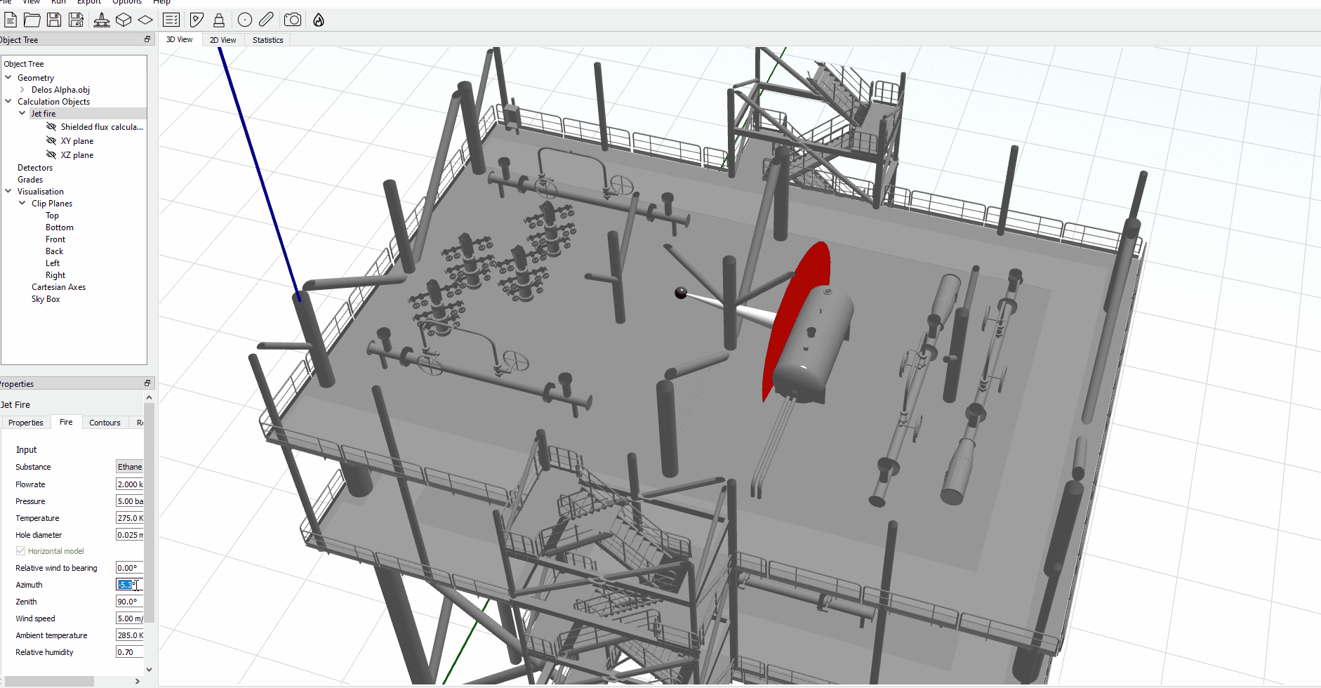
Impacted Jet Fire Model
Calculate the free jet fire properties.
Calculate an impacted jet length scale e.g. half of the free jet tip width.
The impaction model then uses ray casts oriented along the flame direction to determine obstructions.
Each potential obstruction is considered in turn, and the first object which is greater than the impacted jet length scale is taken as the point of impaction.
Notes:
In the next few slides, I will go describe the impacted jet model and radiation shielding model and then go through some of the validation exercises carried out using the model.
The first step for the impacted jet fire model is to calculated the free jet fire properties i.e. the flame dimensions and orientation. These are the properties assuming no obstructions and impaction.
Next we calculated what is called an “impacted jet length scale” and this is basically just taken as half the free tip width.
The model then casts rays along the orientation of the flame to determine any obstructions
And the first obstruction / object which is larger than the impacted jet length scale is taken as the point of impaction.
The animation on the right shows a horizontal jet fire being rotated around a deck on an example platform. When the flame comes into contact with obstacles greater than ½ the tip width you can see the flame widening as it impacts on these obstacles.

Slide 5
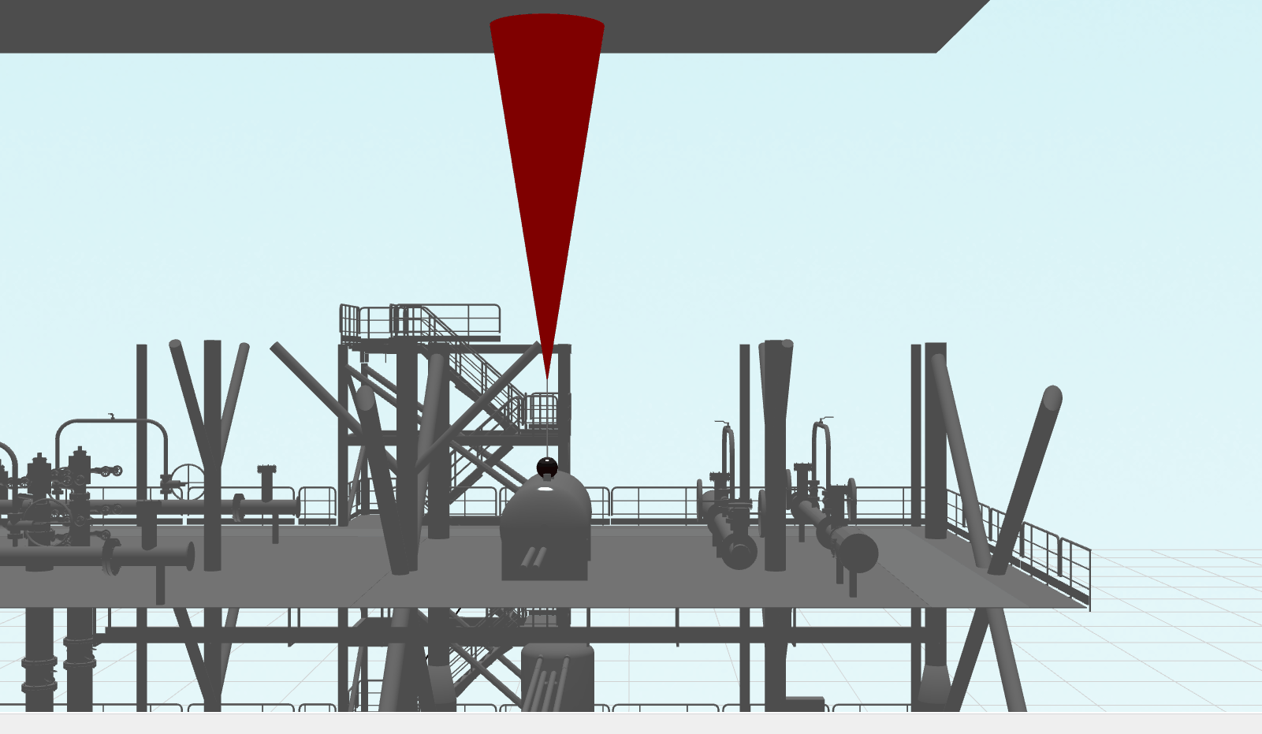
Impacted Jet Fire Model - Continued
No obstructions – free field flame
Impaction point is within the flame section:
the start of the flame volume is kept at a fixed location
the tip centre is set to be at the impaction point and the tip width is widened until the volume of the free jet flame is preserved.
Impaction point is in the lift-off portion of the jet:
the start of the flame is moved towards the source location to prevent flame becoming infinite wide and thin disc
The Surface Emissive Power (SEP) is maintained for each of the base, tip and sides of the flame frustum and the calculation with the modified frustum is performed as per the Johnson model.
Notes:
There are also a number of cases
Case 1 – if there are no obstructions or no obstructions with size greater than ½ the tip width, then we just use the free field flame
Case 2 – If the point of impaction between the flame and the obstacle is within the flame section
The start of the flame is kept at a fixed location
The tip centre is set at the point of impaction and then widen until the volume of the free jet is preserved
One of the fundamental assumptions we are making is the volume of the free jet and impacted jet are the same
Case 3 – Impaction point is in the lift off portion of the jet
In this case we move the start of the flame towards the source – this prevents the flame becoming an infinitely wide and this disc
And in all cases we maintain the surface emissive power for each side of the flame frustum
The animation of the right tries to illustrate these cases, and attempts to show how the impacted flame is treated when the impaction point is in the flame and in the lift off

Slide 6
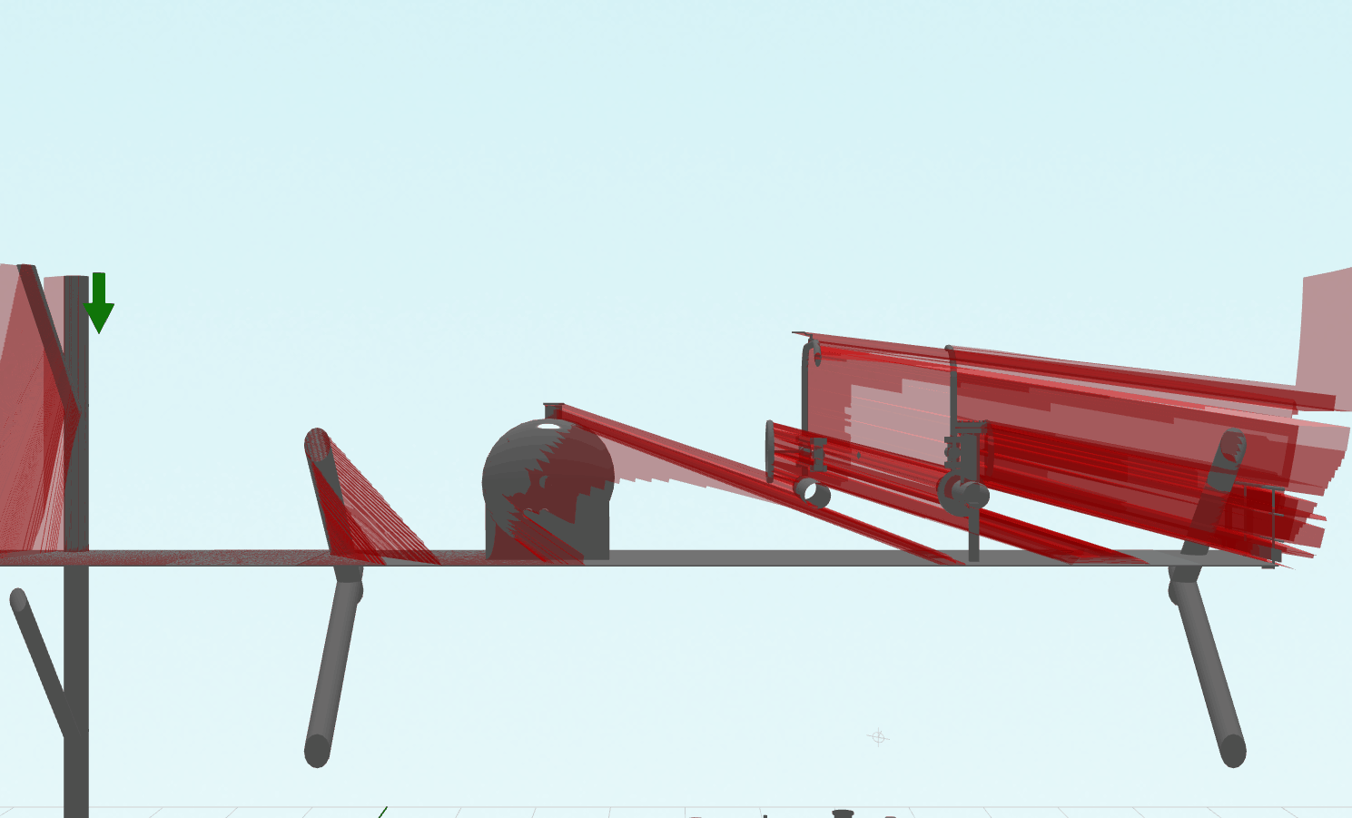
Shielded Thermal Flux Calculation
3D model is loaded into the physics engine
Ray casts are performed for each flame surface point to the receiver point and a shielding factor is generated from the blocked to total ray cast ratio
The view factor is calculated as per the unshielded jet fire radiation calculation and then scaled using the shielded factor.
This is performed for each side / end of the flame frustum and summed to give an overall view factor.
Notes:
To calculate the shielded thermal flux, we first load the model into the physics engine.
First step is to calculate a non-shielded view factor for a free jet frustum to a point in space
Next we perform ray casts from multiple points on each surface of the frustum. From this we determine the ratio of visible (hits) to obscured misses – this gives us a shielding factor.
We then scale the view factor by the shielding factor.
And we perform this for each side and end of the frustum, then sum them up to give an overall flame factor
The image on the right attempts to show the affect of the shielding. As the source is moved from left to right you can see how each of the objects provides shielding.

Slide 7
Validation
Free jet validation
Torch3D model already validated against a range of experimental data
Performed additional of Torch3D validation against the work of Darnaculleta (2019)
Performed FDS simulations
Impacted jet validation
Zhang et al (2014) work on impacted vertical jets
Both Torch3D and FDS simulations
Thermal Radiation Shielding
Notes:
So the remainder of the presentation focuses on the validation carried out on the impacted jet and shielded radiation model
Torch3D has already as explained earlier, been validated against a range of experimental data.
In this presentation, I will summarise some further validation against the work carried out by Darnaculleta
We also performed some FDS simulations and validated the results against the same work.
Next we will look at some of the impacted jet fire validation using the work of Zhang, and here we used both Torch3D and FDS
And finally we look at comparisons of the thermal radiation shielding using Torch3D and FDS.

Slide 8
Free Jet Fire Validation - Setup
Darnaculleta (2019)
Propane jet fires
Vertically orientated
Flame heights determined from infrared images
Experiment | Orifice Diameter (mm) | Fuel Mass Rate (kg/s) | Wind Speed (m/s) | Air Temperature (°C)
D10_0.09 | 10 | 0.09 | n.a. | 20
D12.75_0.13 | 12.75 | 0.13 | 1.02 | 27
D15_0.18 | 15 | 0.18 | n.a. | 21
D20_0.27 | 20 | 0.27 | 1.55 | 22
D25.5_0.34 | 25.5 | 0.34 | n.a. | 24
FDS
FDS cannot model sonic releases
Equivalent expanded jet conditions must be used subject to a Mach number of less than 0.3
Expansion model of Ewan and Moodie (1985) has been used to derive the expanded jet conditions for the FDS run
Notes:
Darnaculetta performed a series of experiments looking at vertically orientated propane jet fires. And the flame height and radiative flux was determined from infrared images
The setup information is shown on the right, and a range of diameter and mass rates were used.
The results were compared against both TORCH3D and FDS.
FDS cannot model sonic releases, and the equivalent expanded jet conditions must be subject to a Mach number of less than 0.3
The expansion model of Ewan and Moodie was used to derive the expanded jet conditions. More detail on the FDS setup is contained within the paper.

Slide 9
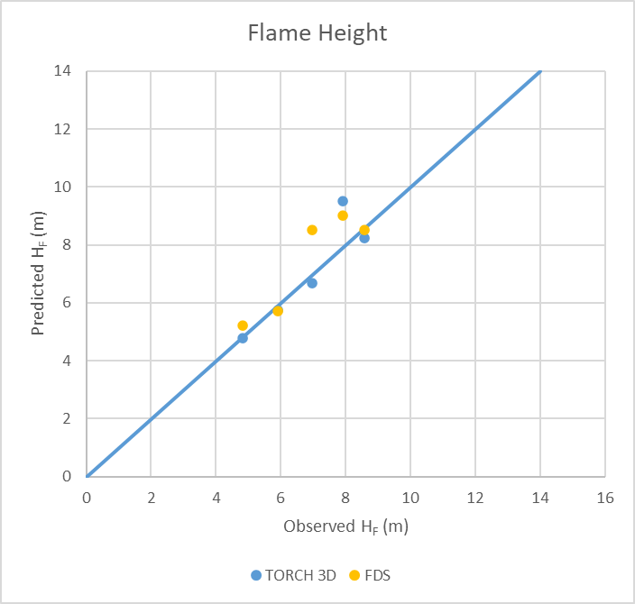
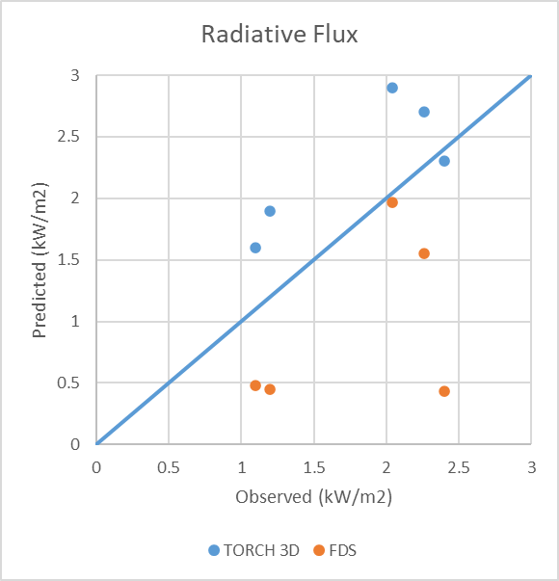
Free Jet Fire Validation - Results
Notes:
The figure on the left shows the predicted versus observed flame heights based on experimental results from Darnaculleta. This has been performed for both Torch3d (blue dots) and FDS (yellow dots).
Basically, the closer the dots are to the line, the better the agreement is in results.
In general, there is very good agreement between the predicted flame heights (both FDS and TORCH) and the observed values – this suggests also close correspondence between the TORCH 3D and FDS predictions for flame height.
The figure on the right presents the predicted versus observed radiative heat fluxes.
In general, for these experiments, TORCH 3D overpredicts the radiative flux at the location of interest and FDS underpredicts.
These differences may be due to the different way thermal radiative flux is calculated by the models. The scatter indicates a significant level of uncertainty for radiative flux predictions for both TORCH 3D and FDS, despite the good agreement of the model predictions with the experimentally observed flame heights.

Slide 10
Free Jet Fire Validation - Findings
Comparison against free vertical sonic propane jet fire experiments
Good agreement between both TORCH3D and FDS and the experimental data flame heights
TORCH3D generally overpredicts the thermal radiation compared to the experimental data
FDS generally underpredicts the thermal radiation compared to the experimental data
Notes:
To summarise the free jet validation
Good agreement between both TORCH3D and FDS and the experimental data flame heights
TORCH3D generally overpredicts the thermal radiation compared to the experimental data
FDS generally underpredicts the thermal radiation compared to the experimental data

Slide 11
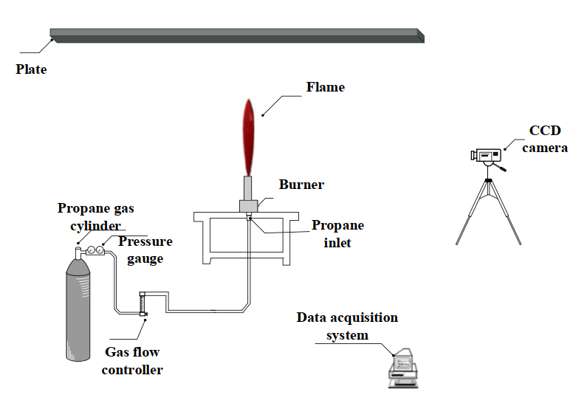
Impacted Jet Fire Validation
Zhang et al (2014)
Propane jet fires
Vertically orientated
Zero wind
Square plate above the flame
Range of distances between burner and plate
Notes:
The work by Zhang investigated the impact of a vertical jet fire impacting on a large horizontal plate in zero wind conditions. They presented various correlations for the flame spread over the plate.
They used propane jet fires vertically oriented into a square plate above the flame.
The experiments were carried out for a range of distances between the burner and plate.
The figure on the right shows the experimental setup used.

Slide 12
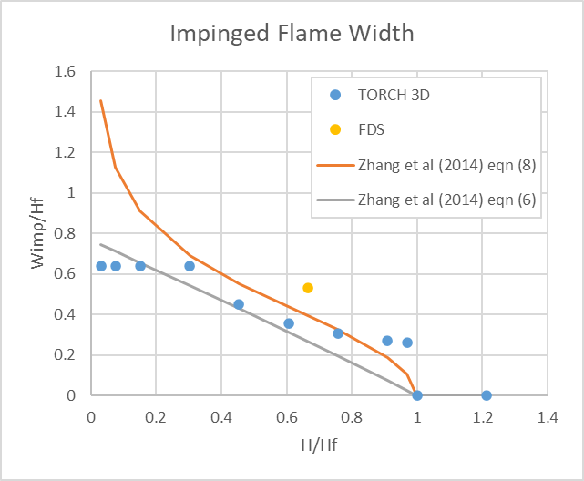
Impacted Jet Fire Validation - Results
Notes:
The results from the impacted jet fire validation provided flame widths and plate heights above the flame source. A convenient way of presenting these data is to plot the width of the flame on the plate against the height of the plate (H) above the release.
And we make both of these quantities dimensionless by dividing by the free flame height (Hf).
The figure on the left shows Width over flame height on the y axis and height of plate over flame height on the x axis. Blue dots show the torch 3D predictions and yellow dot the FDS prediction.
The plot also slows two alternative correlations taken from Zhang et al. (2014) – both these correlations show an increase in the flame width on the surface of the plate as the height of the plate is reduced relative to the free flame height.
One of the correlations (orange) shows an increasing flame width as the height gets closer to the source height, whereas the other correlation (grey) shows a flame width approaching approximately 80% of the free flame length at very close impingement.
The TORCH 3D case is based on a vertical propane jet from a 12.75 mm orifice.
The results indicate that for plate distances between about 20% and 80% of the free flame height, TORCH 3D’s simple impacted jet model produces predictions similar to and lying between the two correlations from Zhang.
TORCH 3D’s impacted jet model shows a discontinuity from the jet tip width to zero at a plate distance equal to the free flame height (because theres no impaction)
As the plate distance reduces to zero the flame width tends to just over 60% of the free flame height.
Also shown in the left figure is a data point (yellow) obtained from an FDS run of a sonic propane jet (conditions as for experiment D25.5_0.34 shown earlier), with a horizontal plate inserted 6m above the release point. The flame extent over the plate has been estimated in the same way as the flame height was determined for the free jet cases. The FDS run shows a slightly greater spread over the plate, but its deviation from the equation (8) correlation of Zhang et al (2014) is similar in magnitude to the difference between the alternative correlations.
Right figure shows an example plot of the instantaneous flame predicted by FDS.
This results suggests the impingement behaviour is mainly controlled by geometry (plate distance divided by free flame length) and we consider the overall agreement between the different approaches as encouraging.

Slide 13
Impacted Jet Fire Validation - Findings
Comparison against vertical impacted jet fire experiments
For plate distances between about 20% and 80% of the free flame height, the simple impacted jet model in TORCH3D produced predictions similar to and lying between the two correlations from Zhang et al (2014).
As the plate approaches zero height above the flame, the flame width tends to just over 60% of the free flame height.
Overall, the results suggests the impingement behaviour is mainly controlled by geometry (plate distance divided by free flame length) and we consider the overall agreement between the different approaches as encouraging, especially given the large differences in scale relative to orifice diameter.

Slide 14
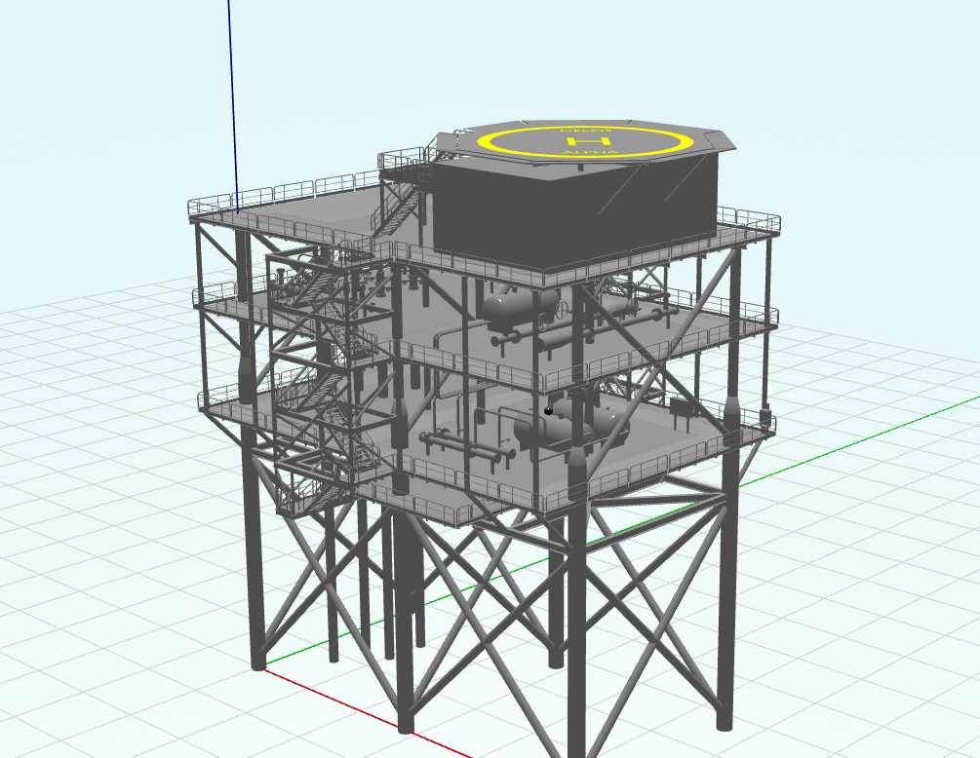
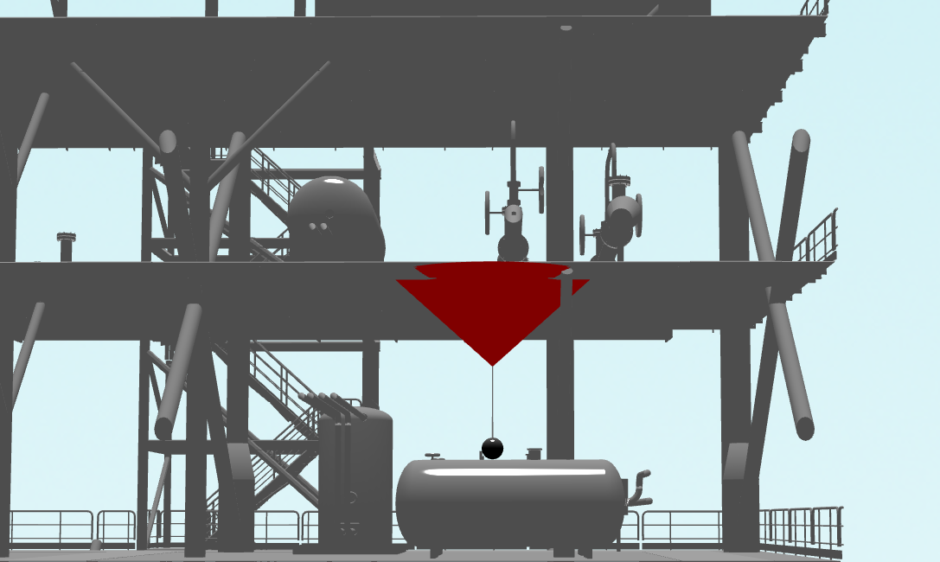
Thermal Radiation Shielding
Source location
z
y
x
Notes:
The final few slides look at comparisons of the thermal radiation between Torch3D and FDS simulations in a real world scenario that includes the effects of shielding.
The figure on the left shows a screen shot of the 3D model representative of an offshore platform including a release point from a separator vessel which is giving a vertical propane jet fire that impacts on the plated deck above.
The vertical jet fire is modelled using the release conditions corresponding to D25.5_0.34 case in shown earlier in the darnaculetta experiments
The figure on the right shows a comparison of the predicted impacted flame spread from TORCH 3D (top of figure) and a snapshot of the heat release rate per unit volume from FDS (bottom of figure).
The models predict similar spread of the jet on the ceiling but differ in geometric shape with TORCH 3D modelling the impacted jet as a fustrum, including the lift-off distance with no combustion, whereas FDS shows a flat radial wall jet on the ceiling and a relatively narrow jet fire extending all the way from the source without any flame lift-off.

Slide 15
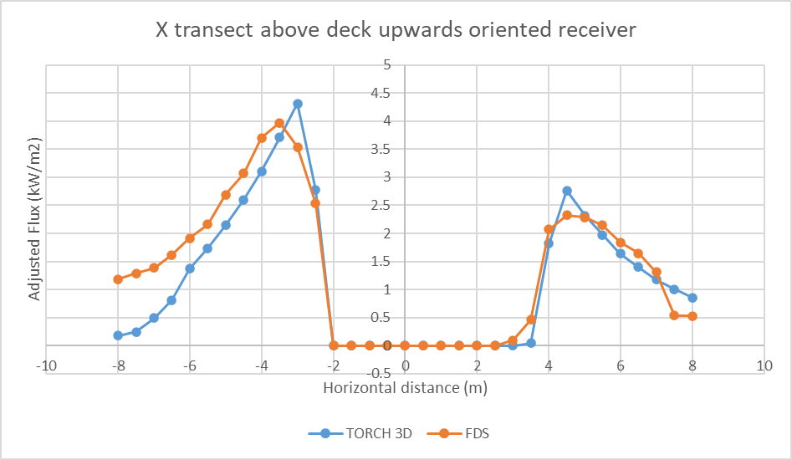
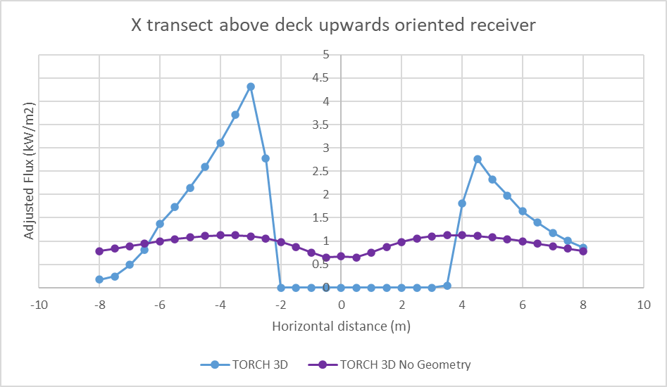
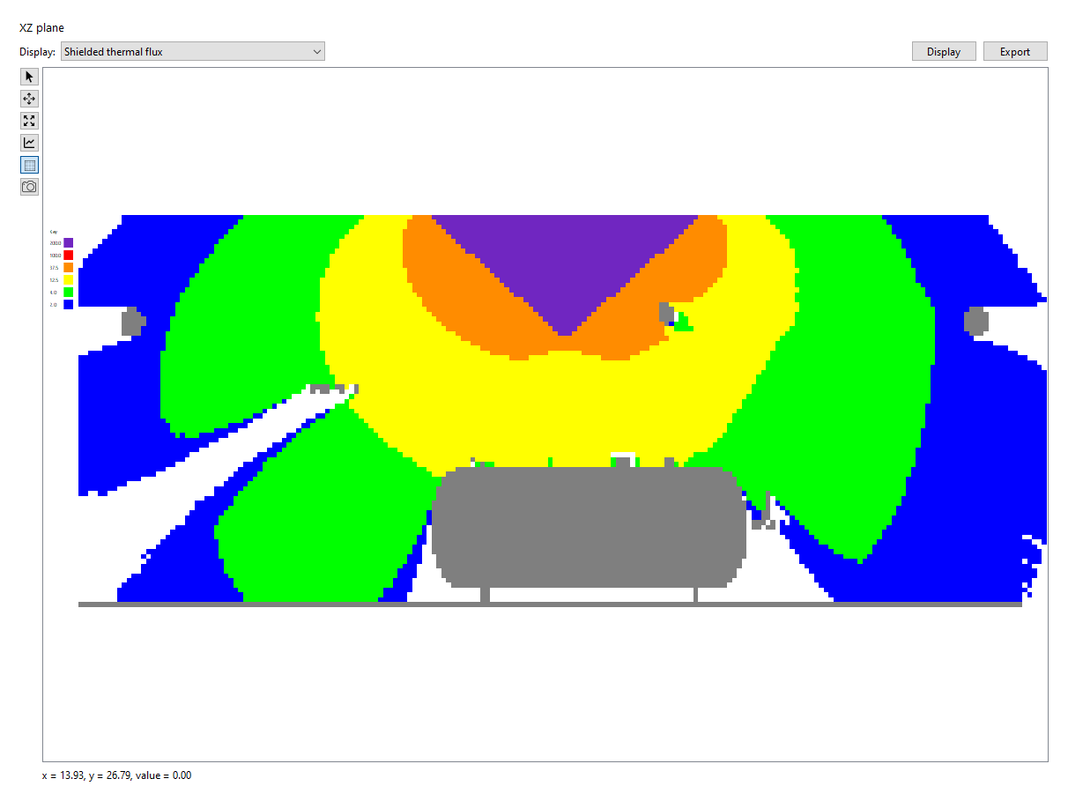
Thermal Radiation Shielding
Transect
Notes:
The bottom left figure shows the radiative heat flux contours from a 2D snapshot from the 3D model.
The release is vertical from the top of the separator and is into the plated deck above. You can see the purple flux level is represented of the flame shame and how it spreads across the plate. The other colours show different levels of radiation, reducing as you get further from the flame.
You can also see regions of now radiative heat flux where the shielding has effectively blocked it.
The dashed red line is a transect where the radiation has been measured in both TORCH3D and FDS.
The top left figure shows the adjusted radiative heat flux against distance along a transect through the X axis of the 3D model. The heat flux for the TORCH3D and FDS results was adjusted based on the overprediction and underprediction results shown earlier against the work by Darnaculetta.
With this adjustment both TORCH 3D and FDS show very similar transects indicating that the thermal radiation screening by obstacles in TORCH 3D is able to reproduce the screening effect of obstacles in the CFD tool (FDS). The similarity of the transects between the two models also suggests that, at least for this configuration, the differences in impacted flame shape is not producing significant differences at 1m height above the lower deck.
The plot on the right show contours of the radiative flux predicted by TORCH 3D along the same transect as those on the right. The blue line represents the shielded flux ad the purple line the unshielded flux. As you can see the effect of shielding by obstacles is clearly evident.

Slide 16
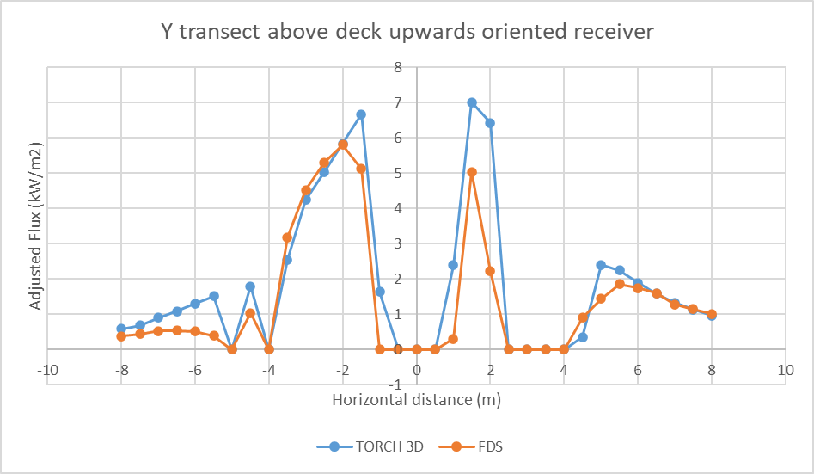
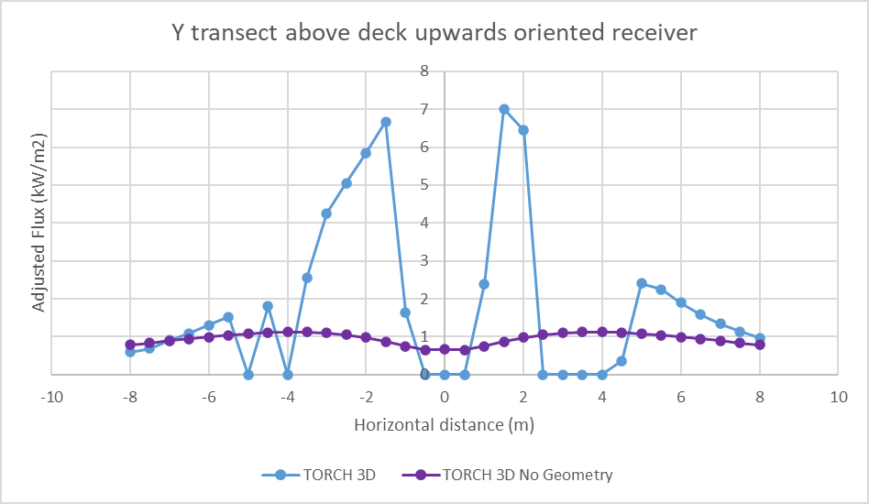
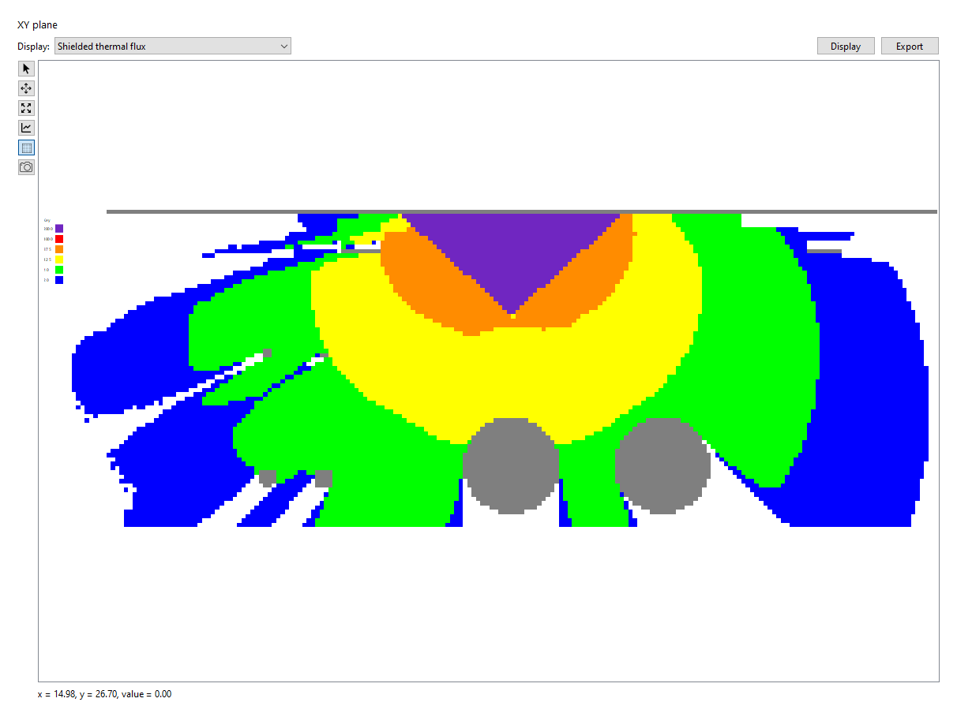
Thermal Radiation Shielding
Transect
Notes:
This slide is the same case as before but showing a different orientation. We are now looking down the end of the separator. You can see the separator vessel on the bottom left figure and the flame impacted the plated deck above. In this orientation you can also see a second vessel which provides shielding.
The top left shows a comparison of Torch3d and FDS adjusted flux levels along the transect. Again the results show very similar results, again indicating that the thermal radiation screening by obstacles in TORCH 3D is able to reproduce the screening effect of obstacles in the CFD tool (FDS). The troughs in the contour indicate regions that are shielded and you can clearly see the shielding effect provided by the two separator vessels.
On the right we show a comparison of the shielded and unshielded flux. The case with no geometry (purple) shows higher flux in the shielded areas when compared to the geometry case (blue), and lower predicted radiative flux in the unshielded locations. The reduction at unshielded locations is simply due to the smaller view factor of the unimpacted vertical flame at these locations, whereas the increased values are a consequence of ignoring shielding.
Therefore ignoring the geometry can lead to the underprediction of radiative fluxes in the module where the jet fire source is located, and overprediction in neighbouring modules which otherwise would be shielded, e.g., due to the presence of a fire wall or solid deck.

Slide 17
Thermal Radiation Validation - Findings
Both models predict similar spread of the jet on the ceiling but differ in geometric shape.
The adjusted thermal radiation results for both TORCH 3D and FDS show very similar transects indicating that the thermal radiation screening by obstacles in TORCH 3D is able to reproduce the screening effect of obstacles in the CFD tool (FDS).
Notes:
To summarise the thermal radiation validation exercises, both FDS and torch3d predicted similar spread of the flame on the celling but with different geometric shape. With torch the modelling the impacted jet as a frustrum, including the lift-off distance with no combustion, whereas FDS shows a flat radial wall jet on the ceiling and a relatively narrow jet fire extending all the way from the source without any flame lift-off.
The thermal radiation results for both torch and FDS show very similar transects, indicating that torch3d is able of producing comparable results to the CFD tool, albeit in this limited scenario.

Slide 18
Conclusions
Model for simplifying the impacted jet flame shape and resulting shielded thermal radiation
Comparison against free vertical sonic propane jet fire experiments
Good prediction of the flame height
Overpredicts the thermal radiation
Comparison against impacted jet fire experiments
Similar lateral flame spread
‘Real world’ simulation
TORCH 3D shielded thermal radiation results showed similar results to FDS simulation
Further validation studies would be beneficial to increase the confidence in applying the impacted jet model to a wider range of situations

Slide 19
Any questions?
Email: andrew.lawson@esrtechnology.com
ESR Technology website: www.esrtechnology.com
Notes:
I would like to thank the co-authors of this paper
Luke Butcher, Ed Walton, Graham Tickle, Jasmine Stainton and Shamsu Hassan
, who, without their help it would have not be possible.
If you have any questions, I would be happy to answer them now.
Or you can contact me at the email address shown here.

