Slide 2
Contaminated Wounds: A Risk Assessment Challenge
Tim Boland, Safety-in-Engineering Lead, Sellafield Ltd.
Richard Cooper, Safety Process & Methodology, Sellafield Ltd.

Slide 3

What is a Contaminated Wound?
Notes:
Consider a person at work.
They receive a wound, breaking the skin as part of their activities. An unfortunate event in itself. [click]
If the wound has foreign material the injury is of even more concern (for example, think of tetanus risks). [click]
If the foreign material is radioactive this is even more concerning. [click]
Particularly as only very small quantities can cause considerable harm and once in the body it can be very difficult to treat. [click]
The nuclear industry describes these hazards as “contaminated wounds”.

Slide 4
Basics of Ionising Radiation
Radiation type Distance in air Shielded by
ALPHA 2-3 cm paper
BETA 3-4 m aluminium
GAMMA γ infinity lead/concrete
NEUTRON infinity jabroc/water
α
β
n
Notes:
A quick review of secondary school physics.
4 types of ionising radiation, with varying penetrating powers.
However, the least penetrating, alpha, has the largest ionising effect over that short distance.
So typically we are interested in alpha contamination because you can easily shield but it has powerful effects over a short distance.

Slide 5
Radiation Pathways
Notes:
The exposure mechanism for radiological hazards affects mitigation strategies and consequences. There are three main harm pathways as shown in this diagram.
External Radiation is where the person is remote from the source of radiation. They are exposed to the “shine” of radiation. We can mitigate by placing “biological shielding” (say thick concrete) between the people and the source. We can also keep people away (distance) or shorten their exposure (time). Basically you can run away from external radiation!
External Contamination is where radioacitve material adheres to a person’s clothing or even skin. Containment is key for prevention. Mitigation is to remove the contamination by removing clothing or cleaning (showers).
Internal radiation is when radioactive materials enter the body via inhalation, ingestion and wounds. There is very little potential for mitigation, it is very difficult if not impossible to remove the radioactive material. It can be there for life hence can be a much more significant problem. Contaminated wounds is about internal radiation risks.

Slide 6
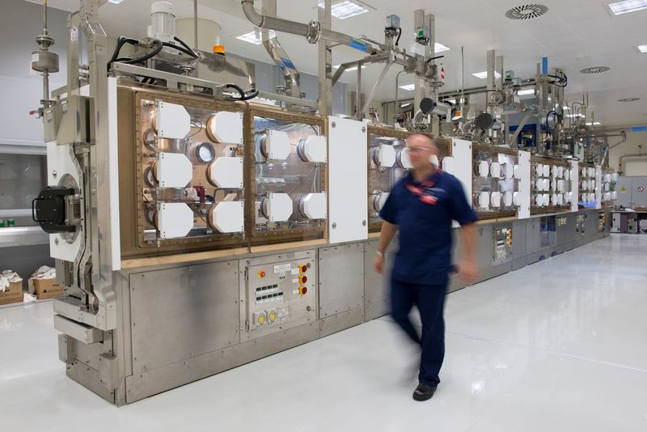
Operations
Notes:
There are a number of activities within the nuclear industry where people need to manipulate things manually. These are typically where a high degree of dexterity is required and the operations are varied batch type operations.
The image here was taken from Alpha Resilience and Capability programme. It shows a laboratory (you can see a conventional fume cabinet in the background). In foreground is a suite of gloveboxes where material is kept in a controlled environment (a depression) and people place their hands in gloves to manipulate. (much more controlled than the Simpsons caricature!) The glove ports are behind guards in this example. If the glove is punctured, a contaminated wound may result.

Slide 7
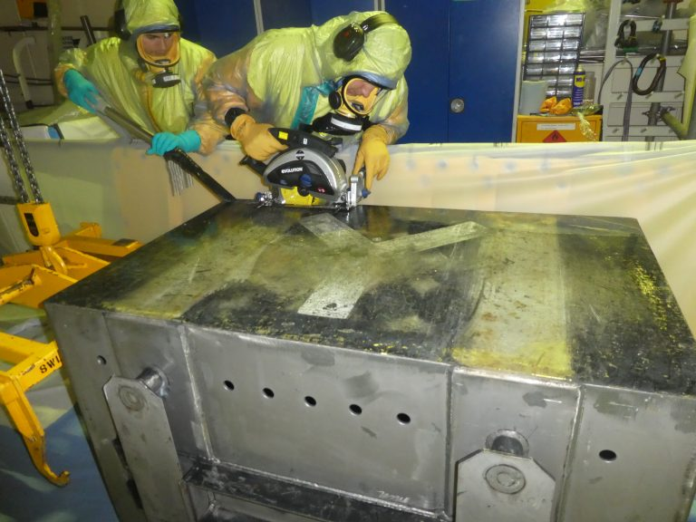
Operations
Notes:
This is a different example, decommissioning work. This photo is from Magnox stations showing size reduction of redundant equipment. Operators are wearing PVC and respirators to prevent contamination. They are size reducing some equipment such that it can be removed and sentenced as waste. To do that they need to use a saw and so contaminated wound is a risk.

Slide 8
Operations
Production of powders and pellets
Opening of legacy packages
Re-packaging of materials
Decommissioning and dismantling of legacy facilities
Analytical laboratory work
Notes:
For Sellafield the types of operations where there may be the risk of contaminated wounds is as follows. [read from list]
Production of powders and pellets (furnaces, milling, grinding, quality control)
Opening of legacy packages (multilayer containers of steel and PVC) for rework (sawing, cutting etc)
Re-packaging of materials into modern containment.
Decommissioning and dismantling of legacy facilities (cutting and packaging of waste)
Analytical laboratory work (hot plates, glassware etc)
(Typically, they all involve high degrees of manipulation difficult to achieve remotely, most are also batch operations)

Slide 9
Conventional Approach
Supply of Machinery (Safety) Regulations 2008
Essential Health and Safety Requirements
BS EN ISO 12100
Assess in advance
Assess measures introduced
Notes:
The potential for wounding is common in most industries and it is typically a consequence of people operating machinery.
.In the UK this is regulated by Supply of Machinery (Safety) Regulations 2008. It requires that a set of Essential Health and Safety Requirements are met. Typically, this is via the application of Designated Standards. Designated Standards are categorised as “C” for particular product types, “B” for common safety issues and “A” for fundamental principles for safety. The relevant “A” standard for applications at Sellafield Ltd. is BS EN ISO 12100 ‘Safety of machinery. General principles for design. Risk assessment and risk reduction’. It requires risk assessment and risk reduction by, in priority, design, safeguarding / protection and information on use. Sellafield Ltd. uses the qualitative scoring approach of PrEN 1050.
The output is a series of identified hazards with a risk score followed by a series of risk reduction measures with a residual risk score.
There is not a requirement for context of why the machine is needed in the first place; the nature of the hazard is only broadly described and alternative non-selected approaches are not mentioned. For conventional hazards this is regarded as proportionate.

Slide 10
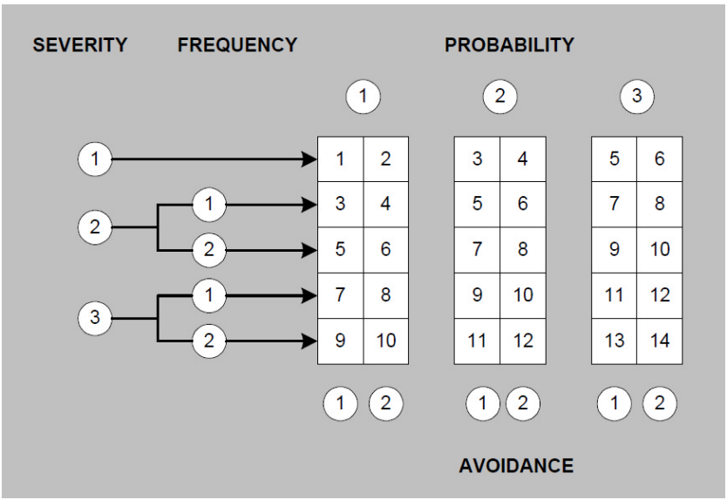
Severity | 1 | slight (normally reversible) injury or damage to health
 | 2 | serious (normally irreversible) injury or damage to health
 | 3 | death
Frequency | 1 | seldom to quite often
 | 2 | frequent to continuous
Probability | 1 | low (so unlikely that it can be assumed occurrence may not be experienced)
 | 2 | medium (likely to occur sometime in the life of an item)
 | 3 | high (likely to occur frequently)
Avoidance | 1 | possible under specific conditions
 | 2 | scarcely possible
Notes:
This is the scoring technique that Sellafield Ltd uses. 4 Broad brush categories, Severity, Frequency, Probability and Avoidance. Algorithm shown in pictorial form gives an overall score.
Absolute score is of less importance than showing proposed measures have an impact.
But for contaminated wounds the potential consequences of even a minor wound could be significant. Therefore the conventional approach does not feel proportionate. More justification is needed. So lets look at “Nuclear Safety” and how it compares to the concept of “Process Safety”.

Slide 11
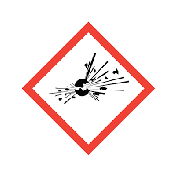
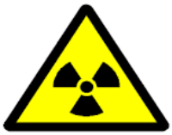
Nuclear Safety and Process Safety
Both about containment of hazardous material
Both concerned with very low frequency high consequence events
However lower tolerability of risk
Lower thresholds
Emphasis on defence-in-depth, determinism and conservatism
Notes:
This could be a presentation all in itself and indeed several papers have been written on the subject, but briefly:
For those unfamiliar with the nuclear sector, Nuclear Safety is comparable with Process Safety. Both deal with high consequence events with very low frequencies and both are concerned with containment and control of hazardous materials. However, there is a lower tolerability of risk for nuclear installations, as explained in Health and Safety Executive’s (HSE) “The tolerability of risk from nuclear power stations”. This results in lower thresholds for severity of harm and the DBA methodology. DBA is very similar to other risk assessment techniques such as Quantitative Risk Analysis (QRA) but with a strong emphasis on demonstrating defence-in-depth, determinism and conservatism. The Office for Nuclear Regulation (ONR) has guidance on their website with more details.

Slide 12
Assessment
Identification of hazards
  HAZOP
  Walkdown / Workface assessment
  “Unexpected” sharps
Consequences
  Mechanism of harm complex
  Physical / chemical / biological interactions
  Broad brush qualitative only
Notes:
So the approach to contaminated wounds is largely similar to Process Safety, that is we need to make a case, an argument that the risks are reduced So Far As Reasonably Practicable.
We identify hazards in a structured way this is typically as a HAZOP using key words to high light hazards. However, this needs further supplementation by considering the spatial aspects of the job by a walkdown or inspection of the workface.
A particular challenge is considering “unexpected” or latent sharps. These are ones that develop with time for example:
a rod sharpened to a point by corrosion or electrolysis
rough, abrasive edges formed by cutting metal with a saw or shear
sharp edges exposed during maintenance or dismantling
normal tools which only become a cutting hazard because of the method of use
The full-lifecycle needs consideration, removing a sharps risk to one group (operators say) may endanger another group (maintenance). Human factors may advise.
The consequence of harm is quite complex. (NCRP guidance in report 156 for those interested…)
Composition of foreign material
Physical state of foreign material (fragment, colloids, solutions etc)
Type of injury
This complexity makes assessment difficult and the temptation is to compound conservative assumptions resulting in very high predicted consequences. So in practice broad brush assessments that largely conclude high consequences are determined.

Slide 13
Hierarchy of Controls
Notes:
On to the measures that can be put in place and are deemed appropriate.
The starting position is the accumulation of knowledge in various Good Practices from decades of operation of these type of facilities at Sellafield, the wider UK Nuclear Sector and internationally. But in order to methodically demonstrate risks are ALARP opportunities are identified by following a hierarchy of controls as shown in the diagram.
I appreciate it may not be clearest so I will run through the contents.
ELIMINATE remove the hazard
Removal of CW hazard through primary containment of inventory - hazardous material contained within robust physical barriers which cannot be breached or pierced
Removal of CW Hazard by removing the need for hands-on operations – e.g. Automated or remotely operated processes
REDUCE the inherent harm potential of the hazard
Reduce the mobile contamination present on exposed surfaces, e.g. Decontaminate prior to hands on operation/maintenance
Reduce the opportunity for (likelihood of) wounding), by reducing the amount of hands-on operation/maintenance required to deliver the operations by design (e.g. inherently sagfe tooling)
Reduce the opportunity for (likelihood of) wounding by Engineering/Operational design/manufacturing - e.g. removal of sharps, heat sources, flammable atmospheres, moving machinery, etc
CONTROL prevent the hazardous material from resulting in harm
Engineered Protection Systemsor or Operational Controls which keep personnel away from contaminated areas or injurious equipment (Isolate) – e.g. Interlocks to prevent entry to room/glovebox, Isolation procedures
Preventing injury by provision of PPE
MITIGATE reduce the level of harm that could result from the hazardous material
Medical intervention to remove the hazardous material from the body (mitigate resulting dose uptake)
(with the preference for those measures near the top of the hierarchy)
I should also mention that experience suggests that mitigation (using chelating agents) in practice in very effective if delivered timely. Therefore some effort is placed in detailing what the mitigation arrangements are.

Slide 14
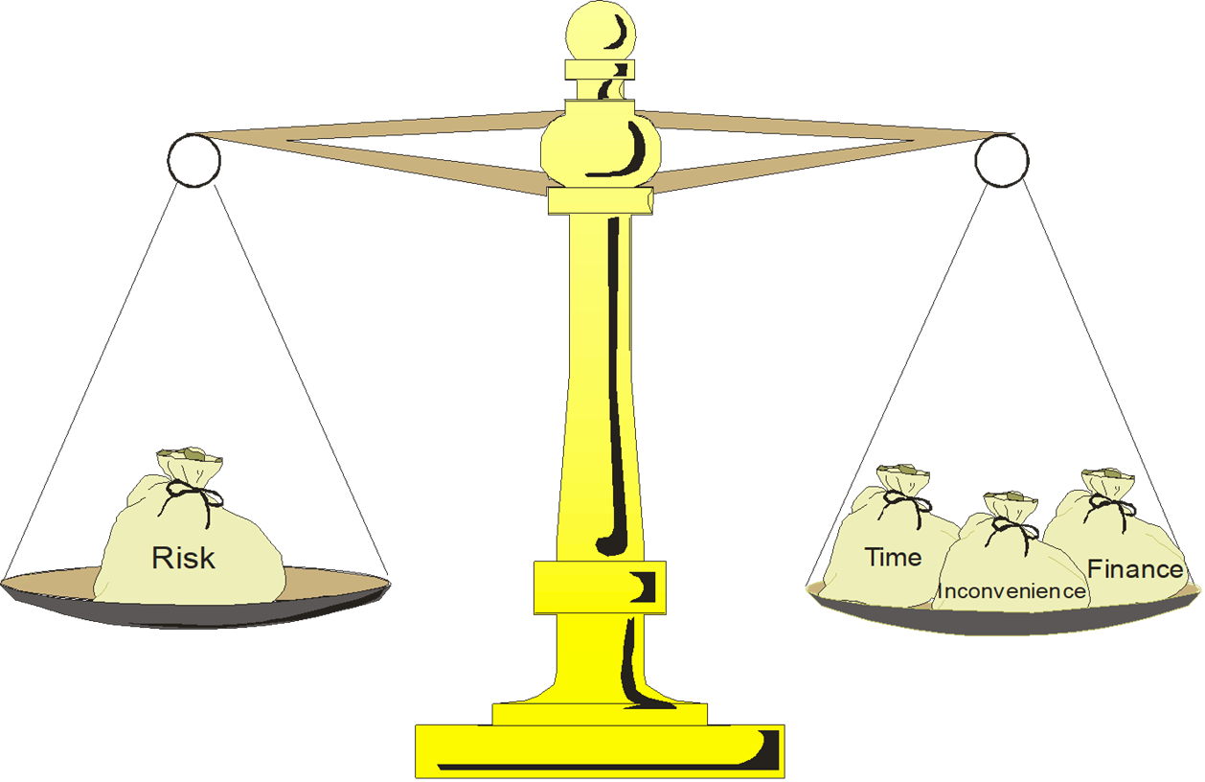
Demonstrating ALARP: Paths not travelled
Some potential barriers are not appropriate
Context of mission?
Adverse consequences?
Notes:
Some measures higher up the hierarchy are often deemed impracticable. But due to the significance of the hazard it is not left at that! On the contrary the reasons why a measure is deemed impracticable must be given.
This is often due to the wider context, for example the operation is required to remove a legacy hazard with a worsening condition (i.e. it is time critical and so cannot be held up by lengthy research and development). The analogy often used is the difference between a plane on the ground and a plane in the air.
Or it could be because of adverse consequences. A typical example would be removal of risk to operator by increased automation increases the risk much further to maintainers. (Note adverse human factors of infrequent maintenance compared with routine operations and difficulty in predicted latent sharps in engineering).
That is what is the balance for NOT doing something

Slide 15
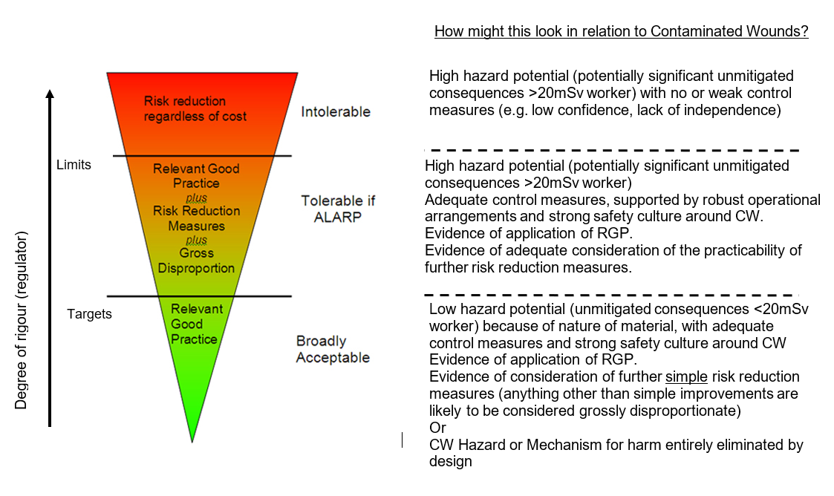
Demonstrating ALARP: Context
Notes:
So here we try to pull everything together to show the general “acceptability” of the case being made.
We’ve shown it as a famous “risk carrot” as per HSE’s R2P2. 20mSv is taken as the threshold between high hazard and low hazard. A risk is only tolerable if a case is made that operational measures are in place, RGP has been applied and reasons why further measures are not appropriate are stated.
Of course all this is framed within the general context of why the operation or “mission” is appropriate in the first place (e.g. to remove a legacy hazard).

Slide 16
Summary
Contaminated Wounds assessment is conventional wound assessment plus!
Difficult to quantify
Requires systematic justification
  Opportunities to improve
  Wider context of operation
Notes:
To summarise:
Contaminated wounds assessment can be complex and difficult. Bounding arguments can make the hazard appear very large with few opportunities for risk reduction. Because of the nature of the hazard something more than a conventional machineries assessment is required.
This is very true when trying to quantify effects and instead the level of effort should be on making the case.
To be proportionate as systematic justification is required showing the application of hierarchy of controls (included paths not travelled) and the wider context of the operation.
Thank you for listening.

