Slide 1
Hazards 32 - Harrogate
Steel fragilization due to emergency depressurization real-scale experiment and modelling

Slide 2

Summary
01
STEEL FRAGILISATION AFTER DEPRESSURISATION OPERATIONS
EXPERIMENTAL SET-UP
EXPERIMENTAL RESULTS
COMPARISON WITH SYMMETRY SIMULATIONS
CONCLUSION
02
03
04
05

Slide 3
Hazards 32
01 - STEEL FRAGILISATION AFTER DEPRESSURISATION OPERATIONS

Slide 4
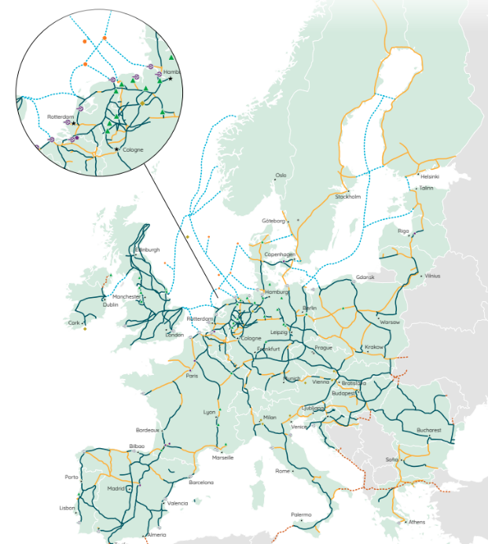
GRTgaz in few words
Hydrogen to decarbonise energy sector
  A challenge for the gas industry to answer to climate change and rarefaction
  New strategies and roadmaps defined by national governments and the
  EU for the development of hydrogen technologies
A common goal for TSOs
  31 european energy infrastructure operators
  are creating the European Hydrogen Backbone (EHB)
  Roadmap up to 2040
  53,000 km based on using 60% of repurposed
  natural gas pipelines and 40% new pipelines
  Investments from 80 to 140 billions € (70 to 125 b£)
European Hydrogen Backbone (2022)

Slide 5
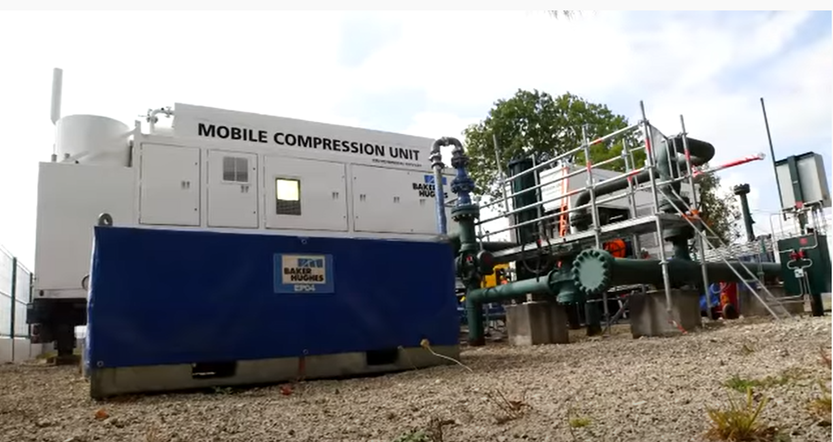
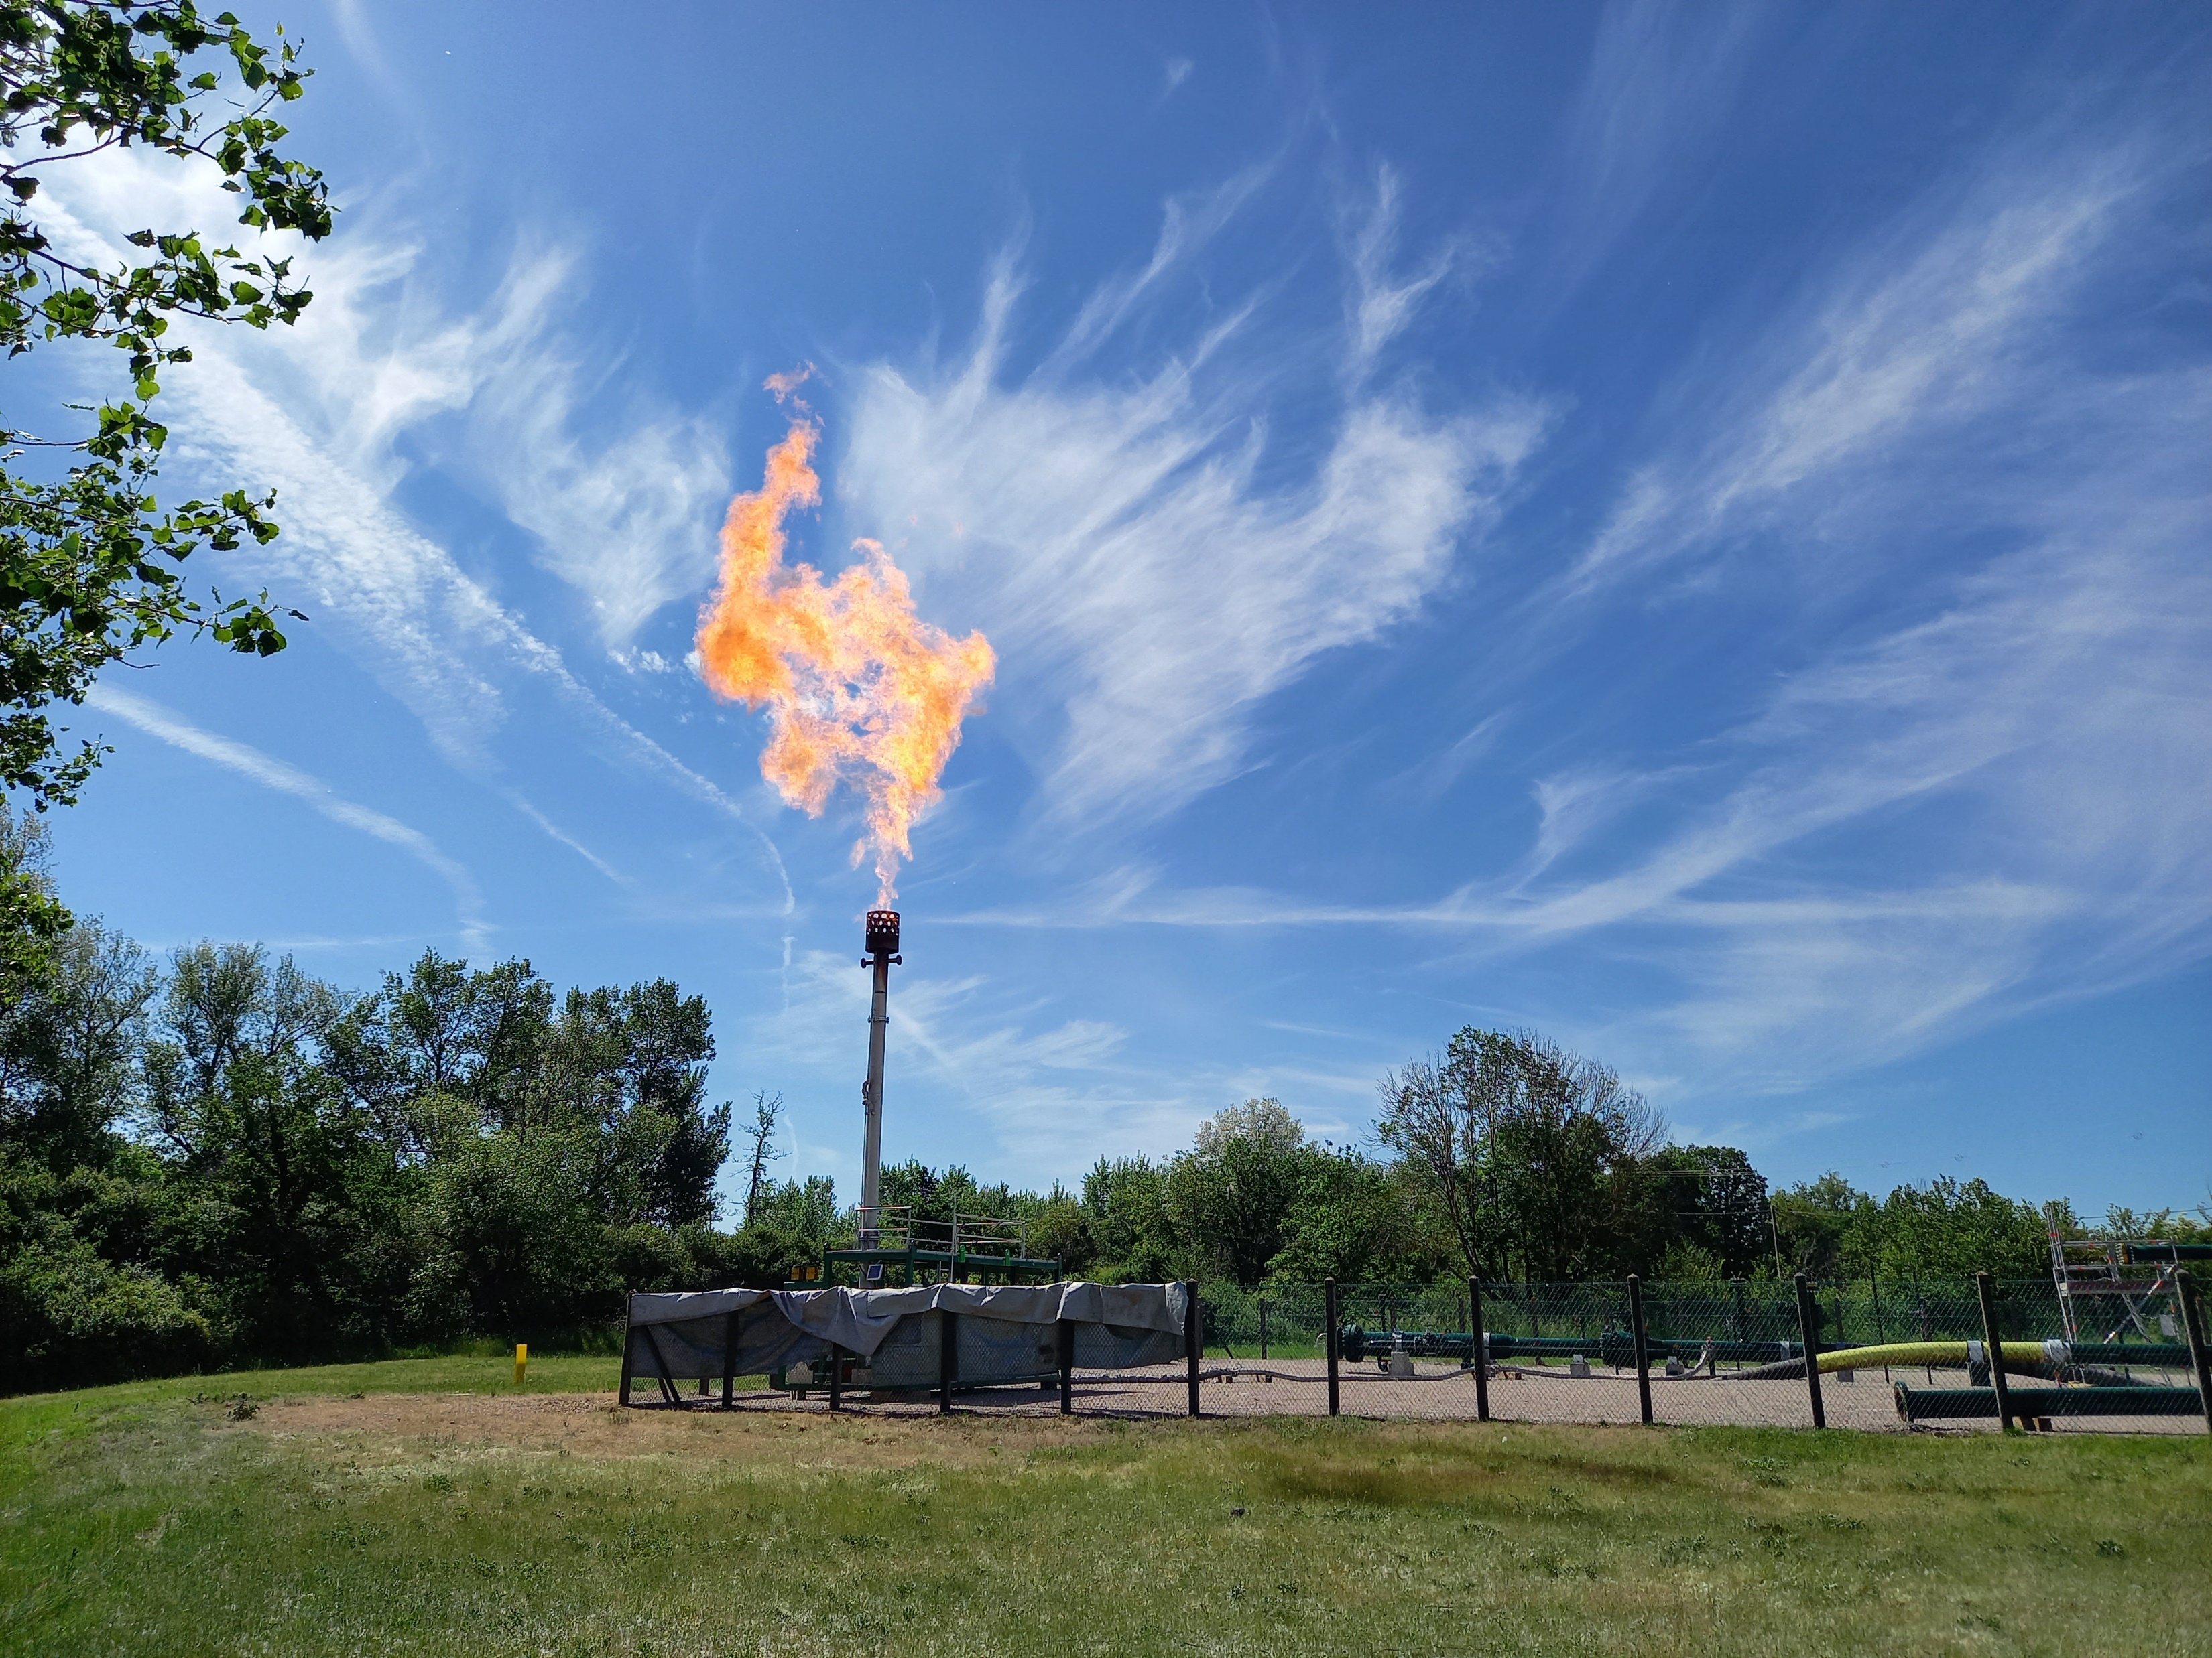
GRTgaz: commitment to limit greenhouse gas emissions
Internal policy to reduce GHG emissions
  GRTaz defined a trajectory to follow COP 21 agreement objectives
  To achieve these objectives Methane emissions is a priority
    Methane is about 45% of scope 1 and scope 2 emissions in 2019
    Reinforcement of the use of gas booster technique (used since 2009):
    now 90% of gas is recovered
    Flaring of most of the other releases: GHG reduction factor of 25
  Energy consumption management is another key
    ISO 50001 certification for its energy performance and consumption
    ISO 14001 environment certification for all its compressor stations
  Fruitful effort to be continued
    2016 to 2019: -43% of GHG emissions
    2019 to 2021: -30.5 % of GHG emissions

Slide 6
Emissions for emergency reasons
Depressurisation outside normal operations
  Two main scenarios
    Pressure exceedance on gas network
    Gas detection in compressor hall
  Outside GHG emissions a potential risk to study
    Local authorities ask about steel fragilization after these sudden depressurization
    From several tens of bars to ambient pressure
    Released gas cool down pipe walls
    GRTgaz must demonstrate that pipe wall temperature may not be lower than
    the limit allowed for steel integrity
    Aim : avoid a steel fragilization that could cause an uncontrolled gas release along
    the feed gas and vent lines

Slide 7
Temperature criteria for steel pipe
Eurocode 3 standard
  Allowed temperature difference with temperature of assembly: +/- 35°C
  Temperature must be between -40°C and +60°C
Gas temperature during the depressurisation
  Rule of thumb : -0.5 °C per bar loss
  Temperature drop of -30 / -40°C is expected for gas at exit
  What about the steel temperature ? Along the line ? At vent stack ?
GRTgaz approach
  Experimental work: temperature measurement during an emergency depressurization
  Modeling work
    Validate the SYMMETRY software on experiment
    Simulate the other configurations

Slide 8
Hazards 32
02 - EXPERIMENTAL SET-UP

Slide 9

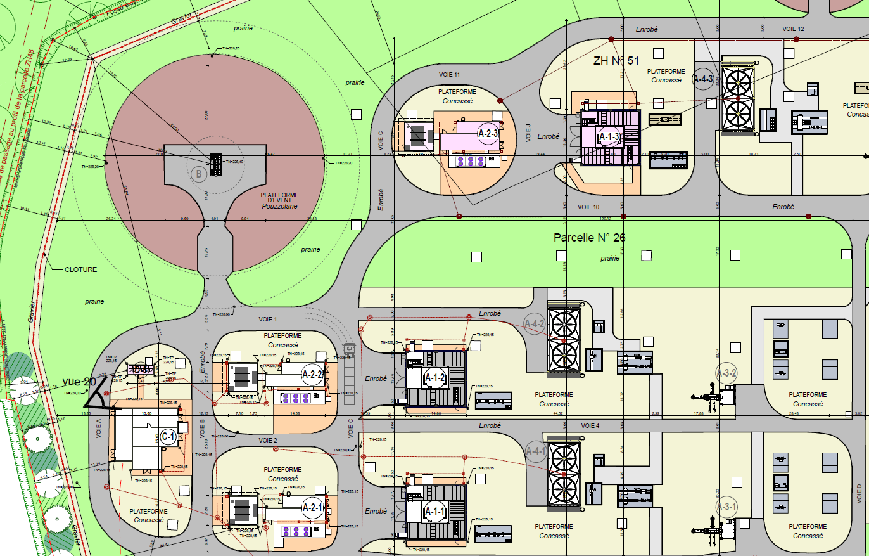
Experimental set-up
Test site: Etrez compressor station
  Location
    About 100km north from Lyon (Southwest of France)
    Close to an underground storage operated by Storengy (Engie Group),
    also located in Etrez
  Main characteristics
    Equipped with 3 electric-driven compressors
    Connects 8 pipelines (diameter from 450 to 120mm)
    Maximal operating pressures: 67.7 or 80bar (g.).

Slide 10
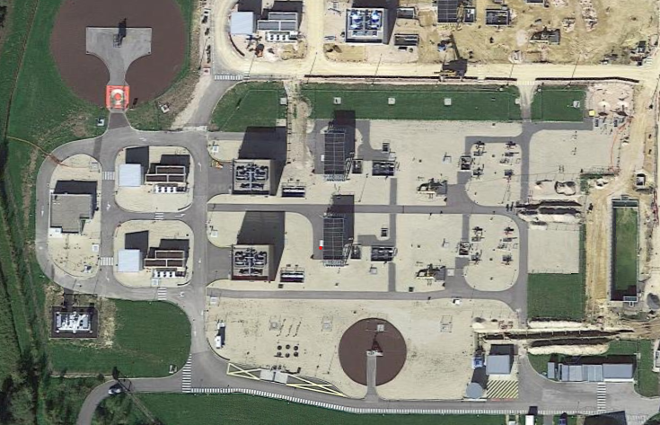
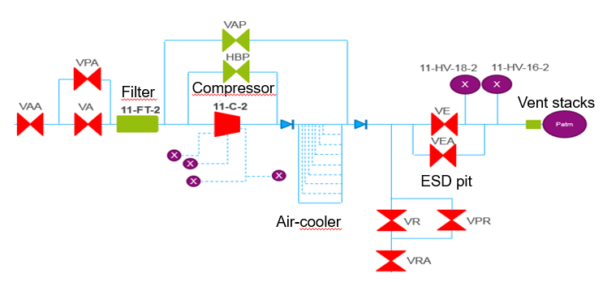
Experimental set-up
Test site: Etrez compressor station
  Emergency depressurisation on Etrez 2
    Initial pressure: 49 bar
    Purged system: 600mm diameter pipe of 800m long +
    secondary lines (total length: 2070m)
    Vent line : 100mm diameter pipe of 300m long
Vent platform
Etrez 2

Slide 11
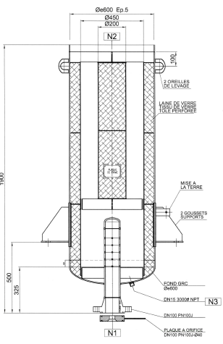
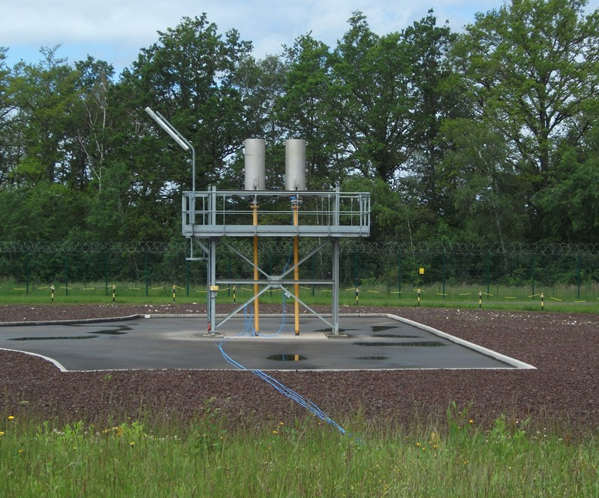
Experimental set-up
Test site: Etrez compressor station
  Temperature measurements
    At vent stack: 4 temperature probes (PT100)
H = 1450 mm
400mm
Temperature probes PT100-1 and PT100-2
(upper vent)
Silencer
100mm
H = 55 mm
Vent line
Temperature probes PT100-3 and PT100-4
(lower vent)
H = 150 mm
40mm

Slide 12
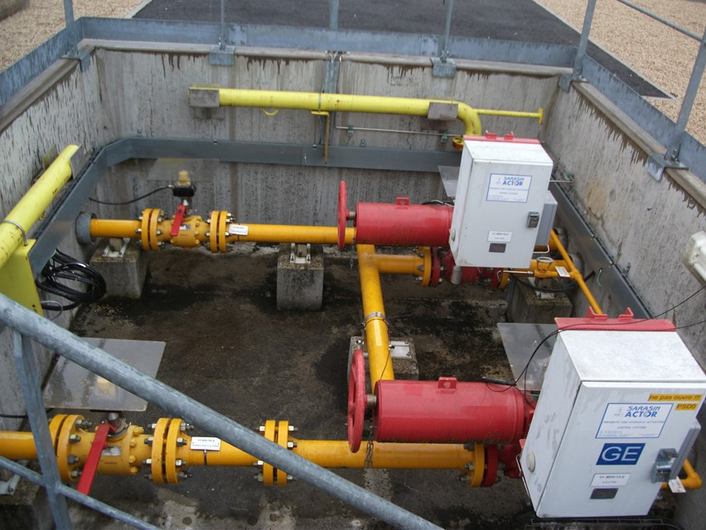
Experimental set-up
Test site: Etrez compressor station
  Temperature measurements
    Inside the Emergency Shut-down (ESD) pit
    Temperature probes used for process operations
    near compressors and air-cooling system are also recorded
  Other measurements
    Gas composition analyzed during the test period
    Pressure from process data system (SCADA)
Thermocouples TC1 and TC2
(ESD pit)

Slide 13
Hazards 32
03 - EXPERIMENTAL RESULTS

Slide 14
Experimental results
Main information
  The depressurization drops from 49 bar(g) to ambient pressure in about 30 min
  Minimal temperatures recorded by the thermal probes are between -6°C to 1.2 °C depending on the location.
  For an initial temperature between 10 to 15°C, the temperature drop is about -14 to -17°C
Probes | Initial temperature (°C) | Minimal temperature (°C) | Temperature drop (°C)
TIT35 (upstream compressor) | 15.1 | -1.6 | -16.6
TIT76 (downstream compressor) | 15.1 | 1.2 | -13.9
TIT74 (upstream aircooler) | 10.3 | -6.1 | -16.4
PT100-1 / PT100-2 (upper vent) | 7.9 / 7.8 | -7.3 / -8.5 | -15.2 / -16.3
PT100-3 / PT100-4 (lower vent) | 9.1 / 9.5 | 1 / 0.4 | -8.1 / -9.1
TC 1/ TC 2 (ESD pit) | 9.5 / 10.3 | -4.3 / -4.1 | -13.8 / -14.4

Slide 15
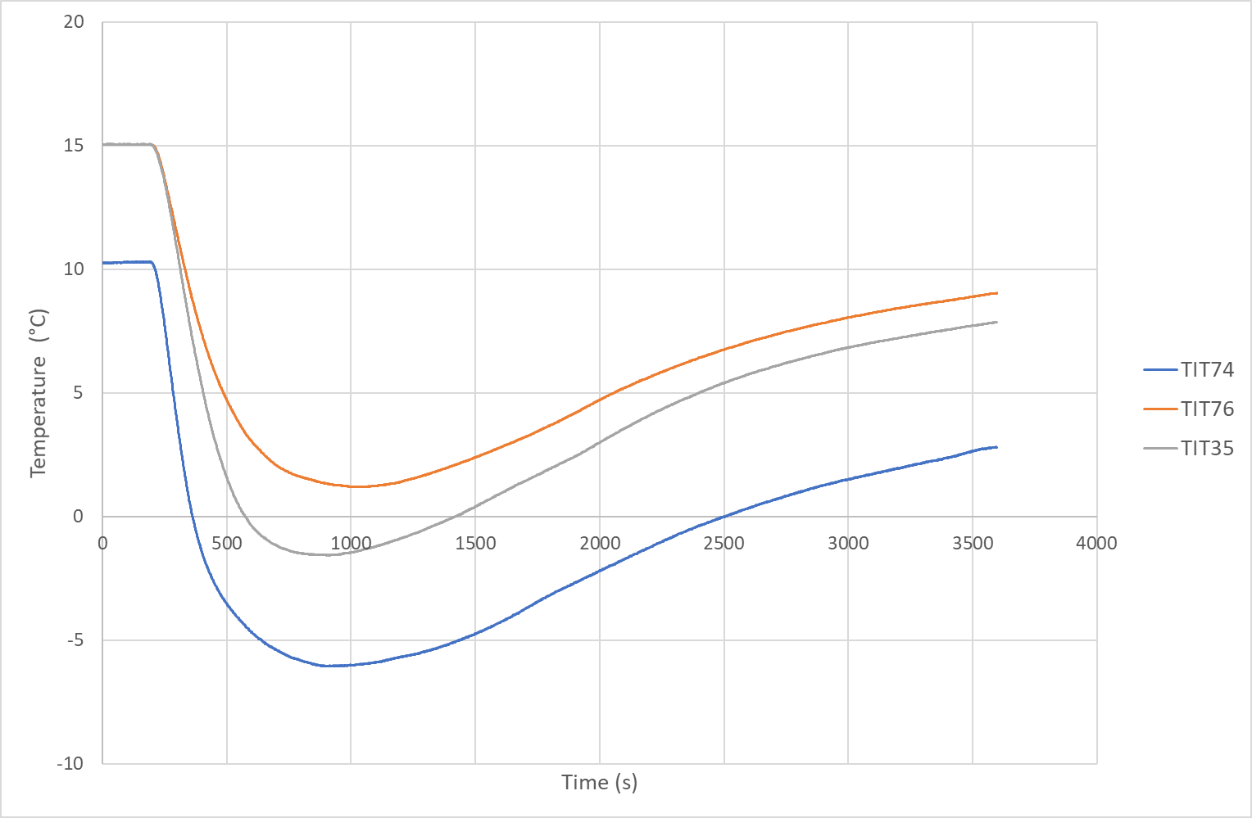
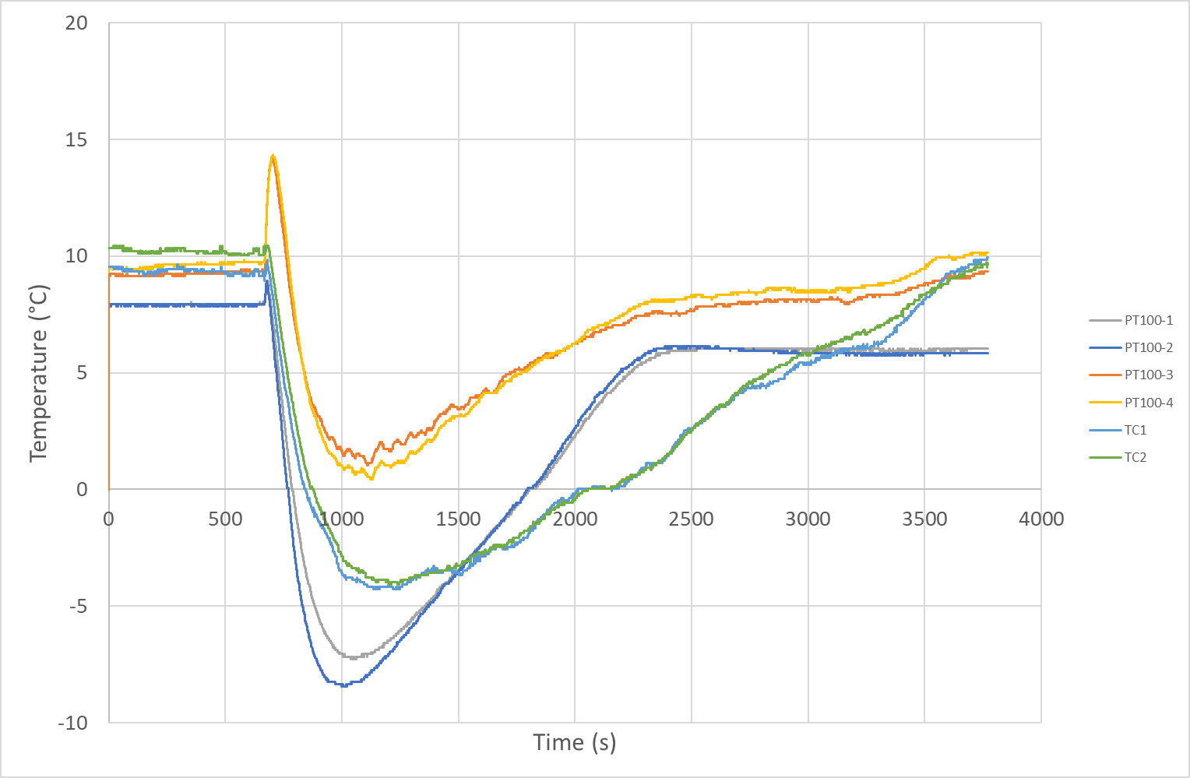
Experimental results
Temperature measurements during the depressurization test (process probes)
Temperature measurement during the depressurization test (test probes)

Slide 16
Hazards 32
04 - COMPARISON WITH SYMMETRY SIMULATIONS

Slide 17
COMPARISON WITH SYMMETRY SIMULATIONS
SYMMETRY chosen for flow modeling
  Software developed by VMG (Schlumberger)
  Use for process calculations for sizing and flow
  assurance
  A dynamic mode to simulate vessel and/or networks
  depressurization by considering heat transfer and
  fluid dynamics
  SYMMETRY couples several 1D models for each
  phenomenon, with a large panel of options and
  submodels to adjust accuracy and computational time
Visuel SYMMETRY

Slide 18

COMPARISON WITH SYMMETRY SIMULATIONS
Simulations set-up
  Real gas mixtures is implemented
  Thermodynamics properties calculated with Advanded
  Peng Robinson Natural Gas 2 (recommended by Schlumberger)
  Crane model (default) used to estimate the pressure drop for
  fittings and valves. Each part is characterized by its K-factor
  from an extensive database
  Colebrook model used to estimate the pressure drop due to
  friction along the pipeline
Gas compounds | Mole fraction
Methane | 0.949
Nitrogen | 0.0035
Carbon dioxide | 0.0024
Ethane | 0.039
Propane | 0.0042
Isobutane | 0.0009
n-Butane | 0.0006
Isopentane | 0.0002
n-Pentane | 0.0001
n-Hexane | 0.0001
$$∆P=F\frac{L}{D}ρv^{2}$$
$$\frac{1}{\sqrt{F}}=−2\log\left(\frac{ε/D}{3.7}+\frac{2.51}{R_{e}\sqrt{F}}\right)$$
With :
ΔP : pressure drop due to friction along the pipeline (Pa)
F : friction factor
L : pipe length (m)
D : pipe diameter (m)
ρ : gas density (kg/m³)
V : gas velocity (m/s)
ε : pipeline roughness (m) → 40 µm steel pipe with several years of operation
Re : Reynolds number

Slide 19
COMPARISON WITH SYMMETRY SIMULATIONS
Simulations set-up
  Heat transfer between steel pipe and ambient air or ground
    For buried pipes: the “Ground-T based” model is used and recommended for fully buried pipe
    For buried pipes: the ground temperature set at 20°C, with a conduction constant of 1.5 W.m⁻¹.K⁻¹
    For above ground pipes: natural convection is calculated by considering a constant heat transfer coefficient
    and ambient temperature (10°C)
  Inner convection is calculated with the HTube mix model based on Dittus-Boelter
  correlations
  Several options in the dynamic solver to adjust accuracy of transient calculations
    For venting : the full Do Pipe Transient DP Calc model is selected to obtain more accurate results
    (developers’ recommendations)
  Difficulty to model the silencer at vent exit
    Interior of the silencer is neglected, even though it may affect pressure drop
    Pipe reduction of 40mm diameter creates a sudden change in the flow: numerical
    unstability after a relatively large simulation time.
400mm
100mm
40mm

Slide 20
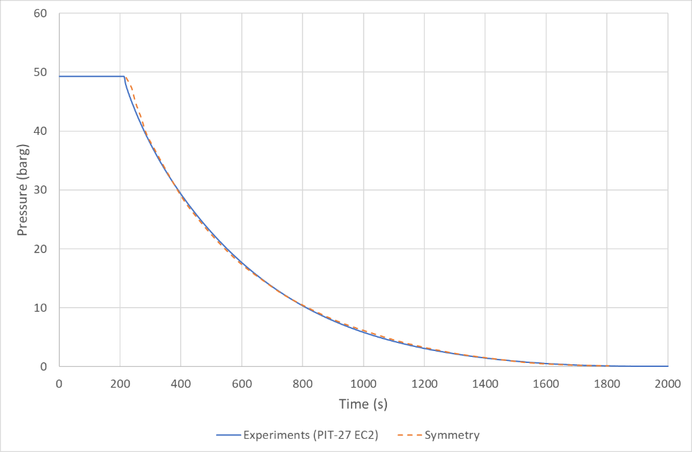
COMPARISON WITH SYMMETRY SIMULATIONS
Simulations results
  SYMMETRY perfectly estimates the pressure decrease

Slide 21
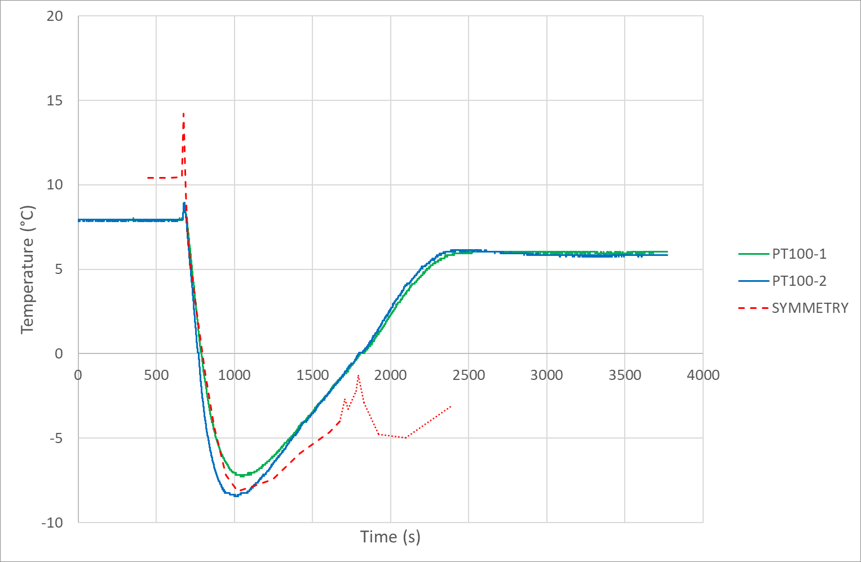
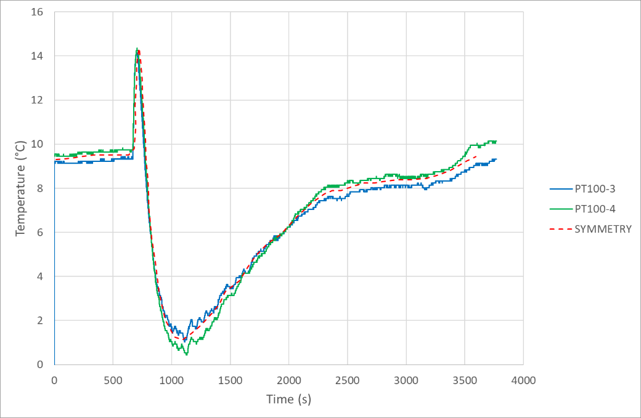
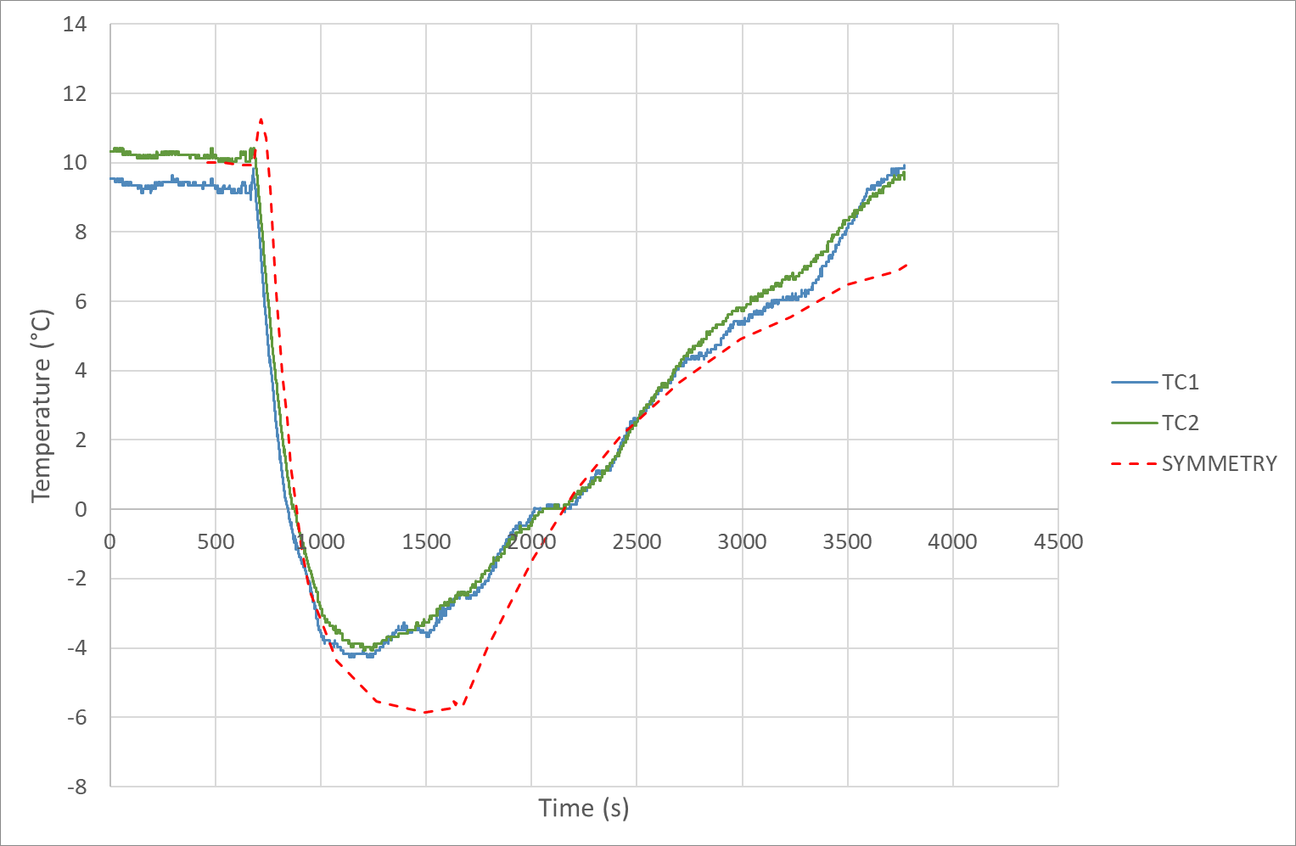
COMPARISON WITH SYMMETRY SIMULATIONS
Simulations results
  Good prediction of the minimal temperature
    Deviation of less than 2°C
    Slope of temperature decrease is very similar with the experimental curve
    Numerical instabilities at upper vent due to pipe reduction in the silencer: smoother results in neglecting the reduction but less accurate results
Upper vent
Lower vent
ESD pit

Slide 22
Hazards 32
06 – CONCLUSION

Slide 23
Conclusion
  The experimental trials of Etrez give valuable data about the pipe temperature decrease during an emergency depressurization.
  The temperature drop is about -8 to -17 °C, under the tested conditions. These values enable to build an argument to justify the choice of steel grades and explain that no damage or unusual fatigue are expected after this kind of depressurization.
  The comparison of SYMMETRY with these data helps estimation of the accuracy of simulation to predict similar depressurization.
  The comparison indicates a very good agreement with pressure and temperature measurements.
  Consequently, with the validated setup, it is possible to simulate depressurization with different pipe geometries and different initial conditions to estimate the risk due to cold gas. Such simulations are ongoing for depressurization at sectioning stations.
  This work will help GRTgaz to answer to the local authorities

Slide 24
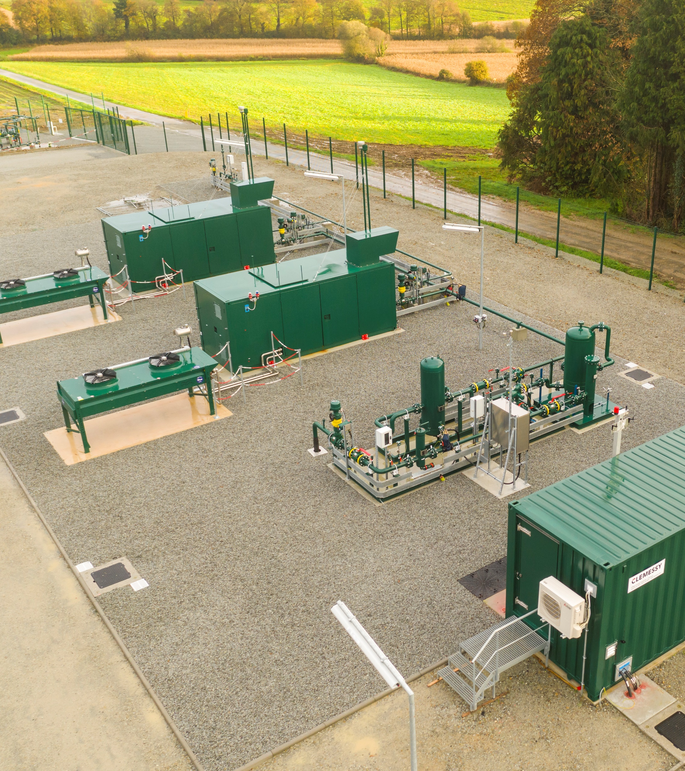
Any questions ?

