Slide 1
What our systems are trying to tell us, and why we need to listen
19/10/2022
OT Cyber Security and OG86
David Allen MSc
Notes:
Good Morning, Good afternoon and Good evening
Thank you for joining me today,
My name is David Allen, and today id like to present my paper on, what our systems are trying to tell us and why we need to listen.
Ill cover throughout the presentation where Operational Guidance 86 (OG86) fits into the OT picture along with what an OG86 risk assessment consists of, discussing such elements as, assigning criticality, assessing potential threats, and looking at opportunities which can allow room for future development in the ever-evolving threat environment.
I will also cover some of the limitations of the OG86 cyber security risk assessment and what further areas may need to be explored to provide a well-rounded cyber security picture.

Slide 2
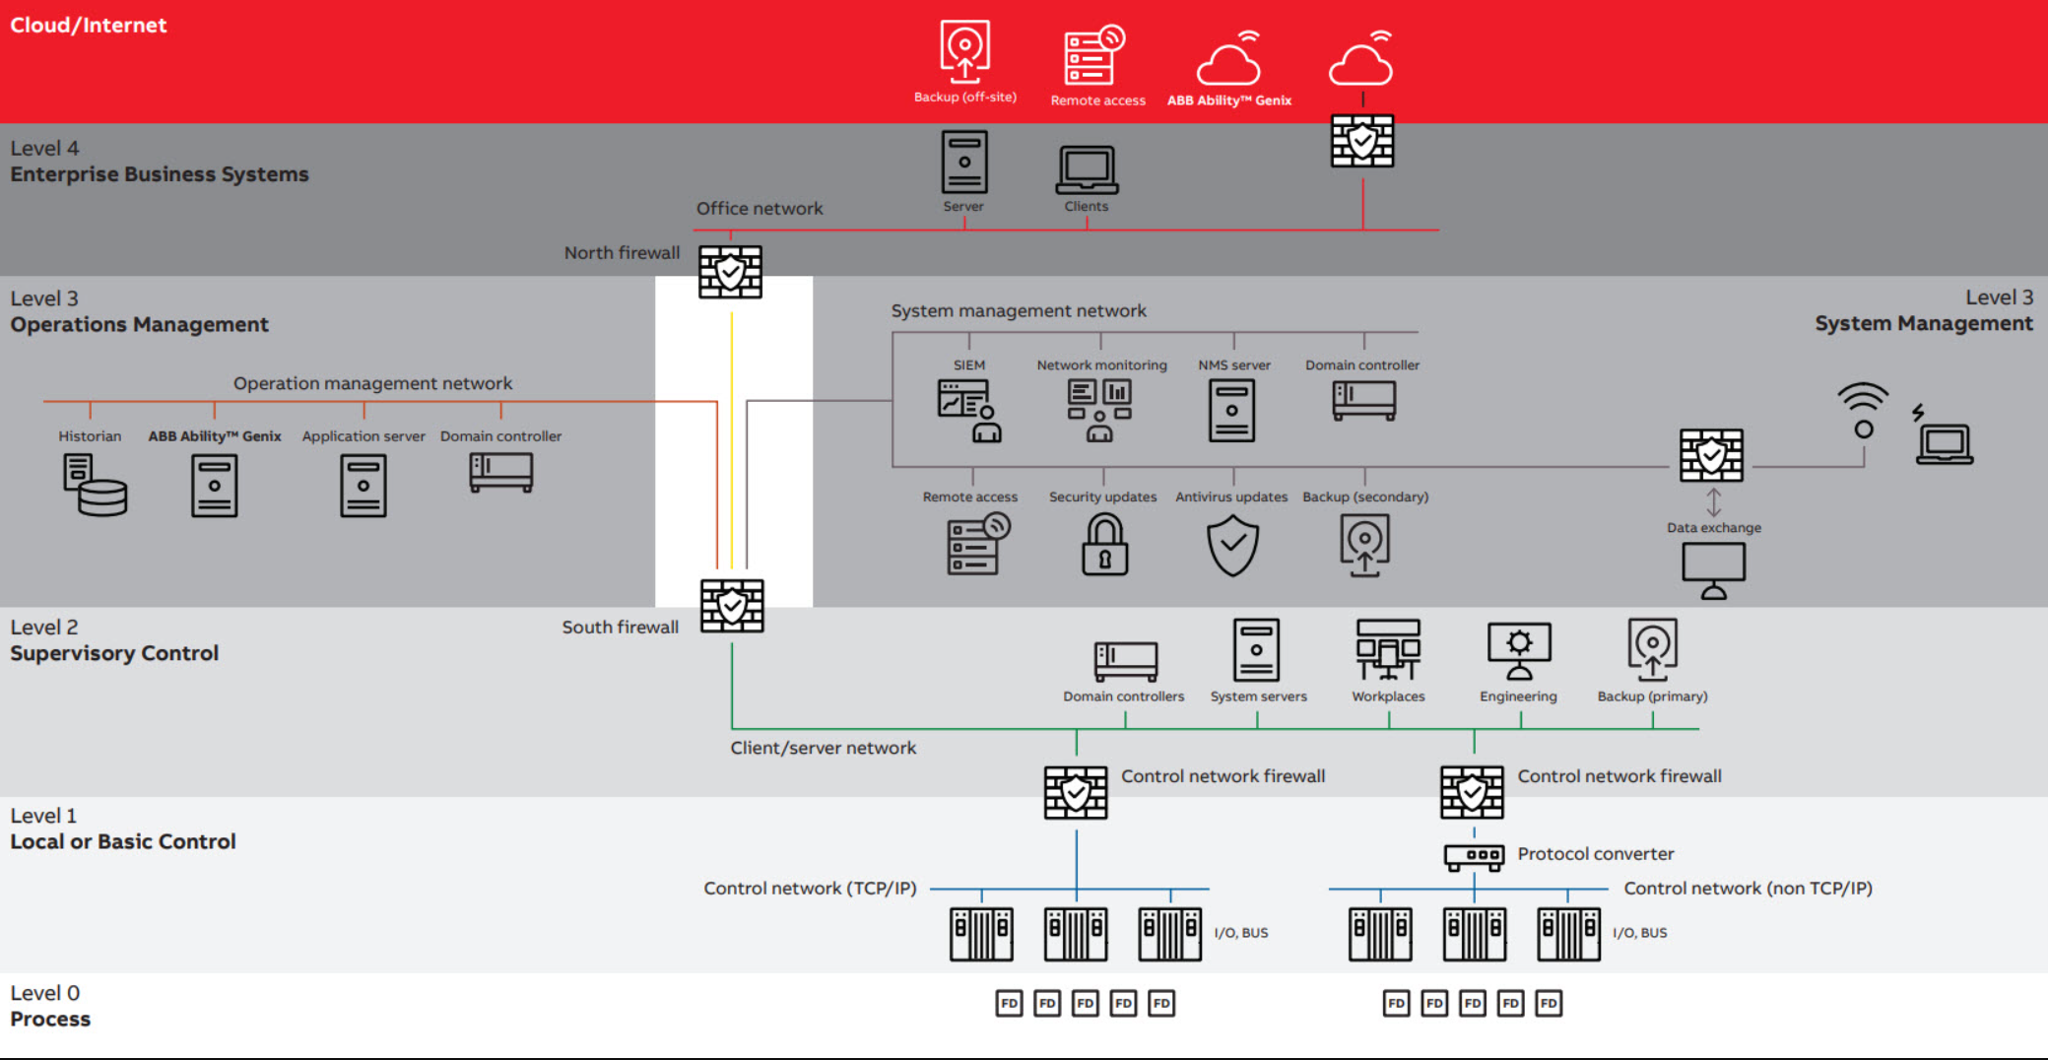
Introduction
Between 2020 – 2021 there was a 102% increase in ransomware attacks globally
IT and OT?
Level 4 - Local IT structure with office computers and other business-related systems
Level 3 (DMZ)– Devices that add functionality but are not critical to the operation of the facility
Level 2 – DCS system
Level 1 – Controllers, I/O and Fieldbus communication
Level 0 – Field instruments and devices that directly measure or control the process
Notes:
Old Knowledge -
Why cyber security suddenly a major concern?
For the OT industry the Industrial internet of things is not recent news, it has been around for over two decades now.
However, we are seeing a rapid growth of digital solution's that are crossing the IT and OT boundary
Allowing an improvement of our interconnected introducing wireless solutions and big data analysis.
New Knowledge -
The new connections on OT systems between the network Level 4 enterprise and Level 3 or even Level 2 is becoming the new normal.
This is the control systems; this is what each level is about. It shows the clear split between the IT and OT.
We need to design systems to that the IT and OT have a barrier between how they are interconnecting.
Between 2020 and 2021 there was a 102% increase of ransomware attacks globally with the utilities sector being one of the highest targeted sectors
How to Use / Benefits
Key principle implemented is a sterile area where communication in and out of the DCS system (level 2) is secured and tightly controlled, data flow between network levels 2 and 4, in either direction, should terminate at a mediation device in the operations or systems management area,
If we fail to protect our system’s at this early stage its not only like like leaving the door open, but not having a door at all.

Slide 3
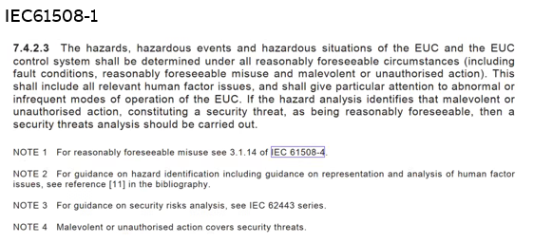

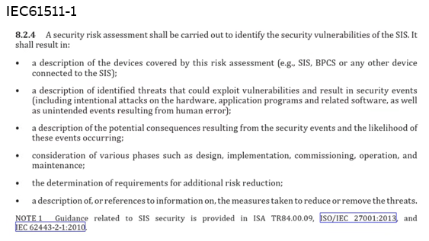


OT Cyber Security
Cyber Security needs to viewed as an evolving journey, in which the developed plans anticipate this cyber evolution.
Cyber security is more than just strong digital protections.
85% of all cyber-attacks have some form of social engineering aspect involved(1).
Notes:
What is OT Cyber security?
What does it mean in the OT industry, talk about standards,
Cyber security can often means different things, depending on where people are on there cyber journey.
Quite often I encounter companies that are looking at it from a high level perspective of protecting there system by implementing key solutions to key problems and sometimes this is without sometimes stopping to consider the wider picture.
Unfortunately this software based approach of implementation foundational solutions such as (Antivirus), Taking backups etc doesn’t cover enough of the picture.
It does provides a good starting point of protecting against basic cyber attacks
Just as we wouldn’t assume that a safety trip solves all our issues, cyber security has the same issue.
We can observer when looking at the functional safety standards that from an assessment point of view, that there is clear and very real need to consider cyber security protections.
Within the IEC61511-1 standard for process control, specifically part 1 clause 8.2, we can again see an explicit requirement in place for conducting a cyber security risk assessment.
However, it still does not cover exactly how cyber security shall be addressed, although the hall marks of needing to consider cyber security are heavily implied.
Looking at section 11.7.2.4 within IEC61508-1, it also mentions ensuring correct security measures but does not elaborate further.
Just like functional safety we need to view Cyber security is a management system considering all the area.

Slide 4





What keeps our machines up at night?
Cyber Security Vulnerabilities
BREAKING
NEWS
Cyber Vulnerabilities
Human factors
Network vulnerabilities
Systems vulnerabilities
Supply chain vulnerabilities
Physical vulnerabilities
Notes:
One of the first questions often asked when looking at implementing cyber security on a system is “What do I need to protect?”.
With systems now more than ever having additional data monitoring and data packaging passing data between the OT system and enterprise systems, we first need to take a small step back to understand where the devices (nodes) within the system reside and how they are communicating.
A node is A device with interconnectivity between other devices.
Each day in 2022 more than 450,000 new malicious programs are being registered (The Independent IT-Security Institute,
So what do we means by Cyber vulnerabilities? They are classed as weaknesses in the system in which the Confidentiality, integrity and availability of the system is affected.
Talk about the different vulnerabilities and threat actors. Mention that it’s not always deliberate
Human factor vulnerabilities in which the users of the system present a major risk. - human factor constitutes a major threat to systems. The UK Government’s yearly cyber survey in 2021 which reviewed a wide range of companies and charities showed that the most common type of attack faced in 2021 was phishing attacks followed very closely by impersonation attacks
We saw on the last slide that 85% of cyber-attacks have a human factor issue and unfortunately we cant solve these risks by just having malware and good backups, it requires cultural awareness.
An example of this is not putting so much demand on our systems and training our staff so that it is more balanced. Systems are not infallible, just like a safety system if you can reduce demand, it increases the overall reliability (As its less likely to fail).
Cyber security requires a harmonious combination of technical solutions, management processes and system expertise to understand the potential OT cyber security risks faced by a system.
Network vulnerabilities are where the network design of the system presents weak areas of communication or access, allowing data to be intercepted and lost or unauthorised access to be gained.
System vulnerabilities encompasses the main industrial control system (ICS) which might have been misconfigured, lack maintenance or have unsecure hardening techniques implemented. Common system vulnerabilities could be poor patching schedules, unmaintained user accounts (elevated privileges), misconfigured connections, weak authorisation techniques or insider threats.
Supply chain vulnerabilities are often overlooked, however when considering IIoT there is a requirement to check that the equipment being supplied is from a controlled and reliable supplier.
*In a supply chain attack, hackers infiltrate the systems through an outside partner that has access to your data. Nearly every company uses outside hardware and software—it would be impossible to build everything a modern company needs from scratch—and reliance on outsiders requires tight security.
Physical vulnerabilities. As systems are as much at risk from physical attacks as they are from digital attacks, we need to ensure they are considered too. When considering physical vulnerabilities, we need to consider the potential threat actors such as insider attacks, 3rd party clients and unauthorised access as they can be just as likely to affect the CIA triad.

Slide 5
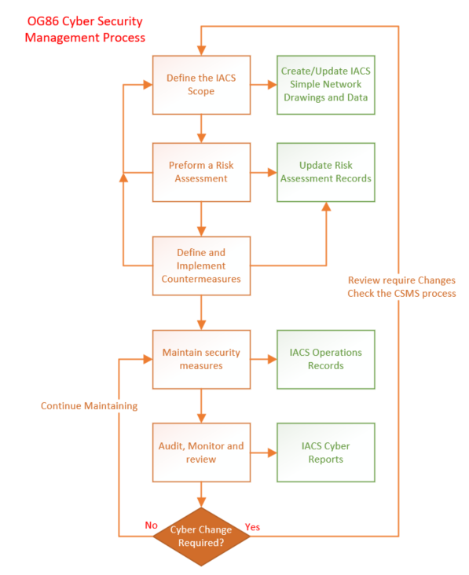
What is OG86? and who needs to know?
What is OG86?
The OG86 document is designed to support HSE assessors
Provides guidance for operational duty holders and IACS System Integrators.
Who needs to know?
The OG86 standard is currently aimed at duty holders who have a site with a potential to cause a major accident (MA) or loss of essential service (LES).
How does it help?
The OG86 process is designed to review the sites’ management systems and to support areas of implementation in cyber security governance, processes, polices, detection and reduction of incidents.
Notes:
OG86 was first published in 2017, The second edition was published in 2018 after going through a review by the industry upon which feedback was incorporated.
The OG86 guidance helps ensure that duty holders are implementing suitable cyber protections on sites with a potential to cause a major accident (MA) or loss of essential service (LES). For sites which fall under COMAH (Control of major accident hazards),
OG86 is considered as a sensible starting point for tackling cyber security.
The main goal behind OG86 is to reduce the likelihood of a cyber incident causing a major accident or causing the loss of an essential service.
COMAH and Loss of essential services (LES) sites, manufacturers and system integrators of IACS systems should also be aware of the requirements as inevitably they will be held up against this guidance.
OG86 does of course acknowledge the other standards such as IEC62443
The OG86 standard was also developed and inspired from existing industry standards to ensure its applicability:
Control of Major Accident Hazards Regulations (COMAH) 2015
Pipelines Safety Regulations 1996
Gas Safety (Management) Regulations 1996
Network and Information Systems (NIS) Regulations 2018
And acknowledges the BS EN 61511 (Edition 2) – Functional safety – Safety instrumented systems for the process industry sector as good relevant practice.
NCSC NIS Guidance Collection (including Cyber Assessment Framework - CAF) and IEC62443
In order to truly be able to design the IACS scope, it will involve understanding the system.
This means making sure there are strong network drawings and asset inventories which can then feed into a Risk assessment.
Helps you identify and understand the risks posed against the system along with identify some of the GAP areas.

Slide 6


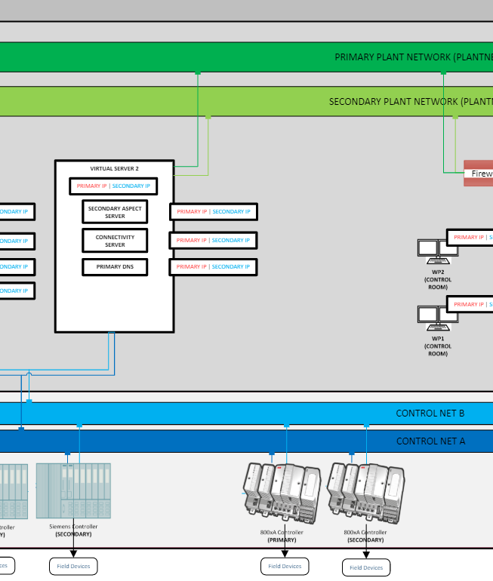
OG86 Risk Assessment
Preparing for the Assessment
Core Team
Identify Key Experts
Essential Documentation
Notes:
Site responsible cyber security owner, it is advisable to build a varied team consisting of technical system experts such as functional safety, operations engineers, maintenance engineers, telecoms specialists and including system vendor support where 3rd party systems are used.
Whomever is conducting the assessment needs to be sutiable competent
Ideally with a demonstrated expertise in control systems and experience carrying out security risk assessments,
IT team when there is a system connection between the OT system and enterprise level. This additional support not only provides an even better understanding of data exchanges between the levels but also enhances the ability to identify potential threats from both sides.
As a minimum, the risk assessment will require a site reference architecture or high-level network diagram identifying the different zones and conduits as these will be assessed during the criticality phase. An asset inventory should also be available to enable the identification of different systems onsite and to ensure all systems are reviewed and considered from a cyber security perspective.

Slide 7









OG86 Risk Assessment
Risk Assessment - Criticality
Identify the Zones under consideration
BPCS
Non-MA
Telecoms
Identifying and Assigning the consequence to each zone
(Major Accident /Loss of Essential Service or Non-MA/LES)
MA
Computers
HMIs
Network components
Identifying the Criticality (Critical or Relevant)
Safety Programmable logic controllers
Remote I/O
Power Gen
Power Systems
Instruments
Printers
Notes:
In order to understand the system criticality, you will first need to group the identifed systems into logical zones. If you already have a network diagram using a zones and conduits diagram will be a simple task of recording them.
If your network diagram isn’t in this format some time will be required creating one.
Once the zones and assets have been identified, the zone consequence and criticality level can be assigned to each, in turn allowing them to be designated as either MA/LES or Non-MA/LES.
During this part of the assessment, it’s important to identify if the zones are also relevant or critical. This is important as it defines whether a zone is directly (Critical) or indirectly (Relevant) supporting the areas identified as MA and/or LES.
Providing a little justification around why each zone has been categorised as it has.
Talk a bit about printer vulnerabilities example – Using printer USB to attack system.

Slide 8





OG86 Risk Assessment
Threats and Countermeasures
Threat Actor(s)
Understanding the possible threats (Who?, Why?)
Nation States
Advanced Persistent Threat
Understanding the threat Scenario (How?)
Cyber Criminals
Considering the threat vector (Local?, Remote?)
Insiders
Supply Chain
Hacktivists
Recording how the system(s) are currently protected?
Hackers
Notes:
IEC62443 standard - Threats are defined as “The potential for violation of security, which exists when there is a circumstance, capability, action or event that could breach security and cause harm”.
We need to look at the identifed MA and LES Zones and then consider which threat actors may be relevant to each one.
Alongside this we must consider the threat scenario, what are the threat actors likely to be doing? What is the scenario in which the threat actor is operating?
Some examples could be:
Hackers who are likely to present a deliberate misconfiguration or deploy malicious software.
Insider attackers who could tamper with the system or deliberately cause a release.
Physical intruders who may be able to gain access to the system resulting in tampering or damage to the system along with potential loss of system confidentially and integrity.
More examples can be seen in the IOG86 Guidance however they are not a definitive list, and each site will have its own risks and threats.
The final step in the assessment will be around assigning countermeasures.
It should be noted at this stage that the HSE have an expectation that multiple countermeasures should be considered where possible rather than relying on one single solution.
A list of expected countermeasures to be considered can also be found in Appendix 5 of the OG86 document. The list is comprised of guidance from the NCSC NIS, IEC62443-3-1 and other industry best practices.

Slide 9

OG86 Risk Assessment
Limitations and what comes next?
Balance
The OG86 Risk assessment does not consider the likelihood of the identifed risks.
Process
The OG86 process is solely focused on Health and Safety.
Reality
An OG86 Risk assessment concludes after defining the countermeasures. (Without going into a Detailed Assessment)
Notes:
Limitation1) An example of this limitation can be observed by considering two zones both identified as having the potential to cause a MA, however one zone is connected to an external source such as the internet and the other zone is only affected by a user accessing a controlled area with a USB device. With an OG86 assessment both zones will be identified as MA and the consequence may be the same, however in reality we can see one zone has a much higher risk and should be prioritised.
Limitation2) Talk about Financial, confidentiality, environmental.
Financial risk and loss of production are commonly the largest risks faced as considerable effort is put into safety systems ensuring they fail safe protecting life. They are not however designed to prevent the loss of sensitive information.
Limitation3) This results in no further investigation into identifying the strength of the countermeasures implemented and if they meet all the required levels of protection needed. An alternative approach can be observed in the security levels as defined by the IEC62443 standard which helps duty holders to identify the level of risk posed to their systems along with the required target level. This in turn allows more appropriate protections to be implemented based on not only how the identifed risk affects the system but also looking at the likelihood of the risk too.

Slide 10
Notes:
For site owners who are looking to further understand their systems regarding cyber security beyond the health and safety aspect, alternative standards may also be worth reviewing in tandem with the OG86 guidance.
Some additional established good practices and standards to review could be the IEC62443 standard, NCSC guidance and NIS Framework, all of which provide further guidance and practices in developing cyber security understanding and compliance.

