Slide 1
Comparison of the Risks associated with Natural Gas and Hydrogen Distribution Networks
Hazards 32, 18th to 20th October 2022
Andy Phillips, Principal Engineer, DNV
Notes:
Duration of around 20 minutes

Slide 2
Introduction
This work has been conducted by DNV as part of Phase 2 of the UK Gas Distribution Networks and Ofgem National Innovation Competition funded H21 project.
Authors of accompanying paper:
Andrew Phillips and Ann Halford (DNV)
Russ Oxley (Northern Gas Networks)
Thank you to
Northern Gas Networks
HSE Science and Research Centre

Slide 3
Contents
Overview of H21 project
Description of CONIFER
Differences between natural gas and hydrogen distribution systems
Example calculations

Slide 4
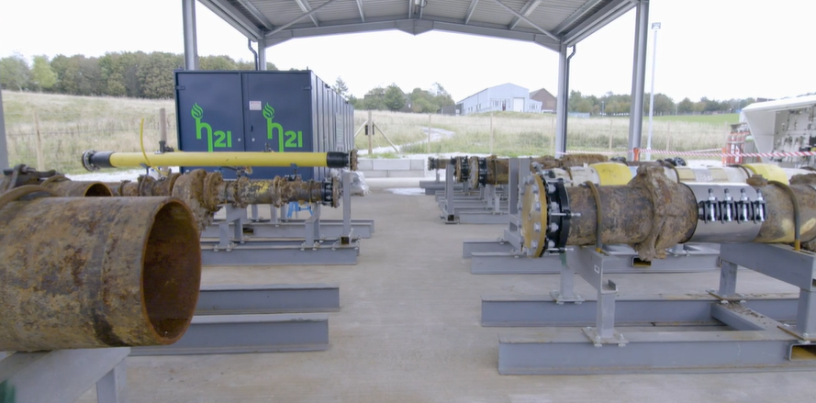
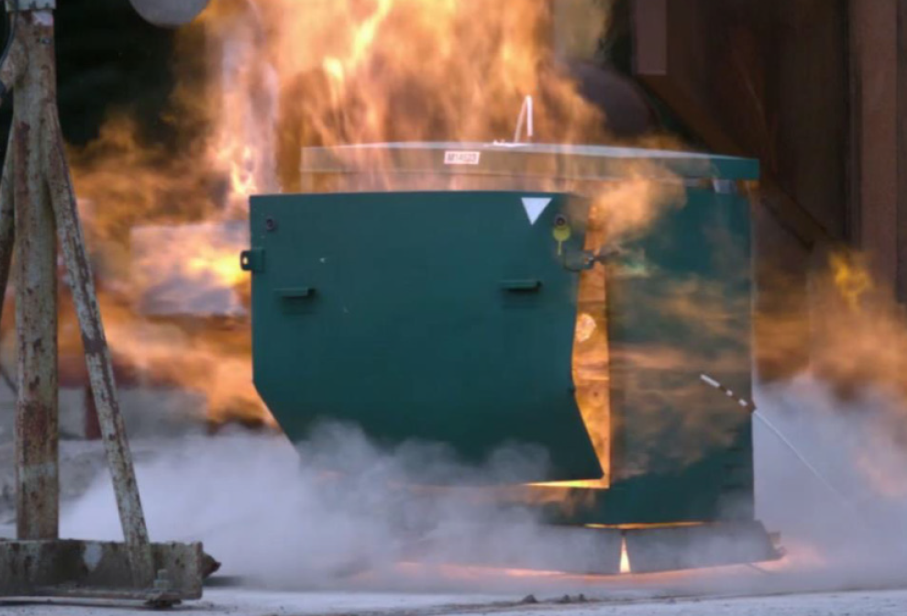
H21 Project, Phase 1
Phase 1A – Background testing
Carried out by HSE Science Division
Investigation of the leakage rate of distribution network assets
Included experimental testing of methane and hydrogen
Phase 1B – Consequence testing
Carried out by DNV
Included large experimental programme at our Spadeadam test facility
Development of a QRA model
Only mains and services upstream of the ECV

Slide 5
Phase 1B Experimental Programme
‘Small’ releases underground
Investigate outflow and migration through the ground
‘Large’ releases
Investigate ground breaking and fire severity
Ignition potential tests
Domestic appliances and common equipment
Explosion tests in a variety of enclosures
Meter box, kiosks etc.
Operational safety tests and demonstrations

Slide 6
H21 Project, Phase 2
Inclusion of releases downstream of the ECV
Meter
Pipework
Appliances
Model developments
Hydrogen explosion model
Hole size distributions
Benchmarking against historical data
Overpressure effects outside buildings
Many minor improvements

Slide 7
The CONIFER Package
Includes releases from
Mains
Services
Downstream of ECV (meter, pipework, appliances)
Hazards modelled include
Fires outdoors
Explosions in buildings
Generation of overpressure from delayed ignition in the open
Detailed enough to quantify risks from
Different gases
Different design options
Different building types

Slide 8
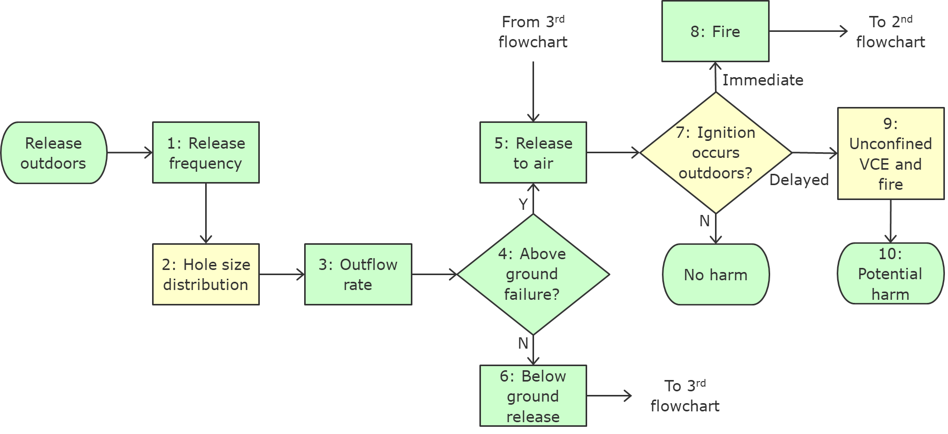
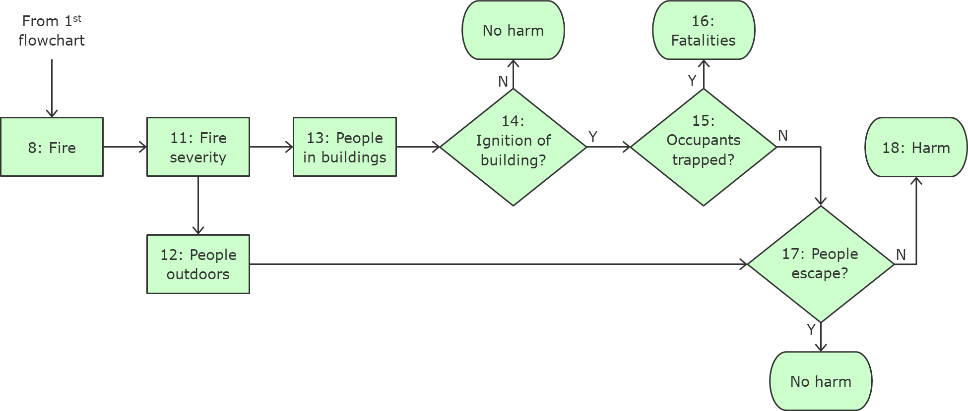
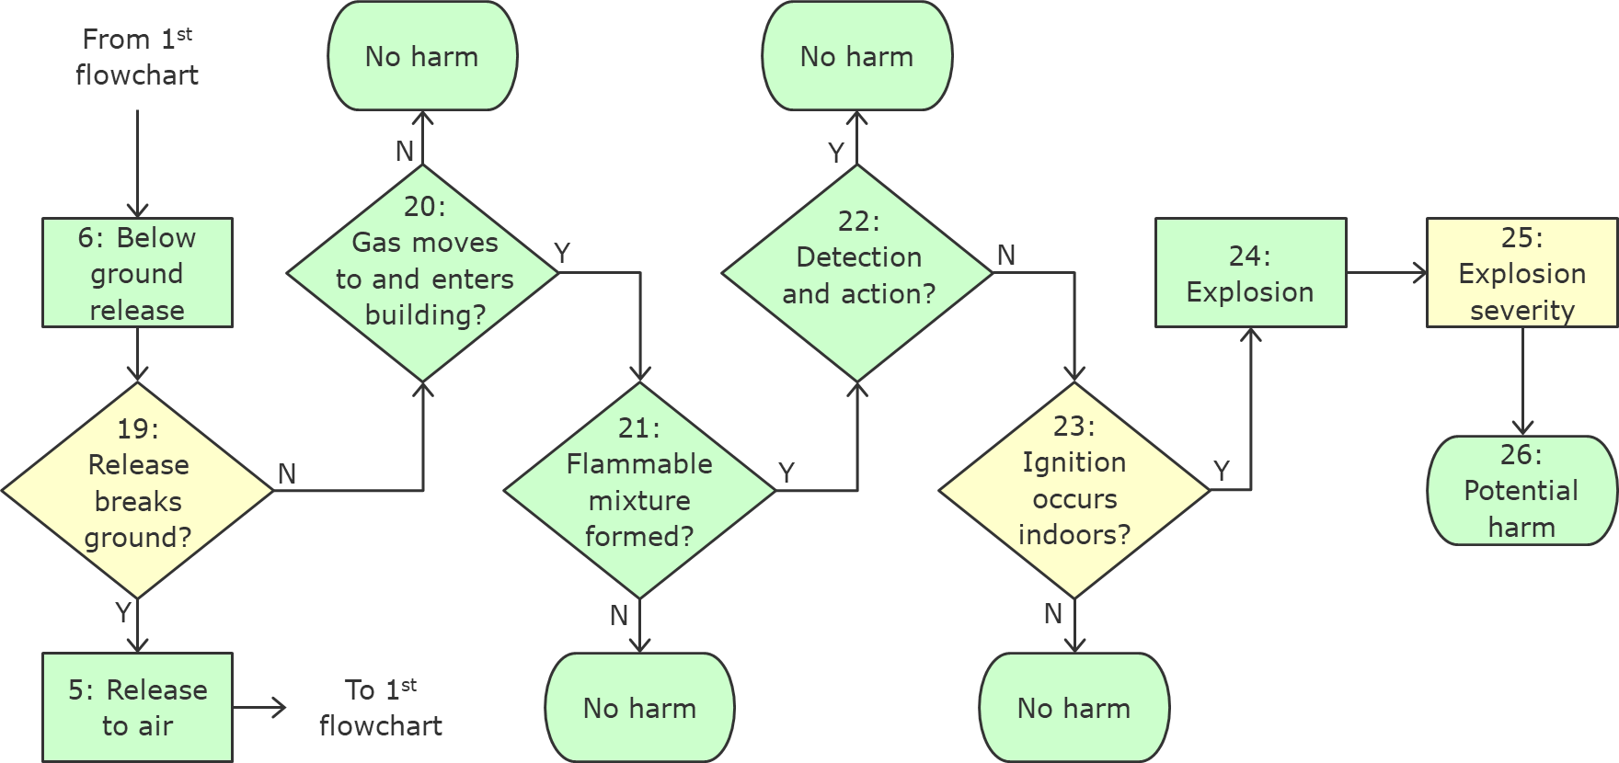
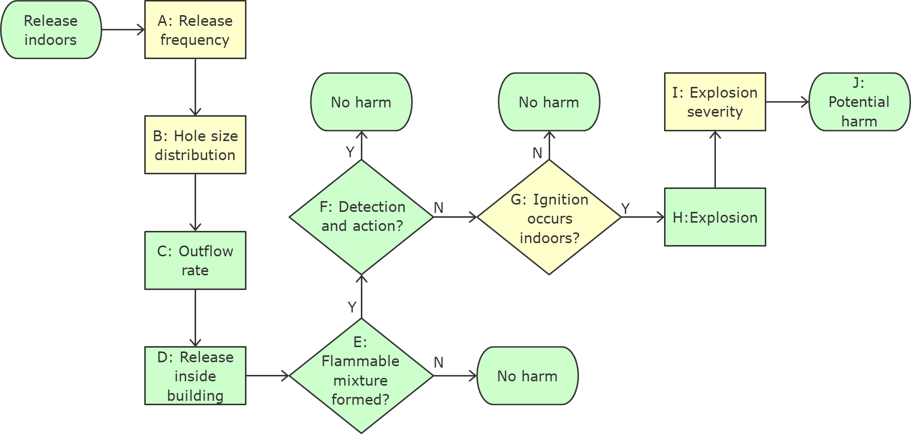
Structure of CONIFER
Notes:
Not discussed in detail, just to give an idea of the number of steps involved and the complexity

Slide 9
Risk Predictions for Great Britain
Risk comparison for natural gas and hydrogen networks
Based on
Detailed data from NGN’s network
High level data from all networks (to scale up the results)
Public data for house sizes and populations etc.
Many combinations of main, service and building considered
Pipe material, pressure and diameter
Building type, occupancy pattern and proximity to main
274,000 combinations of main type, building type and separation distance
62,000 combinations of service type and building type
980 combinations of building configuration for releases downstream of ECV

Slide 10
Benchmarking Natural Gas Results for Great Britain
Release Source | Category | Number per year
 |  | Historical | Predicted
Main | Explosions | 1.0 to 3.1 | 4.8 total, 2.2 over 70 mbar
 | Fatalities | 0.3 to 0.5 | 0.5
 | Injuries | 2.5 to 3.0 | 0.9 serious, 1.0 minor, 1.8 total
Service | Explosions | 0.5 to 1.5 | 2.6 total, 1.1 over 70 mbar
 | Fatalities | 0.1 to 0.3 | 0.2
 | Injuries | 1.0 to 2.0 | 0.5 serious, 0.5 minor, 1.0 total
Downstream of the ECV | Explosions | 4.0 to 6.5 | 22.1 total, 9.4 over 70 mbar
 | Fatalities | 0.5 to 1.8 | 1.7
 | Injuries | 4.0 to 11.0 | 3.8 serious, 4.3 minor, 8.1 total

Slide 11
Comparison between Natural Gas and Hydrogen
Similarities
Release frequencies
Differences
Volumetric outflow rate higher for H₂
Above ground dispersion further
Flammable concentration range (similar LFL but much higher UFL for H₂)
Ignition probability higher for hydrogen
Explosion consequences could be worse for hydrogen
Detonation possible
Effects outside source building
Unconfined explosions in open air
Hydrogen does not produce CO
Below ground dispersion behaviour
Fire severity
Human behaviour, response to leaks

Slide 12
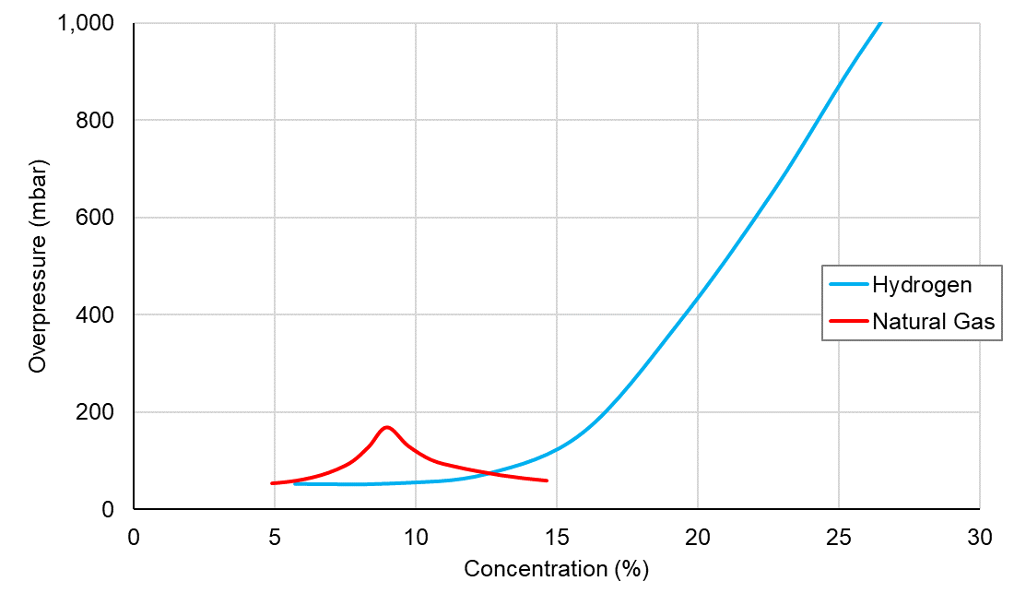
Hydrogen Explosions
Overpressure dependent on concentration
Example room, stoichiometric mixture
Explosions dominate the risk for most mains (natural gas or hydrogen)
Unconfined explosions in open air possible
Explosion develops more quickly
Detonation possible
More likely to cause fatalities outdoors and in other buildings
Notes:
Fires dominate for transmission pipelines, rather than explosions
Unconfined VCEs are not considered for natural gas and historically not an issue
Speed of explosion development doesn’t allow vents and walls to fail in same way as natural gas
New Ferry incident shows the sort of damage that we need to prevent (more severe than natural gas)

Slide 13
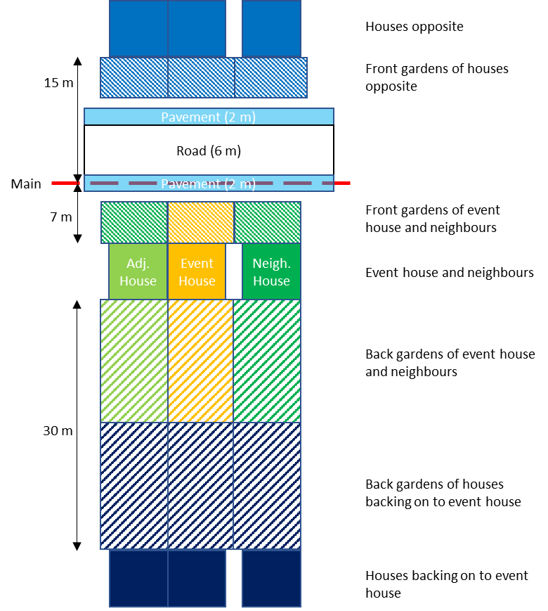
Example of Explosion Effects
Explosion occurs in yellow ‘Event House’
Semi-detached adjoining neighbour
Also affects
Next door neighbour
Houses across the road
Houses at bottom of garden
Risk calculation includes
Explosion effects in the Event House and neighbour
Blast wave impacting other buildings
Direct overpressure effects
Glass and bricks ejected into street

Slide 14
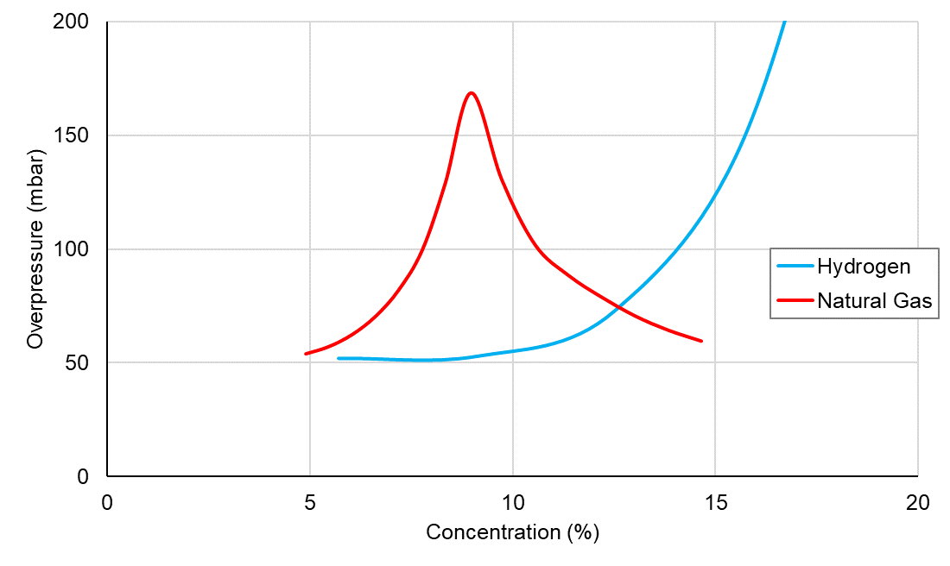
Example Explosion Effects
Credible leak is a 0.3 mm gap around a 22 mm pipe
Natural gas gives 0.90 m³/hour and 9.0% concentration
Hydrogen gives 1.45 m³/hour and 7.2% concentration
Explosion Example |  | Predicted Fatalities
 |  | Event House |  | All Other Houses |  | Total
 |  | Indoors | In Gardens | Indoors | In Gardens | Average | Range
Worst case | Natural gas | 0.27 | < 0.01 | 0.10 | < 0.01 | 0.37 | 0.19 to 0.56
 | Hydrogen | 0.96 | 0.02 | 1.43 | 0.03 | 2.44 | 1.30 to 3.67
Credible leak | Natural gas | 0.10 | < 0.01 | 0 | < 0.01 | 0.10 | 0.05 to 0.15
 | Hydrogen | 0.06 | 0 | 0 | 0 | 0.05 | 0.03 to 0.08

Slide 15
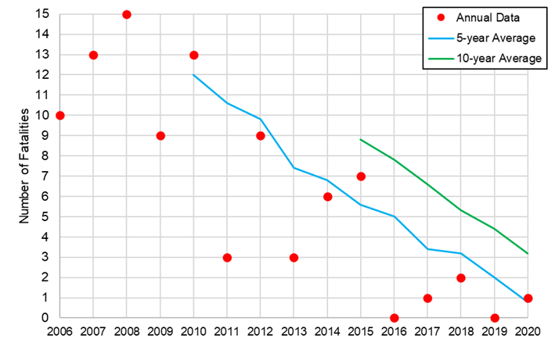
Carbon Monoxide
RIDGAS data from HSE
Downward trend in fatalities
Significant contribution to natural gas risk
Around 2.5 fatalities per year from fires and explosions (with variation)
Similar number or more from CO poisoning
Many more injuries from CO poisoning
Clear safety benefit for hydrogen

Slide 16
Conclusions
Risk assessment methodology for distribution has been developed
CONIFER package
Experimental validation from H21, previous work and public data
Gives realistic predictions of natural gas risks
Allows quantification of all risk sources up to 7 barg
Differences between natural gas and hydrogen distribution systems
Physical properties (hence outflow, gas accumulation etc.)
Explosions do not behave the same way
Carbon monoxide eliminated with hydrogen
Notes:
Quantification of risk sources allows risk mitigation options to be identified and evaluated
Experience with natural gas can be applied, but there are differences with hydrogen

Slide 17
Thank you for your attention
Please feel free to contact me
Andy Phillips, Principal Engineer, Safety and Integrity
Andrew.Phillips@dnv.com

