Slide 1
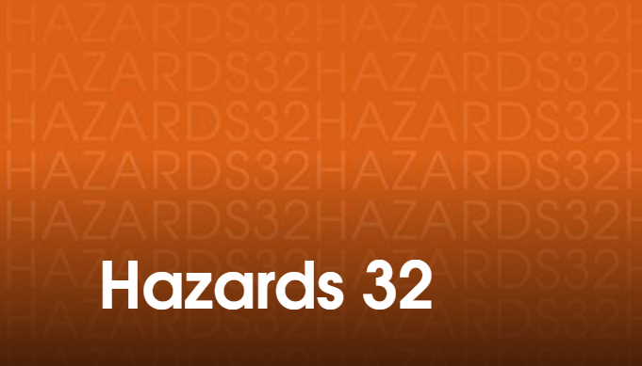


EAZe Process for Hazardous Area Classification of a Multipurpose Chemical Plant
Prashanth Shivakumar

Slide 2
Contents
Multipurpose Chemical Plants & DSEAR
Challenges
EAZe Process – Explosive Gas Atmospheres
Sources of Release – Basis of Design
EAZe Process – Explosive Dust Atmospheres
Conclusion

Slide 3
Multipurpose Chemical Plants
Provides valuable service to the global healthcare infrastructure
Vary in Size and Complexity
Receive, Test, Store and Handle hundreds of chemicals daily
40+ Molecules processed at any given time
Manufacturing processes are fast phased. Plant is constantly changing to allow for new product introduction or to reinstate an old process

Slide 4
Multipurpose Chemical Plant - DSEAR
Many of the chemicals handled are flammable in nature.
Flammability data may not be readily available from published resources for many intermediates – Hazard evaluation laboratory.
Design / equipment needs revalidated for each process to ensure process safety.
Explosive Atmosphere Zone extents needs to be estimated for each process steps and is not a one-time exercise for a Multipurpose plant.

Slide 5
Challenges in Estimating Explosive Atmosphere Zoning extents (EAZe)
Information required
Misaligned guidance
Too many parallel processes
Reviews are not carried out in a timely manner
Documentation is not relevant and current

Slide 6
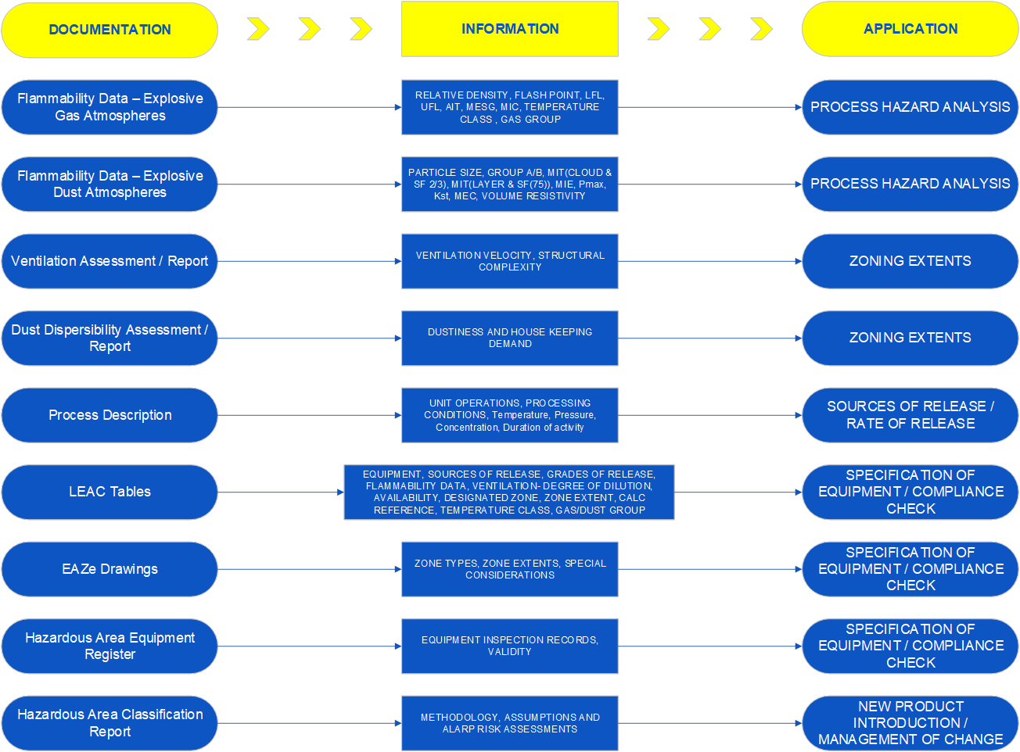
EAZe Challenges - Information Required

Slide 7
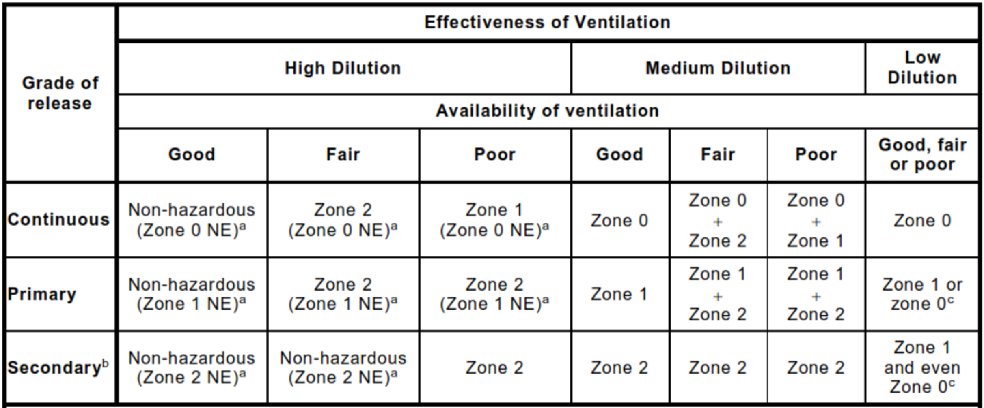
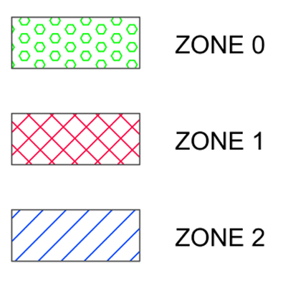
EAZe Challenges – Misaligned Guidance
Excerpt from BS EN 60079-10-1
9 different types of zones across 21 categories;
however only 3 drawing designations !

Slide 8
EAZe Challenges - Continued
Too Many Parallel Processes
  Business Operating Process across various disciplines are not aligned.
  Process for introduction of new chemicals / Management of change are not robust.
Too little or no Reviews
  Equipment are designed, installed and commissioned without the zoning exercise being completed.
  Lack of timely review and validation of assumptions.
Documents are not current
  Area classification some times limited to 2D drawings.
  Lacks details on assumptions and justification of zone types and extents.

Slide 9
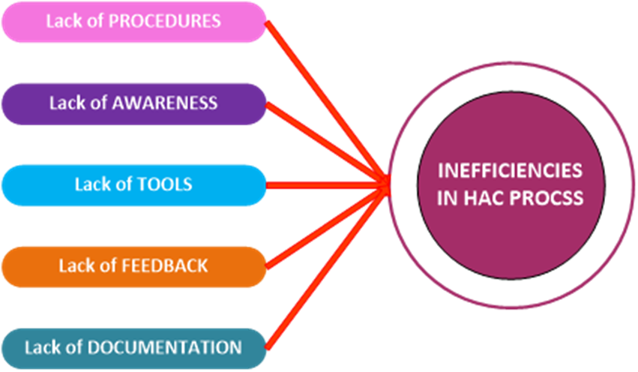
EAZe Challenges Summary

Slide 10
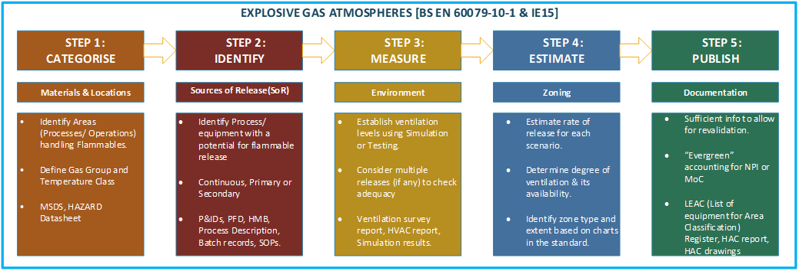
EAZe Process - Explosive Gas Atmospheres

Slide 11
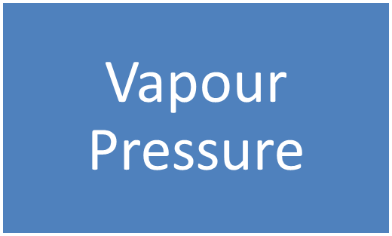
Sources of Release
Pool Evaporation
Pressurised Liquid release
Examples –
Drum Filling - Solvent Charging
Examples –
Flange Leaks, Loss of Containment
Examples –
Pump Mechanical Seal Leak, Pump Discharge flange leaks

Slide 12

Basis for HAC Assessment
Multipurpose Chemical plants could benefit from a quick process to compare and contrast chemicals based on their physical properties.
Thus there is a need to identify base solvent for the plant to extend the validity of HAC assessment.
Using EAZe process methodology and HAZCALC Software PSK Process was able to identify the following factors to rank chemicals based on their physical properties and for similar explosive atmospheric conditions.
The factors identified found to correlate on a power law to the zone extent.

Slide 13
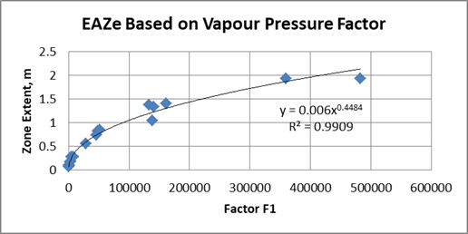
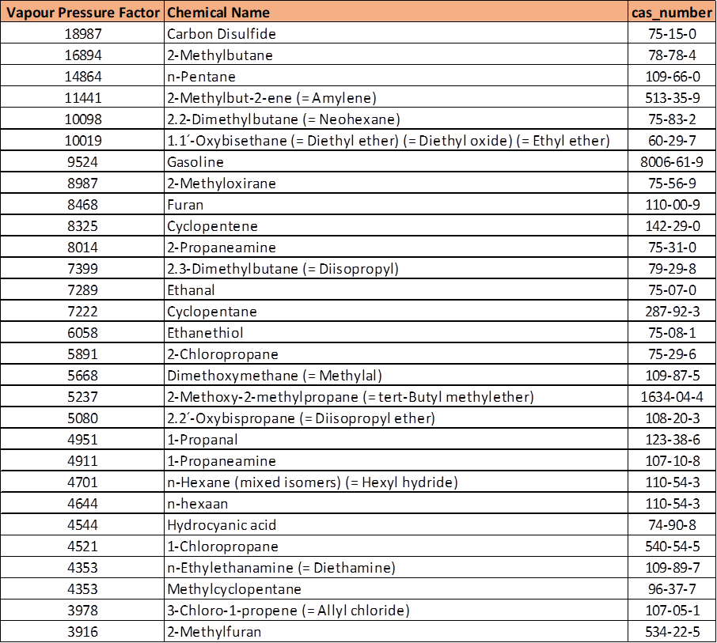

Sources of Release – Vapour Pressure
$Zone Extent=$ ${a∗(F1)}^{b}$
The factor F1 is found to be a function of vapour pressure, LEL, vapour density and molecular weight of the flammable liquid.
Thus, the hazardous area zone for drum filling of tert-butyl methyl ether will be larger compared that of n-Hexane.

Slide 14
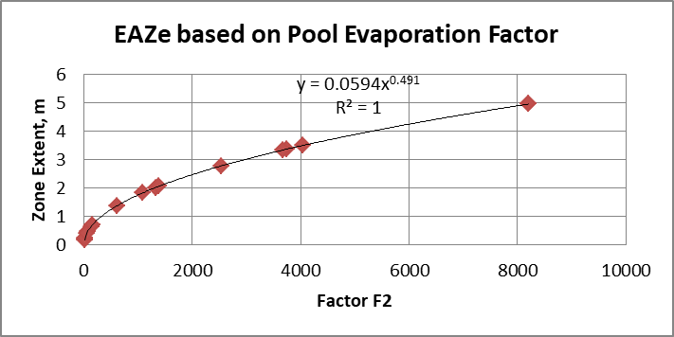

Sources of Release – Pool Evaporation
$Zone Extent=$ ${a∗(F2)}^{b}$
The factor F2 is found to be a function of vapour pressure, LEL, and molar mass of the flammable liquid.

Slide 15
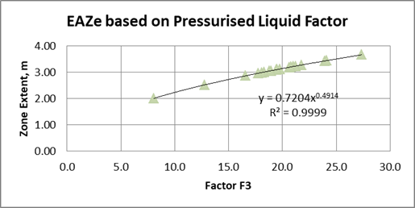

Sources of Release – Pressurised Liquid
$Zone Extent=$ ${a∗(F3)}^{b}$
The factor F3 is found to be a function of LEL, vapour density, and liquid density of the flammable liquid.

Slide 16
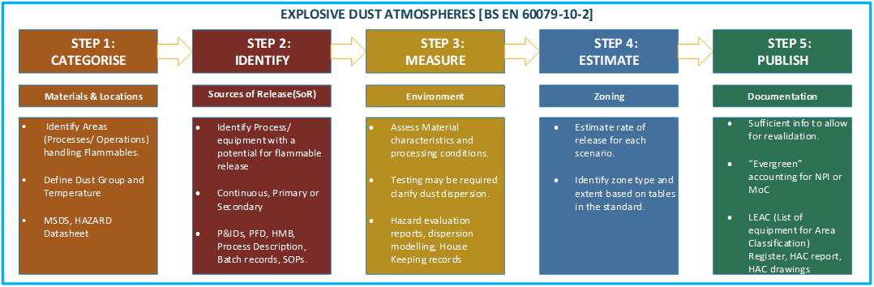

EAZe Process - Explosive Dust Atmospheres

Slide 17

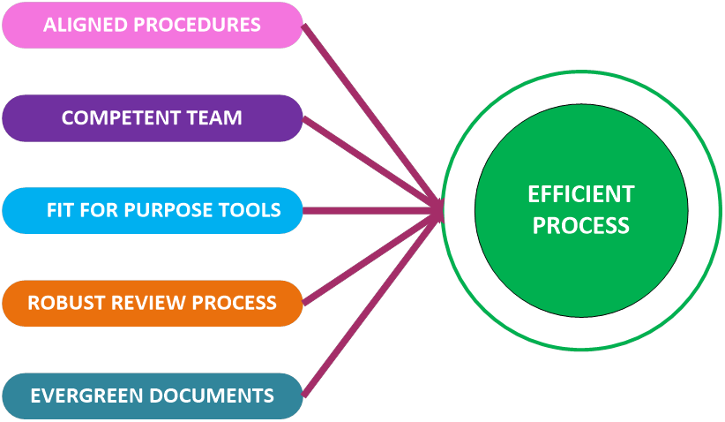
Efficiency improvement in determining EAZe

Slide 18
Conclusion
Comprehensive and Robust process for determining Zoning Extents for Hazardous Areas.
Methodology for recording detailed information on the assessments.
Factors F1, F2, F3 for ranking the solvents to assist with quickly determining the basis of assessment in case of multiple chemicals.
Future work
Extension of the EAZe process to identify more factors to cover all the sources of releases / mechanisms.
Embedding EAZe process with other business processes for ensuring compliance and ease of maintenance.

Slide 19
Thank you
Questions & Clarifications
Prashanth Shivakumar
PSK Pharma Solutions Limited
Pshivakumar.Pharma@gmail.com

