Slide 1

Teesside Members’ Group
Annual Meeting
2023/24
Wednesday 17th May 2023
740 members at 4 May 23
Down 16 members over the year. - 2% (One of the better UK performers. We remain the 9th largest UK branch.)
(Membership growth and involvement was a topic in AOB.)
[Area 72.2 km²]

Slide 2
A.M. Agenda
Apologies and Attendance
Minutes of previous Local AM and Matters Arising
Chair’s Report
Treasurer’s Report
Teesside Member Group Committee
Any Other Business
Summary and Close

Slide 3
Apologies, Attendance and Minutes
Apologies
Attendance Neville Blackwell, Joseph Fisher, Ralph Gros, Steve Pallant, Sam Gooneratne, Adrian Northey, Peter Dodd
Minutes. Received.
Reports of the Chair and Treasurer.

Slide 4
Chair’s Report
Dr Peter Dodd

Slide 5
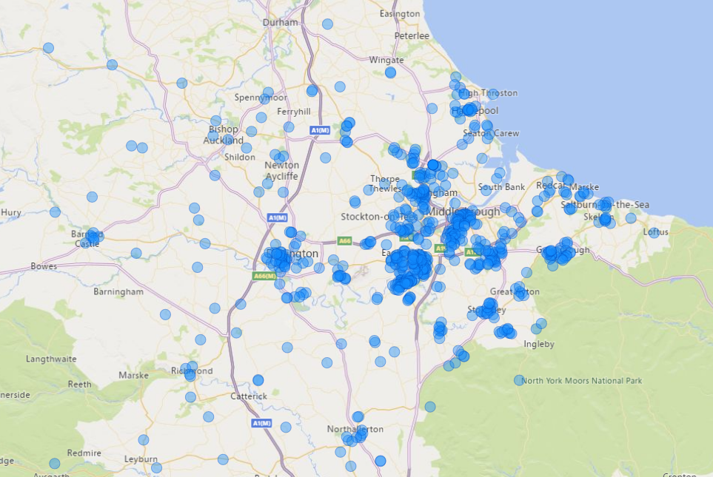
Chair’s Report Data from 2020/21

Slide 7
Activities and Events
Special Mentions and Thanks
Net Zero activities across the Tees Valley – Chris Beck – Tees Valley Combined Authority (20 July)
Student Membership of IChemE – Amy Stewart – IChemE (22 Sept)
Management of Pressure Relief Systems – Alex Jones – ABB (25 Oct)
Membership of IChemE – Olivia O’Callaghan – IChemE (7 Dec)
TU Workshop on Hydrogen Safety – Simon Bradshaw – TU (25 Jan)
Annual Dinner – Wynyard Hall – Chris Rowell - TVCA – Investments in the Tees Valley. Nigel Hirst (Deputy President – IChemE) (9 March)
Incident Reporting – Simon Harrison – 6 Engineering (17 May)
Green Hydrogen Production – Venkat Krishnan – TU (29 June)
Mentoring success – Andrea Pearson Need for more volunteers. There are people asking for mentoring help all the time.
Thank you to all involved.

Slide 8
IChemE’s Main AGM
Tuesday 13 June 2023, 08:00 BST, online
Registration is needed by 6 June.
IChemE's Annual General Meeting (AGM) will be held online.
  Only Voting Members (Chartered Members and Fellows) will be entitled to vote on the day. All Voting Members will be sent a formal notice ahead of the meeting.
  There are elections for the Deputy President and a Trustee which close this week.

Slide 9
Treasurer’s Report
Treasurer – Ralph Grob

Slide 10
Treasurer’s Report – FY2022
Accounts are prepared on a calendar year basis.
  This report is to deliver performance against budget for the 1st Jan 2022 to 31st Dec 2022.
  Audited by IChemE head office at Rugby.
  Final / closing accounts were issued to the Teesside committee in February 2023.

Slide 11
Treasurer’s Report – FY2022
For most of 2022, events were held via GoToWebinar. Costs were minimal as only a couple of face to face meetings were held and venues were supplied by Teesside University. Costs were only incurred for catering at two events:
2022 Annual dinner
  Despite major efforts by the team it was decided to postpone the Teesside IChemE dinner until 2023.

Slide 12
Treasurer’s Report - FY2022
Balance Sheet (1st Jan – 31st Dec 2022)
 | Actual Spend |  |  |  | Annual Budget
Revenue Account | Income | Direct Costs | Gross surplus/ (deficit) |  | Income | Direct Costs | Gross surplus/ (deficit)
 | GBP | GBP | GBP |  | GBP | GBP | GBP
Technical Meetings | 0 | 60 | 340 |  | 0 | 400 | 400
School links | 0 | 0 | 300 |  | 0 | 300 | 300
Networking | 0 | 0 | 860 |  | 0 | 860 | 860
Site Visits | 0 | 0 | 0 |  | 0 | 0 | 0
Bursaries/Prizes | 0 | 200 | 0 |  | 0 | 200 | 200
Committee meetings/ AGM | 0 | 0 | 120 |  | 0 | 120 | 120
Annual dinner | 0 | 0 | 5,220 |  | 0 | 5,220 | 5,220
Membership Development | 0 | 0 | 150 |  | 0 | 150 | 150
Member communication | 0 | 0 | 600 |  | 0 | 600 | 600
Misc | 0 | 0 | 0 |  | 0 | 0 | 0
Net Surplus / (Deficit) | 0 | 260 | 7,590 |  | 0 | 8,170 | 8,170
Notes:
Brackets red indicate –ve costing
All costs and income excludes VAT

Slide 13
Treasurer’s Report – 2023 Budget
That was last year, now for the current year…
As stated, the largest costs of “in real life meetings” are typically:
  Technical meetings.
  Speakers (annual dinner / awards event).
  School links & events. (We continued to support virtual events)
With virtual meetings there were zero costs.
Budget accepted for 2023 (1st Jan to 31st Dec 2023)
  Forecast set at a deficit of £2,210 (exc. VAT) – accepted by the IChemE (December 2022).
Face to face meeting are back.
Most committee meetings remain online

Slide 14
2023/24 IChemE Teesside Committee

Slide 15
Teesside Members’ Group - Role Summary
Committee Role | Description | Eligibility
Chair | Officer: chairs committee meetings, organises and provides leadership of committee activity. | Chartered IChemE member
Secretary | Officer: helps organise meetings and activities. | IChemE member (any grade)
Vice Chairs | Deputise when the Chair is unavailable. | IChemE member (ideally Chartered)
Treasurer | Officer: manages the budget, balance sheet and ensures payments are made / received to time. | Chartered IChemE member
Mentor Coordinator | Manages mentor list and matches mentors to mentees. | IChemE member (any grade)
Annual Dinner Lead | Leads all tasks for the largest Teesside committee event.
Event Coordinator | Helps to manage the list of events – provides optimum timing and coaching on how other members can run events.
Schools Liaison Coordinator | Maintains links with schools / runs a STEM program.
University Liaison Leader | Maintains the link with Teesside University and involves students / local graduates.
University Industrialist | A member from industry who assists with university requests (e.g. accreditation / MEng presentation judging)
Young Members Coordinator | Provides a program of relevant events and information for students and recent graduates on Teesside.
Industry Links Manager | Maintains industry contacts across Teesside and builds the committee’s regional network.
Email Campaign Manager | Emails out event notices to members – critical in terms of optimum timing and clear messaging.
Webmaster | Manages the various online platforms for the committee.
Student Representative | Is a Teesside University student, representing the student perspective – to help encourage student involvement.
Ordinary Committee Member | Attends committee meetings, and helps with initiatives / events when time allows.

Slide 16
Teesside Committee approved in 2022 for 3 years.
Correction; Steve Pallant is a committee member. Open to other volunteers
Committee Role | Forename | Surname | Changes for 2022/23
Chair | Peter | Dodd
Secretary | Joe | Fisher
Vice Chairs | Molly | Bell
 | Ralph | Grob
Treasurer | Ralph | Grob
Mentor Coordinator | Andrea | Pearson
Annual Dinner Lead | Molly | Bell
Event Coordinator |  |  | Vacant
Schools Liaison Coordinator | Adrian | Northey
University Liaison Leader | Samantha | Gooneratne
Email Campaign Manager |  |  | Vacant
Webmaster |  |  | Vacant
University Industrialist | Laurence | Ashley.
Young Members Coordinator |  |  | Vacant
Industry Links Manager | Faisal | Mahmood
Student Representative |  |  | Vacant
Committee Member | Steve | Pallant
Committee Member | Mark | Wilson
Committee Member | Nick | Howard
Committee Member | Neville | Blackwell.
Committee Member | Peter * | Hunt
Committee Member | Ginette | Kontcho
Committee Member | Paul | Dumain
* IChemE Congress Members

Slide 17
AOB/General Committee Q/A
Sam said that Dr Omar Aboelazayem, a TU colleague, was interested in taking the Schools/University role and if he did, she would remain on the committee. Sam would try again to get student involvement with the branch.
Given the unusually low turnout this evening for the technical talk, (14 registered and 7 attended) we should try hybrid meetings. Attempt to make the Green Hydrogen talk on 29 June hybrid. (Peter/Sam)
We have moved to 2 out of 3 committee meetings on line. There seemed to be a generational preference for face to face and virtual networking. There could be a September face to face and the rest on line in order to get the most attendance?
It was said that other branches provide pizzas at technical talks to attempt to change the demographic and appeal. Investigate the possibilities. (Peter/Ralph)
The environment was similar for all learned societies. There are two options. Work more with other societies on Teesside and/or work with IChemE Tyneside and/or Hull and Humber. We are open to cooperation.
The success of the dinner was a sound basis for the branch. IChemE are now members of NEPIC so we need to work on the company links.
Use of social media for communication of meetings, not just IChemE emails. Molly
Can we publicise locally held Special Interest Group meetings to the branch? Peter
Next Committee Meeting: Monday 12th June 17:30 - 18:30 online

