Slide 1
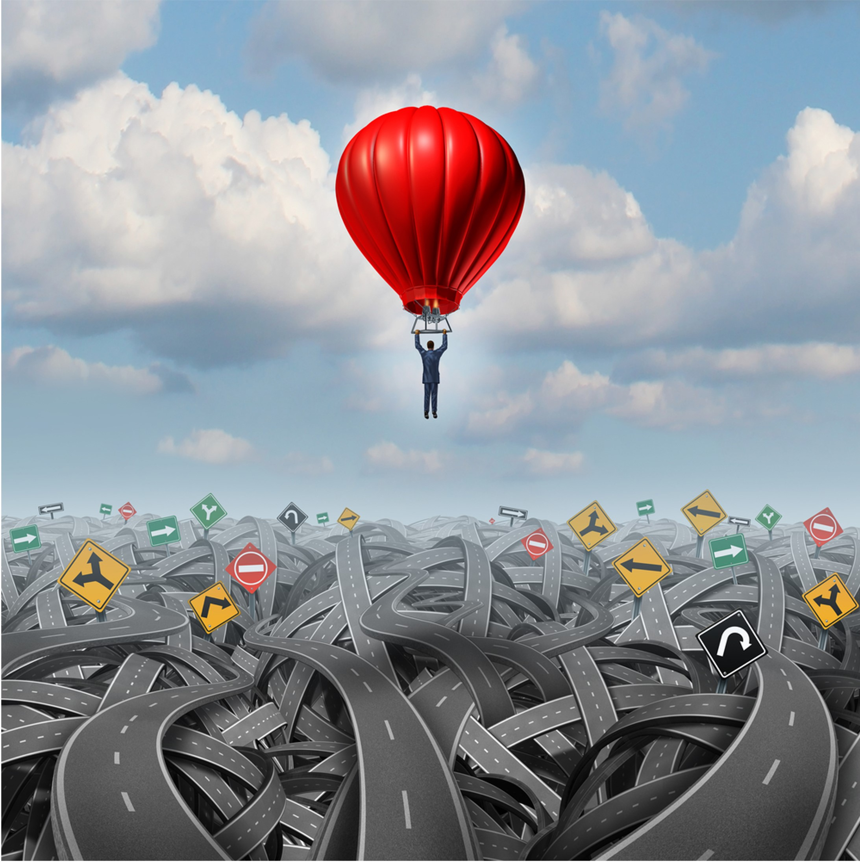


Learning effectively from near miss reporting
A lightweight investigation tool for non-experts
Stuart King | Energy Institute
IChemE Hazards 33 | 7-9 November 2023

Slide 2

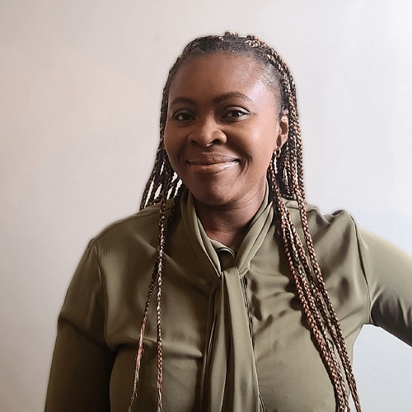



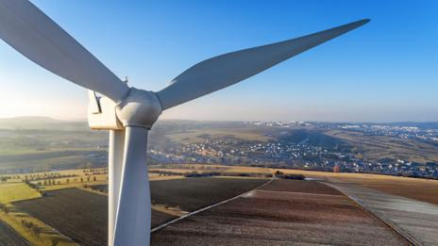

The Energy Institute
Chartered professional membership body for the energy sector – CEng, Cenv, Ieng, EngTech etc.)
Technical institute - $2million annual research fund, publish 50+ industry guidance documents annually
Training provider – providing training on the energy sector itself, risk management, energy management, and more
Registered charity – to disseminate accurate, scientific, knowledge about energy to wider society

Slide 3
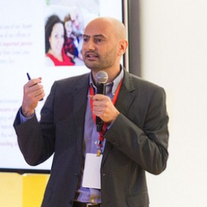
The Stichting Tripod Foundation (STF)
A charity, based in the Netherlands
Setup by Shell in 1998
Worked with the Energy Institute since 2012
Managed by the Tripod Board
The Foundation helps organisations on their journey to become better and safer companies.
This is best achieved by using scientifically proven methods that push organisations forward.
The Foundation provides thought leadership.
The Foundation develops, promotes, and ensures high quality delivery of proven methods to learn from events and sustainably embed learning into your organisation.
Emanuele Cimica | Chair, Stichting Tripod Foundation Board | General Manager, Business Transformation, Shell

Slide 4
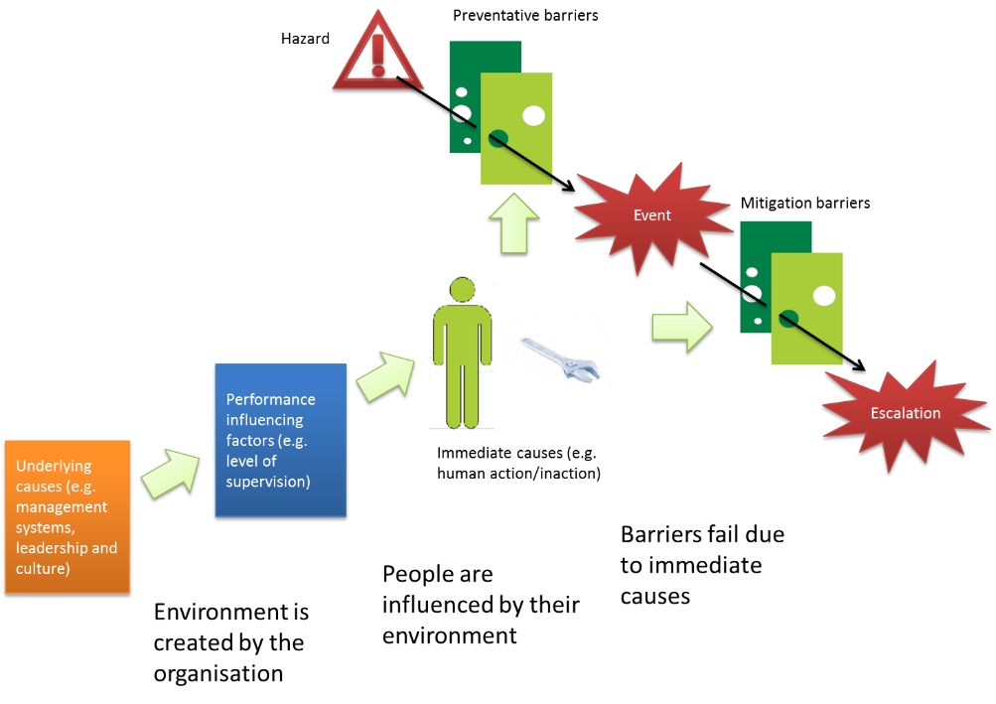
What is Tripod?
It is a way of understanding:
Why incidents, near misses, and unwanted events happen
The barriers that were in place, whether effective or failed
The role of people and human factors in the event
The role of organisational factors – and that these were present and known before the event occurred
What are the aspects that we can control to prevent future incidents?

Slide 5
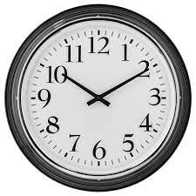

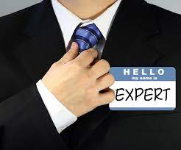
We saw a problem…
Weak signals are being missed
Hundreds or thousands of near miss / low-level incident reports are recorded using a simple form, detailing ‘what happened’ but rarely ‘why’
So why bother reporting the small stuff…?
Because it tells us whether our reporting system is working, This means we learn mostly from rare, serious events, but not from these common ‘everyday’ events. Imagine if we could capture the weak signals from all these events – before serious incidents happen
Time
In-depth investigations take days or weeks to complete
Front level supervisors have limited time (~2 hours) to complete a low-level incident report
Tools
The simplest and most common tools e.g., ‘5 WHYS’, are unstructured and highly dependent on the skill of an investigator
Expertise
A good investigation requires a skilled investigator
It takes time to train someone up to this level

Slide 6
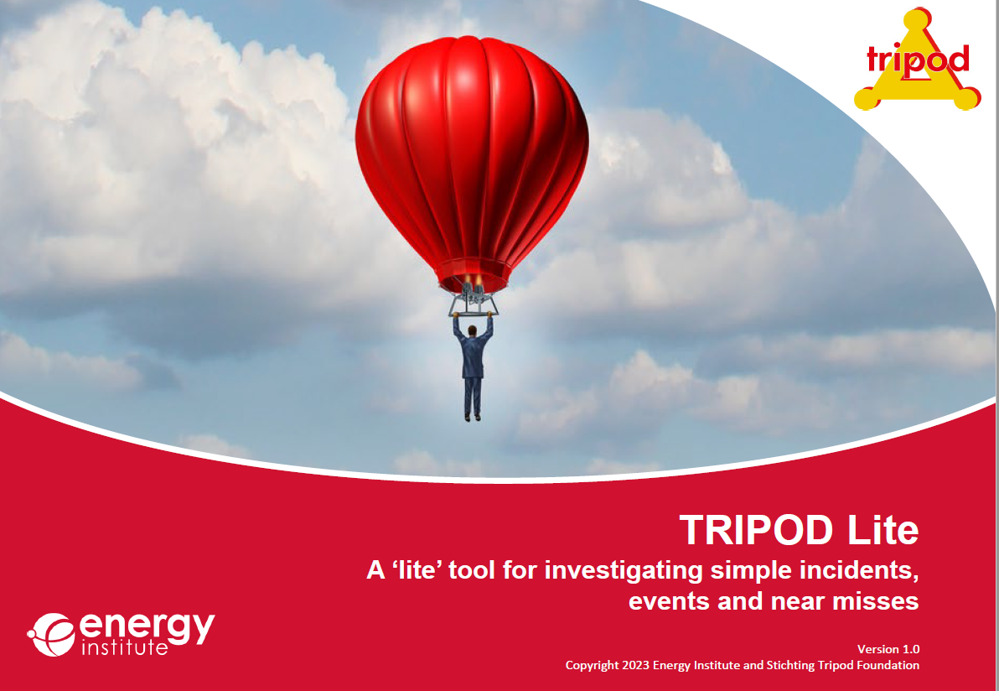
Our Aims
Free to use
Quick and simple to use
Requires minimal training
For supervisors, managers, and trained investigators
Consistent investigations that uncover causes
Suitable for less complex incidents
‘Can it be used by a supervisor who has two hours to conduct a simple investigation of a near miss or low-level incident?’

Slide 7
Method
What we did
The tool was drafted in 2021
Phase 1 testing in early 2022 with two organisations – a water company, and a large international consultancy
Proof of concept showed promise, and initial improvements were made
Phase 2 testing in Q2-Q3 2022. Many users were invited to take part
Collected user feedback via survey, focus group, and written data
Final improvements were made and the tool was published in March 2023

Slide 8
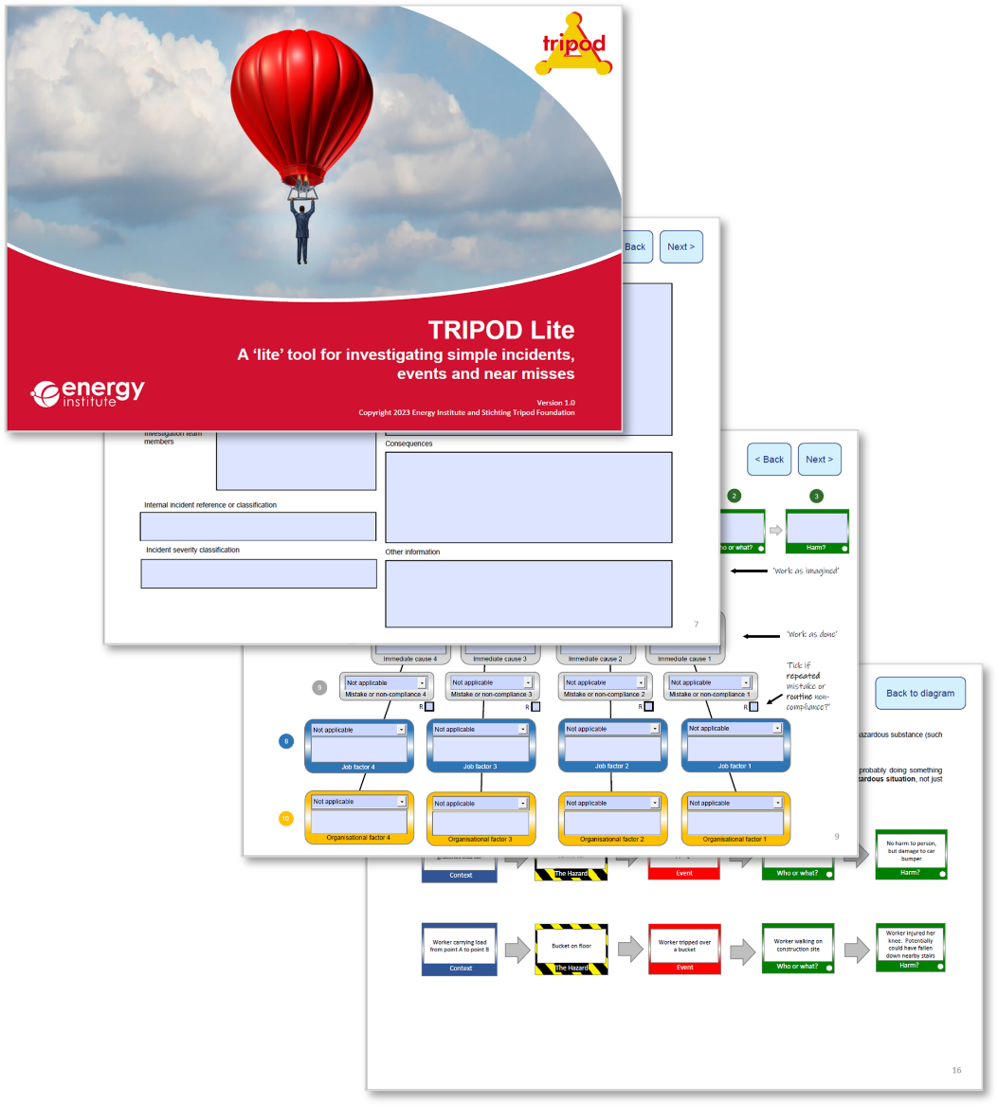


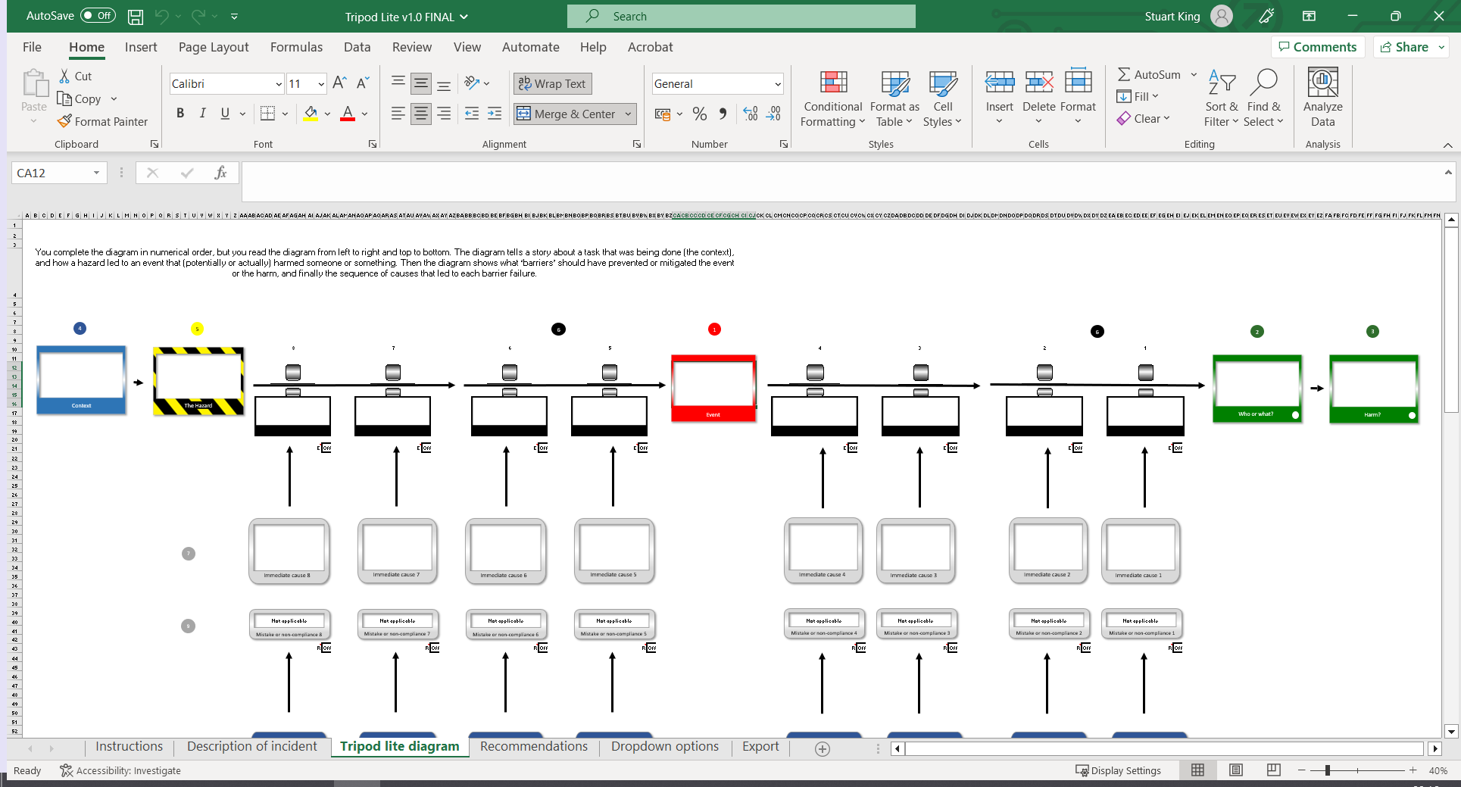
What is Tripod lite?
Lightweight investigation tool
Free to download and use
Available as a PDF or Excel Workbook
Self Contained with comprehensive, simple to follow guidance included

Slide 9

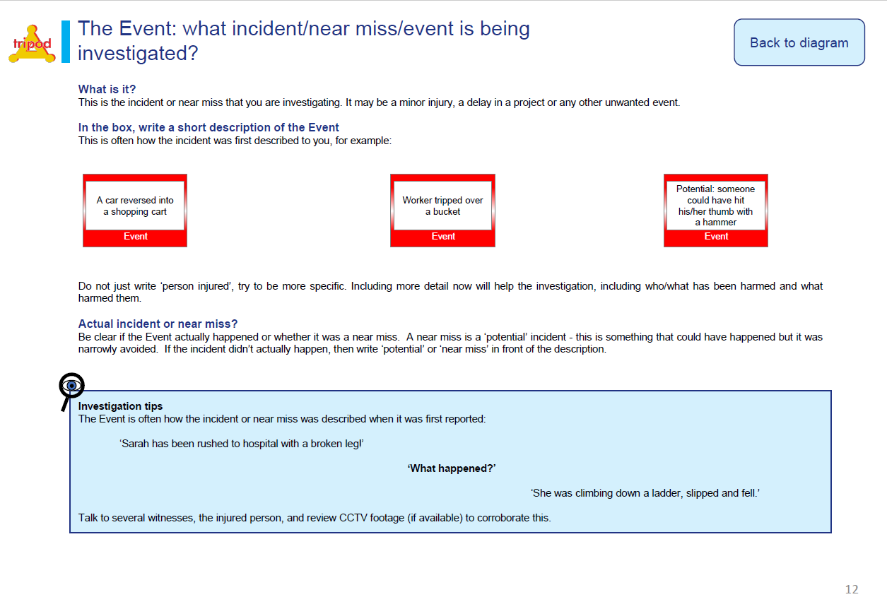
4
5
1
2
3
Jim was walking down the corridor. Interior decorators working in area.
Jim trips over bucket
Bucket on the floor
Jim
Grazed hands
Context
The Hazard
Event
Who or what?
Harm?
Start here
What happened

Slide 10


4
5
6
1
6
2
3
Jim was walking down the corridor. Interior decorators working in area.
Bucket on the floor
Jim trips over bucket
Jim
Grazed hands
Context
The Hazard
Event
Who or what?
Harm?
Store bucket in safe place away from walkways
Close off corridor or cordon off working area
Start here
‘Work as imagined’
Barrier 4
Barrier 3
Barrier 2
Barrier 1
How it happened
Documented in the procedures
Known about by workers

Slide 11
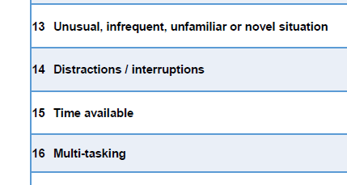
4
5
6
1
6
2
3
Jim was walking down the corridor. Interior decorators working in area.
Bucket on the floor
Jim trips over bucket
Grazed hands
Context
The Hazard
Event
Who or what?
Harm?
Who or what?
Store bucket in safe place away from walkways
Close off corridor or cordon off working area
Start here
‘Work as imagined’
Barrier 4
Barrier 3
Barrier 2
Barrier 1
Bucket was left on the floor by one of the workers
‘Work as done’
7
Immediate cause 4
Immediate cause 3
Lapse
Repeated mistake or non-compliance?’
9
Mistake or non-compliance 4
Mistake or non-compliance 3
R
R
14 Distractions/interruptions
8
Worker got called away to attend to something else
Job factor 4
Job factor 3
Job factor 2
10
Organisational factor 4
Organisational factor 3
Why it happened

Slide 12
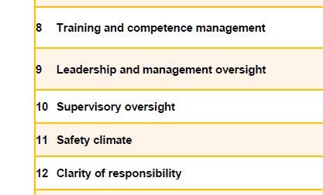
4
5
6
1
6
2
3
Jim was walking down the corridor. Interior decorators working in area.
Bucket on the floor
Jim trips over bucket
Grazed hands
Context
The Hazard
Event
Who or what?
Harm?
Who or what?
Store bucket in safe place away from walkways
Close off corridor or cordon off working area
Start here
‘Work as imagined’
Barrier 4
Barrier 3
Barrier 2
Barrier 1
Bucket was left on the floor by one of the workers
‘Work as done’
7
Immediate cause 4
Immediate cause 3
Lapse
Repeated mistake or non-compliance?’
9
Mistake or non-compliance 4
Mistake or non-compliance 3
R
R
14 Distractions/interruptions
8
Worker got called away to attend to something else
Job factor 4
Job factor 3
Job factor 2
10 Supervisory oversight
10
No one was supervising the job
Organisational factor 4
Organisational factor 3
Why it happened

Slide 13
User feedback from Pilot
Compared to other methodologies, Tripod lite was generally regarded as:
Easier to use
Quicker to use
Better at identifying barriers and causes
Requiring less training
Do you think your organisation should adopt Tripod lite?
‘Easy to use’
‘User friendly and intuitive’
‘Similar to the Swiss cheese model, which is a modern accident analysis tool’
‘Positive that the tool can be used to identify where barriers were effective’
‘Prepopulated fields make it easy for beginners’
‘It blew my mind’

Slide 14
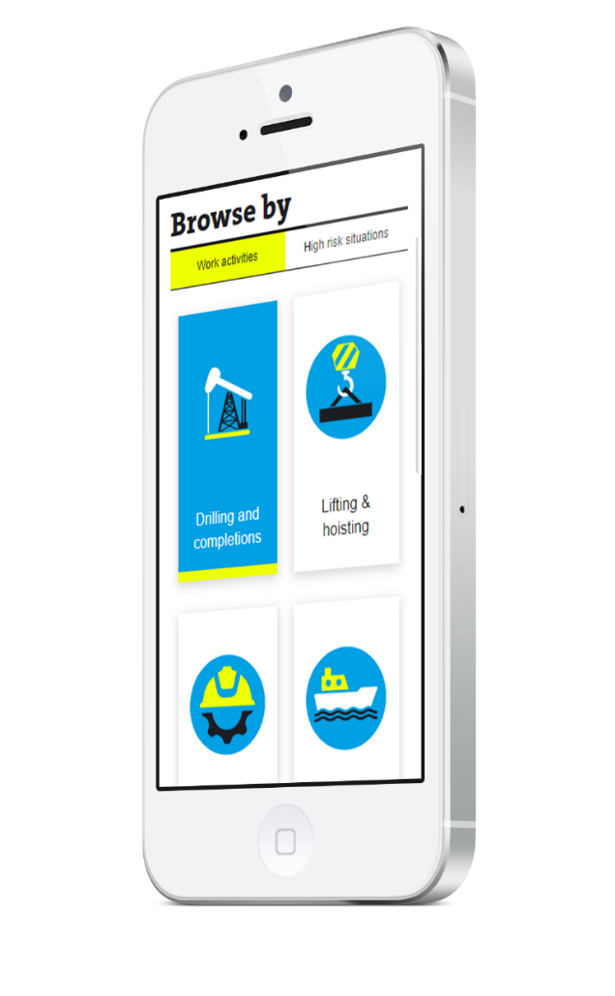
Weak signals
One simple incident, with one or two barriers, and one or two causes identified – it’s a weak signal
By themselves, weak signals are not conclusive proof
We need to strengthen the signal
Typically we only have 2-4 hour to get usable learning from a near miss
As a case study 28 incidents from the ‘Wind Power’ section of the Energy Institute Toolbox database were mapped using Tripod lite
Tripod lite uses a common taxonomy. Therefore, data can be easily aggregated
Number of near miss reports | Number of FTEs required to manage investigations (10 day, detailed) | Number of FTEs required to manage investigations (2 hours, simple)
500 | 25 | 0.625
1000 | 50 | 1.25
2000 | 100 | 2.5
5000 | 250 | 6.25
10000 | 500 | 12.5
https://toolbox.energyinst.org

Slide 15
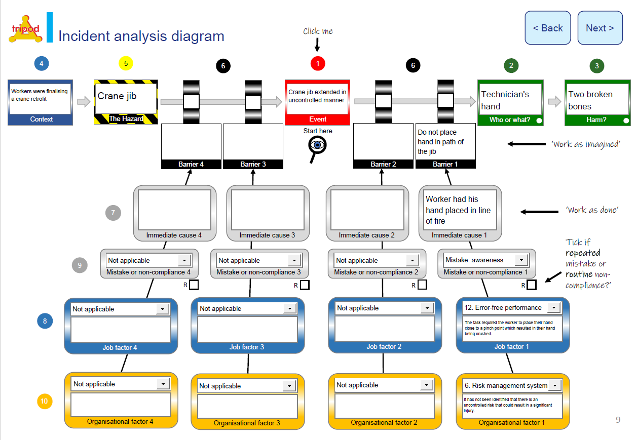
A real example
https://toolbox.energyinst.org/c/presentations/hand-injury-during-craning-operations

Slide 16
Immediate causes

Slide 17
Organisational factors

Slide 18
Correlation of causation

Slide 19
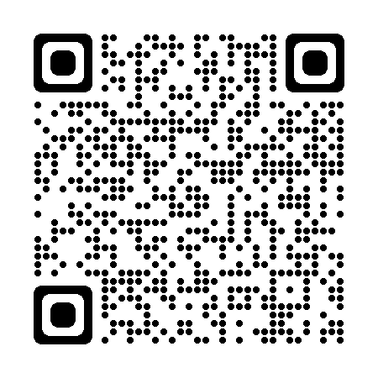
Conclusions
The Tripod Foundation released Tripod lite in March 2023 – for free!
We see potential for it to improve near miss and low-level incident reporting
Companies are already using it
Feedback was positive from testing
Is it perfect? No – this is version 1.0
Download it and give it a go. You have nothing to lose…
Download from: Tripodfoundation.com

Slide 20
Thank you for listening

