Slide 1



Review of gaps and needs in data collection and definition of equipment classes, failure modes and safety equipment for hydrogen systems
Marta Bucelli
Research Scientist
SINTEF Energy Research
Norway

Slide 2
Table of content
Short introduction and motivation
Goal
Methods
HIAD2.0 database
Keyword lists and analyses performed
Results
Conclusions

Slide 3

Background and motivation

Slide 4
Background and motivation
To ensure and demonstrate the safe and reliable operation of hydrogen systems it is crucial to understand and define:
Equipment classes
Failure modes
Safety equipment performance

Slide 5
Goal
A review of the state of the art of the availability and quality of data for quantitative risk analysis is performed to:
Identify gaps and needs in data collection
Understand the challenges for safe use of hydrogen

Slide 6
Methods
Qualitative survey of the HIAD database and the available literature on hydrogen failure modes;
Definition of the "baseline dataset" and Data Frame A & B (based on whether the events were directly related to the presence of H2);
Terminology bibliographic research and database crosscheck;
Definition of keyword lists and word-extractor Python code;
Further analyses on quality classification, cause classification and safety equipment.

Slide 7
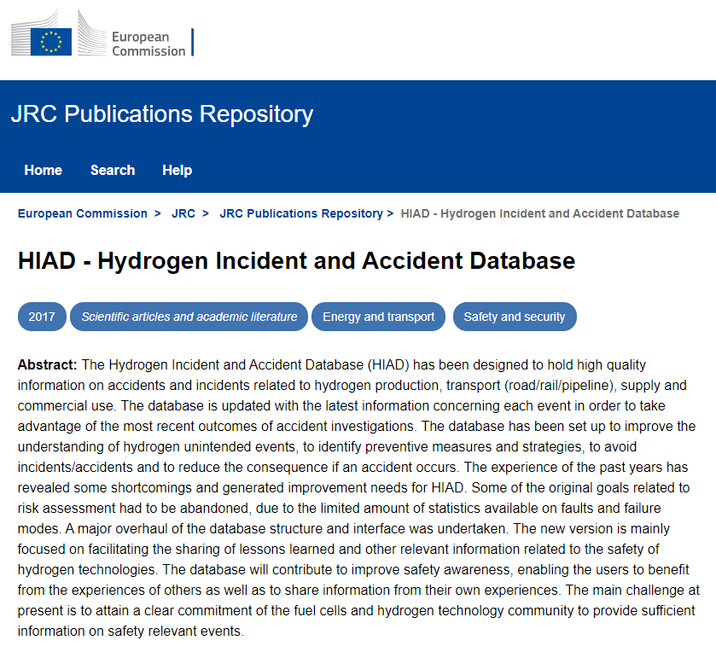
Methods – HIAD2.0
Notes:
JRC Joint Research Center
Melideo, D., Weidner Ronnefeld, E., Dolci, F. and Moretto, P., HIAD - Hydrogen Incident and Accident Database, In: 53rd ESReDA Seminar, 14-15 November 2017, Ispra, 53rd ESReDA Seminar, 2017, p. 326-336, JRC108666

Slide 8

Methods – HIAD2.0
6 Sheets
689 rows and 86 columns
Events
Rows:
689
Columns:
12
Refs
Rows:
689
Columns:
9
Consequences
Rows:
689
HIAD2.0
Columns:
13
Lesson learnt
Rows:
689
Columns:
5
Event nature
Rows:
689
Columns:
31
Facility
Rows:
689
Columns:
16
Last accessed: 07.07.2023
Notes:
12+9+13+…. Columns
689 rows

Slide 9
Methods – Baseline dataset
689 rows and 5 columns
2 Sheets
Q (quality)
Events
Rows:
689
Cause Comment
Columns:
12
Refs
Rows:
689
Event initiating system
Columns:
9
Consequences
Rows:
689
HIAD2.0
Columns:
13
Lesson learnt
Rows:
689
Columns:
5
Event nature
Rows:
689
Columns:
31
Component involved
Facility
Rows:
689
Columns:
16
Full description
Last accessed: 07.07.2023

Slide 10
Methods – Data Frame A and B
689 rows and 5 columns
2 Sheets
Q (quality)
Events
Rows:
689
Cause Comment
Columns:
12
Event initiating system
HIAD2.0
Component involved
Facility
Rows:
689
Columns:
16
Full description
Last accessed: 07.07.2023

Slide 11
Methods – Data Frame A and B

Slide 12
Methods – Keyword list I, II and III
To analyse Data Frame A and B
Keyword list I | Keyword list II | Keyword list III
Component part | Failed component | Operation unit
Diaphragm, valve, pipe, joint, flange, nut, PRD, Rupture disk, disk | Wear, fracture, rupture, impact, fatigue, creep | Truck, heat exchanger, compressor, electrolyser, storage tank, container, cracker, turbine
Full list on available article
Notes:
III used in Python on Data Frame A and B

Slide 13
Methods – Further analyses: quality
Legend:
Q=2 | Very low quality, borderline validated
Q=3 | Low quality
Q=4 | Good quality (but something missing)
Q=5 | High quality (traceable and good sources)

Slide 14
Methods – Further analyses: cause
Keyword list IV
Origin cause
collision, roll over, overturn, road crash, crash, road incident, road accident, accident, ignition, release, explosion, fire, production, formation ignition, deflagration, burst, detonation, release, leak, leakage, failure, malfunctioning, degradation, failing to open, producing, generated, presence unexpected, formation, production fire

Slide 15
Methods – Further analyses: safety systems
Qualitative analysis of safety equipment role for Data Frame A and B:
Proactive barriers
  to prevent or reduce the probability of a hazardous event
Reactive barriers
  to avoid or reduce the consequences of a hazardous event
(Rausand, 2011)
Notes:
Visual qualitative inspection
This category includes the employment of pressure release valves and rupture disks that play an active part in mitigating an event, as well as barricades and dikes that act as physical barriers, fire sprinklers systems gas detectors and alarms. Besides the reactive barriers that are technical in nature, in mitigating the consequences of an incident, the plant emergency response that is made up of on-site operators as well as the community’s emergency response comprised of fire fighters among others, is also included in this category(Rausand, 2011).

Slide 16
Results
Determine the prevalence of complete partial or absent entries in the database
Causes of accidents
Role of safety barriers

Slide 17
Results – Data Frame A and B

Slide 18
Results for Data Frame A
Hydrogen initiating system (Data Frame A)
Rows:
508
Columns:
4
2 Sheets
Events
Facility
Q (quality)
Cause Comment
Component involved
Full description
Notes:
Built on the split of the baseline database per the initiating event column

Slide 19
Results – Completeness of Data Frame A
Failure mode entries
Notes:
. The purpose of the analysis was to determine the prevalence of complete partial or absent entries in the database

Slide 20
Results – Completeness of Data Frame A
Failure mode and component entries

Slide 21
Results – Quality
of Data Frame A
Cause Comment
Components Involved
Full description

Slide 22
Results – Cause classification
Notes:
hydrogen is formed
like obtain via a chemical reaction if I recall correctly
it formed where they didn't expected it
in tracing back the cause of an incident, they determined it after the fact

Slide 23
Role of Safety Equipment
Type | ID | Event | Country, Year | Comment
Sensors | ID401 | Detection of hydrogen release | Norway, 2012 | Initiate a shutdown procedure, credited in the event
Sensors | ID177 | Explosion at a facility | France, 2003 | Failure on demand
Alarms | ID228 | Explosion and fire in a refinery | UK, 1987 | Did not work because previously disconnected
Arial body 28pt one max - subtitle can be deleted

Slide 24
Conclusions
Establishment of centralized data collection and sharing platforms
Development of universal definitions of hydrogen equipment classes and failure modes
Guidelines for adequate selection of safety equipment

Slide 25
Conclusions
Unlikeliness of locating failure mode and component class
Suggestions to add designated columns in the database
  Operation unit
  Failure modes
    Component part (where)
    Failed component (failure itself)
Notes:
Importanc and usefulness

Slide 26
Conclusions
Proactive barriers are mentioned the least
Continuous improvement is needed
  Incorporating advanced technologies like thermal imaging
  Adopt a multidisciplinary approach for effective risk mitigation
  Design more robust systems that consider a broad range of variables
Notes:
Importanc and usefulness

Slide 27
Thank you for your attention!
Marta Bucelli, PhD
marta.bucelli@sintef.no

Slide 28


Slide 29
Results – Completeness of Data Frame A
Failure mode entries
Failure mode + component entries

Slide 30
Results – Completeness of Data Frame B
Failure mode entries
Failure mode + component entries

