Slide 1

Development of a methodology to assess and communicate the effectiveness of COVID-19 risk control strategies
Dr Colin Chambers
April Lockhart
Zoe Chaplin
HSE Science Division
Hazards 33
November 2023

Slide 2
Introduction and presentation outline
This paper presents the Weighted BowTie Diagram risk assessment and risk communication methodology (WBTD) developed by scientists at HSE’s Science Division
Introduce the traditional bowtie diagram method and highlight some of its potential limitations
Introduce the WBTD methodology
Show how the WBTD methodology can be used to assess and communicate risks associated with an example Covid-19 scenario ‘attending the gym’
Show examples of how supporting techniques can be used
Present findings and conclusions

Slide 3
Traditional bowtie diagram basics
Notes:
Talk through BTD basics

Slide 4
Traditional bowtie diagram potential limitations
The visual clarity of the bowtie diagram can potentially be reduced when presenting multiple threats, barriers, and associated degradation events with their controls.
The traditional bowtie diagram is not normally used to perform a qualitative or quantitative risk assessment.
The traditional bowtie diagram does not generally indicate the effectiveness of barriers used, using visual techniques.

Slide 5
The Weighted BowTie Diagram methodology
Starts by populating a traditional bowtie diagram for the top event being considered
A simplified bowtie diagram is produced dependent of the risk assessment aspect to be presented
The relative risk reduction implemented by barriers is depicted on the WBTD, by varying the threat / consequence pathway line thickness in proportion to the relative risk reduction implemented by each barrier
The WBTD methodology uses established risk assessment techniques, combined with expert judgement, to assess the effectiveness of each barrier and to identify other relevant factors

Slide 6
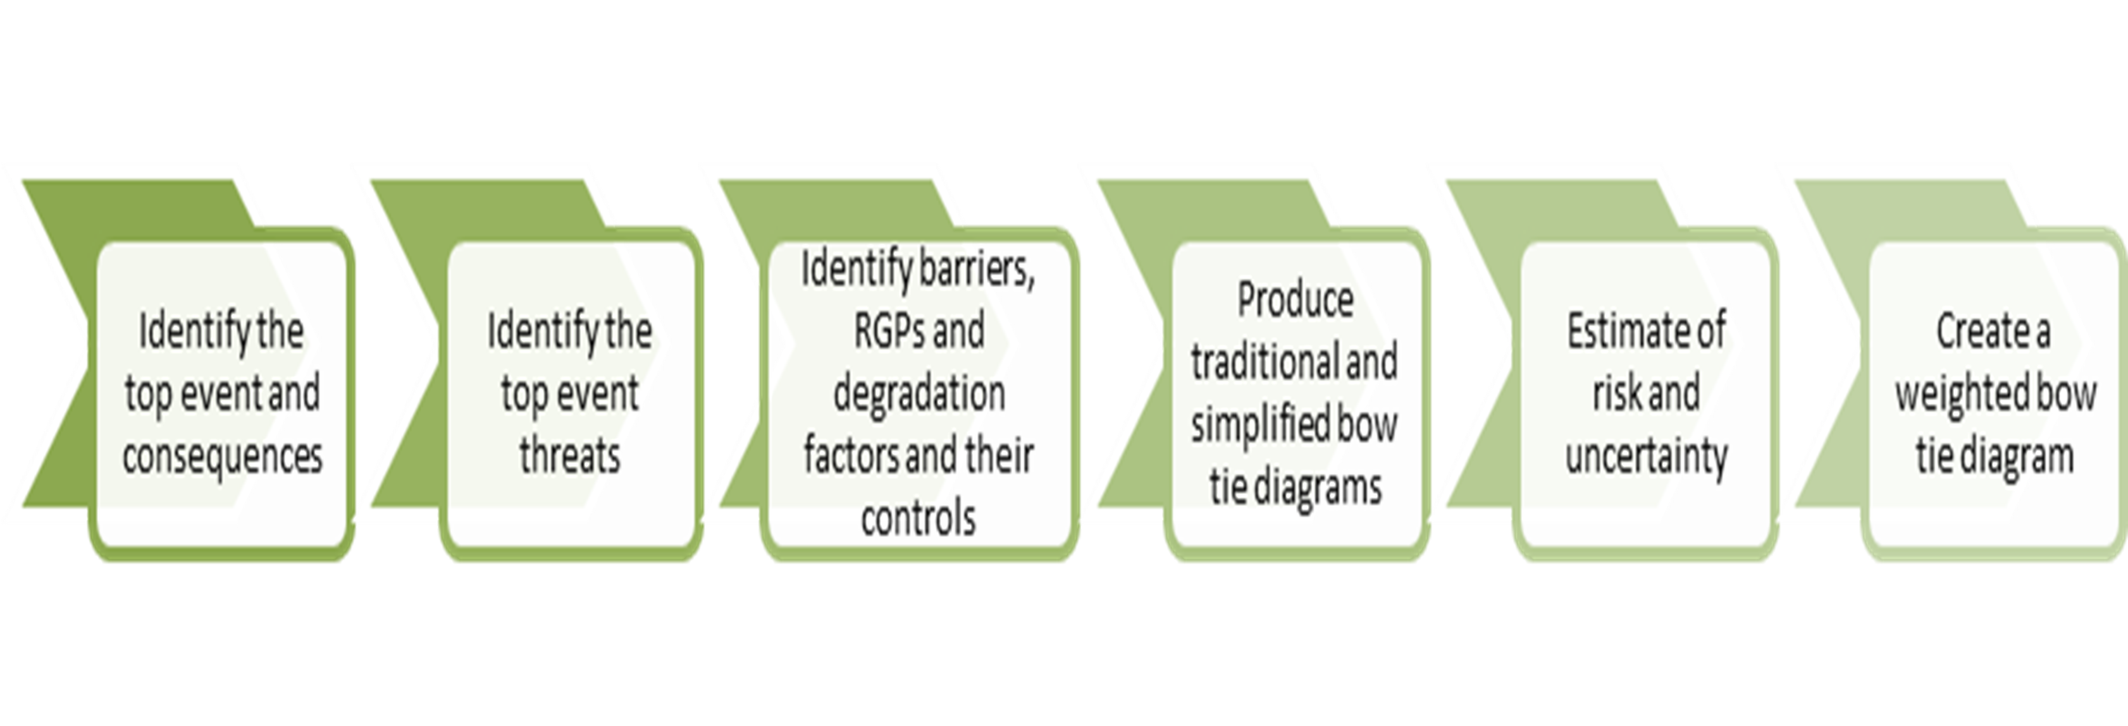
WBTD risk assessment simplified process

Slide 7
‘Attending the Gym’ scenario
Hazard | SARS-Cov-2 virus present in the population
Top Event | Individual is infected with SARS-Cov-2 while attending the gym
Consequences | Admitted to hospital with Covid-19 and recovers Admitted to hospital with Covid-19 and suffers fatality with Covid-19 cited as the primary cause
Main cause | Attending the gym, is broken down into dominant threats
Notes:
Let us outline the example covid-19 scenario used in this presentation

Slide 8
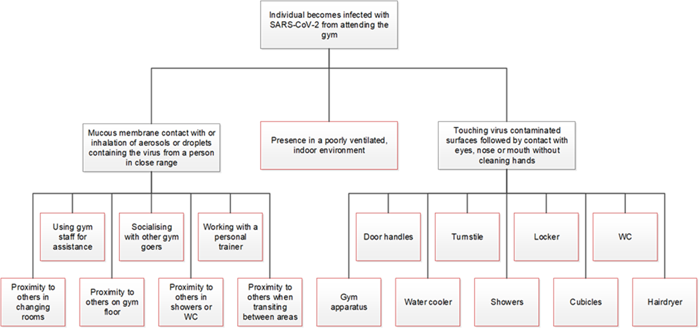
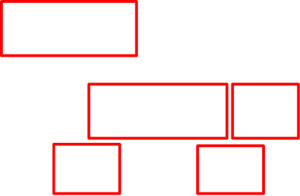
Demand tree used to identify threats

Slide 9
Attending the gym example scenario threats
Example scenario threats for the Attending the gym scenario
Contact with surfaces at external or internal doors and turnstile
Using gym apparatus
Use of locker
Use of showers
Presence in a poorly ventilated, indoor environment for 90 minutes

Slide 10
Person attends the gym example assumptions
Risk assessed from when an individual walks in the gym door to when the individual leaves.
The individual spends 60 minutes in the gym with an additional 5 mins spent in the changing room getting ready and 25 minutes spent in the changing room showering and readying to leave
The shower block contains single occupancy cubicles, cleaned after each use
Air conditioning is not running at the time this individual attends the gym
The individual does not attend a class at the gym
The individual does not have a personal trainer
The water cooler is out of service or removed
Activities are indoors, with no credit taken for passive ventilation in either the gym or changing room
Limited passive ventilation possible, ceiling vents and windows
Doors cannot be propped open due to either being a fire door or for privacy

Slide 11
Preventative barrier identification two stage approach
Top event threat | Threat prevention | Potential barrier
Contact with surfaces at external or internal doors and turnstile | Prevent surface contact Mitigate surface contact | Use non-contact entry Wash/sanitise hands after entry
Using gym apparatus | Prevent contact with equipment Mitigate contact with equipment | Cannot prevent contact so clean equipment before and after use Sanitise hands between use of each equipment item
Use of locker | Prevent direct contact with locker Mitigate contact with locker | Eliminating use of lockers is unlikely so increase frequency of cleaning Sanitise hands before and after use
Use of showers | Prevent direct contact with potentially infected surfaces Mitigate contact with potentially infected surfaces | Individual shower cubicles used Limit shower area occupancy duration Clean shower frequently after use
Presence in a poorly ventilated, indoor environment for 90 minutes | Prevent presence in poorly ventilated area Prevent / limit build-up of the virus carried by aerosol/small droplets leading to potential infection | Might not be possible if gym is to be used Limit duration of each visit Limit access to worst areas in gym Monitor CO2 in different areas of the gym Provide passive ventilation, e.g., open windows Provide mechanical ventilation

Slide 12
Mitigative barriers two stage approach
Top event consequence | Consequence mitigation | Potential barriers
Admitted to hospital with Covid-19 and recover | Improve immune response such that it is likely the infection is mild | Ensure vaccinated as soon as possible. Provide good self-care at home and if admitted hospital the ‘ hospital treatment regime’
 | Take steps to support health and wellbeing at home when symptomatic to reduce likelihood of hospital admission | Provide tips for self-care at home, including hand washing and monitoring of symptoms
Admitted to hospital but suffer fatality from Covid-19 cited as primary cause | Improve immune response such that it is likely the infection is asymptomatic or mild | Ensure vaccinated as soon as possible
 | Take steps to support health and wellbeing at home when symptomatic to reduce the likelihood of hospital admission | Provide tips for self-care at home as soon as symptomatic incl. monitoring of symptoms with admission to hospital if condition deteriorates (early intervention decreases mortality)
 | When in hospital, all relevant measures taken to support a positive outcome | Hospital treatments and care including, but not limited to, drug therapy and mechanical ventilation as required

Slide 13
Risk modification factors and recommended good practice
Risk modification factors (RMF)
  RMF is a factor that contributes to the top event risk but is not an implemented barrier
  An RMF can result in an increase or decrease in risk
  RMFs could be considered analogous to LOPA conditional modifiers
Recommended good practice (RGP)
  Recommendations to support barrier implementation to improve its effectiveness
  Factor for which credit is not claimed in the risk assessment because their contribution to risk reduction cannot reliably be determined, but nonetheless could help reduce risk.
Notes:
Example RMF associated with covid-19 could be pre existing health condition, or age where a person could be younger or older that some defined baseline age

Slide 14
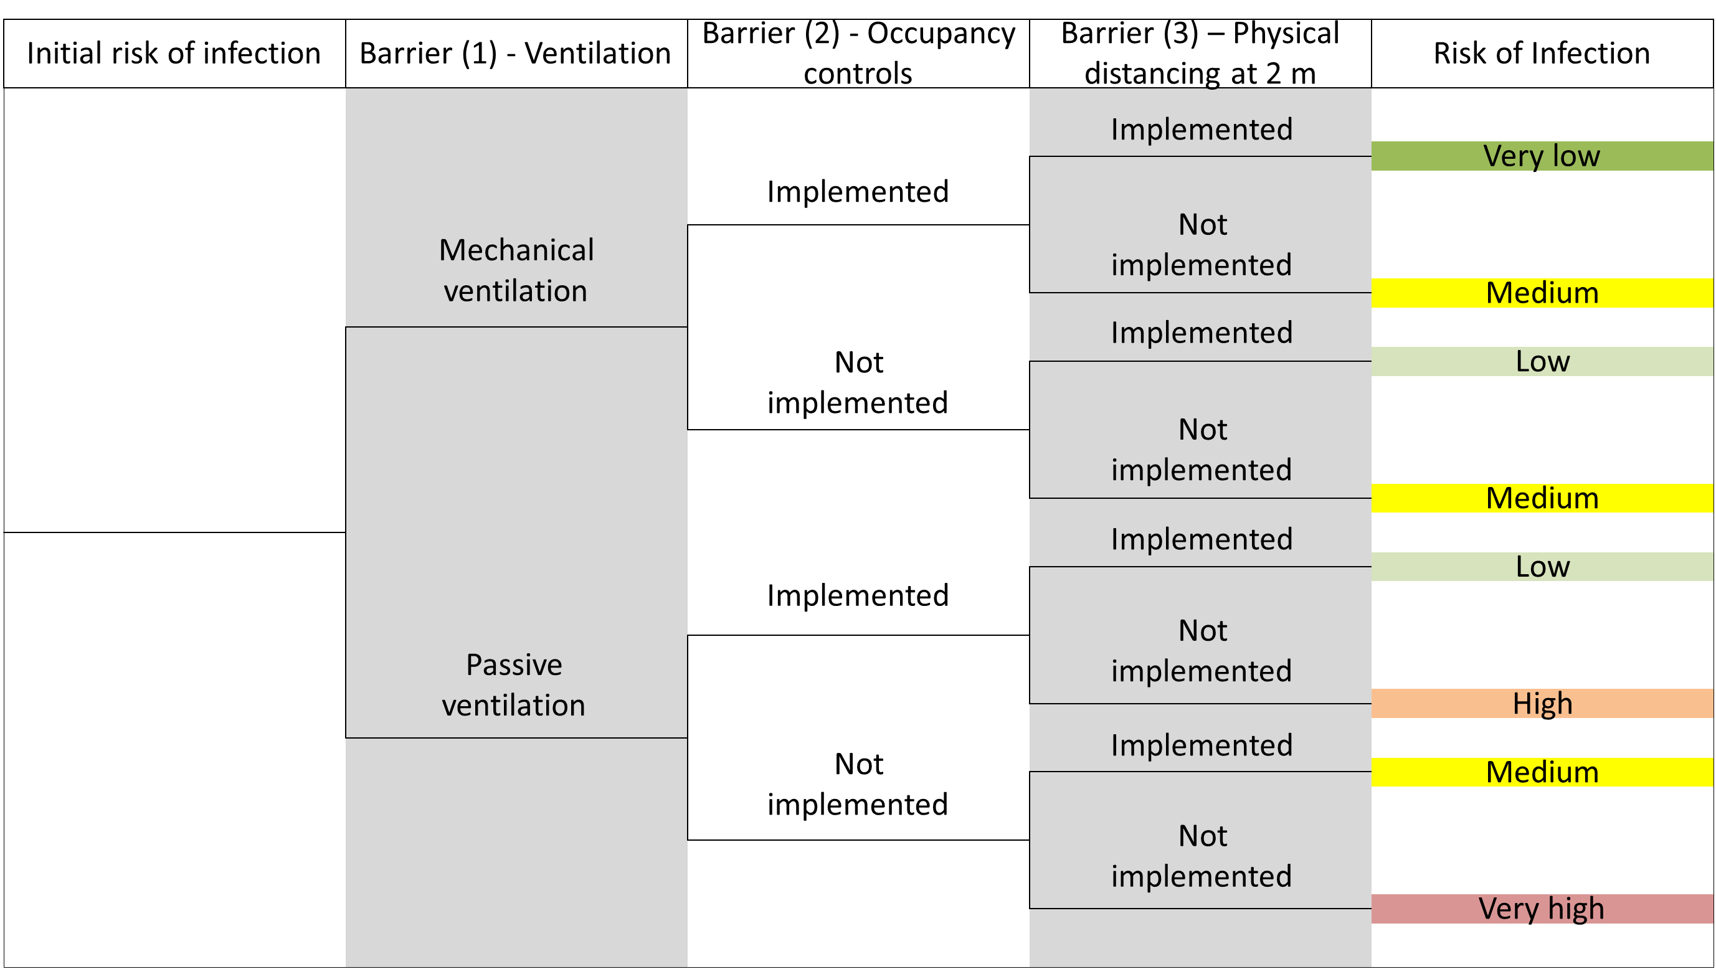
Event tree analysis used to compare risk for different risk control strategies

Slide 15
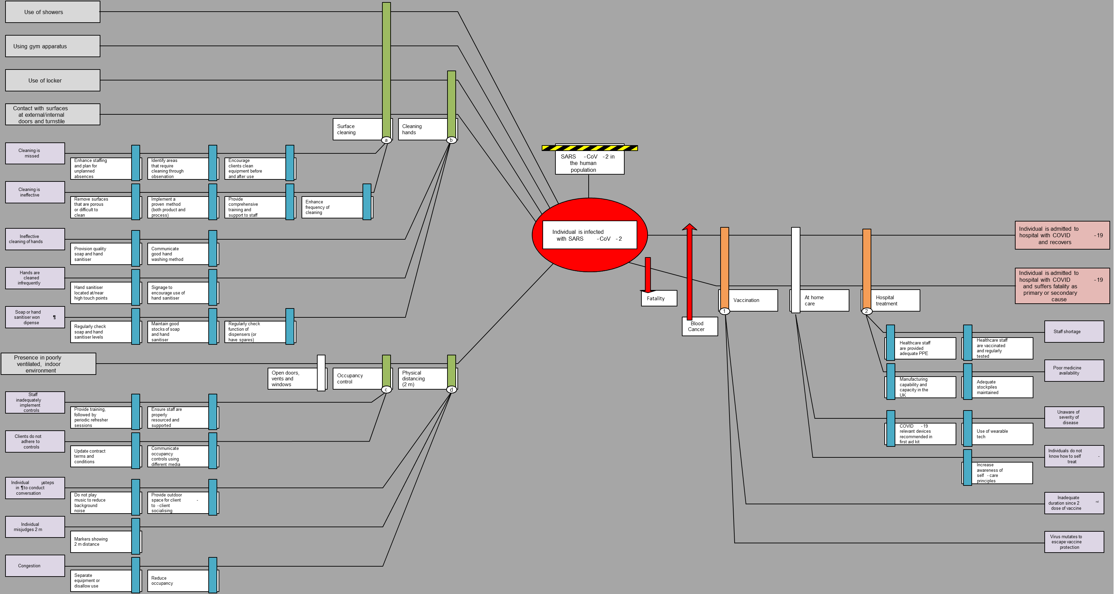
Traditional bowtie diagram for ‘attend the gym’ scenario

Slide 16
Weighted BowTie Diagram for the ‘attend the gym scenario’

Slide 17
Findings
This paper presented a concept demonstration of a novel holistic risk assessment and risk communication methodology, namely the WBTD methodology.
The methodology’s use of established risk assessment techniques was shown to provide useful wide-ranging information about the individual barriers and risk reduction strategies modelled in the example Covid-19 scenario.
The holistic nature of the WBTD methodology was demonstrated via its assessment of the top event risk landscape, from its threats to its consequences, including detailed analysis of the individual barriers, their failure modes and failure recovery mechanisms and recommendations for the effective implementation of the barriers via recommended good practice (RGP) items depicted in the WBTD.
The WBTD methodology included risk modification factors (RMF), such as pre-existing health issues, in the Covid-19 risk assessment, which was better able reflect the actual risk faced by vulnerable persons.

Slide 18
Conclusions
The authors suggest that the WBTD addresses some potential limitations of the traditional bowtie diagram
The authors suggest that the visual clarity of the WBTD provides much-improved risk communication capability over that of the traditional bowtie diagram
The WBTD presents a visually intuitive indication of the amount of relative risk reduction implemented by prevention and mitigation barriers.
The authors propose that the WBTD methodology could prove to be an effective tool in risk assessment and risk communication in the process industries
The authors state that this is an initial concept demonstration and that the WBTD would benefit from further work to improve several aspects of the methodology

Slide 19
Development of a methodology to assess and communicate the effectiveness of COVID-19 risk control strategies
Any questions
colin.chambers@hse.gov.uk

