Slide 1
Data Driven Gas Dispersion Modelling leveraging Machine Learning and Artificial Intelligence
Kenny Shaba, Principal Product Manager / Data Scientist

Slide 2
Meet the Presenter
Principal Product Manager – “Create/Curate products to solve technical/business problems”
Background in Technical Safety / Risk (Consequence Modelling, QRA etc.), Consulting, Process Engineering and Technology/Product Development in the Mining, Oil and Gas and FMCG industries.
Data Scientist / Chemical Engineer by training
MSc. Data Science [AI/ML] / Risk Analysis
BEng (Hons) Chemical and Process Engineering

Slide 3
Disclaimer
This work and views expressed therein are solely those of the author and does not necessarily represent the views of other entities (specifically the Institution of Chemical Engineers and Anglo American [current employer])

Slide 4
Contents
Why this work?
Model Development Approach
Model Performance
Conclusions

Slide 5
Why this work?
Background
Gas Dispersion Modelling is a key tool used to inform diverse issues especially safety e.g., in defining separation distances. Typically approached using first-principle approaches e.g., “Pasquill-Gifford Model” (or similar).
Robust, well-established approach but not without its challenges e.g.,
“Speed of Development”
“Model Accuracy”
The Opportunity
Leverage data-driven (ML and AI) approaches to address the challenges viz-a-viz:
“Speed of Development”
“Model Accuracy”
This Work
Goal (i.e., What?):
ML / AI Model: [Given certain input variables -> predict the concentration of gas at a fixed downwind location].
Speed of Development: Quicker than traditional approaches (typically years to develop)
Model Accuracy: Comparable / better than existing models

Slide 6
Model Development Approach
Model Performance / Evaluation
Model Metrics / Dataset Identification
Model performance using selected metrics
Comparison vs others
Metrics: MAE, RMSE, FAC2 etc.
Prairie Grass Dataset
Model Identification and Selection
Dataset Preprocessing
Initial shortlist of 12x models
Final 2x models
Data
Understand features
Clean data
Delete invalid observations
Feature Engineering
Exploratory Data Analysis
Creation of new features
Removal of irrelevant features (e.g., the experiment number)
Final set of features
Understand the structure of the data / transformations required

Slide 7
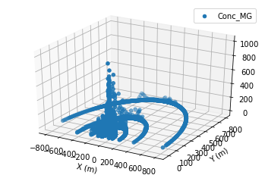
Why Prairie Grass?
Available in binary/csv format, well formatted and ready to use
Has been used extensively for model development (physics and data-driven)
Widely recognized as a standard dataset for model validation
The Prairie Grass Dataset:
Experimental program conducted in the 1950’s
Key goal: Determine the rate of diffusion of a tracer gas (SO₂) as a function on meteorological conditions
10 min average gas concentrations (mg/m³); 1.5m height; 5 Arcs (50, 100, 200, 400 , 800m)
70 experimental runs with ~ 10, 000 observations

Slide 8
Model Input / Output (Target) Features
Input Features
Release Rate / Height [1-2]
Wind Speed [3]
Friction Velocity [4]
Ambient Heat Flux [5]
Mixing Layer Height [6]
Ambient Temperature [7]
Shortlist of 12x models
Input Features (18x)
AI / ML Models
Output / Target variable (1x)
Concentration at a point (mg/m³)
Convective Velocity [8]
Monin Obukhov scale length [9]
Stable conditions indicator [10]
Distance downwind / crosswind [11-12]
Stability Class [13-18]
Select best 2x models

Slide 9
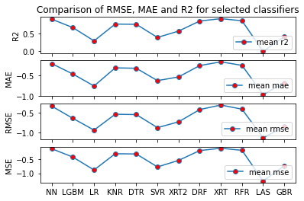
Model Identification / Selection
Key modelling steps/assumptions
Only “stable” observations were used
The input feature vectors were (row) normalized prior to running the model (to eliminate weight bias).
Model evaluation (cross-validation) was done using repeated train/test splits (10x) with a train/test split ratio of 90/10.
The observations were shuffled between splits.
Mean Squared Error (MSE), Root Mean Squared Error (RMSE), Mean Absolute Error (MAE) and R2 were used as evaluation metrics for the comparison work.

Slide 10
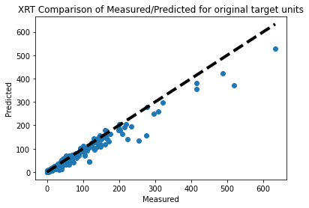
Model Performance (1): Neural Network and XRT

Slide 11
Model Performance (2): Comparison with “Mathematical” models
Model name | Model type | Reference | NMSE | R (aka CC) | FB | FS | FAC2 | Data used
Ideal model | N/A (reference criteria) | N/A | 0 | 1 | 0 | 0 | 1 | N/A
XRT | Data-driven (ML/AI) | (Current work) | 0.009 | 0.962 | -0.012 | 0.097 | 0.990 | Held out test data set
NN | Data-driven (ML/AI) | (Current work) | 0.008 | 0.966 | -0.009 | 0.077 | 0.990 | Held out test data set
CONFIG1 (Pimentel, et al., 2014) | Mathematical | (Pimentel, et al., 2014) | 0.043 | 0.962 | -0.082 | 0.085 | 0.990 | Entire dataset
CONFIG2 (Pimentel, et al., 2014) |  | (Pimentel, et al., 2014) | 0.049 | 0.962 | -0.114 | 0.093 | 0.981
Kumar and Sharan |  | (Pimentel, et al., 2014) | 0.06 | 0.97 | -0.160 | 0.120 | 0.95
The OML model |  | (Pimentel, et al., 2014) | 0.023 | 0.976 | 0.045 | 0.071 | 1.0
Present |  | (Marie, et al., 2013) | 0.05 | 0.96 | 89% | 0.03 | 0.097
OML |  | (Marie, et al., 2013) | 0.09 | 0.92 | 92% | -0.1 | -0.13
Present |  | (Sharan & Kumar, 2009) | 0.075 | 0.970 | -0.106 | 0.263 | 0.78
AERMOD |  | (Sharan & Kumar, 2009) | 0.105 | 0.965 | 0.154 | 0.092 | 0.91
MODELAR |  | (Armani, et al., 2014) | 0.30 | N/A | 0.03 | N/A | 0.80
AERMOD |  | (Armani, et al., 2014) | 0.41 | N/A | 0.29 | N/A | 0.91

Slide 12
Model Performance (3): Comparison with other “Data-driven” models
Model name | Reference | NMSE | R (aka CC) | R2 | RMSE | MAE
Ideal model | N/A | 0 | 1 | 1 | 0 | 0
XRT | (Current work | 0.009 | 0.961 | 0.920 | 0.320 | 0.173
NN | (Current work) | 0.008 | 0.965 | 0.931 | 0.299 | 0.185
BP network with original parameters | (Wang, et al., 2018) | 0.4539 | - | 0.6183 | - | -
BP network with Gaussian parameters | (Wang, et al., 2018) | 0.3529 | - | 0.6687 | - | -
SVR with original parameters | (Wang, et al., 2018) | 1.0024 | - | 0.4587 | - | -
SVR with Gaussian parameters | (Wang, et al., 2018) | 0.3649 | - | 0.6624 | - | -
SVM | (Qian, et al., 2019) | - | 0.5886 | - | 50.9144 | 67.0491
BP | (Qian, et al., 2019) | - | 0.8093 | - | 59.7562 | 23.5882
LSTM | (Qian, et al., 2019) | - | 0.9338 | - | 28.9063 | 16.1069

Slide 13
Conclusions
Conclusions
Work has demonstrated ML/AI can be effectively applied to Gas Dispersion Modelling
Speed of Development: Much quicker than traditional approaches (timescale of “months” vs “years”)
Model Accuracy: At par / exceeds the metrics for both first-principle models and other data-driven approaches
Limitations
Narrow scope of the dataset used – which limits generalizability
No insight into causal understanding of underlying dispersion mechanism / key drivers of predictions
Overall
Not an “either/or” but “and”
Recommendation is to see how the best of both approaches can be combined to achieve better models. For e.g., “domain knowledge” was instrumental in providing key insights to process the data, build the models etc.

Slide 14
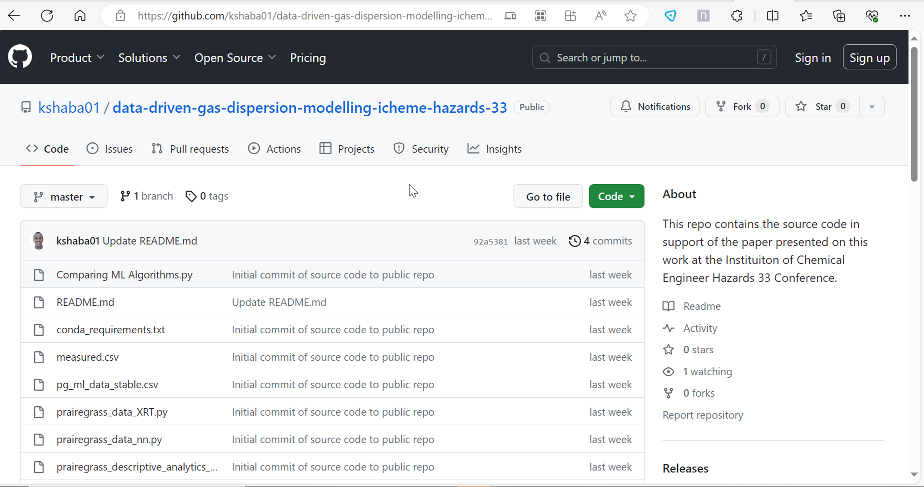
Industry Application
Typical pathways include:
Open: making the model / source code available
Closed: making the model available via a software application (e.g., a Web API or Desktop Software Application)
All information needed to reproduce this work is available online
Includes data and code (Python) to recreate/reproduce this work
https://github.com/kshaba01/data-driven-gas-dispersion-modelling-icheme-hazards-33

Slide 15
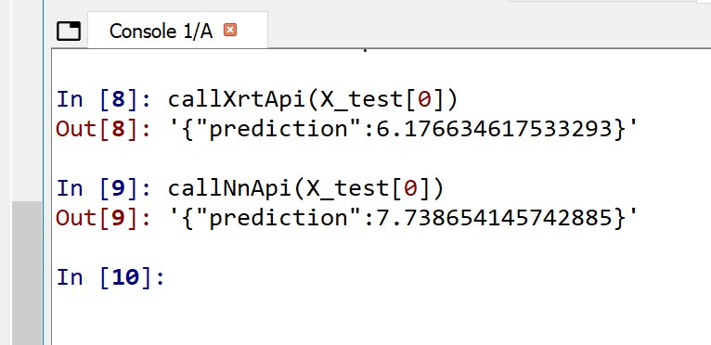
Sample Prediction Use-Case from the models
INPUT
OUTPUT
{"Q (g/s)": 101.5, "Hs (m)": 0.46,"U_1m (m/s)": 6.42, "Ustar (m/s)": 0.5039, "HeatFlux (W/m2)": 48.22,"Zmix (m)": 1620.0,"T (C)": 34.1,"Wstar (m/s)": 1.29,"L (m)": -238.66,"stable": 0.0,"category_A": 0.0, "category_B": 0.0,"category_C": 0.0,"category_D": 1.0,"category_E": 0.0,"category_F": 0.0,"X": -58.77852522924729,"Y": 80.90169943749474}

Slide 16
Final Reflection
“Scientists are still studying the Apollo rocks today. Some of the samples are placed in long term storage “so that scientists not yet born can use instruments not yet developed to answer questions not yet asked”
NASA Astrochemist Jamie Elsila Cook

Slide 17
Questions?

