Slide 1
Additional Fawley Backup
Enhancing Process Safety
This presentation includes forward-looking statements. Actual future conditions (including economic conditions, energy demand, and energy supply) could differ materially due to changes in technology, the development of new supply sources, political events, demographic changes, and other factors discussed herein (and in Item 1A of ExxonMobil’s latest report on Form 10-K or information set forth under "factors affecting future results" on the "investors" page of our website at www.exxonmobil.com). This material is not to be reproduced without the permission of Exxon Mobil Corporation.

Slide 2
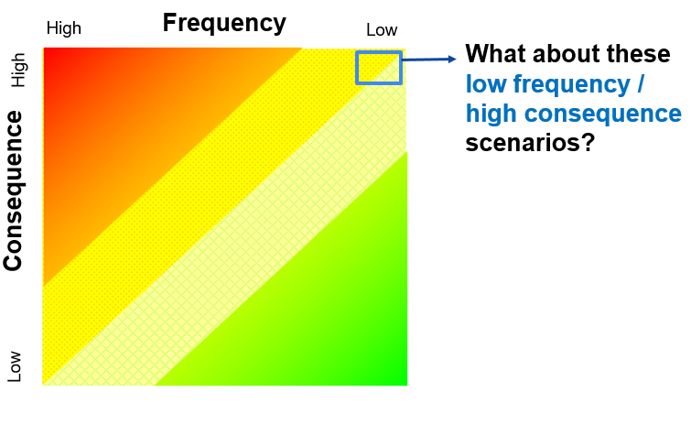
Things That Never Happen, Do Happen
1986
Chernobyl
1979
Three Mile Island
1988
Piper Alpha
1989
Exxon Valdez
1989
Phillips Pasadena
2005
BP Texas City
2010
Deepwater Horizon
1986
Space Shuttle Challenger
1984
Bhopal
2003
Space Shuttle Columbia
2011
Fukushima
2019 Philadelphia Energy Solutions
2020 Beirut Port
2005 Buncefield
Do you know your scenarios?
Do you know the safeguards are healthy?

Slide 3
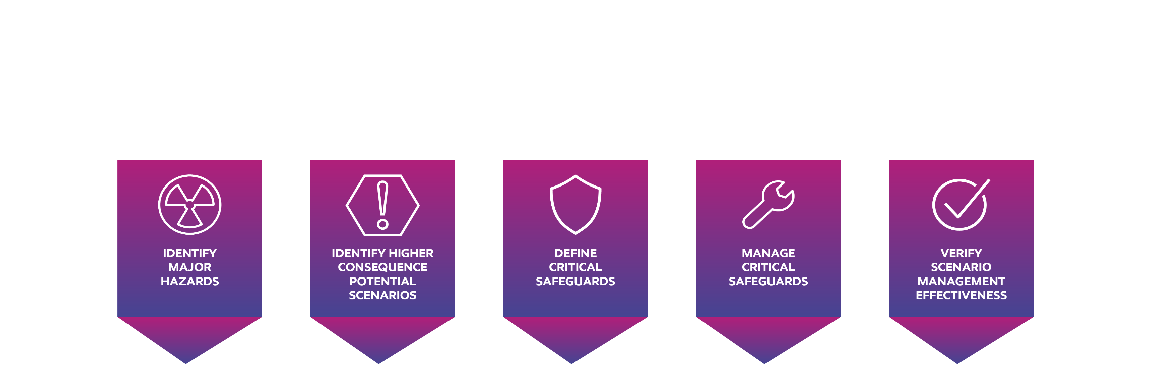
Scenario Management Model
Scenario Generation and Assessment
Critical Safeguard Register
and Health
Inventory of major accident hazards
Identify the higher consequence scenarios.
Identify safeguards that prevent the consequence.
Define the critical safeguards.
Establish performance criteria for critical safeguards
Identify scenario and critical safeguards owners.
Effectively manage scenarios.
Verify overall scenario health.
Validate field effectiveness of critical safeguards

Slide 4
Scenario Management Model
Scenario Generation and Assessment
Critical Safeguard Register
and Health
Inventory of major accident hazards
Identify the higher consequence scenarios.
Identify safeguards that prevent the consequence.
Define the critical safeguards.
Establish performance criteria for critical safeguards
Identify scenario and critical safeguards owners.
Effectively manage scenarios.
Verify overall scenario health.
Validate field effectiveness of critical safeguards

Slide 5
Example of Bowtie – Sphere BLEVE
Level High High Alarm
Liquid Overfill
Isolation
Support Fireproofing
Drainage
Significant Loss of Containment
Level High Alarm
BLEVE
Water Drawoff
Gas Detection &
Emergency Response
Deluge / Firewater
Facilities
Notes:
.

Slide 6
Scenario Management Model
Scenario Generation and Assessment
Critical Safeguard Register
and Health
Inventory of major accident hazards
Identify the higher consequence scenarios.
Identify safeguards that prevent the consequence.
Define the critical safeguards.
Establish performance criteria for critical safeguards
Identify scenario and critical safeguards owners.
Effectively manage scenarios.
Verify overall scenario health.
Validate field effectiveness of critical safeguards

Slide 7
Health Verification Example – Level High Alarm
Review Health of Existing Safeguard
Maintenance
Operations
Continuous
Improvement
Revealed / unrevealed failure
Root cause of alarm Activations
Testing Frequency
Verified knowledge of Alarm Response
Technology
Competency of Technicians
Competency to execute Alarm Response
History of Loss
Testing Procedure Adequacy
Learnings from Other Sites / Industry
Quality of Mitigations if Unavailable
Handback from Maintenance to Operators

Slide 8
Leadership Process Safety Competency Demonstration
Process safety fundamentals for Operations
Risk Management
Key Implementation Considerations
First 60 days on the job
Utilize training packs, existing Process Safety work systems, practical experience, and coaching
Approval restrictions prior to completion
No grandfathering
Assessment step with credible and knowledgeable assessors
Training
Operating Procedures
Critical Equipment
Alarm Management
Work Management
Management of Change
Incident Investigation & Analysis
Environmental
Emergency Response

Slide 9
Things That Never Happen, Do Happen
1986
Chernobyl
1979
Three Mile Island
1988
Piper Alpha
1989
Exxon Valdez
1989
Phillips Pasadena
2005
BP Texas City
2010
Deepwater Horizon
1986
Space Shuttle Challenger
1984
Bhopal
2003
Space Shuttle Columbia
2011
Fukushima
2019 Philadelphia Energy Solutions
2020 Beirut Port
2005 Buncefield
Do you know your scenarios?
Do you know their safeguards healthy?

