Slide 1
Safety Critical Task Analysis
Practical Examples and Application
Toby Garner BSc, MSc, C.ErgHF
Human Factors Consultant
Monaco Engineering Solutions

Slide 2
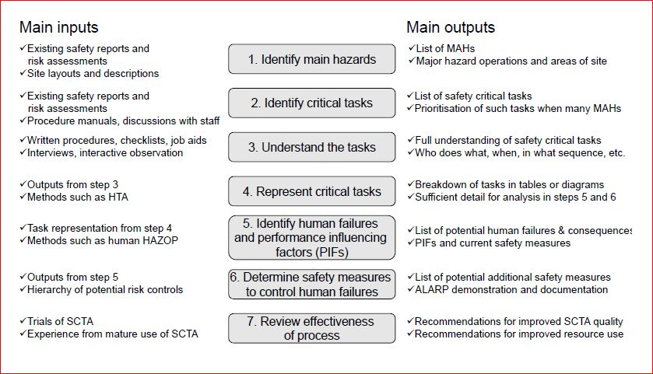
Application of SCTA
SCTA input to:
Design decisions
Risk-based procedure development
Operational concept definition
Performance standards
Resilience planning
Safety Case
Assurance activities
Continuous improvement
Fig.1 – SCTA Process Overview

Slide 3
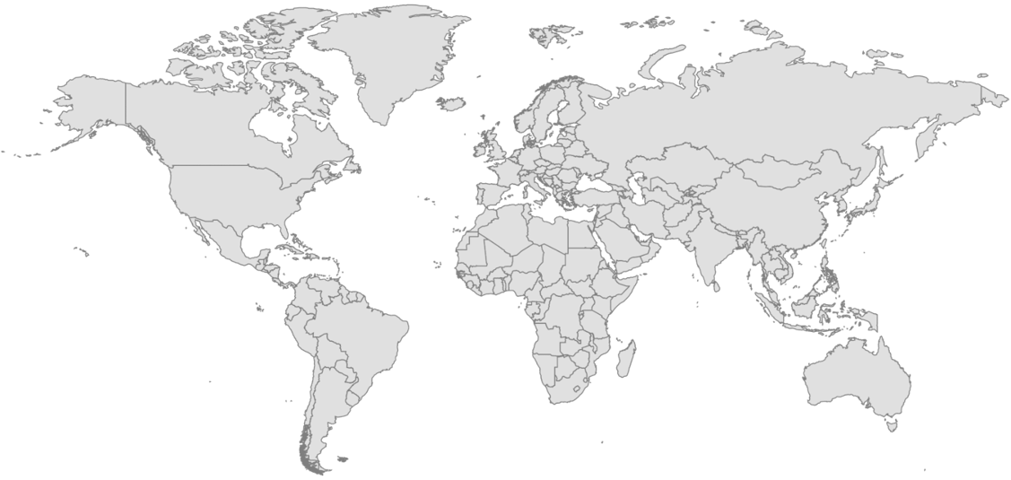
Worldwide application of SCTA
Application of SCTA is global.
The SCTA method applied across different safety critical industries.
Includes also coaching SCTA to site & human performance staff.
Fig.1 – Application of SCTA

Slide 4
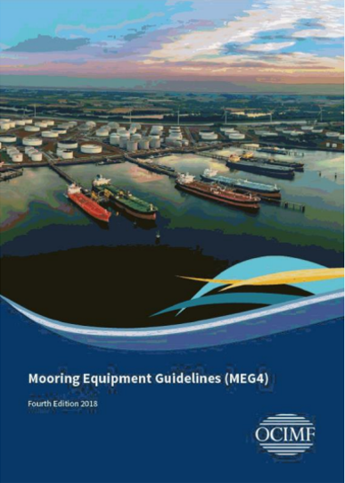

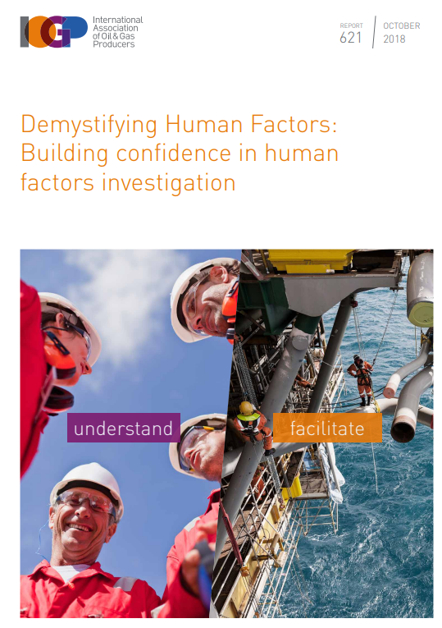

SCTA Examples
1
Vessel Design (maritime) - Korea
2
Safety Case (COMAH site) - UK
3
Incident Investigation (offshore) – N. Europe
Guidance: Vessel Deck Design:
Mooring Equipment Guidelines (MEG4, OCIMF), 2018.
Guidance: SCTA Guidance, Energy Institute (EI), 2020.
Guidance: IOGP (2018), TopSet, Energy Institute (2020), NOPSEMA

Slide 5
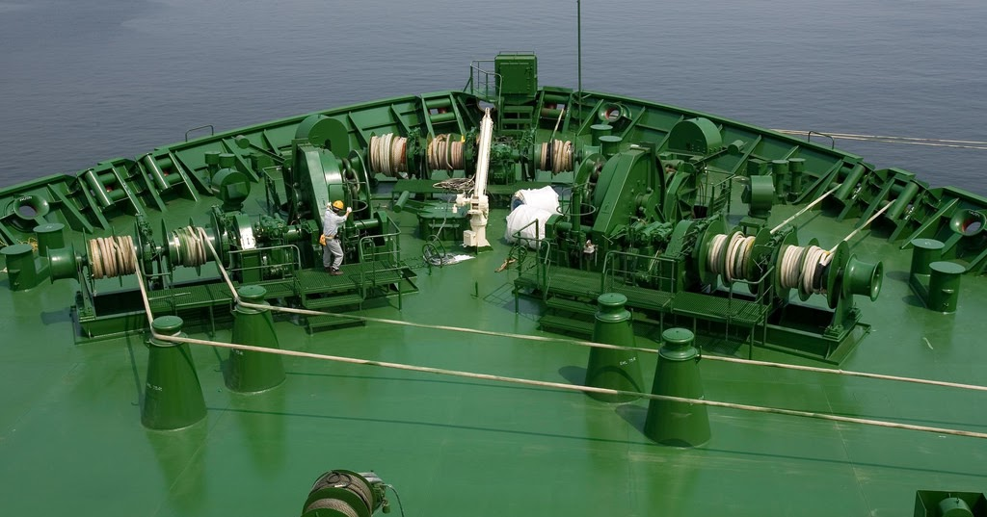
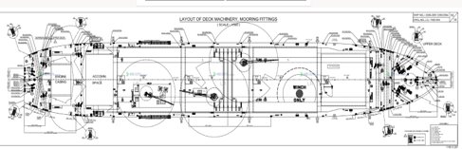
Example 1 - Liquefied Natural Gas (LNG) Carrier Vessel Design
1
Vessel Design (maritime)
SCTA Aim
Design for safe maintenance / operation (LNG Carrier)
Guidance: Vessel Deck Design:
Mooring Equipment Guidelines (MEG4, OCIMF), 2018. Section 2.
Mooring Hazards include
Fig.1 – Typical mooring arrangement
Falling from height
Crew overboard / Falling into the water
Hit by flying objects (e.g., snapback)
Entanglement, entrapment, or crush injuries
Vessel damage
Product Release
Fig.2 – Design plans

Slide 6
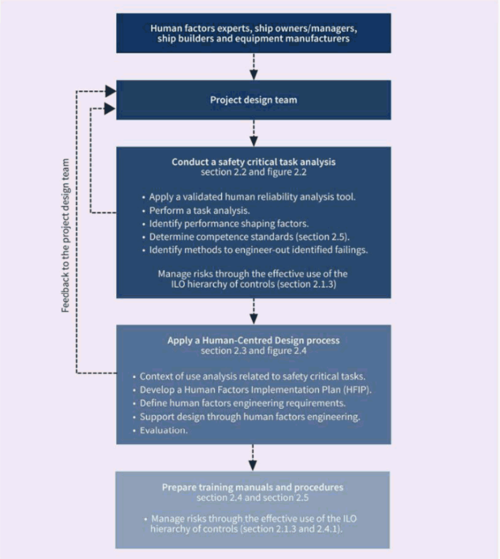
Example 1 - Liquefied Natural Gas (LNG) Carrier Vessel Design
1
Vessel Design (maritime)
SCTA process
Guidance: Vessel Deck Design:
Mooring Equipment Guidelines (MEG4, OCIMF), 2018. Section 2.
Fig.1 – Typical mooring arrangement
Fig. 3 - MEG4 SCTA process
Task scenarios include:
  Pier / Jetty
  Ship-to-ship mooring (FSRU)
  Emergency tugboat
  Canal transit
  Bunkering / Loading
Fig.2 – Design plans

Slide 7
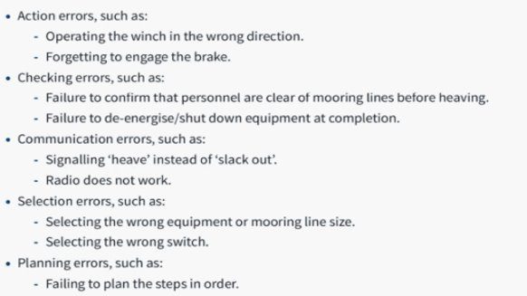
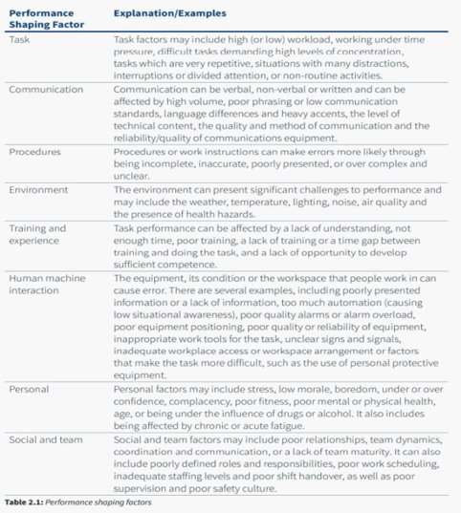
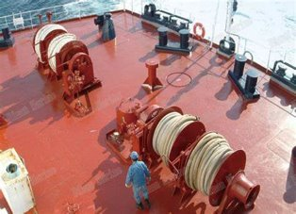
Example 1 - Liquefied Natural Gas (LNG) Carrier Vessel Design
Human Errors
Performance Shaping factors
Notes:
Performance Shaping Factors Include:
Command’s situational awareness of mooring team
Crew risk awareness
Physically demanding / fatigue
Suboptimal environment conditions

Slide 8
Example 1 - Liquefied Natural Gas (LNG) Carrier Vessel Design
SCTA Recommendations
Remote winch operations
Guardrail / barrier protection
CCTV coverage
Identification of Safety critical task
Line tension monitoring systems
Reduction in obstructions
Clear sightlines over mooring
Snap-back area warning
Safe locations for mooring team
Lighting coverage
Further consideration
Existing Safeguard

Slide 9
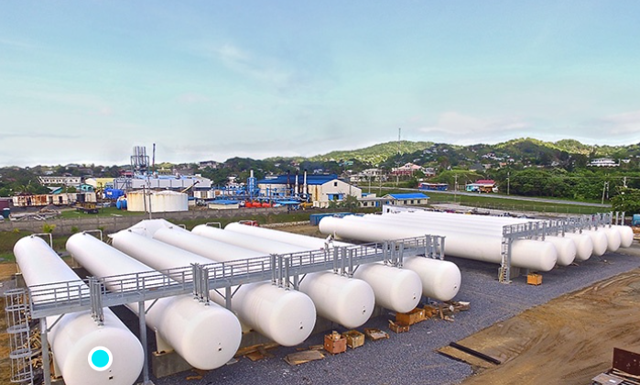
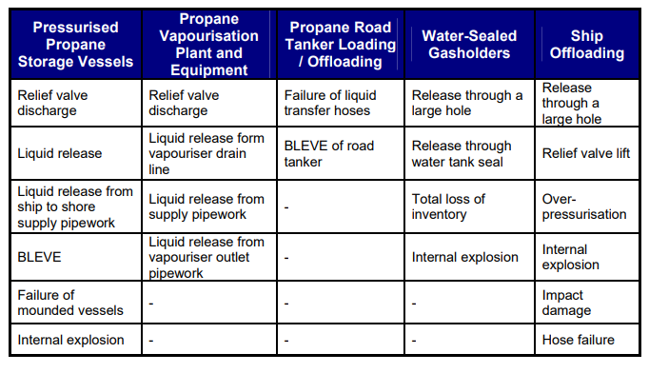
Example 2 – COMAH Safety Case
2
Safety Case (COMAH)
Guidance: SCTA Guidance, Energy Institute (EI), 2020.
Fig.1 – LPG distribution site
Fig.2 – Major Accident Hazards

Slide 10
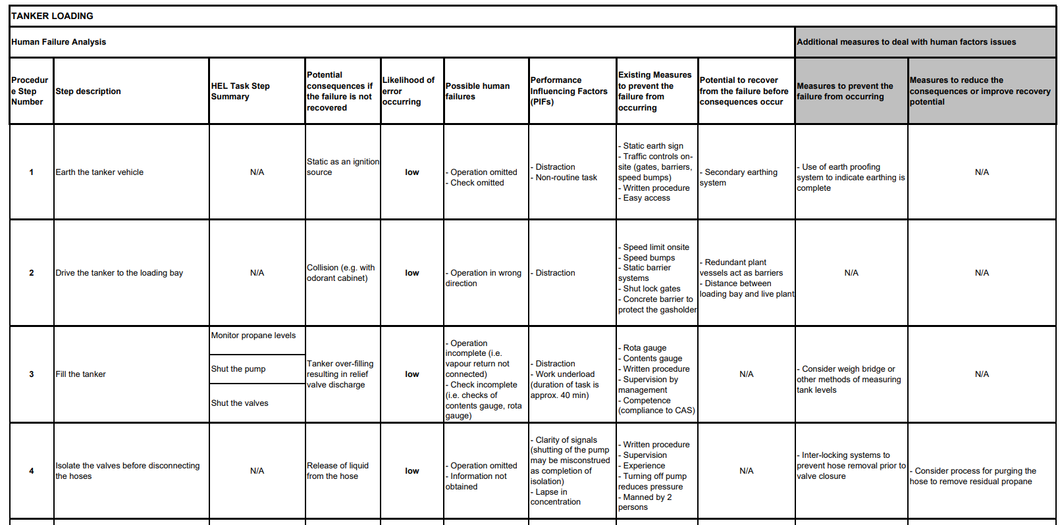
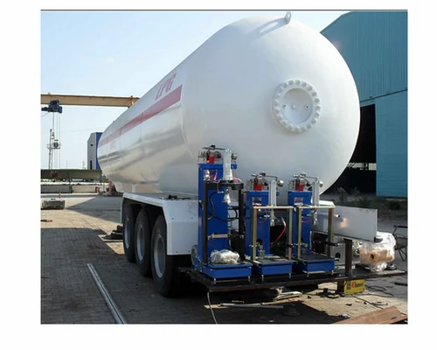
Example 2 – COMAH Safety Case
2
Safety Case (COMAH)
Guidance: SCTA Guidance, Energy Institute (EI), 2020.
Fig.1 – Tanker offloading
Fig.1– SCTA excerpt

Slide 11
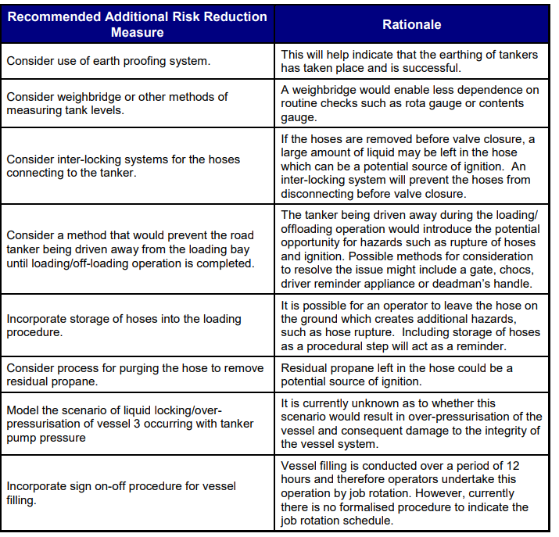
Example 2 – COMAH Safety Case
2
Safety Case (COMAH)
Guidance: SCTA Guidance, Energy Institute (EI), 2020.
Fig.1 – Tanker offloading
Fig.2 – Example Recommendations

Slide 12
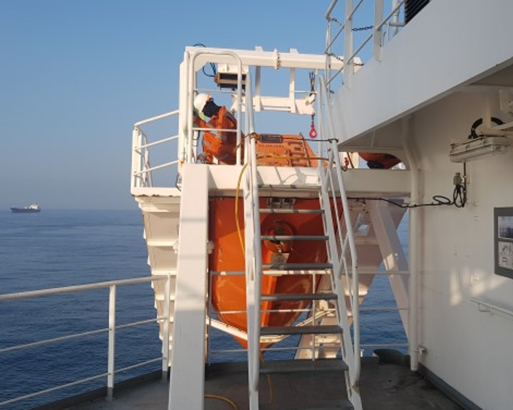
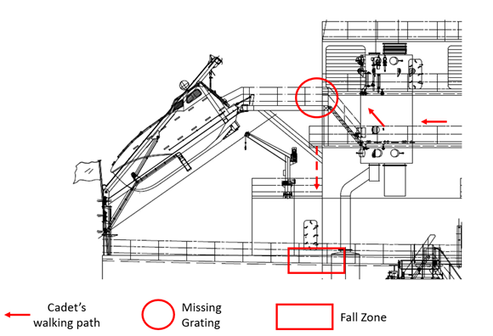
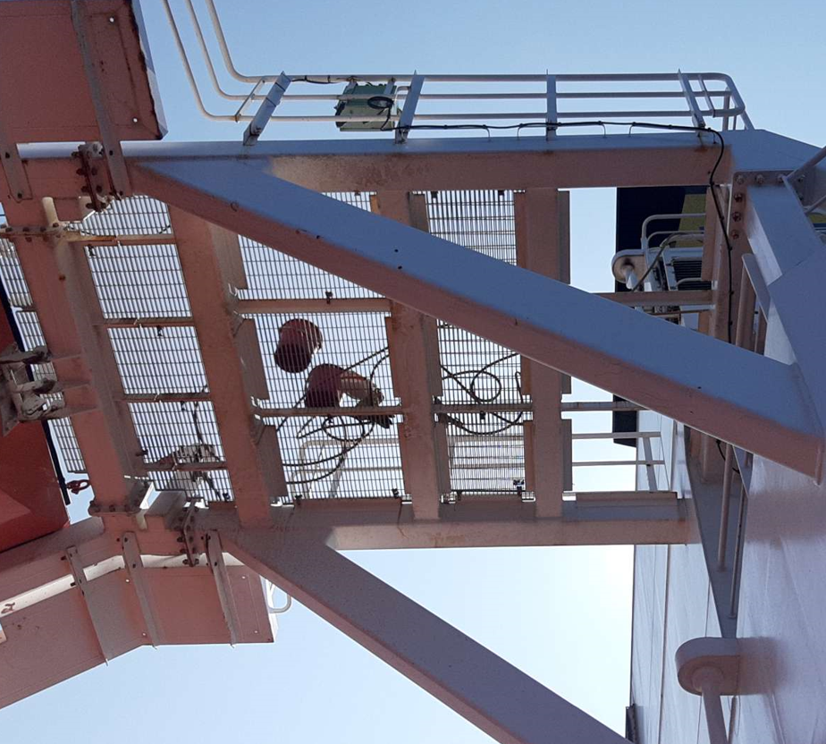
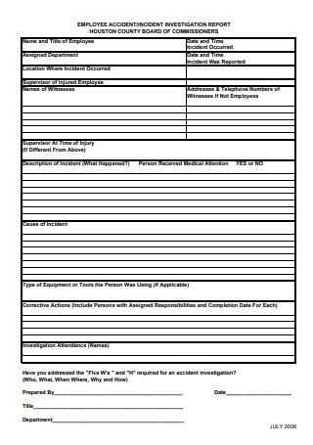
Example 3 - Deck Cadet fatality
3
Incident Investigation (offshore)
SCTA Aim
Derive Human Factors learnings from a fatal accident.
Guidance: IOGP (2018), TopSet, Energy Institute (2020), NOPSEMA
Accident Overview
Deck Cadet fell from height (8m).
Fell through open grating that was being cleaned.
Initial conclusion ‘Cadet at fault from entering unsafe area’
i.e., human error.
Fig. 1 – Incident Overview
Fig.2 - Accident report form

Slide 13
Example 3 - Deck Cadet fatality
Fig.1 - Timeline with actors/critical events

Slide 14
Example 3 - Deck Cadet fatality
Fig.1 - Performance Shaping Factors

Slide 15
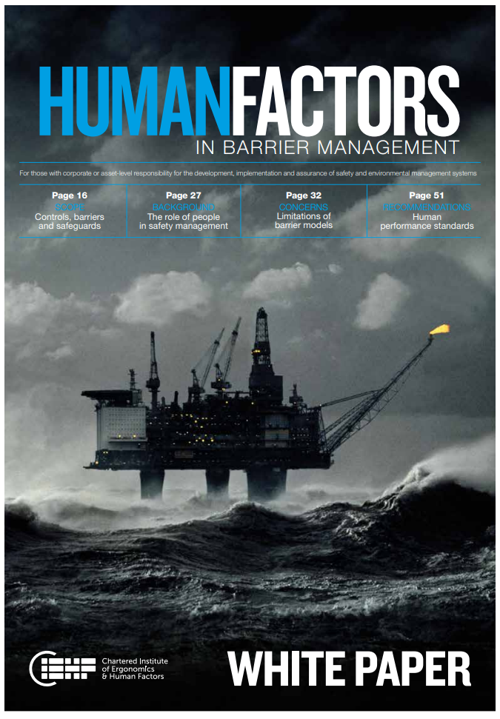

SCTA Learnings
Relies upon participation and contribution of various disciplines e.g., workshops, site walk-throughs (if possible).
The method should be proportionately applied (e.g., error types, number of safety critical tasks, type of safeguards).
Value of SCTA is from challenging the way people think about safety and human error.
It is an opportunity to generate, record and integrate improvement ideas from staff members into a company’s management process.

Slide 16
Mr Toby Garner (MES Human Factors Consultant)
toby.garner@mes-international.com

