Slide 1
LEAK TESTING WHEN REINSTATING PLANT
IT’S MORE COMPLICATED THAN YOU THINK
ANDY BRAZIER AND MICHELLE CORMACK
Notes:
We have two aims with this paper
Highlight issues to consider when deciding the leak test method to use
Illustrate that Safety Critical Task Analysis can be a useful method for assessing plant reinstatement

Slide 2
SIRP – Safe Isolation and Reinstatement of Plant
What is reinstatement of plant?
Returning the process plant back to service following intrusive maintenance
What does it achieve?
Control of major accident hazards
Prove integrity of plant
Reduce likelihood of leaks when process fluids are reintroduced on plant restart
How is this achieved?
Leak testing
Notes:
An acronym that has been used widely in the UK offshore oil and gas sector for a while. Maybe less so in other industries although equally important.
Most applicable to intrusive maintenance to avoid losses of containment when breaking the pressure envelope and when reintroducing process fluids after maintenance.
Different to the ‘normal’ plant shutdown and start-up.
The focus for reinstatement is to prove integrity of plant, which is required because joints will have been broken during maintenance
Detecting leak sources before introducing process fluids
Leak testing is a key element of reinstatement.

Slide 3
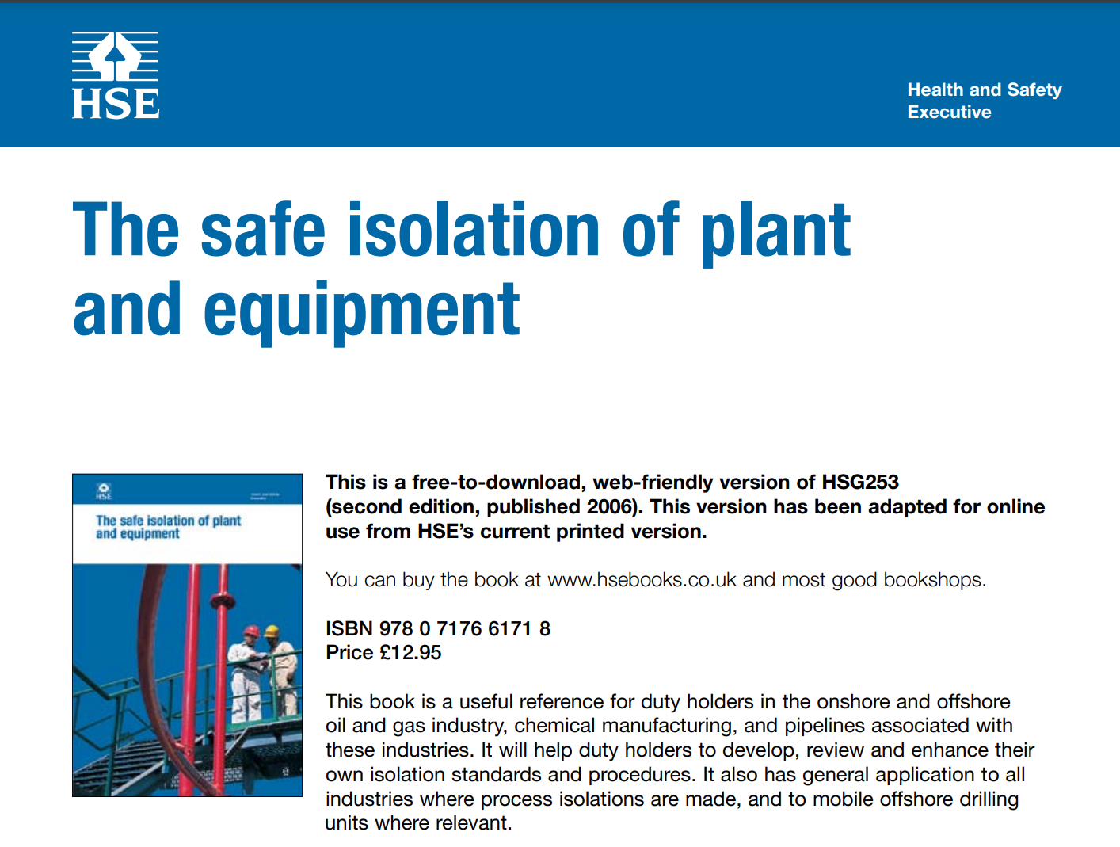
Relevant Industry Guidance
HSG253 - The Safe Isolation of Plant and Equipment, (HSE, 2006)
Almost no mention of how to safely reinstate plant
Guidance on Safe Plant Reinstatement, (Energy Institute, 2023)
Issued in 2023 to plug the industry guidance gap
Notes:
We have had reasonable guidance for preparing plant for maintenance for some time from HSG 253.
There has been a gap for reinstatement.
The Energy Institute’s recent guidance aims to address that.

Slide 4
Types of Leak Test
Full reinstatement leak test
Typically carried out at 90%-95% of the system design pressure if there is a system PSV installed or 100-110% of system design pressure where no system PSV installed
Sensitive leak test
Uses a tracer gas, such as helium, and specialist detection equipment to detect leaks as small as 5scf/yr
Gross leak test
Carried out at low pressure typically to check for larger leaks before a full leak test or service test
Service test
Reintroduction of process fluids with periodic leak checks carried out of a pre-determined duration
Reverse integrity test
Uses specialist gaskets to prove individual joint integrity
Notes:
Leak testing has always been carried out to a greater or lesser extent.
There are different methods that may be considered to provide greater or lesser coverage of hazard potential.
Full reinstatement testing may be considered the Gold standard and perceived by many as the default required of the recent EI guidance.
Gross leak testing at lower pressures and service testing with process fluids have been far more prevalent in industry.

Slide 5
Choosing the correct test
Full Reinstatement Leak Test
Pneumatic or hydraulic test carried out at, or close to, system design pressure
Demonstrates disturbed joints do not leak at highest foreseeable pressures
The safest option, or is it?
Notes:
The main feature of full reinstatement leak testing is that the plant is taken to a high pressure using an inert fluid.
This means it can detect leaks across the full operating range but the leaks that occur present a relatively low hazard.
It can be a significant undertaking, but if it is the safest option there may be little scope to accept a lesser test.
However, high pressures are hazardous and inert does not mean safe.
One message from our paper is that it requires very careful planning and evaluation and cannot be assumed to be safe by default.

Slide 6
Hazards of Leak Testing
High pressures
Stored energy and projectiles
Flexible hoses
Temporary equipment and fittings
Fluid injection (100psi is all it takes to penetrate the skin)
Asphyxiation from test gas
Low temperature embrittlement
Hydrates
Corrosion
Humans
Notes:
Here is a list of potential hazards of leak testing. It is fair to say that many are more related to personal rather than process safety.
It can be particularly difficult to find the best balance point when managing potential to harm individuals vs major accident hazards.
Although not an obvious hazard, introducing complexity in activity increases our exposure to human error. This needs to be factored into our selection process and planning.

Slide 7
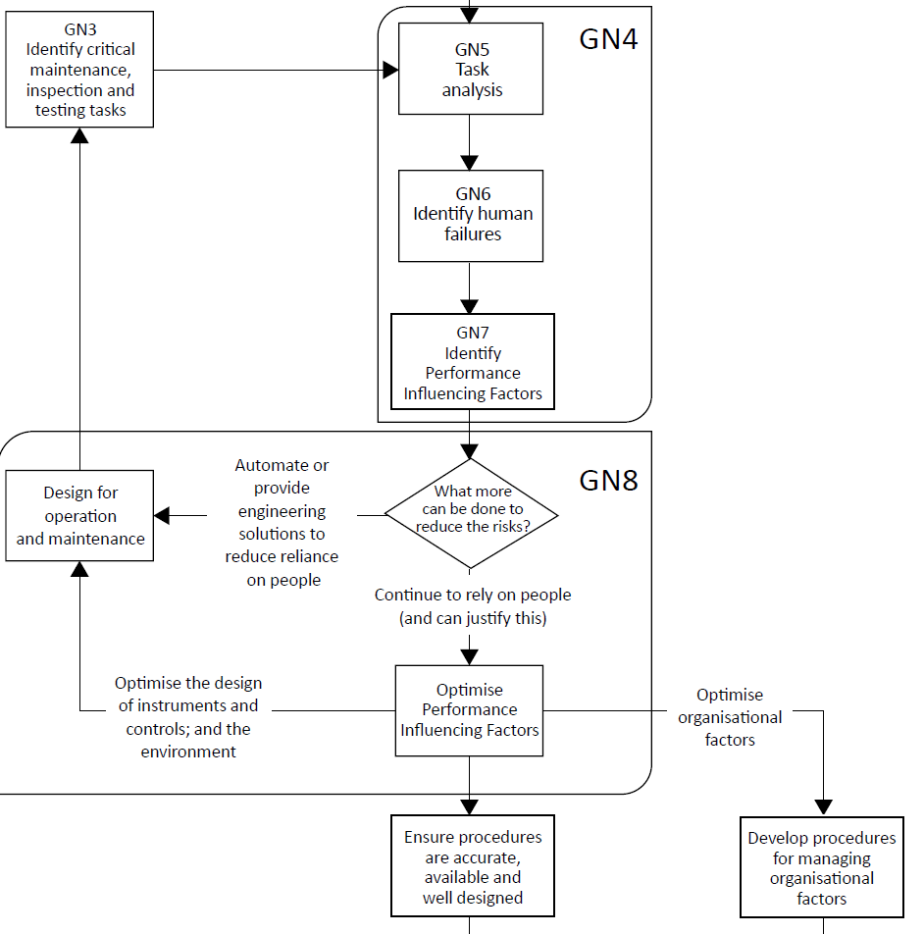
Safety Critical Task Analysis (SCTA)
Tried and tested qualitative method. It involves:
Describing the task method in a structured and systematic way so that anomalies, ambiguities and inconsistencies can be identified and resolved;
Analysing each task step to identify potential human errors and consequences;
Evaluating Performance Influencing Factors (PIF) that may make the likelihood of error greater;
Considering the risk controls in place and determining if they are sufficient to reduce risks of the task to As Low As Reasonably Practicable (ALARP).
Leak testing is amenable to this approach
Notes:
Leak testing can be a safety critical task in two respects:
The hazards of the leak testing
The reliability of the test affects the likelihood of loss of containment when process fluids are introduced.
We carried out Safety Critical Task Analysis following the method described in the recent guidance from the Chartered Institute of Ergonomics and Human Factors (CIEHF). This proved to us that it could be a very worthwhile approach for leak testing.

Slide 8
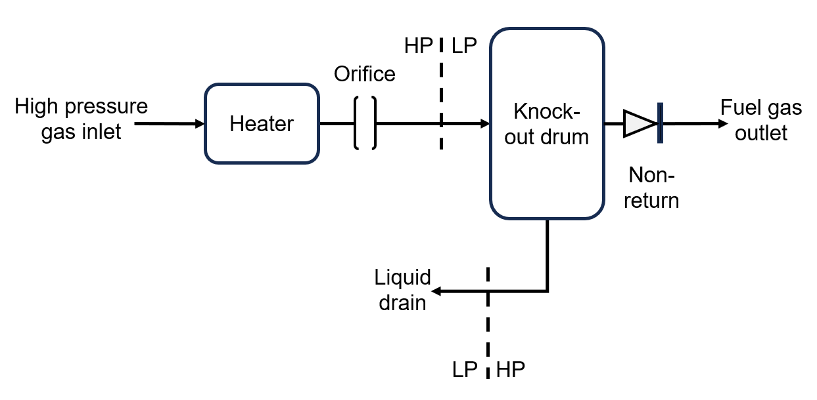
Case Study Fuel Gas System on Offshore Gas Installation
Notes:
Our case study is a fuel gas system at an offshore production platform.
In simple terms it takes gas at high pressure.
Heats it to make up for temperature losses due to the Joule Thomson effect.
The gas pressure is reduced by passing it though an orifice.
It passes through a knock-out drum to remove any liquid before it is passed on to the fuel gas consumers,
A couple of key points to note here are the High Pressure Low Pressure interfaces and the non-return valve.

Slide 9
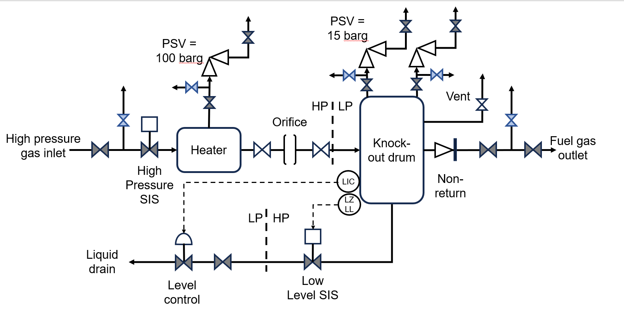
Leak Test Envelope
Notes:
This more detailed diagram shows the state of the plant when it is undergoing maintenance.
Double block and bleed isolations are in place at the inlet and outlet.
Single block and bleed isolations are in place at the pressure safety valve inlets.
Valves are closed in the connection to the liquid drains
A vent on the knock out drum is open to prove the system is depressurised.

Slide 10
Leak test options
Service test – deisolate the plant and introduce gas via its normal route
Gross leak test – inject low pressure nitrogen through the vent on the knock-out drum
Full reinstatement test – inject high pressure nitrogen via a ‘suitable’ connection
Platform had prepared a detailed leak test procedure
Marked up P&ID
Notes:
Looking at the different types of leak testing we could see we had several options.
A service test is usually the easiest but means that if there is a leak during the test a flammable gas cloud may form.
Gross leak testing avoids this problem but uses pressures significantly lower than can be experienced during operation. It would be followed by a service test.
There was a perception that a full reinstatement test should be carried out if possible.
The platform had prepared what looked like a very good procedure supported by marked up P&ID.
At first reading it appeared to demonstrate an effective and reliable approach.

Slide 11
Leak test SCTA
Notes:
A key part of Safety Critical Task Analysis is representing the task in a structured and systematic way. We used Hierarchical Task Analysis to do this.
Here I am showing how we identified 7 main activities or sub-tasks. Each was broken down into its detailed steps. For example, sub-task 4 was broken down into 5 steps.
It is easy to see that this is just a fancy way of displaying a procedure but the discipline of developing a hierarchical structure encourages you to think deeply about what has to be done. In this case reference to PSV isolations, HP-LP interfaces and NRVs all stood out to us as areas we need to look at more carefully.

Slide 12
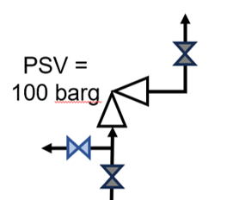
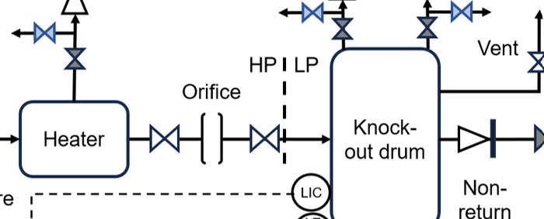
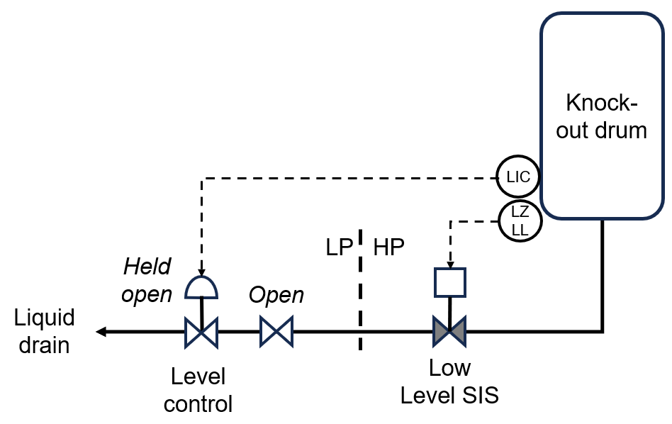
Leak test – potential pitfalls
De-isolating PSVs but not the rest of the system
Sanction To Test (STT)
Finding a suitable connection for the leak test gas taking into account
Non-return valves
HP-LP interfaces
Accessibility
Gas break-through to drains
What if remedial work had to be done?
Notes:
From the SCTA we could see that it would not be safe to use a high pressure gas for leak testing without protecting the plant from over pressure.
The pressure safety valves had to be isolated to allow the maintenance to work. We would need to use a Sanction To Test or similar to allow this to happen. It can be done but it added complexity.
We needed to find a connection point for the leak test gas. It had to be on the high pressure side of the plant, so we couldn’t use the vent on the knock-out drum. We were going have to be very careful that we isolated the two sides. Again possible, but more complicated and prone to technical failures (valves passing) and human error (failing to close valves). In this case the NRV was not much of a problem, but could be in other cases.
One item we didn’t spot at first was the second HP – LP interface on the drains system. During normal operation our main control is a liquid level. But at the time of leak testing there would be no liquid. We could not leave the line to drain open because we would not be able to pressurise the plant. However, we had to be careful that we didn’t isolate on the low pressure side of the system.
Finally, we realised that it was easy to have a mindset that the leak test would pass. We always had to bear in mind that leaks may be found and remedial work would be required. The more we disturbed the original isolation the more difficult it may be to prepare the plant for that work.

Slide 13
Summing up
We had a procedure that looked good and appeared to be consistent with latest guidance
The SCTA highlighted a number of potential issues – in addition to the personal safety issues of handling high pressure gas
Using a liquid leak test fluid would be less hazardous – but
Not an option in many gas systems
Contaminated liquid to be disposed of
Can we reduce the test pressure if operating pressure is much lower than design pressure?
Reverse Integrity Test (RIT) gaskets may be a future option – but introduce their own issues
Notes:
We started this case study with what looked like a very good procedure.
SCTA was very effective at highlighting potential issues. Devil in the detail
There may be options to reduce risks such as using liquid leak test fluid. But this is often not an option.
It made us question whether a lower pressure could still be considered as a full leak test given that the plant was operated at much lower pressure than its design capability.
RIT gaskets were mentioned as one option, but need to be used with care as they introduce their own issues.

Slide 14
Conclusion
Human errors during plant reinstatement
Failure to make a joint (missing gasket, bolts not tightened)
Joints made incorrectly (wrong gasket, misalignment etc.)
Full reinstatement leak testing is not inherently safe, it adds complexity and is vulnerable to human error
SCTA proved to be effective
Full testing at high pressure is clearly required for commissioning new plant
How often do joints fail catastrophically after normal intrusive maintenance?
How much credit can we take for good plant design, joint integrity management systems and competent technicians?
Notes:
The two main errors of reinstatement we are concerned with is the simple failure to make a joint and the more subtle errors in the way the joint is made. Leak tests at low pressure are effective at finding the first, but not the second. But is full reinstatement that much more capable? The leaks may not occur immediately and are likely to be small and hard to detect.
There are risks with full reinstatement testing, including human error.
Our case study proved that SCTA was an effective method of highlighting potential issues.
We fully acknowledge that full reinstatement testing is required when commissioning new plant but following normal maintenance our concern is around joints. Is there evidence of them failing catastrophically if made up correctly?
One potential concern is a focus on leak testing leads us to pay less attention to plant design, joint integrity management systems and the competence of our technicians making up joints. Why bother with all that if the leak test is perceived to be fully effective?

