Slide 1

Effect of hydrogen depressurization on steel pipe in case of puncture
HAZARDS 33

Slide 2
Introduction
01

Slide 3
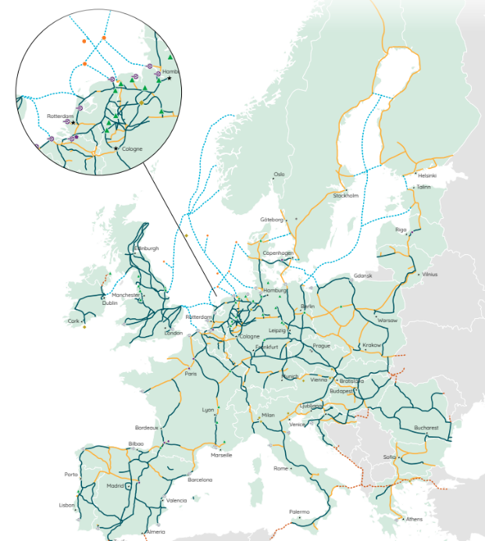
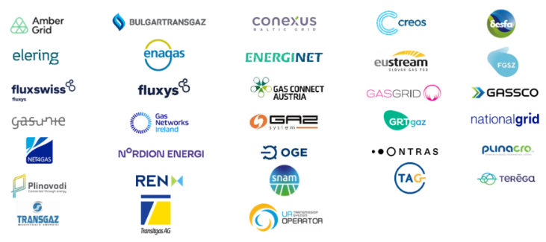
Hydrogen – a growing perspective for GRTgaz
Hydrogen to decarbonise energy sector
  A challenge for the gas industry to answer to climate change and rarefaction
  New strategies and roadmaps defined by national governments and the
  EU for the development of hydrogen technologies
A common goal for TSOs
  31 european energy infrastructure operators are
  creating the European Hydrogen Backbone (EHB)
  Roadmap up to 2040
  53,000 km based on using 60% of repurposed
  natural gas pipelines and 40% new
  pipelines
  Investments from 80 to 140 billions €
  (70 to 125 b£)
European Hydrogen Backbone (2022)

Slide 4
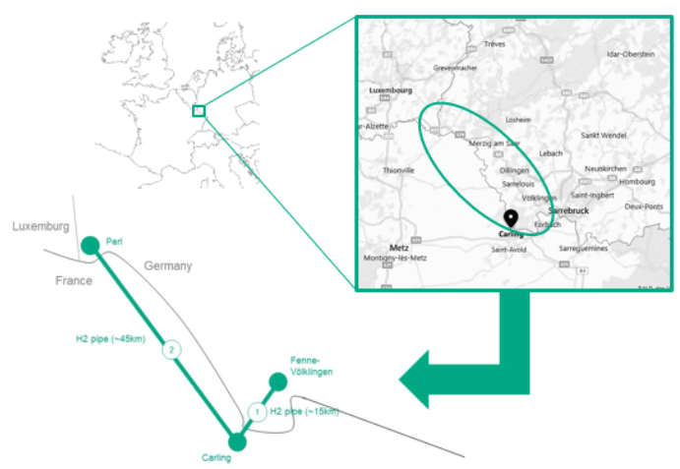

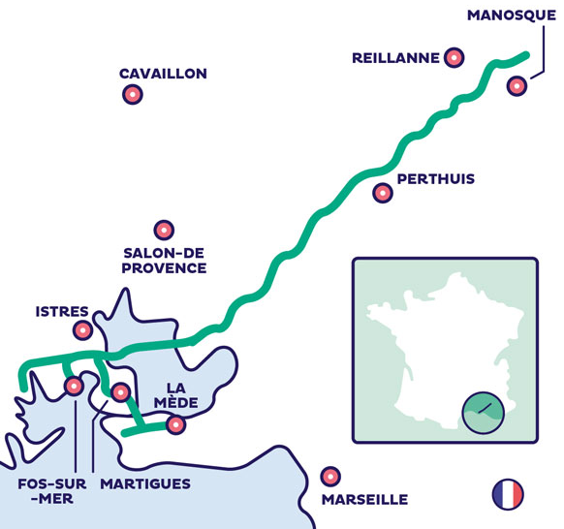
Hydrogen – a growing perspective for GRTgaz
GRTgaz: EHB projects are coming
  MoSaHyc project
    Convert two existing gas pipelines to 100% hydrogen transport
    70km long network for a capacity up o 20,000m³/h
  RHyn project
    100km pipeline with 60km of natural gas repurposed pipeline
    125,000 tons of hydrogen per year
  Hynframed project
    50 km of hydrogen pipeline in the industrial-port zone of Fos-sur-Mer
    and underground storage facilities in Manosque
    Potential connection to BARMAR
Technical challenges are numerous
  Adapt good practices for both repurposed and new pipelines
  Demonstrate the quality of the risk management

Slide 5
Cold-embrittlement in case of puncture on pipe wall
A safety concern for hydrogen ?
A recurring question for natural gas
  French authorities asked to verify the absence of cold embrittlement on natural gas facilities
    First question : Is there a risk that a sudden depressurisation due to an ESD can cause a brittle fracture of the vent line (immediate or delayed) ?
    Second question: Is there a risk that a non-detected leak becomes a major release?
  In case of sudden depressurisation
    GRTgaz performed ESD tests and simulations for the demonstration (see our article at HAZARDS 32)
  In case of puncture
    GRTgaz made CFD simulations with OpenFOAM in 2017
    And experiments in 2019 with INERIS
Now the question is for hydrogen: today, a focus on the leak case

Slide 6
Experimental set-up
02

Slide 7


Cold-embrittlement in case of puncture on pipe wall
A safety concern for hydrogen ?
Joule Thompson effect vs isentropic effect
  Joule Thompson coefficient: negative for H₂
    Temperature increase
  Isentropic depressurisation at the orifice
    Expected lower temperature for H₂
    If T₀=15°C, T1 = -24°C for methane
    T1 = -34°C for hydrogen
$$μ=\frac{∆T}{∆P}$$
No simple theory to estimate steel temperature around the outlet

Slide 8
Cold-embrittlement in case of puncture on pipe wall
A safety concern for hydrogen ?
GRTgaz chose to conduct small-scale tests
  Collaboration with INERIS
  Tests at Verneuil-en-Halatte (60km north of Paris)
Test matrix: 10 tests
  Two release diameters
  Two release pressure: steady-state
    Continuous gas supply
  Repeated tests for each configuration
Tests | Release diameter (mm) | Release pressure (bar)
1 – 2 | 1 | 40
3 – 4 | 1 | 70
10 – 12 – 13 – 15 | 2 | 40
11 - 14 | 2 | 70

Slide 9
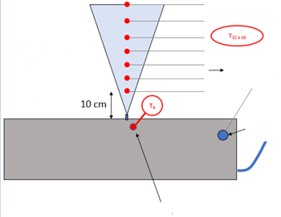
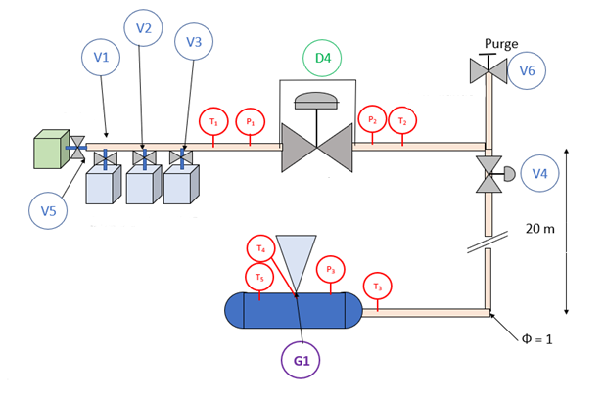
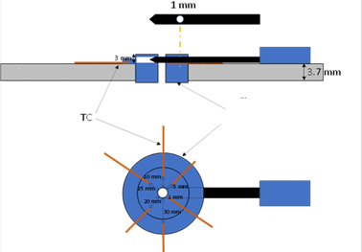
Cold-embrittlement in case of puncture on pipe wall
A safety concern for hydrogen ?
Array of external thermocouples: every 5cm
Experimental system
Pressure sensor (P₃)
N₂: for purging
Thermocouple inside the released gas flow (T₄), close to the release
Pressure -reducing valve
H₂: 2 or 3 bottles racks
Pipe wall
Release device: perforated rod (remote sliding system)
Tank equipped with a release system

Slide 10
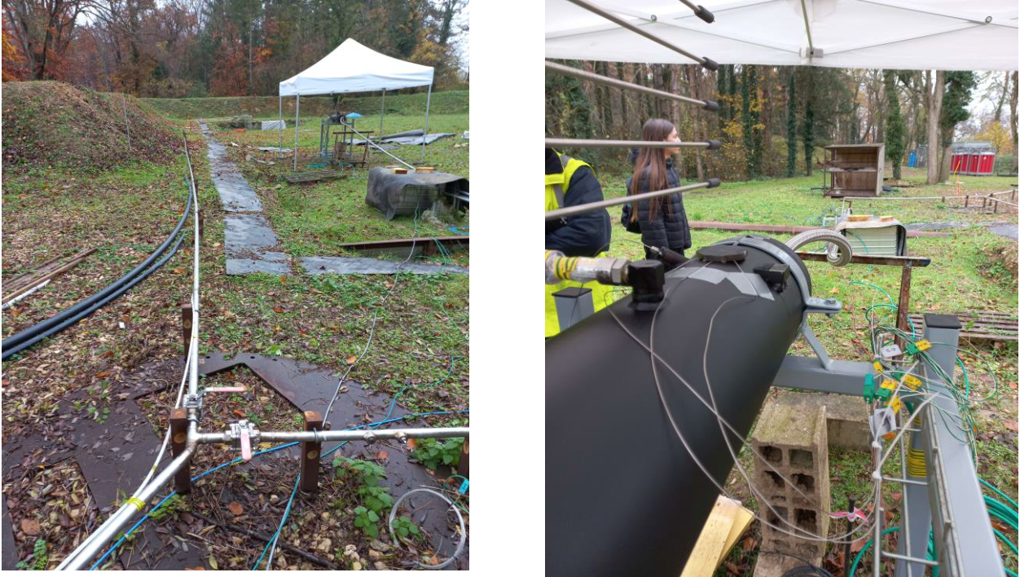
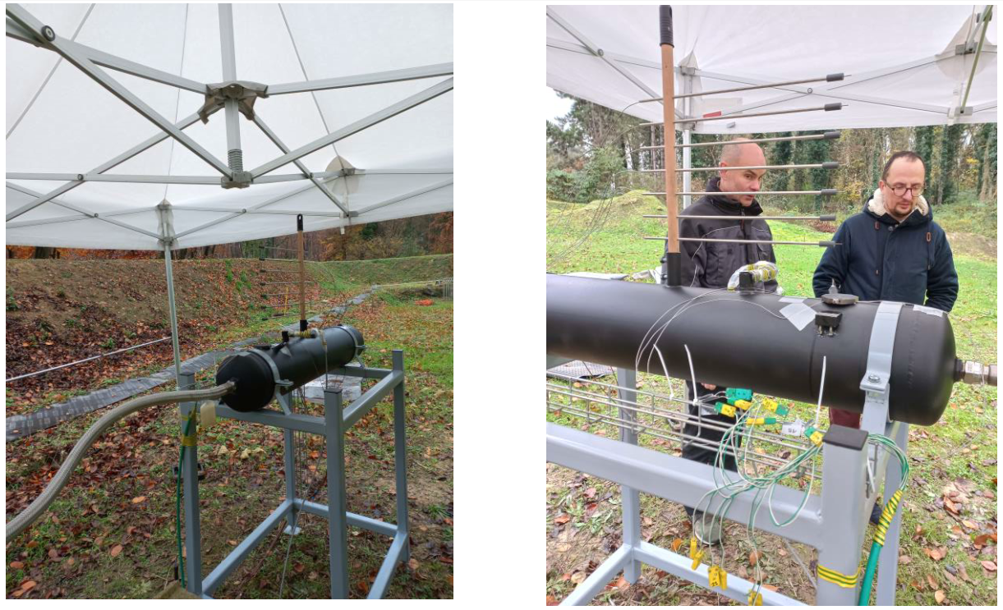
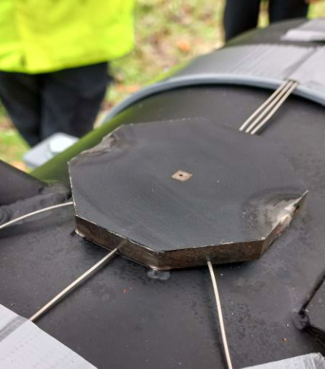
Cold-embrittlement in case of puncture on pipe wall
A safety concern for hydrogen ?
Experimental system

Slide 11
Results presentation and analysis
03

Slide 12
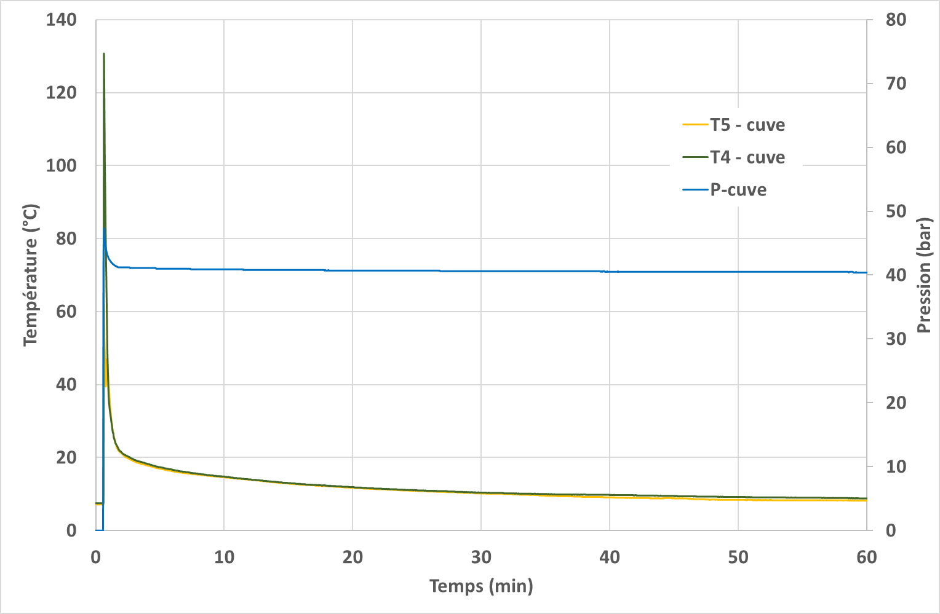
Cold-embrittlement in case of puncture on pipe wall
A safety concern for hydrogen ?
Test preparation
  Initial temperature
    Significant temperature increase during the
    tank filling (up to 130°C)
    Before the test, the tank is left to rest during at least 60min
    so that internal temperature decreases to
    ambient temperature
  Initial pressure
    Very low pressure decrease during the stand-by
    period due to a diffuse leak close to the
    release device
    No significant impact on the test results:
    about 4% of the release flow rate during
    the test for the 2mm release

Slide 13
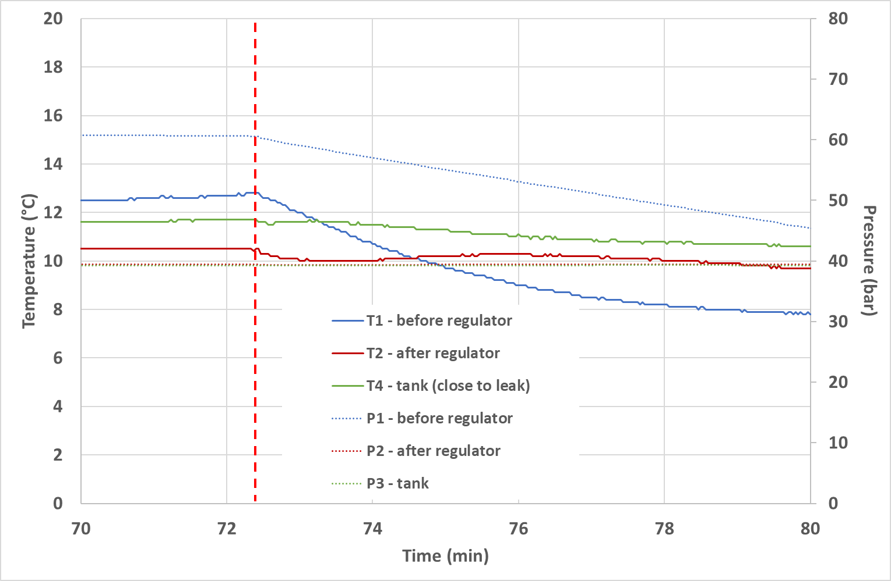
Cold-embrittlement in case of puncture on pipe wall
A safety concern for hydrogen ?
Temperature evolution around the pressure-reducing valve and in the tank
  Release of 1mm at 40 bar
    Quasi-constant temperature
  Release of 1mm at 70 bar
    Quasi-constant temperature
  Release of 2mm at 40 bar
    Temperature decrease before the pressure
    reducing valve (about -5°C)
    Lower variation after the valve: prior cooling
    compensated by a positive Joule-Thompson effect

Slide 14
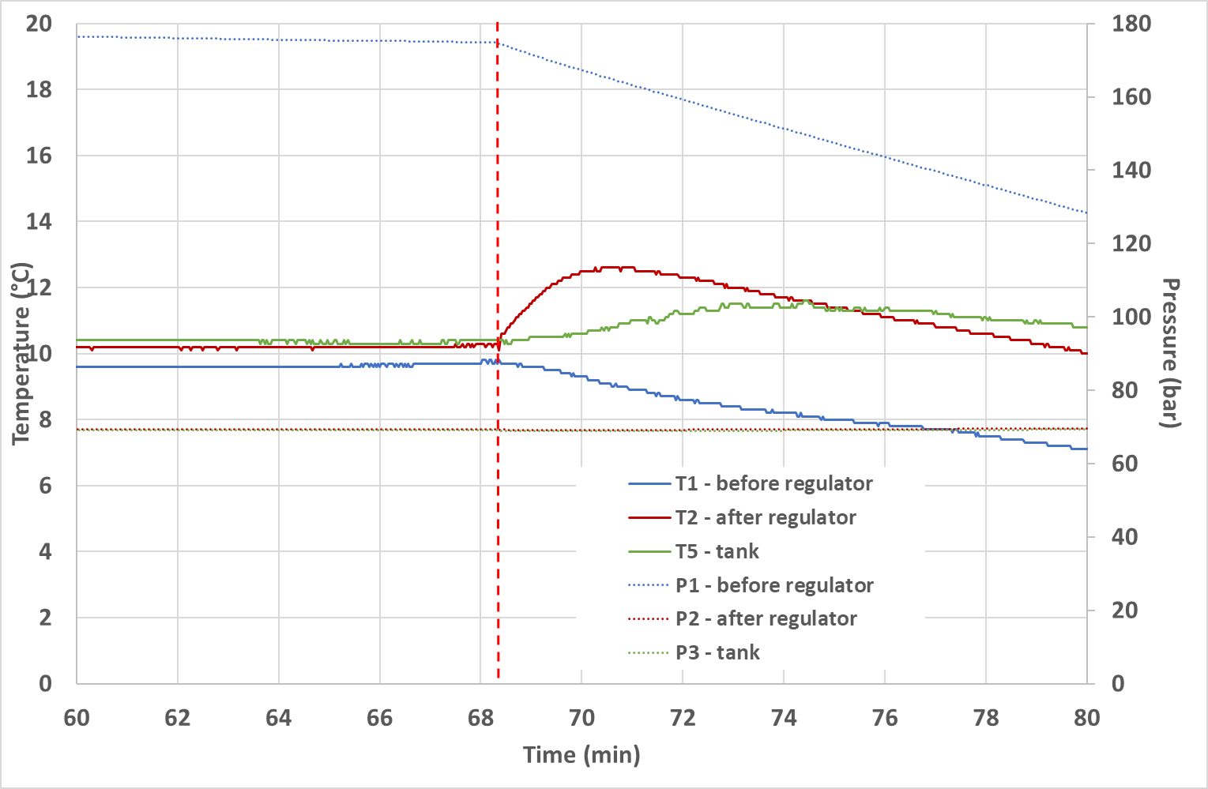
Cold-embrittlement in case of puncture on pipe wall
A safety concern for hydrogen ?
Temperature evolution around the pressure-reducing valve and in the tank
  Release of 2mm at 70 bar
    Temperature decrease before the pressure
    reducing valve (about -6°C)
    Attenuated variation after the valve: prior cooling
    compensated by a positive Joule-Thompson effect
    (about +3.5°C)
  Slight difficulty to interpret the test
    Unsteady temperature of the incoming gas
    Not consistent with a real puncture on a
    long pipeline

Slide 15
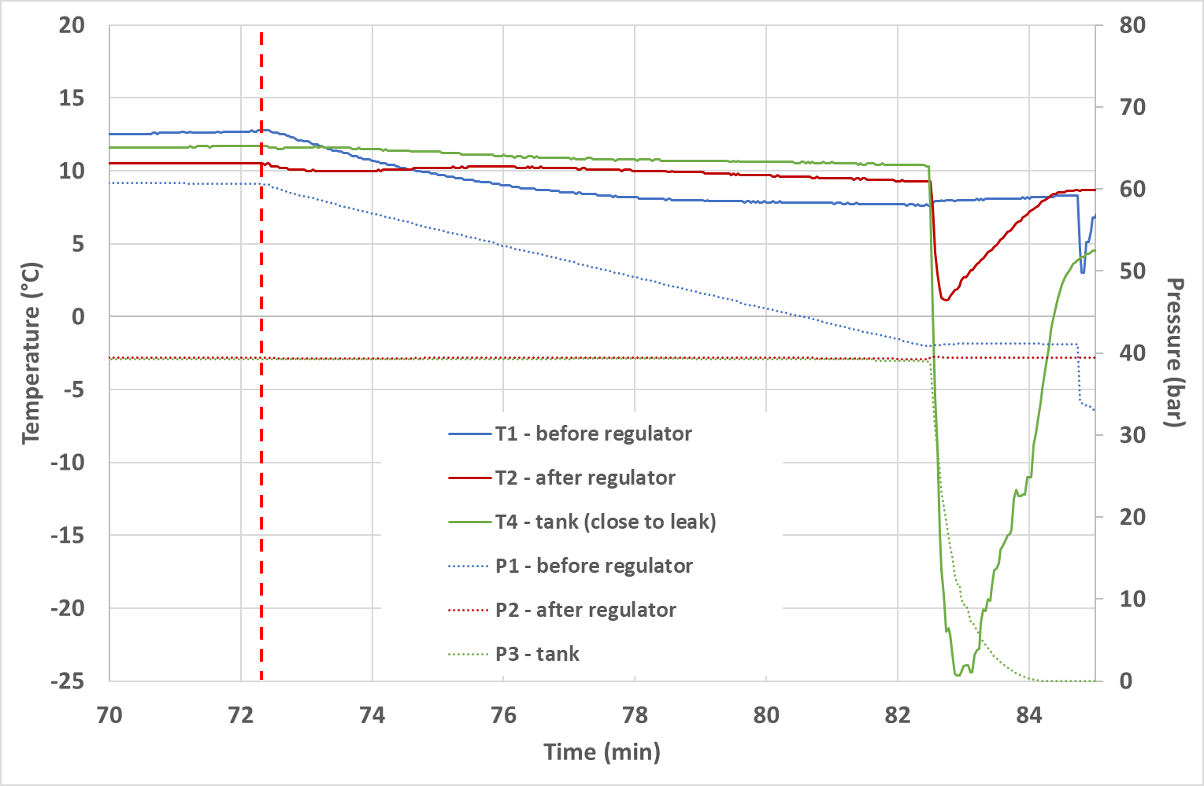
Cold-embrittlement in case of puncture on pipe wall
A safety concern for hydrogen ?
Temperature evolution around the pressure-reducing valve and in the tank: after the test
  After the test: tank blow-down
    Temperature continuously measured
  Important temperature decrease
    Cooling effect due to blow-down
    Temperature decrease about -35°C

Slide 16
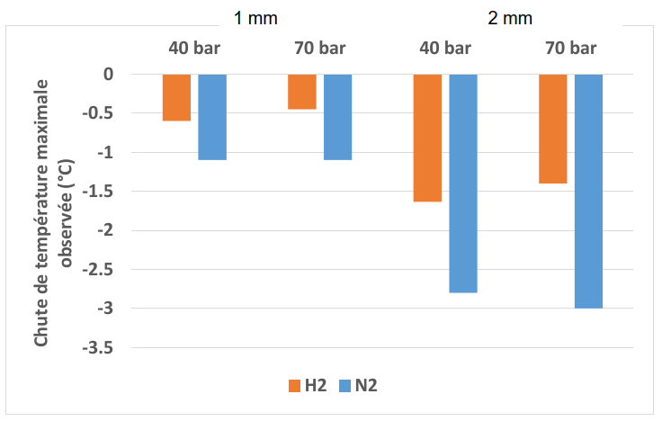
Cold-embrittlement in case of puncture on pipe wall
A safety concern for hydrogen ?
Temperature development in the discharge device
  Interpretation of the tests by INERIS
    Very low temperature drop in steel: around -0.5 to -1.5°C
    Influence of the orifice diameter on the temperature is more
    important than the influence of the initial pressure.
    The temperature drop increases by a factor of 2.5 to 3
    between the 1 mm and 2 mm rejection,
    while it is fairly stable for pressures of 40 and 70 bar
  For INERIS, these temperature variations
  are too small to lead to mechanical
  embrittlement
Measured temperature drop (°C)

Slide 17
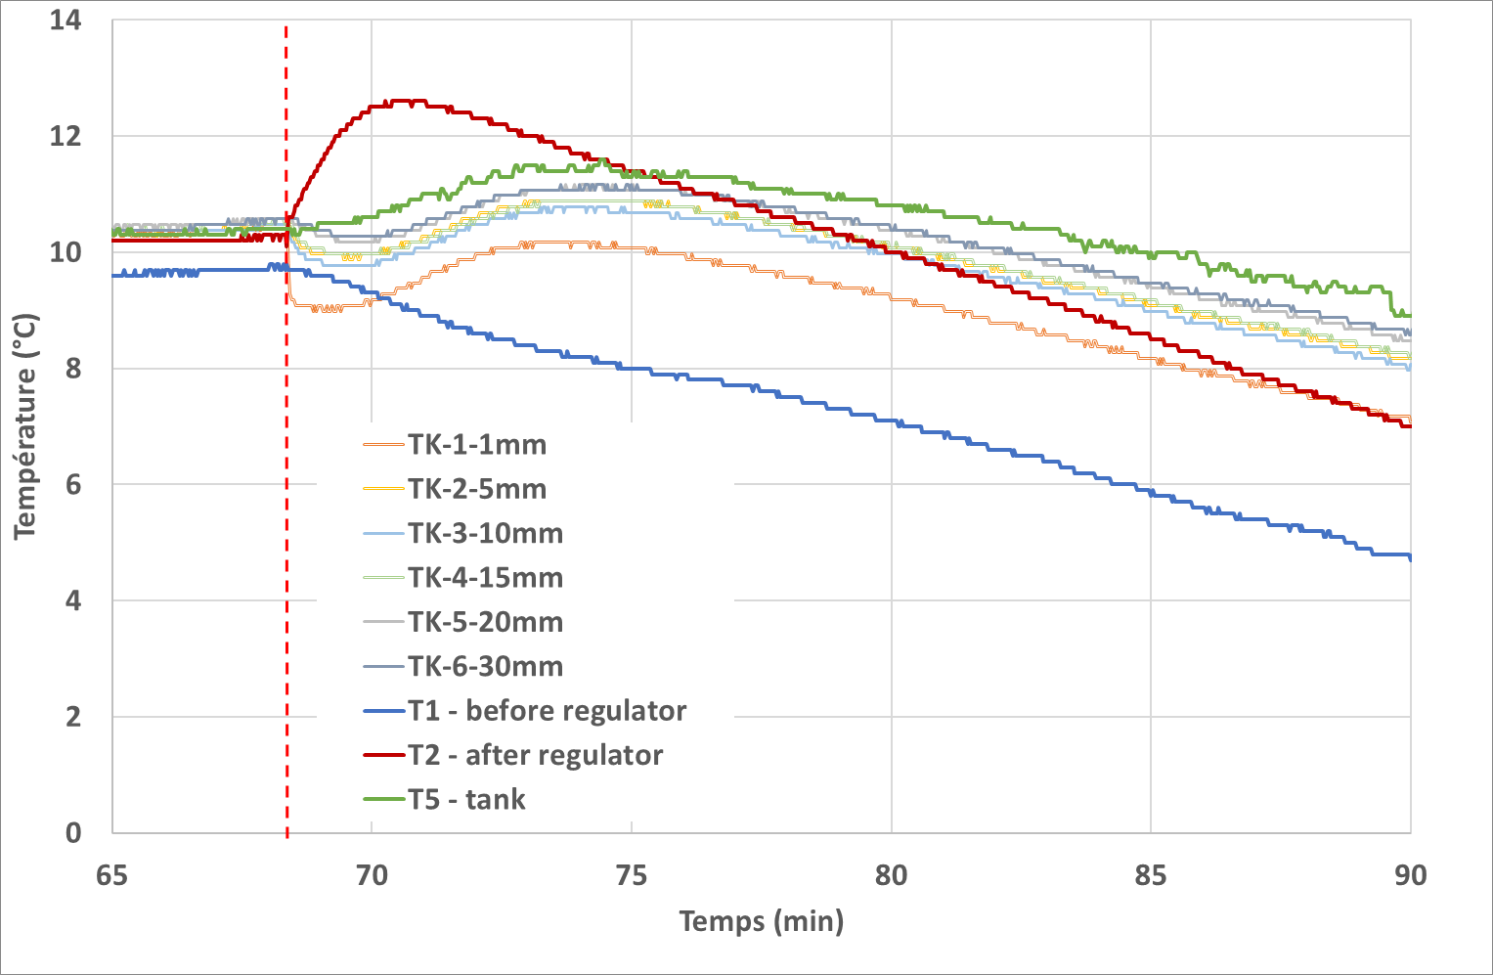
Cold-embrittlement in case of puncture on pipe wall
A safety concern for hydrogen ?
Temperature development in the discharge device
  Limitations of INERIS Tests
    A discharge device thicker than a real actual
    pipe of the same diameter
        No particular influence on the release rate
        Still representative of larger-diameter pipe
        This device avoids uncertainties obtained with a
        surface temperature measure by giving a
        direct measure inside the pipe wall
    Temperature variation of the incoming gas
        Expansion of the hydrogen in the storage cylinders:
        temperature drop
        Expansion inside the regulator: temperature increase due
        to a positive Joule-Thompson effect
        Heat transfer along the line between regulator and tank

Slide 18
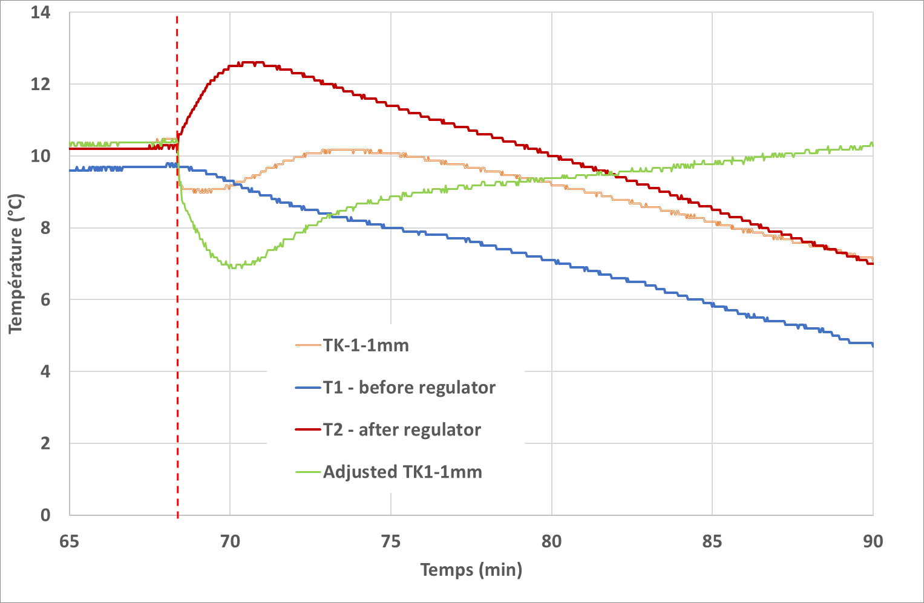
Cold-embrittlement in case of puncture on pipe wall
A safety concern for hydrogen ?
Temperature development in the discharge device
  Proposed correction
    Objective: compensate the temperature variation at regulator exit
    Proposed solution: subtract the temperature variation at the outlet
    of the regulator from the values at the orifice
    Temperature drop of approx. -3.5 °C
    Still very low difference with the initial temperature
  Comparison with natural gas
    INERIS tests done in 2019 with a different protocol (buried release,
    outer surface temperature, etc.)
    Temperature decrease around -8°C for a release of 2mm at 50 bar
    Temperature decrease for hydrogen is slightly lower
    than for natural gas
    For a better comparison: tests with methane will be performed with this new protocol

Slide 19
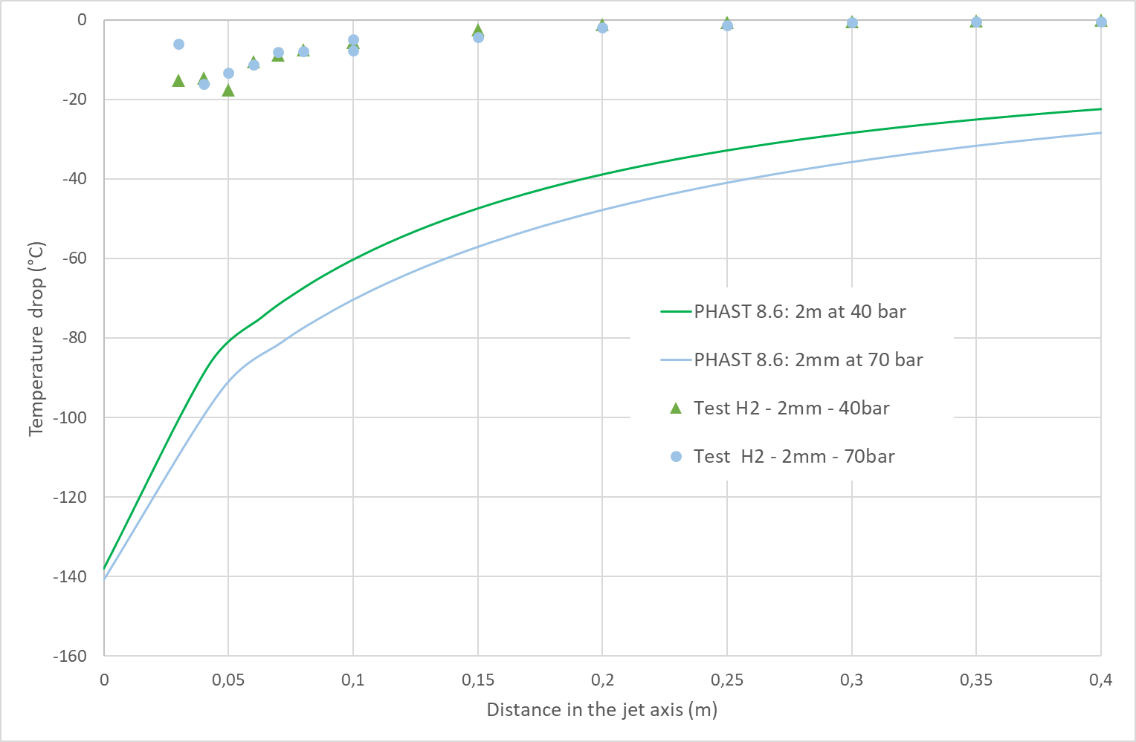
Cold-embrittlement in case of puncture on pipe wall
A safety concern for hydrogen ?
Evolution of the temperature in the jet axis
  Expansion outside the pipeline tends to cool the
  released hydrogen
    No positive Joule-Thompson effect outside
    Sharp drop in temperature in very close field: about -20°C
    Rapid heating in the plume
  Preliminary comparisons with PHAST 8.6
    With default settings: temperature decrease in the jet axis
    seems to be strongly overestimated
    More investigations are necessary

Slide 20
Conclusion and further work
04

Slide 21

Cold-embrittlement in case of puncture on pipe wall
A safety concern for hydrogen ?
Moderate temperature drop in the steel around the orifice
  Valuable results for pipeline integrity expert to estimate the level of risk
  Temperature drop apparently lower than for natural gas
  Further work:
    Extrapolate results for different release diameters and pressures
    Compare with natural gas tests in the same conditions
    Similar tests with CO₂
More significant temperature drop outside
  Further work
    GRTgaz will compare different combinations of dispersion models and notional nozzle models to estimate which fit the best
    with the measurements
    Integration in our inhouse software: PERSEE+
CH₄ and CO₂

Slide 22
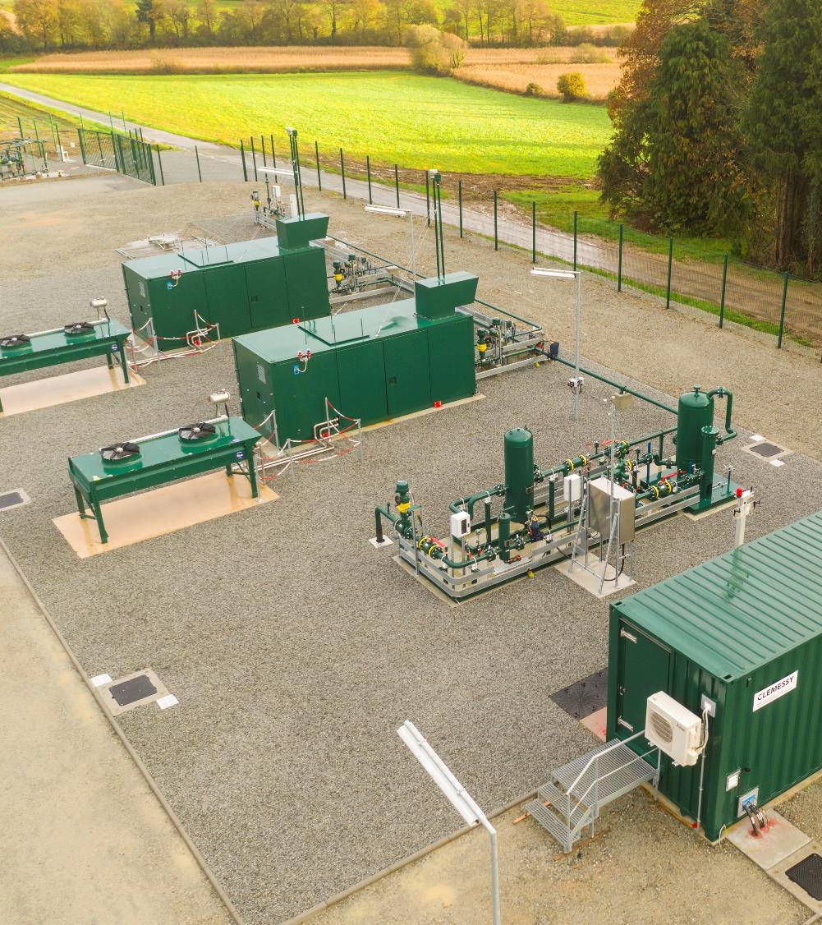
Thank you for your attention

Slide 23


Merci de votre attention
RICE – Research & Innovation Center for Energy
1-3, rue du Commandant d’Estienne d’Orves
92 390 Villeneuve-la-Garenne – France
researchbyrice.com
Votre contact 1
Vincent BLANCHETIERE
Risk assessment expert
+33 7 62 64 23 52
vincent.blanchetiere@grtgaz.com
Votre contact 2
Romain JAMBUT
Risk assessment expert
+33 6 45 43 60 25
Romain.jambut@grtgaz.com
Classification GRTgaz : Public [ ] Interne [X] Restreint [ ] Secret [ ]

