Slide 1
Lesson learned from H2-related incidents: criticality of maintenance operations
Giulia Collina
PhD Candidate
NTNU – Department of Mechanical and Industrial Engineering

Slide 2
Contents
Background
Hydrogen undesired events database
Methodology
Statistical results and discussion
Other results and discussion
Conclusion
Future step
1
2
3
4
5
6
7

Slide 3




Background
CO₂ emissions
increase
CO₂
Global warming
Hydrogen is a promising solution to achieve the target of a zero-emission society.
It has the potential to be a key player in several sectors (transportation, industry, etc.)
Fossil fuel consumption

Slide 4
Background
Lower heating value:
119.96 MJ/kg
Density at NTP:
0.0883 kg/m3
Flammability range:
4 -75 %vol
Combustion products:
H₂O, NO_{x}
Flame visibility:
scarce
Minimum ignition energy:
0.017 mJ
No toxicity
Colour and odour:
none
Molecule diameter:
120 pm

Slide 5




Background
Maintenance errors
(initiating event)
Maintenance activities:
PREVENTION
MITIGATION
prevention measures
contribute to undesired events
Fault events
Critical
event
Consequences
Investigation of maintenance-related undesired events in Hydrogen databases
Lack of maintenance
(no prevention activities)

Slide 6
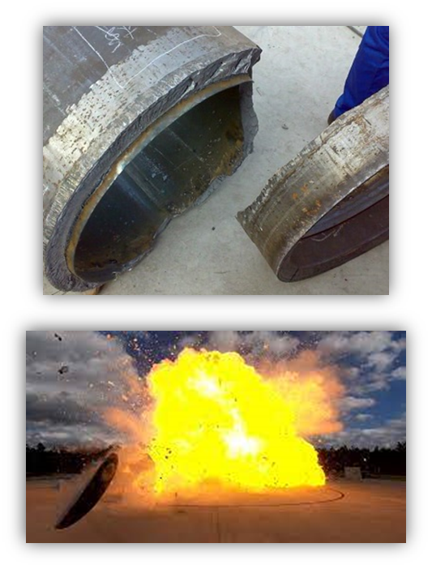
Hydrogen accident reporting
Knowing and understanding past accidents are fundamental to avoiding similar events in the future.
Safety reporting systems are necessary to maximize the lessons learned from H₂-related undesired events.

Slide 7

H2-incidents database
Database | Hydrogen specific | N˚of H2-related events
ARIA | No | 395
eRAMS | No | 96
FACTS | No | 481
MHIDAS | No | >9000
H2TOOLS | Yes | 221
HIAD 2.0 | Yes | 628
HIRA
Hydrogen-related Incident Reports and Analyses
43 numerical and categorical features to overcome the main limitation of the previous database
325 events
Alessandro Campari et al., “Analyzing Hydrogen-Related Undesired Events: A Systematic Database for Safety Assessment,” 2023, 427, https://doi.org/10.3850/978-981-18-8071-1_P021-cd.

Slide 8

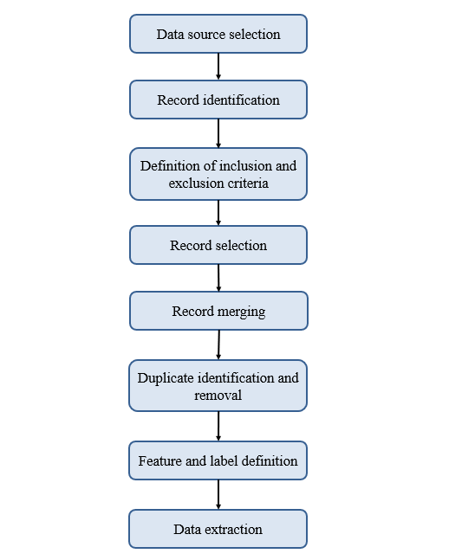
HIRA
HIAD 2.0 and MHIDAS databases
Included:
Events that occurred in the H₂ supply chain
Events that involved H₂-specific technologies
Events that involved flanges, piping, compressors
Releases of pure H₂ or H₂ -rich mixtures
Clearly defined features, categories, and glossary

Slide 9
Methodology
Database selection
Maintenance-related events selection
Statistical results
Understanding maintenance contribution
Lack of maintenance
Generic errors / Human errors

Slide 10
Methodology
Time
Threat stress
Task complexity
Experience/training
Procedures
Human-machine interface
Attitudes to safety, work, and management support
Teamwork
Physical working environment
Human errors
Petro-HRA
(Human Reliability Analysis)
9 Performance Shaping Factors (PSFs)

Slide 11
Maintenance events over the years
76 events

Slide 12
Statistical results (1)
Maintenance can contribute to the events in different ways.
Lack of maintenance: the failure could have been avoided by more effective maintenance management.

Slide 13
Statistical results (2)
Maintenance-related undesired events occurred along the entire value chain.
Consistent with the analysis carried out considering all type of events.

Slide 14
Statistical results (3)
Pipelines, valves, tanks and compressors responsible for most industrial failures.
Pipelines are not designed for H₂ transport.
Consistent with the previous result: transportation and distribution are the most critical.

Slide 15
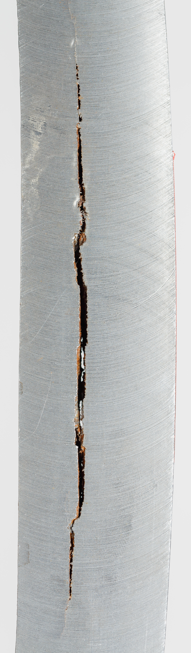

Lack of maintenance: lesson-learned
Main undetected causes:
  Hydrogen embrittlement (HE)
  Hydrogen-induced cracking (HIC)
  Hydrogen-induced stress corrosion cracking (HISC)
  High-temperature hydrogen attack (HTHA)
Equipment designed before the publication of Technical Report ISO/TR 15916 for hydrogen-materials compatibility
Selection of adequate materials and maintenance planning

Slide 16
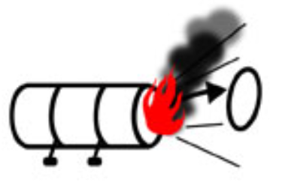
Errors in maintenance: lesson-learned
1
Explosion and fire in Sodeguara refinery in Japan in 1992.
  Break-off of the lock ring of the channel cover of a heat exchanger due to several maintenance errors:
  repeated ratcheting → reduction of diameter of the gasket retainer
  removal of insulation
2
Explosion and fire in an industrial plant in USA in 2011.
  Ignition of hydrogen through the friction sparks produced by maintenance operations.

Slide 17

Errors in maintenance: lesson-learned
Event ID | Date | PSF responsible | Application stage | Component
ID 47 | 31.12.1969 | Experience/training + procedures | Hydrogen application and utilisation | Anaerobic chamber
ID 52 | 10.04.1982 | - | Hydrogen transportation and distribution | High pressure injection pipe
ID 85 | 25.05.2007 | Human-machine interface | Hydrogen application and utilisation | Compressor
ID 117 | 28.07.2005 | Experience/training | Hydrogen transportation and distribution | Pipeline
ID 256 | 21.05.1993 | Procedure | Hydrogen transportation and distribution | Coolant pipeline
ID 299 | 04.07.2003 | Procedure | Hydrogen storage | Cylinder
ID 345 | 16.06.2003 | Teamwork | Hydrogen transportation and distribution | Pipeline
ID 475 | 01.06.2019 | Attitudes to safety, work and management support | Hydrogen transportation and distribution | Shut-off valve
ID 561 | 04.08.2019 | Procedure | Hydrogen production | Generator
ID 562 | 06.07.1985 | Procedure | Hydrogen transportation and distribution | Pump gasket
ID 673 | 28.10.1996 | Procedure | ___ | Furnace
ID 717 | 10.08.2004 | - | Hydrogen application and utilisation | Anaerobic chamber
ID 718 | 05.12.1998 | Procedure | Hydrogen application and utilisation | Furnace
ID 749 | 23.04.1987 | Task complexity | Hydrogen transportation and distribution | Valve
ID 773 | 03.08.1987 | Experience/training | Hydrogen transportation and distribution | Pipeline
ID 912 | 23.02.1989 | Procedure | Hydrogen transportation and distribution | Bolt
ID 935 | 17.01.2013 | Procedure | Hydrogen transportation and distribution | Pipeline
ID 943 | 20.09.2011 | Procedure | Hydrogen transportation and distribution | Flange
ID 988 | 24.09.2019 | Procedure | Hydrogen transportation and distribution | Flange
ID 3227B | 01.10.1981 | - | Hydrogen transportation and distribution | Joint
Procedure
Formation of explosive mixture during maintenance is the most common initiating event
ISO 19880-1:2020
adequate isolation of the equipment

Slide 18
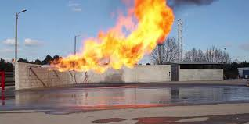
Errors in maintenance: lesson-learned
Event ID | Date | PSF responsible | Application stage | Component
ID 47 | 31.12.1969 | Experience/training + procedures | Hydrogen application and utilisation | Anaerobic chamber
ID 52 | 10.04.1982 | - | Hydrogen transportation and distribution | High pressure injection pipe
ID 85 | 25.05.2007 | Human-machine interface | Hydrogen application and utilisation | Compressor
ID 117 | 28.07.2005 | Experience/training | Hydrogen transportation and distribution | Pipeline
ID 256 | 21.05.1993 | Procedure | Hydrogen transportation and distribution | Coolant pipeline
ID 299 | 04.07.2003 | Procedure | Hydrogen storage | Cylinder
ID 345 | 16.06.2003 | Teamwork | Hydrogen transportation and distribution | Pipeline
ID 475 | 01.06.2019 | Attitudes to safety, work and management support | Hydrogen transportation and distribution | Shut-off valve
ID 561 | 04.08.2019 | Procedure | Hydrogen production | Generator
ID 562 | 06.07.1985 | Procedure | Hydrogen transportation and distribution | Pump gasket
ID 673 | 28.10.1996 | Procedure | ___ | Furnace
ID 717 | 10.08.2004 | - | Hydrogen application and utilisation | Anaerobic chamber
ID 718 | 05.12.1998 | Procedure | Hydrogen application and utilisation | Furnace
ID 749 | 23.04.1987 | Task complexity | Hydrogen transportation and distribution | Valve
ID 773 | 03.08.1987 | Experience/training | Hydrogen transportation and distribution | Pipeline
ID 912 | 23.02.1989 | Procedure | Hydrogen transportation and distribution | Bolt
ID 935 | 17.01.2013 | Procedure | Hydrogen transportation and distribution | Pipeline
ID 943 | 20.09.2011 | Procedure | Hydrogen transportation and distribution | Flange
ID 988 | 24.09.2019 | Procedure | Hydrogen transportation and distribution | Flange
ID 3227B | 01.10.1981 | - | Hydrogen transportation and distribution | Joint
Jet fire occurred after a leakage in a chemical plant.
Maintenance operator mistakenly replaced an alloy steel elbow with a carbon steel part in a high-pressure, high-temperature line
  failure due to HTHA

Slide 19
Conclusion
The HIRA database was investigated: 76 undesired events were maintenance-related.
Transportation and distribution are the most critical stages of the hydrogen value chain. Pipelines are the most critical components.
Developing proper maintenance planning is imperative to avoid events due to lack of maintenance or proper procedure. Training for operators is also essential.

Slide 20



Future step
Hydrogen in several sectors: glass production
Introducing hydrogen in a new sector brings many challenges.
  Furnace and combustion development
  Analysing possible changes in the quality of products
  Safety
Maintenance approaches: risk-based maintenance
https://h2-glass.eu/

Slide 21
Thank you for your attention
Contact
Giulia Collina: giulia.collina@ntnu.no

Slide 22
Explosion and fire in Sodeguara refinery in Japan in 1992.
Repeated ratcheting, leading to a reduction in the diameter of the gasket retainer which keeps the heat exchanger airtight
Incorrect replacement of the gasket retainer which contributed to hydrogen gas leak
Removal of insulation, which induced temperature difference (new hazard) that led to thermal deformation of the inner parts of the tube area and contributed to the increase of the diameter of the channel barrel,
Inadequate replacement of the internal flange set bolts, leading to their destruction, increased load on the channel cover set bolts, bending and diameter decrease in the lock ring (maintenance error)

