Slide 1
Responding to Climate Change: Improving Resilience to Changing Natural and External Hazards at a Nuclear Fuel Facility
David Threlfall CChem MRSC AIChemE, Safety Engineer
Rebecca Bettison MSc MIET, Safety Engineer
November 2023
This presentation, including any opinions and/or conclusions expressed, are those of the authors alone and do not necessarily reflect Rolls-Royce policy.

Slide 2
Natural & External Hazards – Safety Assessment Principles for Nuclear facilities
Regulatory Expectations
EHA.11
Facilities should be shown to withstand weather conditions that meet design basis event criteria. Weather conditions beyond the design basis that have the potential to lead to a severe accident should also be analysed
EHA.12
Facilities should be shown to withstand flooding conditions up to and including the design basis event. Severe accidents involving flooding should also be analysed.
EHA.15
The design of the facility should prevent water from adversely affecting structures, systems and components.

Slide 3
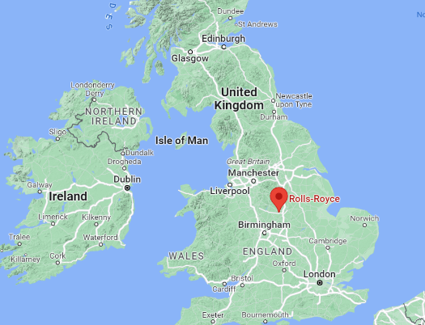
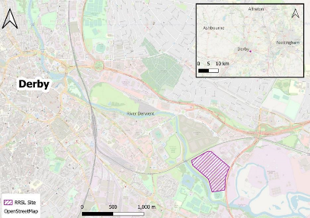
Rolls-Royce Site Location

Slide 4
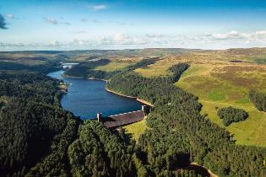
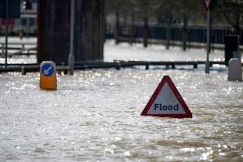
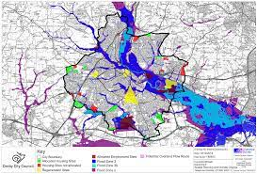
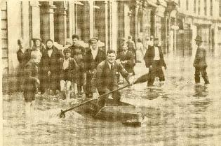
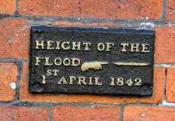
Flood Hazards
Images Sources: Derby City Council, Derby Telegraph, Peak National Park

Slide 5
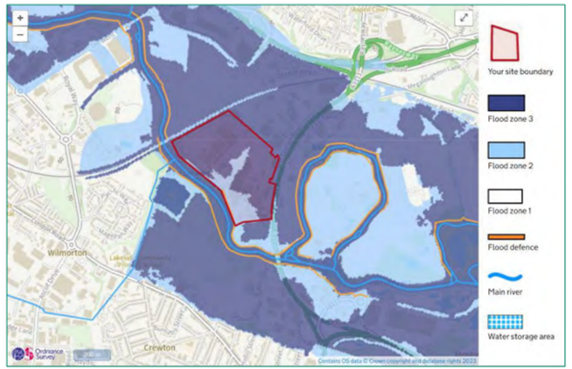
Flood Major Accident Scenario (FMAS) | Typical site arrangements vs. flood zones
1. Flood within the establishment directly causes major accidents | Nuclear material & COMAH dangerous substances present in flood risk area
2. Flood within the establishment can indirectly cause or escalate Major Accident | No dangerous substance in flood area but Major Accident hazard relevant equipment / utilities / access routes susceptible to challenge from flooding
3. Flood outside establishment | Establishment near flood risk area which could challenge protection layers
4. National wide area flooding exacerbates Major Accident risk | Flooding in another part of the country but not near establishment
Flood Major Accident Scenarios and Flood Zones

Slide 6
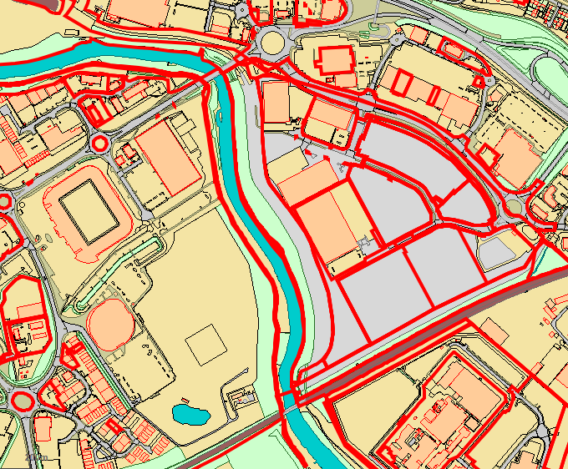
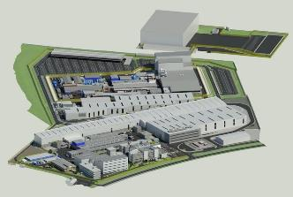
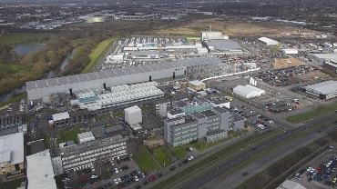
Source: Derby City Council Planning Portal
City & Site Development and Flood Protection

Slide 7
Localised and site flooding can create Common Mode Failures, due to the multiple modes of actions:
Physical disruption to structures due to the force exerted by flowing water, buoyancy effects, and impact from debris,
Electrical short circuits both internal and external,
Rapid cooling (or warming) of temperature-controlled systems,
Blockage of internal movement routes,
Displacement of loose objects, waterborne debris and stored materials, and
Dilution and flushing-out of liquids.
Flood Protection
Common Mode Failures

Slide 8
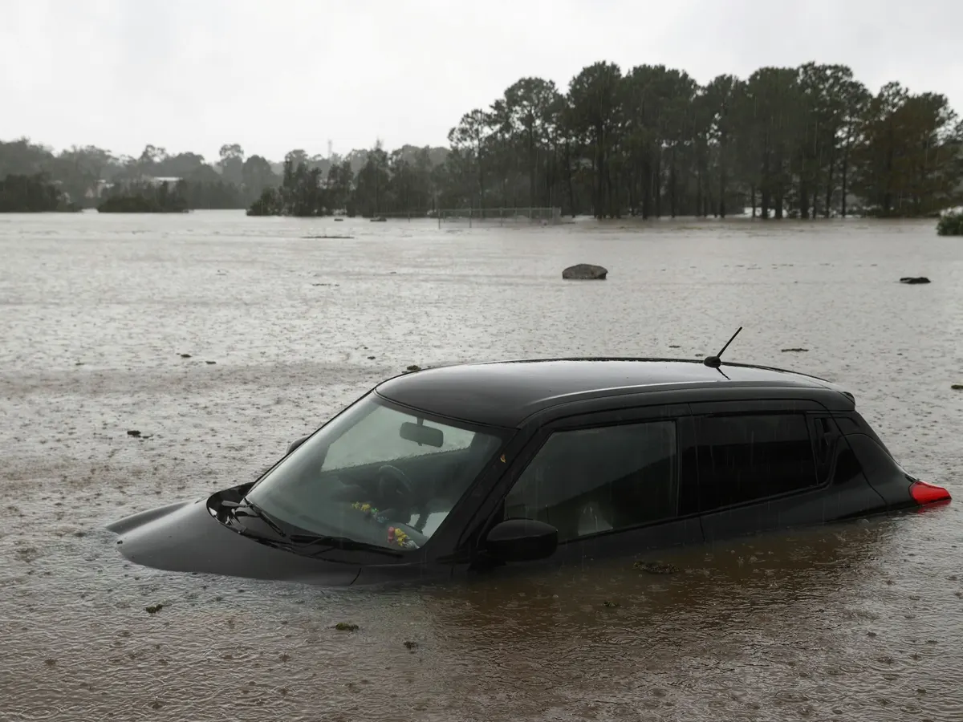
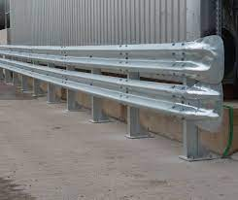
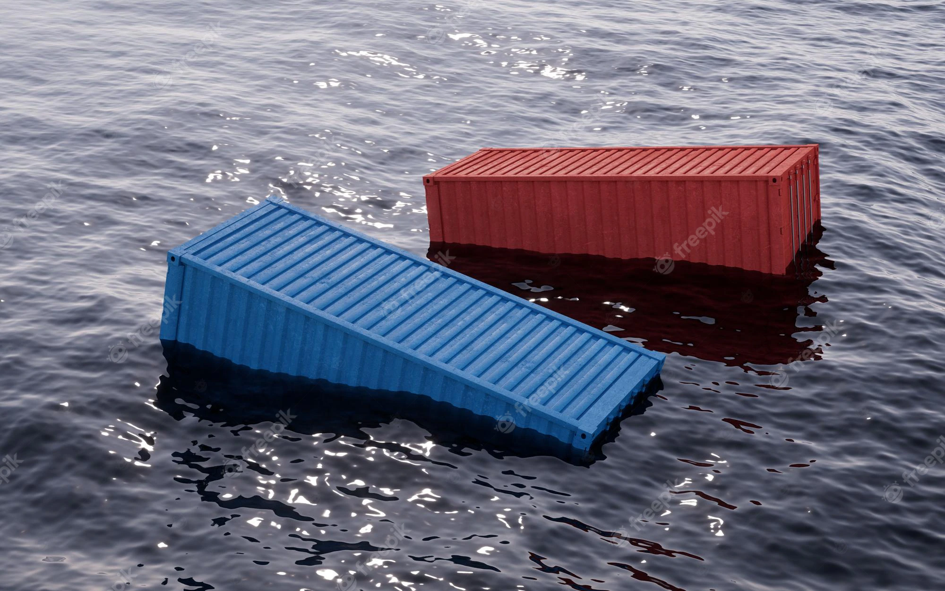
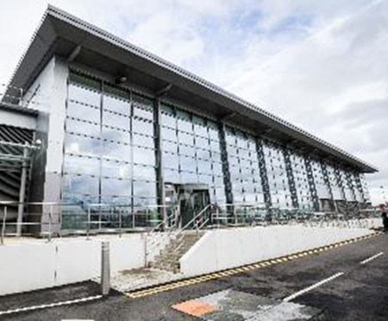
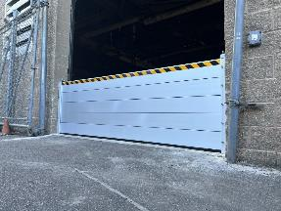
Flood Protection

Slide 9
Flood Warning Level | Flood Response Action
Flood watch | Monitor river level and rate of rise locally every 4 hours
Enhanced Flood watch | Increase monitoring to every 3 hours
Flood alert | Level 1 (e.g. Review site operations)
Operational warning | Level 2 (e.g. Shut down high risk activities)
Flood warning | Level 3 (e.g. Shutdown low risk activities)
Flood hazard | Level 4 (e.g. Make safe and secure)
Flood Protection

Slide 10
Climate Change and Predicted Site Flood Height

Slide 11
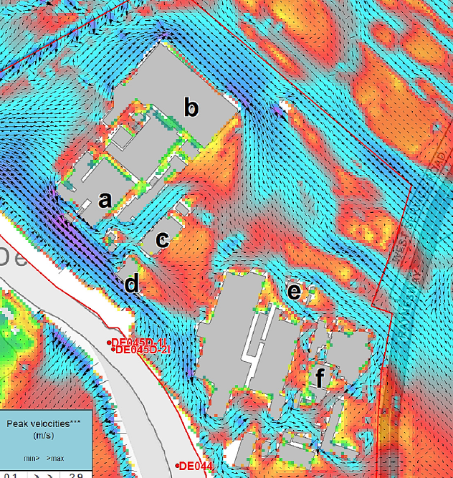
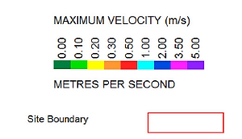
Peak Floodwater Velocity and Flowpaths.
Illustrative Modelling
Source: Flood modelling report, Jeremy Benn Associates Ltd 2018 for Rolls-Royce
Contains Ordnance Survey Data

Slide 12
Physical Measures | Site Evaluation
Building of levees around exposed sites to protect them from floods | Not feasible due to existing facilities and infrastructure. Detrimental to operational arrangements
Building of artificial channels that convey flood waters away from the site | Not feasible due to location and surrounding infrastructure
Riverbank stabilisation to prevent erosion and spill-over when a river swells | Stabilisation and improvement works are in place through others.
Rearranging of the plant layout by moving critical equipment to areas where it is less exposed to natural hazards (e.g. outside the floodplain area); | Not feasible due to location and local topography
Erection of elevated dry areas where safety-critical systems should be placed in case the site is located in an area with flood or tsunami hazard | This is a credible measure for the site development.
Improving Resilience to Changing Natural and External Hazards
Adapted from Natech Risk Management – Guidance for operators of hazardous industrial sites and for national authorities (Necci, 2022)

Slide 13
Conclusion
Improving Resilience to Changing Natural and External Hazards
Rolls-Royce is increasing resilience to flooding and adapting to the challenges of site expansion, local development and climate change
RR continues to improve flood defence in depth measures:
Location and Elevation of Operational and Emergency Facilities
Enhanced protection of process, safety and emergency equipment in the existing facilities
Sealing building penetrations
Installing barriers to debris
Improving protection of people

