Slide 1
Engineering Substantiation in the Nuclear Industry
Gareth Davies, Safety-in-Engineering Centre of Expertise, Sellafield Ltd.
Adam Marriott, Chief Mechanical Engineer, Hinkley Point C Project, EDF Energy.
Tim Boland, Safety-in-Engineering Centre of Expertise Lead, Sellafield Ltd.
Notes:
Introductions Gareth & Adam.
This presentation and accompanying paper has also been produced in collaboration with Tim Boland who is the safety-in-engineering centre-of-expertise lead for Sellafield Ltd. who is in the audience, give us a wave Tim.
In the presentation today I’m going to be talking about engineering substantiation in the nuclear industry, with the aim to share learning with wider industries.

Slide 2
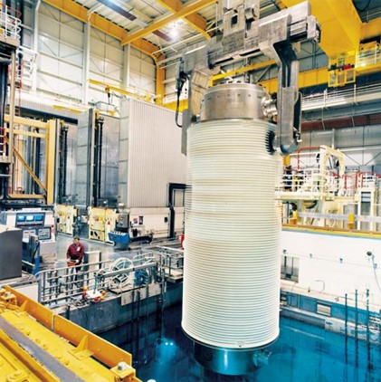
What is Engineering Substantiation?
Best way to explain the process is by examples.
Transport flasks provide a containment function.
Clearly important to prevent release of radioactive material.
Ability of a flask to provide these safety functions requires demonstration.
Higher consequences require higher confidence and therefore higher levels of demonstration.
Notes:
So what do we mean by engineering substantiation? You have probably come across the term substantiation in the context of engineering before, however in this context it has a specific meaning.
I think the best way to explain what engineering substantiation is, is by talking through an example, I will then come back to a definition in the next slide.
So, in the photo on the right of the slide you can see a spent nuclear fuel transport flask. This flask was used to transport fuel from power stations around the UK to the ThORP at the Sellafield site and here you can see it being lowered into a pond to remove the spent fuel for reprocessing, when THOrP was in operation.
The purpose of the transport flask is quite simply to prevent the uncontrolled release of radioactive material which could cause harm to workers, the public and the environment. As you might expect this includes during normal operations but also a range of fault scenarios such as drops or impacts.
The ability of the transport flask to maintain containment of the contents requires demonstration with appropriate evidence i.e. back to our dictionary definitions. The level of certainty in the evidence or what is considered sufficient evidence, depends on the safety risks to people from exposure to the radioactive material being transported i.e. the higher the risks the higher the confidence required in the engineering to perform its safety function.

Slide 3
What is Engineering Substantiation?
Basic requirement of engineering substantiation is to:
Demonstrate that plant and equipment contributing to safety, by providing what is known as a safety function, achieve all the safety requirements identified in the nuclear safety case.
Notes:
Therefore, the basic requirement of engineering substantiation is to:
Demonstrate that plant and equipment contributing to safety, by providing what is known as a safety function, achieve all the safety requirements identified in the nuclear safety case.
Meaning that the plant or design will perform with regards to safety, in the manner intended and as has been claimed in the nuclear safety case.
The key distinction with the engineering substantiation process is that its all about safety and has nothing to do with demonstrating functionality and other requirements.

Slide 4

Where does it come from?
Office of Nuclear Regulation - nuclear site license conditions
Environment Agency - radioactive substances regulations
Other broader legislation:
  COMAH
  Health and Safety at Work Act 1974
  Management of Health and Safety at Work Regulations 1999
Notes:
So where does is come from?
I’m not going to dwell on this too much in this presentation, but I think this is important to touch on this because it highlights how the engineering substantiation process is also applicable to meeting broader legislation outside of the nuclear industry, and hence why it might be of interest to other industries and not just nuclear.
However, if you’d like to know more about the origins, as with many other aspects of the topic I would encourage you to read the accompanying paper.
When we consider the H&SWA and management of H&SW regulations, although not explicitly stated, the activities often necessary to demonstrate that safety risks have been managed to ALARP, requires the identification and demonstration of the adequacy of protective systems put in place throughout the life of the particular plant or operations. Which is a key part of engineering substantiation.
Although, its worth saying that helping to demonstrate the achievement of ALARP is just one aspect, and we will discuss further additional short term and long term benefits of the process throughout the presentation.

Slide 5
The Process
Notes:
Now that I’ve provided some background to engineering substantiation I’m going to take you through the process in a bit more detail.
We’ll then take you through some examples from nuclear power generation side at Hinkley Point C and from the reprocessing, decommissioning & storage side at the Sellafield site.

Slide 6

Substantiation Strategy
Develop a strategy and programme of key decisions, deliverables and dates.
Include all project stages.
Maintain live throughout.
Where captured and detail will depend on scale of project.
Objective to manage risks and uncertainties in a controlled way.
Reduce chance of significant shortfalls/ gaps discovered later on.
Notes:
At the very start of a project the strategy for implementing and undertaking engineering substantiation should be developed.
This includes a strategy and programme of key decisions, deliverables and dates, which support project delivery timescales. This should include all stages of the project lifecycle up to handover to the Operations team to ensure good alignment.
It should be maintained live and updated through out the project lifecycles as project maturity increases or changes occur.
Where it is captured will depend on the scale and timescales of the project or task, so on major projects it might be its own document whereas small tasks might capture this information in other work plan documents.
The benefit of developing the strategy upfront is to reduce risks and uncertainties associated with the process and wider safety case in a controlled way. Thereby reducing the chance of significant shortfalls be realised at the back end of a project which can be costly to correct and create project delays.

Slide 7

Engineering Schedule
Captures plant and equipment providing safety functions.
Provides a consistent approach.
Purposely simple and streamlined.
Develops alongside the design process.
Drive forward the design with respect to safety.
Key communication tool between the project team and into operations.
Maintained live throughout lifecycle of a facility.
Notes:
First thing to explain, is that by schedule it simply refers to the way in which the safety functions are presented as a list in a table arrangement, I have an example coming up on the next slide to demonstrate. There is nothing complicated about it and that is intentional, with the aim to make it simple and easy to follow, and provide consistency.
The engineering schedule is a very important aspect of engineering substantiation, if used as intended it becomes a focal point and key communication tool between all the various project team members and ultimately plant personnel.
It is maintained live throughout the project phases and it develops alongside the design process, therefore as the design becomes more mature so to does the detailed captured in the schedule.
A key point to stress is that the engineering schedule should not just be used as a way of recording the safety functions. Instead to be an effective tool and work as intended, the engineering schedule should be viewed as the glue that binds together the various project activities that are related to process safety. This means using the schedule to provide some structure and instead to drive forward the design with respect to safety and the safety case that supports it, rather than safety being an afterthought or add on. This can be achieved by quite simply having regular meetings with all the disciplines/ teams involved to populate the schedule and then continuously updating/ reviewing it as the design progresses.

Slide 8
Engineering Schedule
SSC Number & Name | Safety Function | Safety Function Class | Safety Designation | Performance Requirement | References
Unique Identifier + simple description of item | Describe the high-level function. | SFC levels indicate importance of the safety function. 1 being highest and 3 being the lowest. | List hazard type: nuclear, environmental, COMAH, chemical etc. + List contribution to safety i.e. safety related or directly related + Include safety system target pfds. | State numerical operating conditions or limits that the SSC must operate under. | Link to safety/ risk assessments + underpinning evidence.
Notes:
This table shows the layout and typical contents of the engineering schedule.
Starting on the left…
The SCC or system, structure, component is simply the plant and equipment providing a safety function, so back to an earlier slide this might be the transport flask, you would also provide a unique number.
Next we provide a high level description of the safety function, so in the case of the transport flask it might be to provide containment of the spent fuel contents.
Then we include what’s known as a safety function class, which effectively categorises the importance of the safety function in terms of safety.
Next we define the safety designation which describes what aspect of safety the plant and equipment to providing protection against i.e. environmental, COMAH etc. it also defines the PfD for safety instrumented systems.
Very important column next is the performance requirement this defines the specific limits and conditions under which the SSC must provide its safety function e.g. under what conditions is the transport flask expected to maintain containment so maximum and minimum ambient temperature for example.
And lastly we have a column to reference out to the associated safety case documents and underpinning evidence etc.

Slide 9

Engineering Substantiation Record
Recorded in various formats e.g. drawings, calculations, reports, certificates, records etc.
Presents the evidence plant and equipment can meet the safety function.
Evidence clearly and logically laid out.
Easier to peer review and check evidence.
Provides confidence that safety functions are supported with sufficient evidence.
Notes:
The engineering substantiation record documents the conclusions, arguments and evidence that demonstrate the adequacy of the SSC to meet its safety function. The record will justify, assess and demonstrate, at a level appropriate to the safety contribution, that the SSC will deliver the safety function throughout the lifecycle of the asset. The record should include appropriate information and arguments to demonstrate how the SSC is substantiated and should reference out to supporting underpinning evidence.
The substantiation evidence is about laying out clearly and logically the justification of the ability of the SSC to achieve its safety function, such that reasonable, and suitably qualified and experienced peers can review and challenge the arguments and evidence as necessary. Often this detail is tacit and obscured so it is not easy to unpick (commercial issues can even make it impossible), which is one of the main reasons for presenting it in this way to avoid oversights or misjudgements.
The engineering substantiation evidence can be recorded in any number of formats to suit the application, what is already available and the preferences of the operations team who will own it for the lifecycle of the facility.

Slide 10
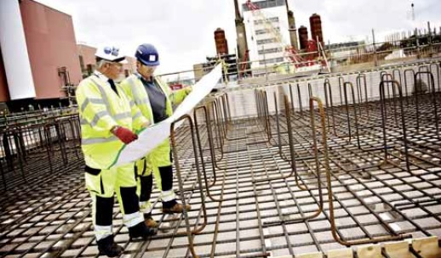
Manufacturing, Construction &
Commissioning
Majority of safety functions are fully demonstrated during these phases.
Importance of plant and equipment to safety needs to be effectively communicated.
Including specific activities or measures that need to be incorporated.
Engineering substantiation record may need updating.
Notes:
Most safety functions can only be fully demonstrated (and therefore substantiated back to our dictionary definitions) after the design phase once they are manufactured, constructed or commissioned. The ability to demonstrate that plant and equipment meet the required specifications during these phases is particularly true for the nuclear industry where intervention once in service can become extremely limited or costly.
As a result, it is important that the relative importance to safety, and specific requirements in those phases to close out the substantiation are understood by those carrying out the work activities. This relies on clear articulation of the residual activities to be carried out, and an effective handover between the different teams.
It is equally important to make sure that the safety function requirements can be achieved during the manufacturing, construction or commissioning stages. Which involves early engagement between the various teams.
Once the safety function has been demonstrated the engineering substantiation report/s will need to be updated with the relevant evidence.

Slide 11

Operations & Decommissioning
Informs operations of the important safety functions.
Information feeds in working level documents.
Informs inspection, maintenance and testing activities throughout operations.
Informs of any residual risks.
Maintained live throughout operations.
Can inform investment decisions or improvement activities.
System health reports – day 0.
Notes:
Once a safety function has been fully substantiated that is not the end of the substantiation process, and in some ways just the beginning as the equipment providing the safety function will need to be managed throughout the plant operating life to make sure it continues to provide its function. This may include inspections, maintenance, proof testing intervals or any residual risks that cannot be removed during design, manufacture, construction or commissioning.
Residual risks may include deterioration mechanisms that over time could reduce the lifespan or capability of plant and equipment. Even something as seemingly benign as not cleaning gutters regularly, which could over time cause blocking and lead to overflowing of rainwater into the building fabric, thereby degrading the structural integrity more rapidly of equipment providing a safety function.
Those who operate the equipment need to be informed of the safety function that it is performing so if any issues or problems occur they can quickly coordinate the appropriate corrective actions i.e. stop operations or identify suitable temporary alternatives.
The substantiation evidence and residual risks described above can also be used to feed into the initial plant health reports or equivalent means of monitoring an asset’s condition over time. At Sellafield Ltd. system health reports are carried out on a system basis and the aim is to align the substantiation evidence so that the pertinent information can flow into the system health reports from day one.

Slide 12
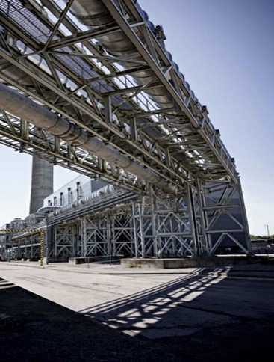
Example: Nuclear Decommissioning,
Reprocessing & Storage
Pipe Bridge Supports:-
Used widely on the site.
Carry ventilation pipework, ducting, essential services etc.
Complex site often brings supports into close proximity with vehicles.
Need to demonstrate ability to withstand credible impacts (faults) if failure can result in radiological harm.
The safety requirement can end up driving the design of the pipe bridge support.
Notes:
Pipe bridges are commonly used to support pipework, ventilation ducting and services around the Sellafield site.
Where the pipework or ducting performs a critical function that could result in a radioactive release on the supporting plants or if direct damage would result in a radiological release then it is important that the pipe bridges are capable of performing their function in a variety of scenarios.
For example, where vehicles operate frequently in the vicinity of a pipe bridge then it is credible that an impact from a vehicle could occur, albeit unlikely, accounting for the training and experience required of operators of such machinery. In this case the design team would work with the safety assessors and operations teams to determine what a credible impact could involve e.g. speed and weight of the vehicle. The pipe bridge then needs to demonstrate that it can withstand such an impact and carry on providing the support to the ducting or pipework it is supporting.
Depending on the scenario you can find that the safety function driving the design of the plant i.e. the pipe bridge must be designed with that ability incorporated. You can see why it is important to understand the safety requirements of plant and equipment early before the design of plant and equipment has progressed to far, so as to minimise rework. In this case the design team would include the relevant structural calculations and other evidence into the engineering substantiation report.
In this example the majority of the evidence to support the substantiation can be demonstrated in the design phase, whereas many safety functions cannot be fully demonstrated (tested) until the later project phases. However, the pipe bridge still needs to be manufactured and installed in line with certain quality requirements and in the correct location/ orientation to ensure it will perform the safety function.

Slide 13
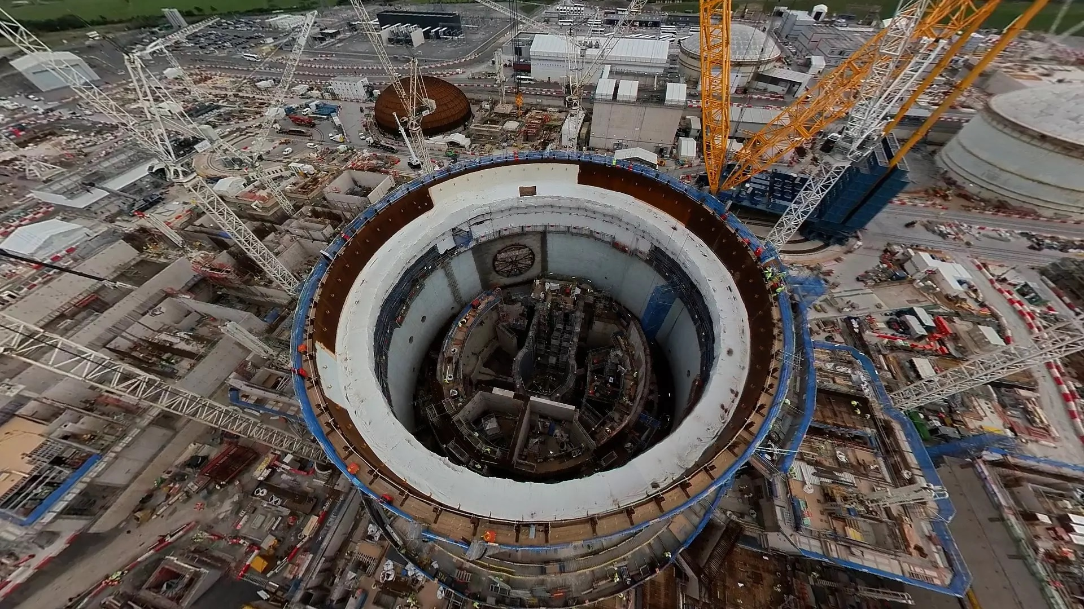
Example: Nuclear Power Generation
How do you demonstrate an entire power station is safe?
Three fundamental safety functions
  E.g. Fuel Heat Removal
Broken down into Plant Level Safety functions
  E.g. Remove heat from the reactor coolant to the ultimate heat sink
Then to Lower Level Safety Functions
  E.g. Control of steam generator level
Achieved by Safety Features
  E.g. Ability to start up an emergency feedwater train
Safety Feature Performance Requirements
  E.g. Supply water at 45m³/hr
Notes:
Hello, my name is Adam Marriott and I work on the design and construction of the new nuclear power station at Hinkley Point C.
In this example we’re going to look at how the overall safety of entire power station can be linked to and traced to the specification of individual pieces of equipment.
We start at the top of the tree by defining fundamental safety functions – the absolute must dos - keeping control of these will allow the plant to remain in a safe state.
For Hinkley these have been defined as:
Control of Fuel Reactivity – in other words keeping the nuclear reaction under control and controlling how fast neutrons are being produced
Fuel Heat Removal – which covers everything we need to do to get heat out of the reactor
Confinement of Radioactive Material – which is fairly self-explanatory – keep the nuclear material where it is supposed to be
However, to get down to the performance of individual pieces of equipment we need to break these functions down into a series of more detailed requirements over a number of levels. To keep this understandable, I’m going to focus on just one system, in this case the emergency feedwater system which supplies water to the steam generators (which are effectively rather large boilers) should the main feedwater system fail. The system, at a very high level consists of four tank/pump pairs to supply and transfer water with an appropriate degree of redundancy.
This system supports the fundamental safety function of Fuel heat removal as the steam generators are part of the chain that transfers heat out of the reactor and boilers without water do not work that well. The fundamental function is broken down into a number of Plant Level Safety Functions which state that we need to be able to, for example maintain enough water in the primary cooling loop to allow core cooling, get heat out of the core and into the coolant and then get that heat from the coolant into the ultimate heat sink, also known as the Bristol Channel.
The emergency feedwater system contributes to the Plant Level Safety Function of removing heat from the reactor coolant to the ultimate heat sink. However, even that is a reasonably complicated affair, so the Plant Level Safety Function is further broken down into Lower Level Safety Functions which, when talking about this system include the ability to remove heat via the steam generators, being able to control the level of water in the steam generators and ensuring that the emergency feed system cannot accidentally drain the steam generators.
Going down one last level, we reach the Safety Features, which are the functions that a specific system must be able to perform. For the emergency feedwater system these include the start up of a feed train – so getting water flowing, being able to isolate a feed train – to limit water loss should we have a pipe failure and being able to control the water level in a steam generator.
Finally each safety feature has a series of performance requirements. This is where we get into the guts of the engineering. For the Safety Feature to start up a feed train, the system must, amongst other things, supply 45m/hr of water, it must supply water at less than 50°C, it must establish flow within 20 seconds and have a pump bearing vibration displacement of <75µm
This then gives us the system performance that is required to maintain nuclear safety. These requirements, along with the others for this system are collated into a Functional Criteria Matrix which is then used as the basis for the design of the commissioning tests for the system.
Our substantiation can then be made in which it is demonstrated that the system is designed to provide the required safety features, that the system components were manufactured in line with the design, the system was installed as per the design, that appropriate commissioning tests were undertaken and the results appropriately assessed and that future operators have all the information they need to operate the plant safely. Moreover, we can demonstrate a “Golden Thread” following an auditable trail from the Fundamental Safety Functions all the way down to the performance of an individual pump.

Slide 14

Lessons Learned
Follow the process
Get the engineering schedule right
Collaboration
Communication
Gradual risk reduction
Notes:
I’m now going to talk through some key learning points from many years of experience of using the process.
These will all seem obvious and possibly dull, but for one reason and another in a project context they can go out the window. They can also have a significant impact if not done correctly.
1) First off follow the process, it can be too easy to crack on with the design and safety case, and simply capture everything towards the back end of the project in the required format, however by treating it as a bolt on or afterthought a significant benefit of following the process can be missed. By instead using the engineering substantiation process, particularly the engineering schedule, to guide the development of the design and safety case, this will make for a more joined up, understood and well-reasoned output at the end. The integration can also benefit other non safety aspects.
2) Getting the engineering schedule populated to the right level of detail takes some skill, iteration and experience. A common issue is not being specific enough and pitching it at a level of detail that is too high. Whilst this is to be expected in the early stages of a design, as the design maturity increases and things start to take shape, so too should the engineering schedule become more detailed and specific. In particular, the performance requirements need to reach a point where they provide a clear set of quantifiable conditions under which the plant and equipment (SSCs) must operate to achieve the required safety function. At the end of the day engineering is all about numbers, so you should expect lots of numbers to measure against…
3) Close working between key disciplines/ parties involved at the right time in a project is very important. Otherwise, decisions can be made that influence the design or safety case that ultimately need changing and depending how advanced the project is when the change is realised, it can be costly and time consuming to correct. Examples of this can include safety claims on engineering equipment that cannot be achieved, or checks that cannot be implemented during manufacturing or commissioning, such as inspecting golden welds.
4) Engineering projects often involve large multi-discipline teams which rely on effective communication to convey important information to those who need to know. This is particularly important when you have the long durations and complexity often associated with nuclear facilities or mega projects. But still relevant for projects of all sizes. By establishing what information is important to the different disciplines and how they would like to receive it, this can help to establish good lines of communication within the team so that important information when it comes to engineering substantiation gets correctly conveyed to the right people.
5) Production of the engineering substantiation reports often occurs towards the end of the design phase, this can sometimes lead to the undesirable outcome of leaving the majority of the effort of gathering and articulating all the substantiation evidence towards the end. This can run the risk of finding that the engineering evidence is not as robust as first thought and therefore requiring some kind of further work to be undertaken, which in the later stages of a project can be costly. The aim is to progressively gather and articulate the engineering evidence as the design matures, thereby flagging up earlier where any shortfalls might exist. Having a substantiation strategy helps here.

Slide 15


Positives and Negatives of Engineering Substantiation
Single approach. Single process. Applied to non-nuclear. Link SSCs with multiple safety functions. Provide safety ‘golden thread’. Project efficiency. Aid operations safety understanding. Digitisation. Knowledge management. Investment decisions and future strategies. Reduce rework and additional costs. | Additional time and effort. SFC confidence levels need defining. Hard documentation extra burden to archive and manage. Evidence might not be available e.g. IPR. Effort to incorporate/ replace existing processes.
Notes:
Hopefully that has given you a good overview of the substantiation process and I just wanted to bring this presentation to an end by simply highlighting some of the pro’s and con’s of adopting the engineering substantiation process.
Some final points I recommend reading the associated paper which goes into further detail than has been possible here.
I would also like to thank Adam Marriott and Tim Boland for their contributions and help, as this was not a lone effort.
Thank you for listening.

