Slide 1
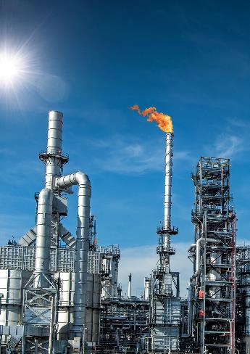
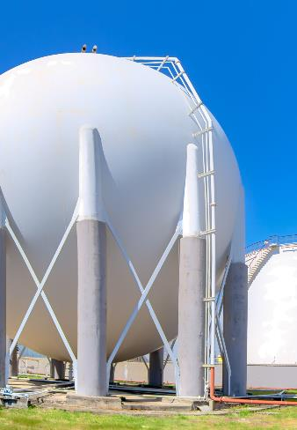
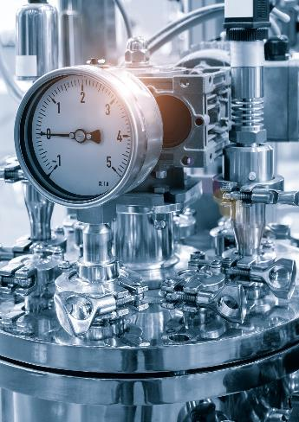
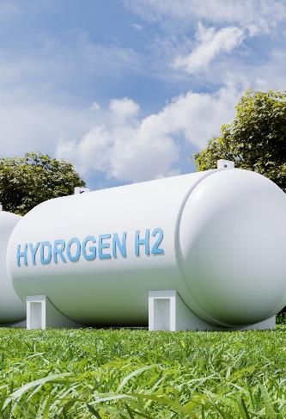
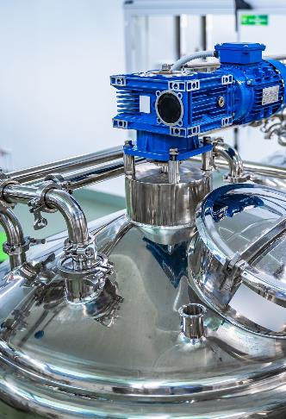
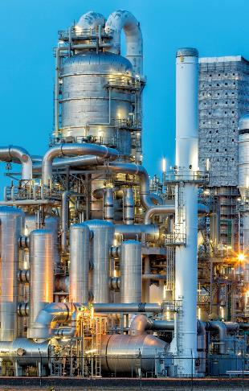
Hydrogen Failures Without Hydrogen
www.axiom-ltd.com
Conor Fraser
Materials Engineer
Notes:
Hello
Been at Axiom 5 years conducting failure investigations
Hydrogen failures are something we see pretty often
However, they are never from something on hydrogen duty, but from occur where the isn’t any hydrogen apparent at times.

Slide 2
Topics
Hydrogen Atoms
Sources of Hydrogen
Safe/Unsafe Materials
Low Temperature Hydrogen Damage Mechanisms
Case Studies
www.axiom-ltd.com
Notes:
Quick look at hydrogen atoms and molecules, then some sources of hydgrogen and safe/unsafe materials and a brief look at hydrogen damage mechanisms before diving into some case studies.

Slide 3
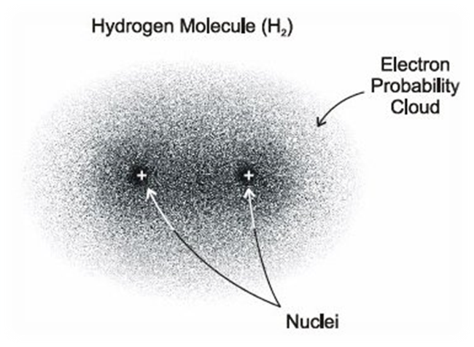
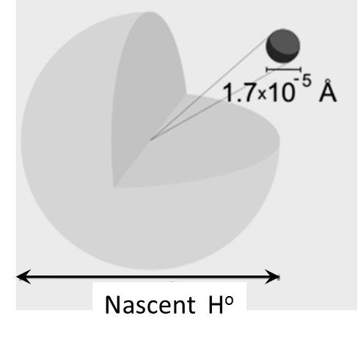
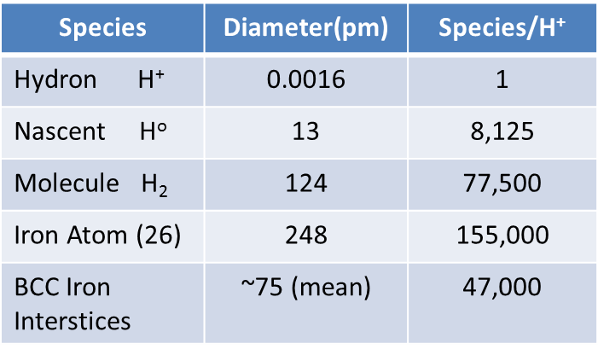
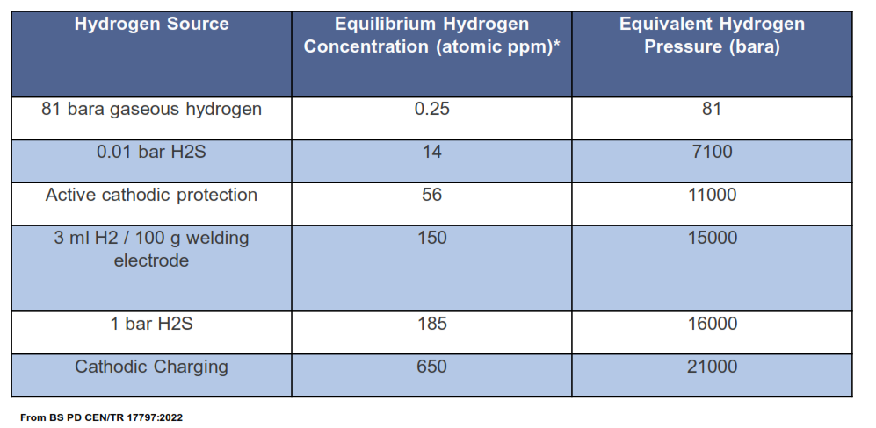
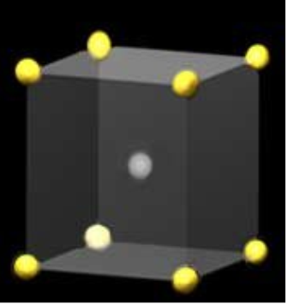
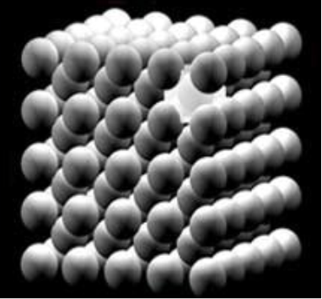
Hydrogen Atoms
(e⁻)
H⁰ can be accommodated in steel, H₂ gas cannot!
A pm is 1 trillionth of a metre (1/ 1,000,000,000,000 m)
Body Centred Cubic (BCC) Iron/ Steel
www.axiom-ltd.com
Notes:
Here, table shows relative size of Hydrogen atoms and molecules as well as BCC Iron interstices, the gap between iron atoms in their metallic crystal structure.
The space between iron atoms is this ~75pm, hydrogen molecule is too large to fit through this.
Atomic hydrogen is much smaller and so can enter the metal. This also means that if the hydrogen atoms recombine into a molecule in the material it cannot escape!
Build up of hydrogen atoms drives their diffusion into the metal and so the greater amount of atoms present, the more hydrogen will diffuse into the steel
This table shows the amount of atomic hydrogen present in different sources and their equivalent hydrogen pressure.
Not a lot in gaseous hydrogen but other sources have hundreds or thousands times more atomic hydrogen to drive diffusion.
Iron and in this case carbon steel, forms BCC structure which is seen below.
Metals and alloys are crystalline solids.
Metal solidifies the atoms begin to form into solid crystal structures, additional atoms then join onto these and cause them to grow forming grains.
This orderly arrangement of atoms is called a lattice. Different grains are where individual crystal structures meet.

Slide 4
Sources of Hydrogen in Steel
There is a proportion of atomic hydrogen in gaseous and liquid hydrogen
Residual hydrogen from manufacture
Aqueous Corrosion (Acidic corrosion is worse than alkaline corrosion)
Damp Welding rods
Acid cleaning prior to a plating or coating process
Cathodic protection - the current drives hydrogen into steel (bolt failures)
www.axiom-ltd.com
Notes:
While hydrogen gas and liquid does contain a small proportion of atomic hydrogen, the main sources of hydrogen damage come from elsewhere, the list below taken from API 571, states the most common sources of atomic hydrogen.
Corrosion – most aqueous corrosion mechanisms generate hydrogen as a byproduct
Welding – poorly stored or wet electrodes or electrodes with a high hydrogen content / high moisture content flux, can introduce hydrogen into the material
Acid cleaning or pickling prior to manufacturing process such as galvanising or plating
Residual hydrogen from manufacture.
Cathodic protection can charge materials with hydrogen.

Slide 5
How much Hydrogen?
Embrittlement of 1,860 MPa UTS steel (>600 Vickers) with hydrogen content of 0.5 ppm
(1 hydrogen atom per 40,000 metal atoms)
Substantial embrittlement of high strength steel with hydrogen contents of 2 to 3 ppm.
(less than exists in a low H welding electrode).
ASM - 122/Corrosion in the Petrochemical Industry.
High-strength martensitic steel,
UTS >1,400 MPa (370 Vickers). Susceptible to embrittlement with hydrogen levels of 0.5 to 1 ppm (wt.).
Steels with UTS >750MPa (230 Vickers) require ~10 ppm hydrogen for embrittlement to be significant.
SP Lynch. Hydrogen embrittlement
www.axiom-ltd.com
Notes:
Really don’t need a lot of hydrogen to cause damage, especially in high strength steels, these are considered to be >1000 Mpa UTS or 250 Vickers hardness
Above about 750-800 MPa is a bit of a grey area but embrittlement is still possible. Likely requires greater amounts of hydrogen.

Slide 6
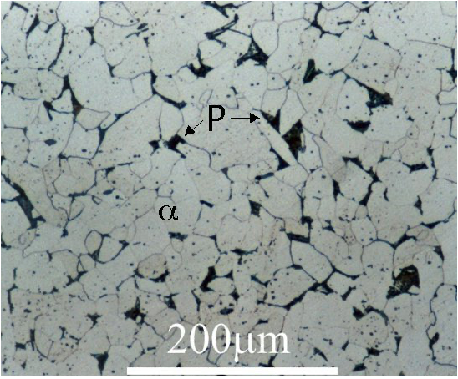
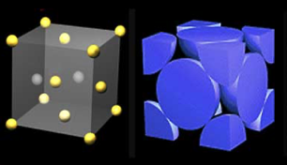
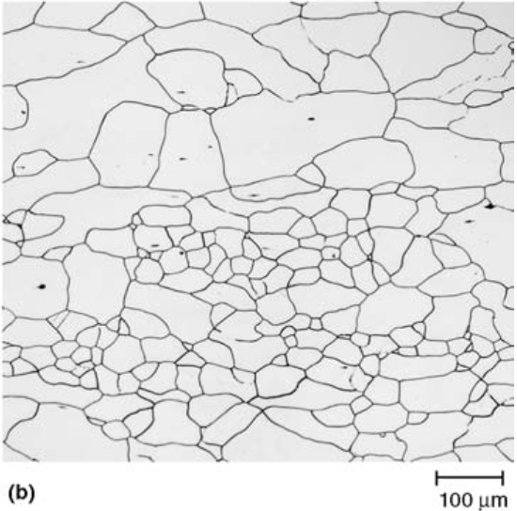
Safe / Unsafe Materials
Low strength / low carbon steels. Annealed austenitic stainless steel
Old ‘dirty’ low strength carbon steels
Medium strength low alloy steels (CrMo Steel, B7 bolts, 8.8 bolts)
Steels with pre-existing notch defects.
Zinc plated bolts 8.8 and above (800 to 1,000 MPa UTS is a grey area)
Ferritic stainless steels (5,7,9% Cr)
High Strength steels (< 1,000 MPa UTS e.g. 10.9 and 12.9 bolts)
Zinc Plated high strength bolts and chains
Other Problem areas
Cathodic protection causes charging of steel
Cold worked carbon steel and hard zones in welds
Cold worked 300 series stainless steels - turns austenite into martensite
Other Problem materials (Listed in ASME B31.12)
Cast iron.
Nickel, Nickel alloys, some copper alloys can embrittle if associated with corrosion.
Metals that form hydrides: often exotic, usually OK on hydrogen duty so long as the is no corrosion.
Safe
Unsafe
Fe
Fe Fe
Body Centred Cubic - Iron (32% empty)
Face Centred Cubic - SS (26% empty) More closely packed (Substitutional alloy)
BCC Carbon Steel
FCC 304L Stainless Steel
Fe Cr
Ni
www.axiom-ltd.com
Notes:
susceptibility to hydrogen embrittlement increases as strength increases
others experience specific damage mechanisms such as hydride formation or reaction with oxygen within the material which deems them unsuitable,
Materials generally considered suitable for hydrogen service are carbon steel, austenitic stainless steel, oxygen-free grades of copper alloys.
Carbon steel can suffer hydrogen embrittlement at welds or due to cold working if its hardness exceeds 240/250HV. Likewise austenitic stainless steels can embrittle if heavily cold worked.
SS is generally not affected by hydrogen due to its crystal structure. Iron is BCC and stainless steel is FCC
In order to cause ‘damage’ hydrogen (H⁰) has to be mobile within the atomic lattice.
BCC lattice has more space and also more trap sites (carbides & inclusions) where hydrogen can accumulate. These features also act as conduits for H⁰ migration. So, the mobility of hydrogen within BCC iron is far greater – which is a major factor.
FCC SS are a solid solution alloy, with very few inclusions or other precipitates (no traps). They exhibit high H⁰ solubility but slow diffusion rates. Cr oxide may be an effective barrier to H⁰ ingress.
Data for the use of aluminium alloys is limited but are thought to be resistant to embrittlement in dry hydrogen but not in hydrogen where moisture is present.

Slide 7
LT (MACRO) MECHANISMS DEFINED
Hydrogen Embrittlement (HE)
Degradation in mechanical properties, i.e. reduced ductility / reduced toughness,
increased notch sensitivity (KIC), increase in vulnerability to fatigue crack initiation / propagation.
Hydrogen Induced Cracking (HIC)
The development of internal / external macro and micro (mostly) transgranular cracks
Hydrogen Stress Cracking (HSC)
The development of internal / external macro and micro (mostly) intergranular cracks
Despite there being three distinct macro damage mechanisms, they are the result of certain underlying nano / atomic mechanisms, but manifesting differently at the macro level depending on the material microstructure
www.axiom-ltd.com
Notes:
Numerous abbreviations HSCm HIE, SOHIC, HIC, HE, HAC, HEAC but (probably) there are only three distinct macro-scale mechanisms HE, HSC, HIC
But! there are underlying nano-scale processes which cause these ‘macro’ manifestations . . HELP, HEDE, AIDE

Slide 8
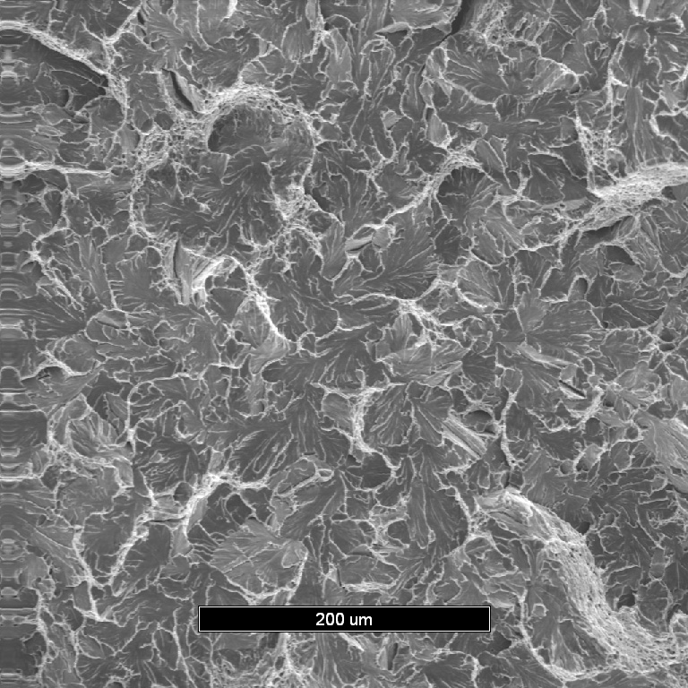
LOW TEMPERATURE MECHANISMS - EXAMPLES
Brittle quasi cleavage planes
Intergranular cracking
www.axiom-ltd.com
www.axiom-ltd.com

Slide 9
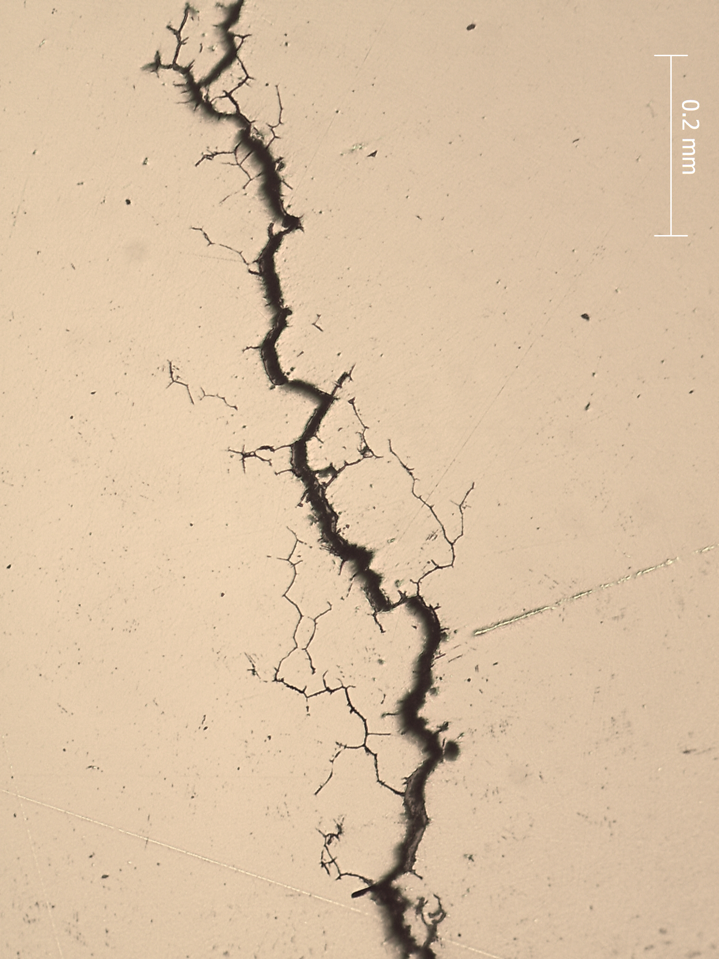
LOW TEMPERATURE MECHANISMS - EXAMPLES
Hydrogen Induced Cracking
Hydrogen Stress Cracking
Sub-surface micro cracks in a 4 mm grade 8 chain link
Intergranular cracks in a grade 12.9 Allen bolt (sour duty)
www.axiom-ltd.com

Slide 10
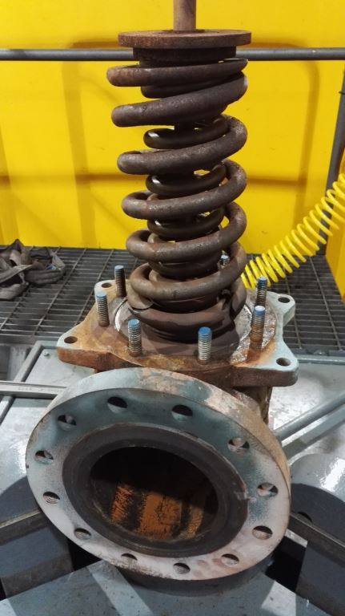
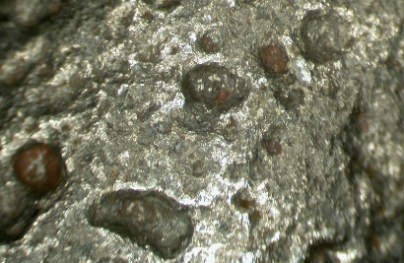
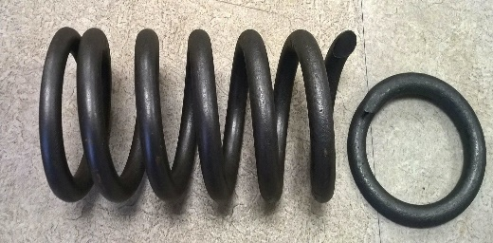
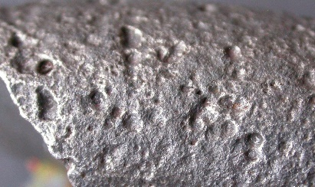
Case Study – PSV Spring
www.axiom-ltd.com
Notes:
failure of a spring from a HP steam export safety valve from a HRSG which was found to be cracked in two locations during routine scheduled overhaul.
The valve had been in operation for approximately 8 years.
Material cert states high strength steel with a tempered martensite structure.
The failed spring is showed in-situ
Then removed and cleaned of rust
The outer surfaces of the spring were quite heavily pitted for an RV spring with a level of damage that was inconsistent with the light flash rusting and only affected the lower half the coil.

Slide 11
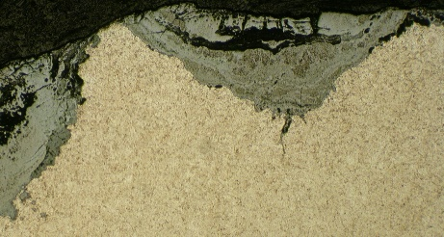
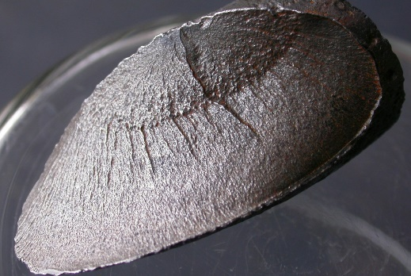
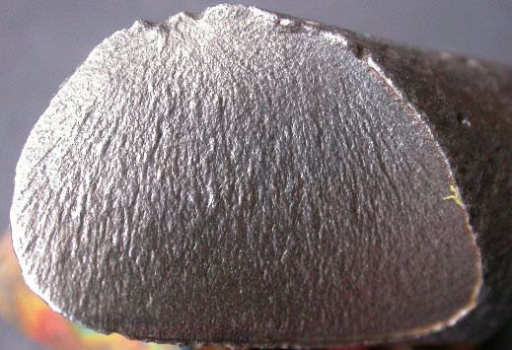
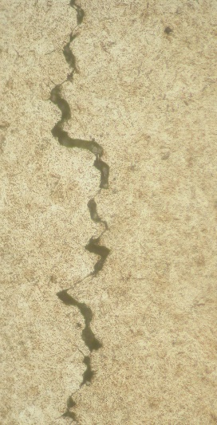
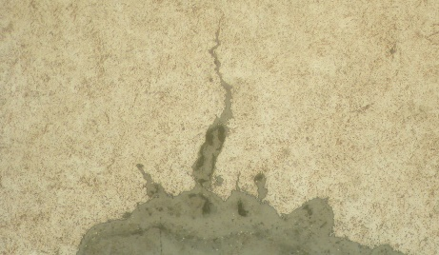
Case Study – PSV Spring
(i)
(ii)
www.axiom-ltd.com
Notes:
It was evident by visual examination that FS ‘B’ failed in a single event,
FS ‘A’ bore the hallmarks of a multi-stage failure. aving a distinct beach mark at approximately one third wall thickness.
Both fractures initiated at the OD and were coincident with a region of deep pitting corrosion
Fractographic SEM examination was unfeasible due to deformation ,smearing, corrosion pits, due to contact between the mating faces.
secondary crack below the main fracture surface. step-wise are characteristic of hydrogen cracking.
external corrosion pits, harboured acute oxide penetrations, one developed into a crack.
microstructure in the quenched and tempered condition (tempered martensite)
520 Vickers, higher than the threshold value, together with high operating stresses would result in the spring being extremely vulnerable to hydrogen related failure if exposed to a suitably unfavourable environment
pitting inconsistent with current operational regime with the spring being enclosed and operating over 100°C and so would not be anticipated to corrode, meaning the spring shroud is probably un-lagged / exposed and operates cooler.
experienced aggressive aqueous corrosion which has brought about hydrogen diffusion into the steel over the longer term, leading to failure by hydrogen embrittlement.
The oxide intrusions at root of corrosion pits also suggests an element of fatigue cracking, however this too would have been exacerbated by hydrogen adsorption.

Slide 12
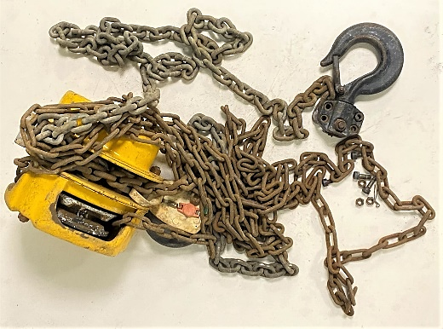
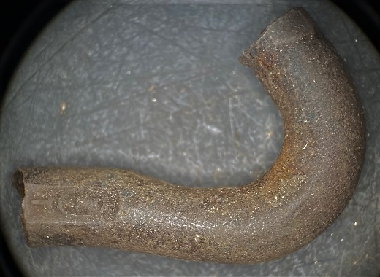
Case Study – 1 Tonne Lifting Block
www.axiom-ltd.com
Notes:
failure of a 1 tonne lifting block on a UK chemical site. Grade 8 chain.
being used to support a vessel that was being filled with process material as part of cleaning works. T
he material being cleared from the vessel was reported to have been falling onto the lifting hook in question. T
he process material would have been reacting with moisture in the air to create hydrochloric acid fumes for several hours.
The lifting chain had been inspected recently also pre-use checked as per LOLER requirements.
failed at the link directly attached to the hook and situated within the hook housing,
staining due to corrosion was observed on the hook and was greatest on the links adjacent to the hook
half of the failed chain link heavily corroded.
no necking associated with the fractures, suggesting that failure was due to a brittle cracking mechanism.

Slide 13
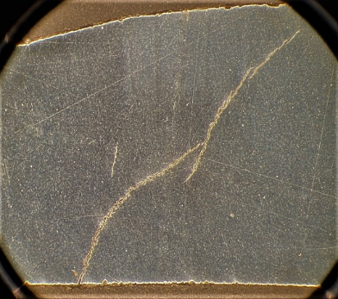
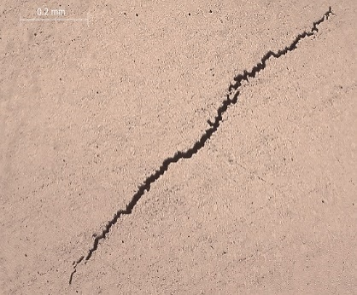
Case Study – 1 Tonne Lifting Block
www.axiom-ltd.com
Notes:
chain contained numerous randomly oriented, stepwise cracks, some of which were entirely subsurface and with others emanating from surface corrosion pitting
The defects were considered to be text-book examples of hydrogen induced cracking.
hardness values of over 400 HV10 which approximates to an UTS of 1314 MPa which is in range or a grade 8 chain.
As described in HSE Document PM 39, due to the potential for hydrogen damage, it is not recommended that grade 8 lifting chains be used in an acidic (corrosive) environment.
Failure occurred due to hydrogen induced cracking in the link directly attached to the hook,
no other lifting links in the same vicinity were affected.
This ‘confined space’ would promote entrapment of any corroding species, thus exacerbating the potential for corrosion of the bottom link.
The hydrogen / cracks were deemed to not be present from manufacture as only the one link failed. If due to manufacturing, for example, from acid cleaning multiple links would be similarly affected.

Slide 14
Summary
The majority of hydrogen related failures do not occur on hydrogen duty, particularly when equipment has been designed for hydrogen service
Failures arise from the introduction of atomic hydrogen to a susceptible material where hydrogen damage mechanisms may not be anticipated
There are numerous sources of atomic hydrogen for engineering components, most common of them are corrosion and welding rods
Molecular hydrogen is too large to enter the material while atomic hydrogen is small enough to pass through the interstitial spaces of metallic crystals
Once hydrogen has entered the material, however, the underlying theoretical mechanisms are not fully understood.
www.axiom-ltd.com
www.axiom-ltd.com

