Slide 1

Understanding Industrial Cyber Risks to Biosafety
Phishing for Biohazards
Hazards 33, November 2023
Presented by Gavin Oldroyd, Principal Consultant at ERM
Notes:
Today I am going to talk to you about the fast changing topic of cybersecurity within industrial control systems. The title is phishing for biohazards because I will be using a case study risk assessment which we performed for a client within the biopharmaceuticals sector.
Although I’m focusing on biopharma, the process I’m going to discuss is equally relevant to the wider process industry.
If you find this useful and would like to know more, please come and find me at the conference, and take a look at the technical paper which accompanies this presentation.

Slide 2
Agenda
Introduction
Context of Cybersecurity within Biosafety
Recent Cyber Attacks with Potential Biosafety Consequences
The benefits of Cybersecurity Risk Assessment
Case Study

Slide 3
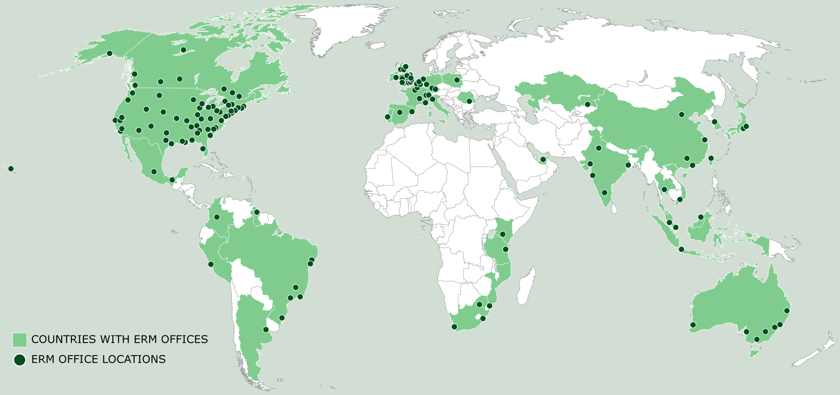
Introduction
ERM Overview
8000+ Professionals |  | 40 Countries & territories |  | Technical Safety 40 world class consultants in the UK
150+ Offices |  | 50+ Years of experience |  | #1 Sustainability service provider – HFS 2022
ABOUT ME
Principal Consultant at ERM, based in Edinburgh
10 years' experience in the UK Petrochemical Industry as an Instrumentation, Control, Electrical Engineer
Specialist in compliance & assurance activities including Functional Safety, DSEAR & Cyber Security
Certified Global Industrial Cyber Security Professional (GICSP) through the SANS Institute
Working with multiple clients operating containment level 3 and 4 facilities under SAPO, to meet regulatory expectations.
    Development of Cybersecurity Management Systems
    Cybersecurity Risk Assessments
    Training Delivery
We partner with… |  | 70% of Fortune 100 |  | 55% of Fortune 500
3

Slide 4
ERM Cyber Security Capabilities
Providing Cyber Security Support throughout the lifecycle for OT systems
1
2
3
4
5
Concept
Development
Front-end Engineering (FEED) & Detailed Design
Engineering, Procurement & Construction
Operations & Maintenance (O&M)
Modification / Decommissioning
Cyber Security Planning
Initial Cyber Security Risk assessments
Initial Cyber Security Requirements Specification
Cyber Security Management Gap Analysis & Development
Cyber Security Risk Assessment
Cyber Security Requirements Specification
Security Validation activities
Cyber Security Management System
Security Maturity Level Assessment
Cyber Security Training
Cyber Risk Assessment for Modification

Slide 5
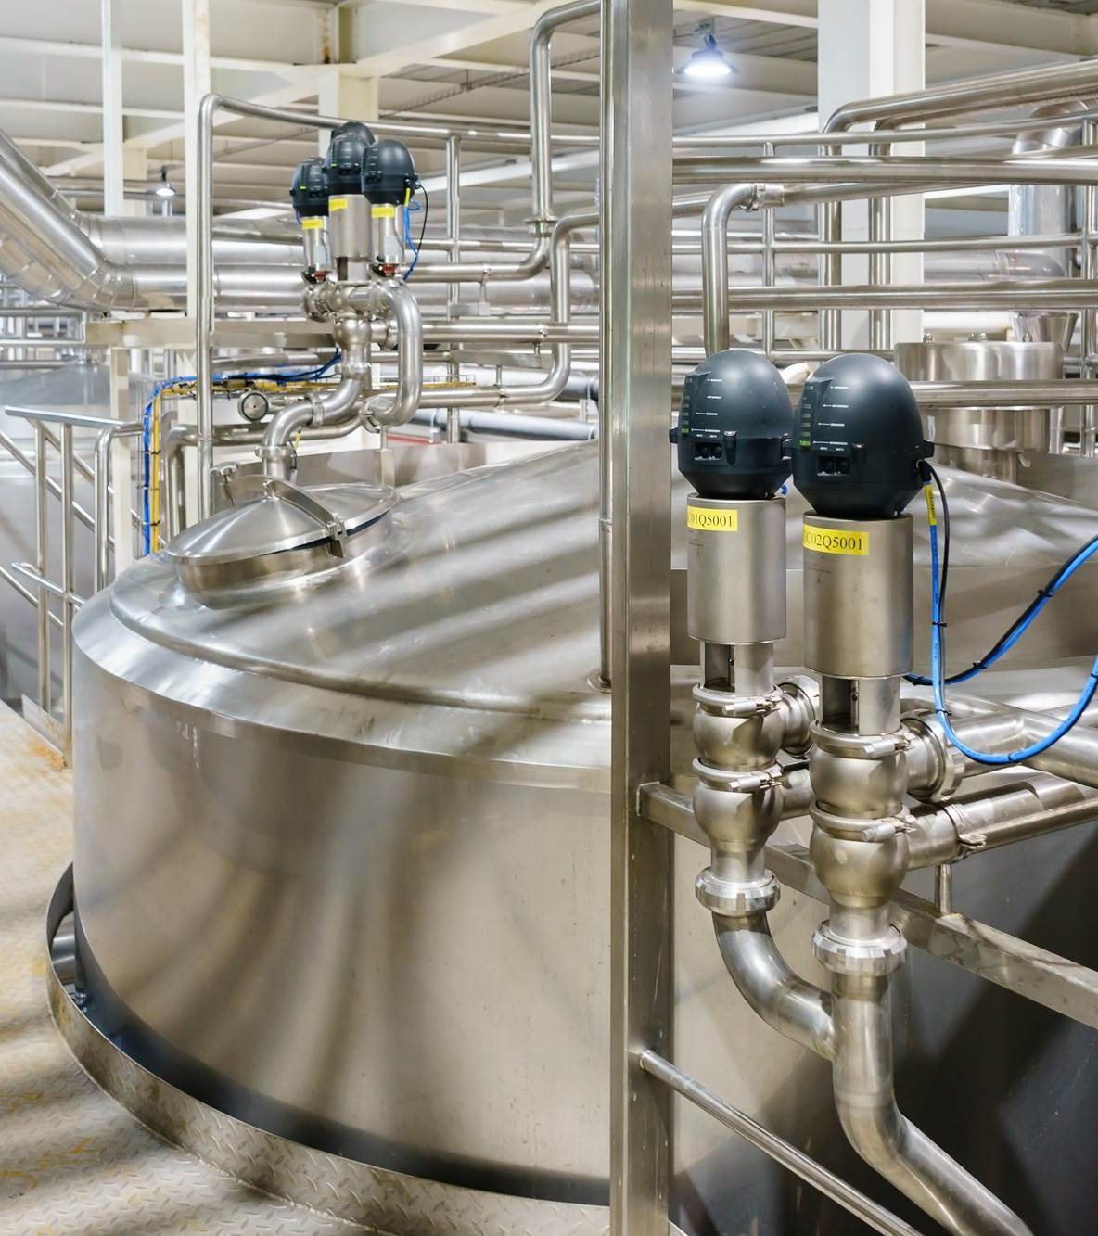
Context
Cybersecurity within Biosafety

Slide 6
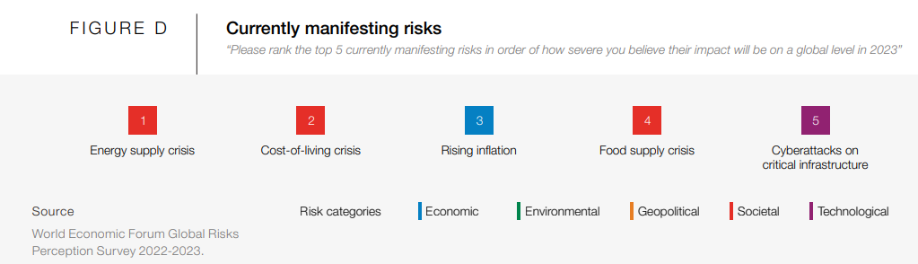

Industrial Control System (ICS) Cybersecurity
Cybercrime is a growing threat globally
    Cyberattacks on critical infrastructure is ranked as the 5th most severe currently manifesting risk in 2023
    The WEF attribute this perception of risk to high profile attacks against Ukrainian institutions in 2022.
    Hostile actors can use malicious software to disrupt and damage cyber infrastructure. This can range from taking a website offline to manipulating laboratory, process or energy control systems.
Notes:
It is well publicised that cybercrime is a growing threat globally. According to the World Economic Forum Global Risks Report 2023 [1], cyberattacks on critical infrastructure is ranked as the 5th most severe currently manifesting risk in 2023, behind Energy Supply, Living Costs, Inflation, and Food Supply.
A wide range of hostile actors include foreign states, criminals, and “hacktivist" groups. Foreign states are generally equipped to conduct the most damaging cyber espionage and computer network attacks. Hostile actors can use malicious software (or malware) to disrupt and damage cyber infrastructure. This can range from taking a website offline to manipulating laboratory or process control systems.

Slide 7
Biosafety & Biosecurity
ICS Cybersecurity is relevant to both
BIOSAFETY
Prevention of unintentional or accidental release of specified biological agents and toxins
BIOSECURITY
Prevention of intentional or negligent release of biological materials
Acquisition of knowledge, tools, or techniques that could be used to cause harm.
Unintentional
Failure of ICS components due to obsolescence, insufficient MoC, systematic failures in maintenance.
Intentional
Exploitation of vulnerabilities by an internal or external attacker.
Notes:
Biosafety provides policies and practices to prevent the unintentional or accidental release of specific biological agents and toxins, whereas biosecurity provides policies and practices to prevent the intentional or negligent release of biological materials or the acquisition of knowledge, tools, or techniques that could be used to cause harm.
Within BIOSAFETY, we can attribute the types of ICS failures which would normally be captured within hazard analysis techniques such as or Control HAZOP (CHAZOP).
Obsolescence leading to reliability or compatibility issues. An example could be a SCADA system running on an unsupported windows OS which has a higher likelihood of failure.
Improper MoC leading to unrevealed failures in the ICS including the network. i.e., replacement of a network switch or firewall which disrupts critical traffic.
Systematic failures such as causing a control system to fail during routine maintenance or network management activities. i.e., proactive network monitoring which may disrupt network traffic.
Within BIOSECURITY lies the intentional attack aspect of cybersecurity
Phishing leading to theft of ICS data
Weak logical access leading to external attacker gaining access to an open network port
Disgruntled employee making changes to recipes or set points.

Slide 8
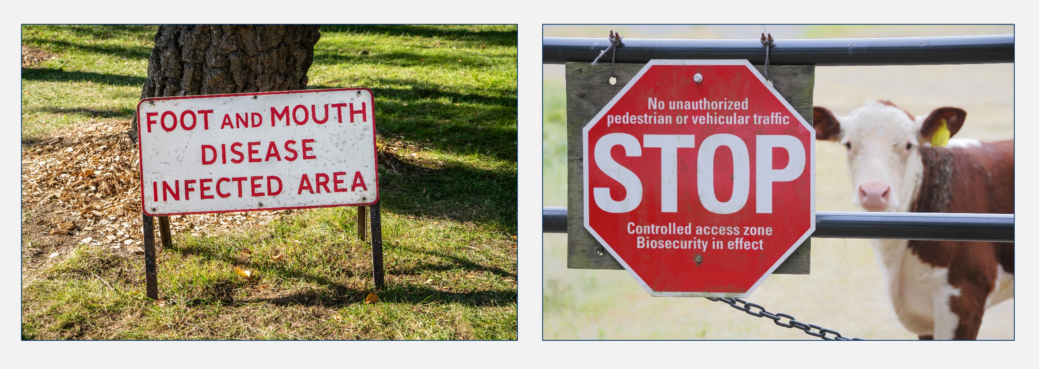
Potential Consequences
Foot and mouth disease outbreak from research laboratories, UK, August 2007

Slide 9
Recent Attacks
Cybersecurity within Biosafety

Slide 10







NotPetya (2017)
Suspected state sponsored attack from Russia targeting Ukraine.
Ransomware attack, encrypted the target computers’ hard drives and demanded ransom in bitcoin.
Spread via the ‘MeDoc’ tax accounting software used in Ukrainian businesses, using an exploit called ‘EternalBlue’ which may have been developed by the United States National Security Agency.
Infected the global networks of the multinational organisations with offices in Ukraine using ‘MeDoc’
Merck’s operations were disabled for two weeks, with 30,000 computers disabled by the attack and $870 Million financial impact due to the inability to continue manufacturing pharmaceuticals.
Notes:
NotPetya is widely attributed as a state sponsored attack from the Russian targeting Ukraine [3]. As a ransomware attack it encrypted the target computers’ hard drives and demanded ransom in bitcoin. It was spread via a centralised update to the ‘MeDoc’ tax accounting software used in Ukrainian businesses and used a specialist exploit called ‘EternalBlue’ which may have been developed by the United States National Security Agency [4].
NotPetya infected the global networks of the multinational organisations with offices in Ukraine using ‘MeDoc’ which included Merck. Merck’s operations were disabled for two weeks, with 30,000 computers disabled by the attack and $870 Million financial impact due to the inability to continue manufacturing pharmaceuticals [4].
Although no safety or biosafety consequences were directly attributed to the attack, this example shows the far-reaching consequences an attack of this type can have, with impact on both IT and OT systems.
[3] U. G. National Cyber Security Centre (NCSC), “News Article - Russian military 'almost certainly' responisble for destructive 2017 cyber attack,” 14 February 2018. [Online]. Available: https://www.ncsc.gov.uk/news/russian-military-almost-certainly-responsible-destructive-2017-cyber-attack. [Accessed 04 October 2023].
[4] A. Greenberg, “The Untold Story of NotPetya, the Most Devastating Cyberattack in History,” Wired, 22 August 2018. [Online]. Available: https://www.wired.com/story/notpetya-cyberattack-ukraine-russia-code-crashed-the-world/. [Accessed 18 August 2023].

Slide 11







Dragonfly (2014)
Spear phishing campaign targeting pharmaceutical companies < 50 employees
Collected data from outlook address books and local software files about their ICS suppliers which would enable more significant attacks in future.
Malware was deployed in three different ways
      Spear phishing – Senior employees were researched and targeted with malicious PDF attachments.
      Watering hole attack – Websites commonly visited by pharmaceutical employees were compromised to download the malware automatically.
      ICS vendors websites hosting software downloads were compromised. The download file was modified to include the malware.
Notes:
Dragonfly is a cyber espionage group attributed to Russia’s Federal Security Service (FSB) [5]. Dragonfly used a spear phishing campaign to target multiple pharmaceutical companies which employed under 50 employees, with a view to collecting data which would enable more significant attacks in future. Following the initial attack, Dragonfly collected data from outlook address books and local software files about the suppliers of these small Pharmaceutical companies to confirm which proprietary software was in use on their control systems.
Two different types of malware were installed on target computers, one being a remote access tool, and the other a trojan which allowed files to be uploaded and downloaded remotely. Importantly the Dragonfly attack demonstrates that there are multiple pathways to compromise a control system as three different attack vectors were used.
Spear phishing – Senior employees were researched and targeted with malicious PDF attachments which contained the malware.
Watering hole attack – Websites commonly visited by pharmaceutical employees were compromised to download the malware automatically.
ICS Vendor software – It was discovered that three ICS vendors websites hosting software downloads were compromised. The download file was modified to include the malware.
The impact of the Dragonfly attack was limited to data theft, including ICS software files detailing proprietary recipes, production batch sequences, volumes, and records. With this information a more targeted attack to modify and disrupt control sequences would be possible, which could result in real safety or biosafety consequences.

Slide 12



Israel Water Treatment Attack (2020)
Twice in 2020, five different Israeli Water Authority treatment facilities were compromised.
Intention was to introduce dangerous concentrations of Chlorine in the public water supplies.
The vulnerability was a Human Machine Interface (HMI) on the ICS network which was connected directly to the Internet and accessible without any authentication.
% Cl
Notes:
In April 2020, and again in June 2020, the industrial control systems of five different Israeli Water Authority treatment facilities were compromised with the intent of introducing dangerous concentrations of Chlorine in the public water supplies. In this instance the vulnerability was a Human Machine Interface (HMI) on the ICS network which was connected directly to the Internet and accessible without any authentication. Once the attackers gained access to the HMI they had full remote control, allowing them to modify water pressure, temperature, and dosing set-points.
Fortunately, the changes made to the system were highlighted and rectified, however the consequences could have been severe. Once again, this is thought to be a nation state attack, this time attributed to Iran.

Slide 13
ICS Security vs IT Security
Control and safety systems within biopharmaceuticals bring specific challenges associated with cybersecurity.
    Control system technology is designed for reliable operation using vendor specific equipment, software, and communications.
    Many older control systems are now interlinked with modern IT systems for ease of access and data transfer.
    Control system networks require different management processes to maintain security and integrity. This is well understood within traditional ‘high hazard’ industries, but less so when the consequence is biosafety.
Given the potential consequences of a cyber-attack on critical infrastructure, or high hazard industries, recognised best practice is to conduct a focussed risk assessment to identify vulnerabilities within the network or hardware, assess the consequences of a breach, and assign mitigations. This is specified within the ‘Identify’ phase of the United States National Institute of Standards and Technology (NIST) Cyber Security Framework (CSF) [7] which applies equally to IT and ICS environments.
    IT systems are routinely upgraded to keep up with technology and manage obsolescence.
    ICS systems are expected to last 15-20 years, in an environment with strict management of change processes.
Notes:
As demonstrated by the three real incidents explored in this paper, cyber attacks can occur through a wide varied of attack vectors and vulnerabilities. Most organisations understand the potential worst-case consequences of a control system failure via the established methods of process risk assessment, however few organisations understand how a cyber security breach may result in that failure.
The control and safety systems within biopharmaceuticals bring specific challenges associated with cyber security. Many older control systems are now interlinked with modern IT systems to provide the functionality we now expect such as remote access capability for maintenance, or access to process data within the corporate network, however control systems require very different management processes to maintain their security and integrity.
Control system technology is designed for continuous and reliable operation using vendor specific equipment, software and communications, which differs from the IT realm using Windows or Linux based systems which come with ‘out of the box’ security solutions.
Another key difference is asset lifecycle. A typical enterprise IT system will be upgraded every few years to keep up with emerging technologies and an ever-changing threat landscape, whereas the lifecycle of ICS equipment is by comparison far longer. Control systems are subject to the same management of change processes as operational plant, with a control system upgrade being significant undertaking which may occur once in a 30-year asset lifecycle. As a result, security vulnerabilities take far longer to rectify in ICS, if they are identified at all.

Slide 14

Risk Assessment
Cybersecurity within Biosafety

Slide 15
Introduction to Cybersecurity Risk Assessment
Given the potential consequences of an attack on critical infrastructure, or high hazard industries, a cybersecurity risk assessment is considered recognised best practice.
      Identify vulnerabilities within the network or hardware.
      Assess the potential consequences of a break (and optionally, likelihood)
      Assign mitigations
      Address gaps
  Challenges
Industry and regulators have not yet settled on a standard ‘best practice’ format or methodology such as HAZOP has become in process hazard assessment.
What is the right level of detail? Simple to identify assets, however there are multiple threat scenarios for each asset.
Likelihood depends greatly on the attacker’s resources and motivation; in many cases it is easier to ignore likelihood.
Notes:
Given the potential consequences of a cyber attack on critical infrastructure, or high hazard industries, recognised best practice is to conduct a focussed risk assessment to identify vulnerabilities within the network or hardware, assess the consequences of a breach, and assign mitigations.
Although it is recognised that a risk assessment is required, industry has not yet settled on a standard format or methodology such as the recognised hazard studies 1 through to 6 which have become the standard in the process industry. Another challenge in completing a successful assessment is achieving the right level of detail. It is simple to identify the assets which may be compromised and the potential worst-case consequences, but much more challenging to assign a likelihood to threats as this depends greatly on an attacker’s motivation, experience, and resources. In many cases likelihood is best ignored which means quantitative or semi-quantitative risk assessments are not practical.

Slide 16
Risk Assessment & Regulatory Expectations
Specified within the ‘Identify’ phase of the United States National Institute of Standards and Technology (NIST) Cyber Security Framework (CSF), which applies equally to IT and ICS.
Within the UK, Cyber Security is now a key topic within the E,C&I delivery guide under Control of Major Accident Hazards (COMAH).
The HSE have made it clear within operational guidance OG-0086 that this requirement applies equally to operational license holders under the Specified Animals Pathogens Order (SAPO), meaning that the Biosafety sector is held to the same standard as operators under COMAH.
Notes:
Given the potential consequences of a cyber attack on critical infrastructure, or high hazard industries, recognised best practice is to conduct a focussed risk assessment to identify vulnerabilities within the network or hardware, assess the consequences of a breach, and assign mitigations. This is specified within the ‘Identify’ phase of the United States National Institute of Standards and Technology (NIST) Cyber Security Framework (CSF) [7] which applies equally to IT and ICS environments.
In the UK, the Health and Safety Executive (HSE) has updated their expectations under the Control of Major Accident Hazards (COMAH) Regulations to include cyber security as a key topic. The HSE expectations are closely aligned with the Cyber Assessment Framework (CAF) published by the National Cyber Security Centre (NCSC), which includes the requirement to complete a specific risk assessment to identify security vulnerabilities within the ICS.
The HSE have made it clear within operational guidance OG-0086 [8] that this requirement applies equally to operational license holders under the Specified Animals Pathogens Order (SAPO), meaning that the Biosafety sector is now held to the same standard as operators under COMAH.
Although it is recognised that a risk assessment is required, industry has not yet settled on a standard format or methodology such as the recognised hazard studies 1 through to 6 which have become the standard in the process industry. Another challenge in completing a successful assessment is achieving the right level of detail. It is simple to identify the assets which may be compromised and the potential worst-case consequences, but much more challenging to assign a likelihood to threats as this depends greatly on an attacker’s motivation, experience, and resources. In many cases likelihood is best ignored which means quantitative or semi-quantitative risk assessments are not practical.

Slide 17

Case Study
Cybersecurity within Biosafety

Slide 18
Case Study Background
In 2022 ERM supported a client in the UK by developing an Industrial Cyber Security Management System (CSMS) and completing Cyber Security Risk Assessments on its operational facilities.
Facility handles SAPO Containment Level 4 pathogens.
Required to meet an action from the HSE following a cyber intervention under the SAPO regulations.
Control systems found at the facility were varied but with minimal interconnection between labs, plant rooms and processes.
IT network support centralised outside of the UK, with no awareness of the ICS assets.
Notes:
In 2022 ERM supported a client in the UK by developing an Industrial Cyber Security Management System (CSMS) and completing Cyber Security Risk Assessments on its operational facilities, which was required to meet regulatory expectations from the UK HSE.
The client operates a facility handling SAPO level 4 pathogens, requiring the highest level of containment. The control systems present were varied, and distributed throughout labs, processing areas and plant rooms with minimal interconnection. Prior to the regulator turning attention to cyber security the operator had minimal resources dedicated to the maintenance and operation of its control systems, and IT/ICS network support was centralised outside of the UK.

Slide 19
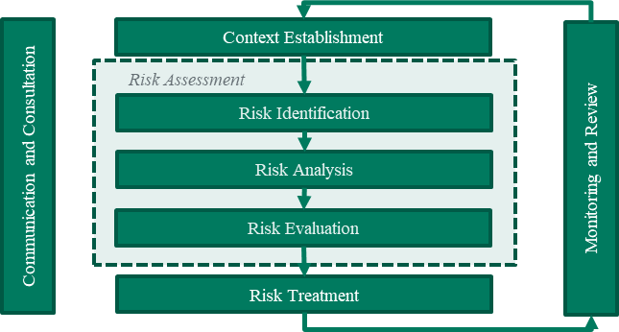
Risk Management Framework
Within the CSMS, we defined a risk management policy aligned with IEC 27005 Risk Management Framework (below)
Notes:
Our methodology in defining a cyber risk management policy was aligned with the IEC 27005 Risk Management Framework as shown in Figure 1, and the expectations laid out within OG-0086.

Slide 20
Context Establishment
The following steps were taken to establish the context:
A corporate policy was drafted to include the overall risk management framework and responsibilities, with reference to existing policies and procedures.
Operational areas and systems with associated safety and biosafety risks were identified by referring to existing process hazard risk assessments.
Site surveys were completed to identify control systems and assets, resulting in detailed asset registers.
Simplified network diagrams were prepared to define the control system boundaries for each operational area based on the Purdue reference model , which separates assets into 5 layers based on their function and ability to influence the equipment under control.
Notes:
The first stage of the risk management framework is context establishment, which is the process of defining and documenting the organisation’s mission, purpose, goals and priorities. Context establishment involves identifying the critical areas of the business, in terms of regulatory compliance, protection of people and the environment, and business continuity.
A further part of context establishment is defining the organisation’s risk appetite, which in this case was simply achieved by referencing the existing corporate risk matrix and tolerability criteria to closely align with process and functional safety risk management policy.
The following high-level steps were taken to establish the context:
A corporate policy was drafted to include the overall risk management framework and responsibilities, with reference to existing policies and procedures.
Operational areas and systems with associated safety and biosafety risks were identified by referring to existing process hazard risk assessments.
Site surveys were completed to identify control systems and assets, resulting in detailed asset registers.
Simplified network diagrams were prepared to define the control system boundaries for each operational area based on the Purdue reference model [9, 5], which separates assets into 5 layers based on their function and ability to influence the equipment under control.
The result was a corporate policy stating the organisation’s position and strategy to understand and minimise their exposure to threats, defining how the risk framework is controlled and directed, and which specific processes and control systems fall under the framework.

Slide 21
Context Establishment
External Zone
Purdue Reference Model
HAZOPS are broken into nodes
Cyber Risk Assessment used similar approach
  Zones rather than nodes
    BPCS Zone
    SIS Zone
    Management zone
    External zone (corporate/3rd party)
  Some assets move between zones
BPCS Zone
SIS Zone
Notes:
Purdue reference architecture was developed for ICS networks by a public & private consortium and Purdue University.
It suggests dividing ICS systems into five levels (0-4), based on risk and the influence of assets on the equipment under control.
Level 0 is the lowest level, representing the sensors and field devices in direct contact with the process.
Level 0 is grouped into distinct processes, manufacturing lines, skids.
Level 1 contains the controllers for that groupings processes, PLCs, DCS controllers or hard wired controllers.
SIS, F&G, condition monitoring will of course have separated levels 1 & 0, which is what is referred to as ‘zones’, i.e., BPCS zone, SIS zone.
Level 2 contains local supervisory systems directing each of the process groupings, this is the HMI and engineering workstations.
Level 3 is then the ICS management level of the network which contains systems which support operation but are not necessary for real time execution. Typically, historians, event logging, active directory.
Level 4 is the local business unit network, the office LAN.
Level 5 may also be included which includes the enterprise network for larger operators.
Also shown are assets which may move between levels and trust zones such as portable devices and vendor laptops.

Slide 22
Risk Assessment Methodology
RISK IDENTIFICATION
Risk identification focusses on all ‘inputs’ to the system, whether these are at the boundary between the control system and the IT network, a sensor in the field, or an operator workstation.
In this case study, a total of eight one-day workshops took place, one per process area containing SAPO risk.
A brainstorming workshop was used, following a set of targeted guidewords, with the result not unlike a HAZOP worksheet.
      Unauthorised access (employee)
      Unauthorised access (3rd party)
      Misconfiguration
      Denial of Service
      Malware
      Patching
      Social Engineering
Notes:
Having established the context and defined the scope of the control systems, the next step was to identify risks. Risk identification focusses on all ‘inputs’ to the system, whether these are at the boundary between the control system and the IT network, a sensor in the field, or an operator workstation.
The methodology we selected to identify risks was a group brainstorming exercise using a multi-disciplinary team with knowledge of operations, process risk, the control system, and the communications network. The result is a worksheet similar to Hazard Identification (HAZID) or Hazard and Operability Study (HAZOP).
Workshops were held focussing one operational area at a time, using the simplified network diagram as a basis. The team methodically discussed each asset in turn and brainstormed potential vulnerabilities relevant to the asset using guidewords. The guidewords included:
Unauthorised access (employee)
Unauthorised access (3rd party)
Misconfiguration
Denial of Service
Malware
Patching
Social Engineering

Slide 23
Risk Assessment Methodology
RISK ANALYSIS
For each asset / guideword pairing, the team discussed
The potential impact this may have on the asset
The worst-case consequence in terms of personnel safety, biosecurity and commercial impact.
Each vulnerability was assigned a consequence rating using the agreed risk matrix, ignoring all existing countermeasures.
Existing countermeasures were then discussed, along with their effectiveness, e.g.,
Threat | Relevant Countermeasures (example only)
Unauthorised access (employee) | Unique credentials via active directory, Strong password rules, Multi-factor authentication, Defined access levels based on role, subject to periodic review, Physical access control via swipe card, subject to approval by area supervisors, Employee DBS checks, Remote access connections are established only as required and terminated when not in use;
Notes:
For each asset / guideword pairing, the team discussed the potential impact this may have on the asset, and in turn the worst-case consequence in terms of personnel safety, biosecurity and commercial. Each vulnerability was assigned a consequence rating using the agreed risk matrix, ignoring all existing countermeasures. Existing countermeasures were then discussed, along with their effectiveness.
Likelihood was assessed at a very high level, based on the existence of suitable countermeasures, and the status of the asset. For example, if it was raised during the workshop that an HMI was running an obsolete operating system and not subject to regular security patches, a higher likelihood of malware infection was assigned. Similarly, an unsecured 3rd party connection was assigned a higher likelihood due to the lack of countermeasures.
An example of typical countermeasures which were identified against each threat type is provided in Table 1, note that depending on the scenario, process countermeasures such as secondary containment, hard wired safety relays, incident response and decontamination may also be relevant.

Slide 24
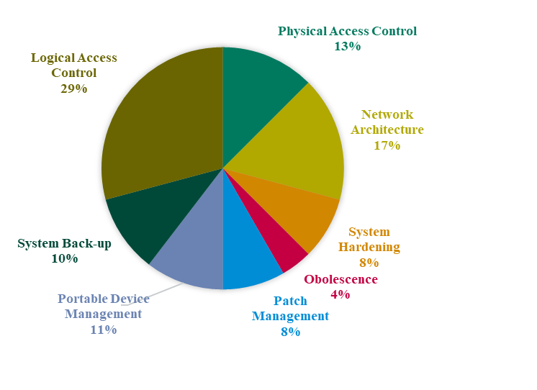
Risk Assessment Findings
Overall Findings
Vulnerabilities within the ICS were identified which could lead to high consequence releases to the environment.
Processes in question were much less reliant on automation for overall safety than Process Industry.
Heat treatment plants present the most obvious pathway to a release.
Recommendations were raised to address
Additional countermeasures required to meet HSE guidance.
Deficiencies in existing countermeasures
Other opportunities to reduce risk
Summary of Recommendations Raised
Notes:
The risk assessments conducted as part of this case study concluded that multiple vulnerabilities existed within control systems which could result in high consequence events, including loss of containment and release of pathogens into the environment.
It should also be noted that that the processes in question were less reliant overall on automation to avoid environmental incidents, and therefore several robust human factors and incident response countermeasures were recorded. Things like showering in and out of secure areas, use of autoclaves, personnel quarantine periods.
Heat treatment plants present the most obvious pathway to a release.
All recommendations have been categorised and summarised in to highlight the most significant risk factors which were observed.

Slide 25
Risk Assessment Findings
Key Issues
Logical Access Control
  Weaknesses were identified in passwords management and control of access levels. The minimum access should always be provided to individuals based on their responsibilities and competence.
System Architecture
  Control network equipment (servers, switches) was found to be shared with the office IT network. Recommendations were raised to segregate IT and ICS assets, create an enforcement boundary, and move the management platforms for any boundary assets into the ICS zone.
Patch Management
  Patching is a common challenge in industrial systems and refers to the software updates released by manufacturers. It was discovered that the IT organisation ‘own’ the patching process but were not aware of many of the ICS assets. This resulted in assets being more vulnerable to malware.
Notes:
Logical Access Control
Weaknesses were identified in passwords management and control of access levels. The minimum access should always be provided to individuals based on their responsibilities and competence.
System Architecture
Control network equipment (servers, switches) was found to be shared with the office IT network. Malware infection from e-mail and web browsers could easily spread unnoticed to the control network. Access could also be gained through building WiFi. This also makes response to a cyber-attack more difficult. Recommendations were raised to segregate IT and ICS asserts, create an enforcement boundary, and move the management platforms for any boundary assets into the ICS zone.
Patch Management
Patching is a common challenge in industrial systems and refers to the software updates released by manufacturers. It was discovered that the IT organisation ‘own’ the patching process but were not

Slide 26
Conclusions
Globally the threat landscape relating to cybersecurity is continually changing.
Industrial control systems are also vulnerable to attack, with different priorities and management needs vs traditional IT systems
Within biosafety, risk assessment is now an expectation under SAPO in the UK.
Our case study shows a practical way to conduct risk assessment in line with OG86 & CAF.
The best countermeasure is defence-in-depth
    Physical and logical access control
    Physical segregation
    Strong enforcement boundaries
    Working with vendors who provide security solutions as standard

Slide 27
For further information, please contact
Gavin.Oldroyd@erm.com
Fan.Ye@erm.com

