Slide 1


Valuation of the Environment for COMAH Cost-Benefit Analysis
Project Update
Rob Ritchie
Hazards 33, 9 November 2023
Notes:
Welcome to this presentation, which is a progress update for an ongoing project that is focussing on the valuation of the environment, and that’s specifically in the context of COMAH Cost-Benefit Analysis’ and the associated ALARP demonstration.
So we actually presented on this last year as well. But for anyone who missed it, the project is part of the Energy Institute’s technical work programme.
…and the ultimate goal is to define some financial values and to develop a guidance document, that can be used when we’re making decisions on where and how much to invest in risk reduction efforts. It’s all very well us agreeing that we want to minimise risk (who wouldn’t), whether that’s to people, the environment, to your business, …but we need a reliable and consistent approach, or at least goalposts within which to do that.
My name’s Rob Ritchie and I’m a process safety specialist at RAS.

Slide 2

Notes:
And I’ve just got this slide as a brief intro to who we are, and of course the Energy Institute with whom we’re working.
So at RAS, we’re risk management consultants, and we work across three main areas; safety, business and environmental risk, recognising that there’s a strong interplay between each of these. And that’s important to us. Today we’re homing in on the environmental aspect of risk, particularly COMAH, but that is of course one part of the jigsaw. So when we’re thinking about investing in risk reduction, it's also important to stand back and remember the bigger picture and ask what the overall risk benefits are, for people as well as the environment.
And then of course there’s the Energy Institute, which I’m sure many are familiar with.
…but as an overview, the Energy Institute (or the EI) is the professional body for the energy industry. Its aim is to develop and share knowledge, skills and good practice as well as support continuous improvement towards safe, secure and sustainable energy systems.
And as I mentioned, they have a technical work programme to achieve this, …and that involves original, independent research and investigation to provide industry with focussed information and guidance on relevant technical issues.
So this project around Cost-Benefit-Analysis is one strand of that.

Slide 3
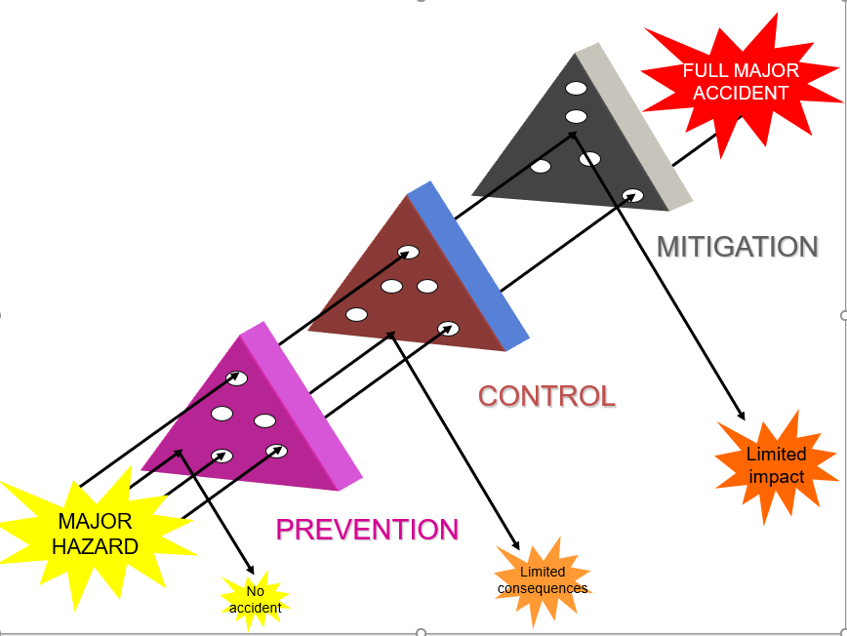
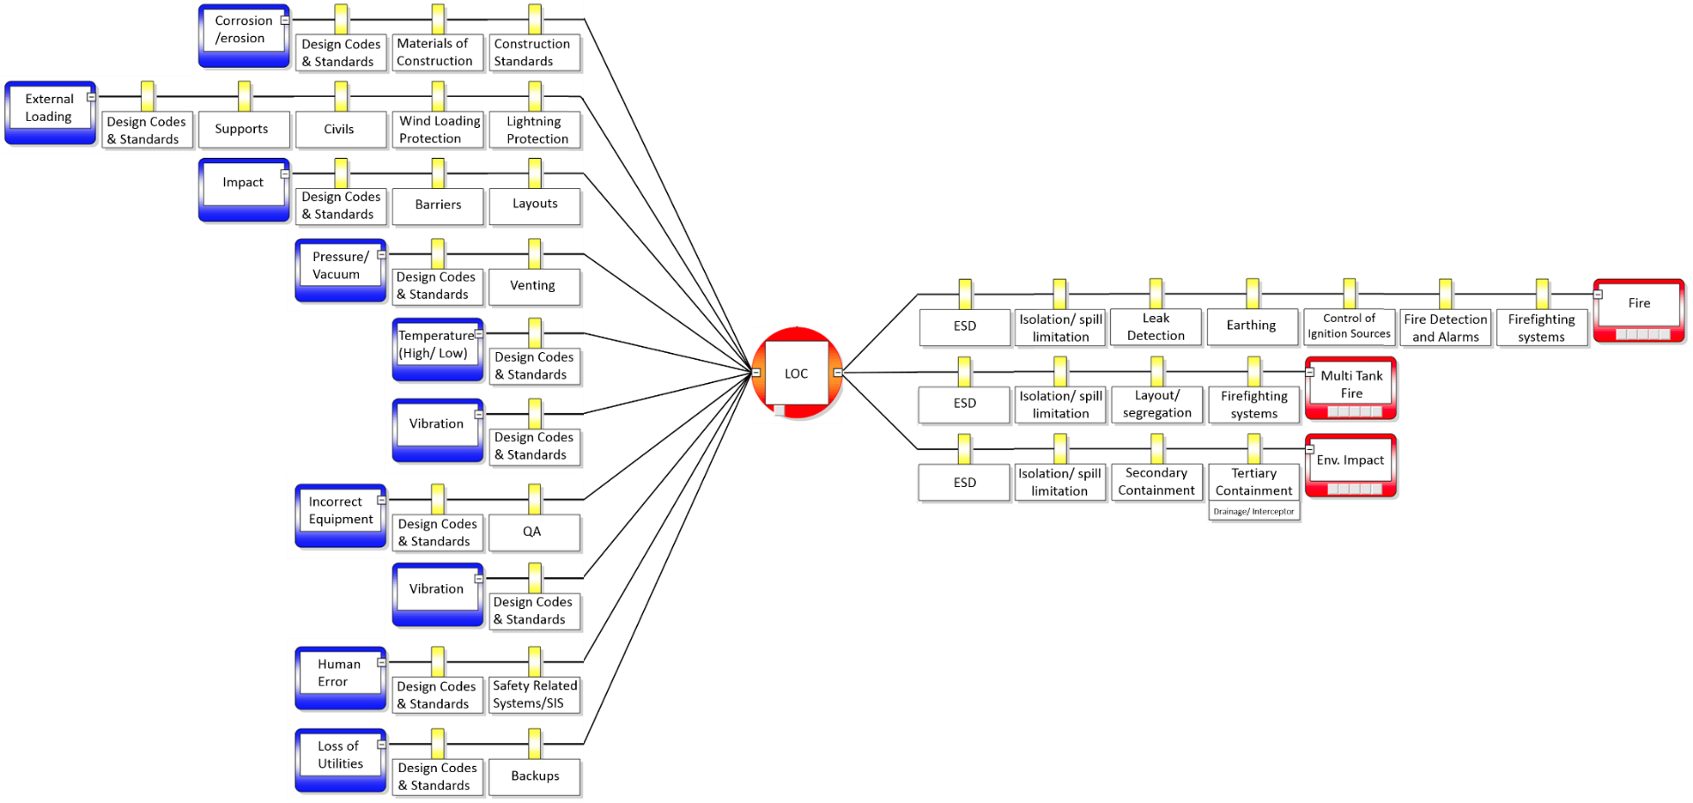
What more could be done to reduce risk?
Benefits:
  Value of avoided fatality → established guidance
  Value of avoided environmental harm → no guidance or accepted value(s)
    MATTE: Major Accident To The Environment
      4 levels with increasing consequence (MATTEs A-D)
Notes:
So, as always, a little bit of background to set the scene.
Thinking of COMAH risk assessment from the perspective of safety to people, we’ve got a long and well established (and generally accepted) approach when it comes to Cost-Benefit-Analysis (or CBA). …and I’m talking about times when we need to make decisions over whether and what to implement to further reduce risk to people.
So, in CBA, all costs and benefits are expressed in financial terms, and that’s to allow the comparison between different options.
So the cost part of the equation is typically based on the financial outlay involved in a given improvement measure. Things like the installation costs, continued operation, maintenance and training, depending on what the specific measure or improvement is.
…and then the benefit component is a measure of the reduction in risk. So that could be fewer or less likely fatalities. But, remembering that things need to be expressed in financial terms, and taking fatality as the example, we use a financial value for a single fatality (or, to switch that definition around a bit, a value for the avoidance of loss of life, hence it being the benefit of reducing the risk).
There’s a slight nuance here in that you can think of a specific improvement measure, I don’t know, something like flammable gas detection, or deluge, or tertiary containment, like a second bund wall or some other form of containment. And containment might be relevant in the next presentation which is thinking about natural hazards.
Anyway, you can think of a specific improvement measure and feed that into a CBA calculation. The result of the calculation (or maybe better to say, estimation) can inform the decision on whether or not to implement that measure. But that’s just thinking of individual specific measures.
Alternatively, you can strip things back and do a justified spend calculation and work out (regardless of what the improvement options might be) how much you would be justified in spending in order to reduce the risk to a given degree. And often with a justified spend calculation, you can start with the theoretical position of ‘how much would it cost to completely eliminate the risk’ and then work back from that, since very few measures will practically eliminate the risk.
So we’ve got established guidance and figures for harm to people but not to the environment.
And just a quick side note, remember that we define harm to the environment in terms of ‘MATTEs’, Major Accidents To The Environment, of which there are four levels, A-D, with increasing consequences.

Slide 4
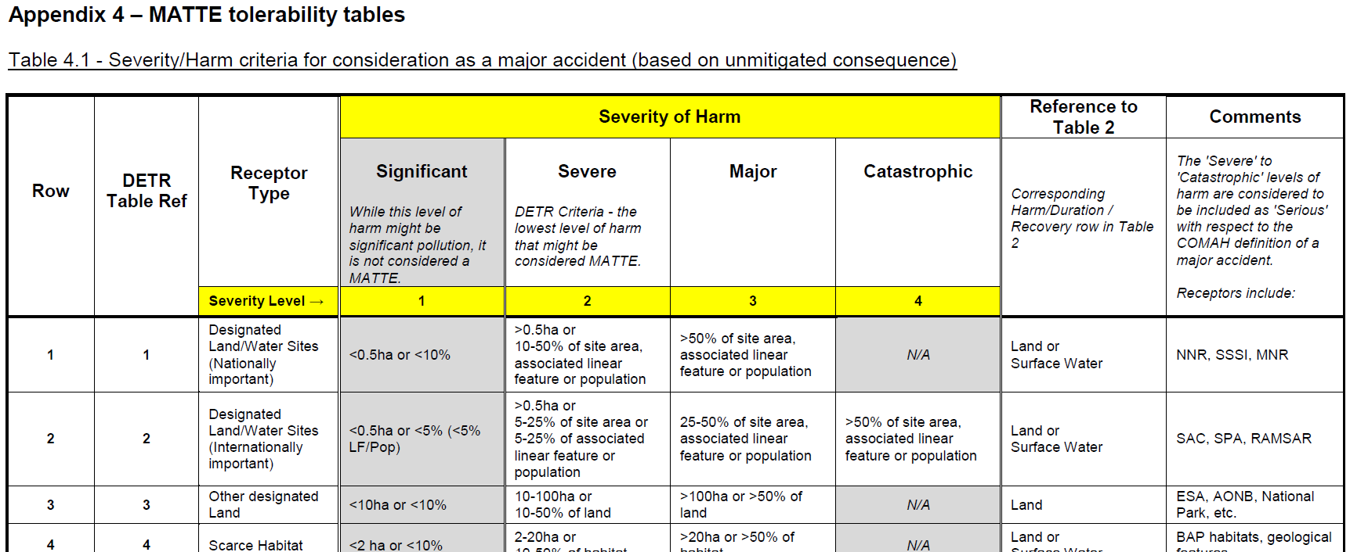
MATTEs A-D but also different receptor categories based on designations
  Receptor types: surface water, marine, groundwater, terrestrial
Notes:
So we’ve got MATTE’s A-D which you could think of as analogous to a spectrum of harm to people, such as injuries running all the way up to fatality.
But where, for safety risk, we’ve just got people as the receptor of harm, for the environment, there’s absolutely all sorts.
Hence why things are grouped or categorised depending on their nature, sensitivity and importance.
So in this snippet from a MATTE guidance document from CDOIF, you can see designations down the right-hand side for different features; things like Sites of Special Scientific Interest, nature reserves, geological sites and even listed buildings and monuments.
This table has 15 rows or categories of receptor which each have these different thresholds for defining how severe harm to them is. They’re shown in the yellow in the middle.
So you’ve got MATTEs A-D, receptor categories 1-15 and receptor types surface water, marine, groundwater, terrestrial.
Anyway, the point here being that there’s more to juggle when you’re (a) doing an environmental risk assessment and predicting what sort of harm could occur and then (b) when you’re trying to justify a financial cost associated with that predicted damage.

Slide 5
Energy Institute Project
2019, suggested:
  The need for baseline values
  A method for applying to specific scenarios
Three-phase EI project launched:
  Phase 1: Review of existing data, guidance and gaps
  Phase 2: Process data and propose values
  Phase 3: Develop guidance for selecting and applying values to specific sites and scenarios
Notes:
So that’s the problem. What have we been doing to deal with it?
Well, back in 2019, we suggested this need for a collaborative effort, to come up with some values and a guidance document.
The topic was later accepted by the EI and split up into these three overarching work phases.
We’re currently at Phase 2 which I’m imagining is the hardest part really because, in a nutshell, it involves looking over a bunch of past incident data and costs and using that to propose some values.
And notice I say values plural, …well that’s following on from my previous slide. We need a set, because of the variable consequence levels, receptor types and so on.
And, not wanting to run before we can walk, I imagine Phase 3, writing some guidance, will be fairly easy, although we’ll want to put a great deal of effort into how it is written clearly and make it as user friendly as possible. We want the guidance to be a positive thing that people want to use and which helps us all work within consistent bounds.

Slide 6
Phase 2 Activities
Phase 2 is split across four activities:
  2a: Past incident refinement
  2b: Cost data and gap filling
  2c: Identifying patterns and trends
  2d: Defining a series of values
Notes:
This phase of the project has been sub-divided into these activities. RAS has been developing, or collating you might say, our own database of past incidents, specifically through the lens of harm to the environment. The database has drawn from all manner of sources, things like the existing ARIA database, the EA and SEPA have contributed and commented, and it also gets updated each time a new incident happens. Most of the credit for that should go to my colleague Aimee who’s actually speaking next on NaTechs.
But as you can imagine, if we’re keeping this sort of live database, we’re not necessarily getting information in a nice neat parcel that tells us “ok, it was this substance, to this receptor category and the MATTE level was A, B, or C etc”.
So there’s been a fair degree of sorting, processing and qualifying in and out of incidents based on what we can deduce and what we do have enough info for.
That sorting and data processing stage was Phase 2a. Then we issued our database to the EI steering committee for review, comment and then crucially the volunteering of additional information. That’s Phase 2b.
We believe we can move forward with the amount of data that we currently have, but there are a lot of incidents for which we do not have data, so we’ve had to screen them out. Therefore, we wanted to gather as much as we could.
That assumes the data exists! But following on from that, we do need to draw a line somewhere and move formally to Phase 2c. Phase 2c will involve looking for patterns and trends and then proposing a set of financial values for different MATTE levels and receptors.
So really, we’re at the point where we want to draw that line, but this presentation, in part, is a sort of last call for interest – is anyone out there willing to take a look at our database and with a bit of luck, help fill some gaps and widen the pool of useful data?

Slide 7
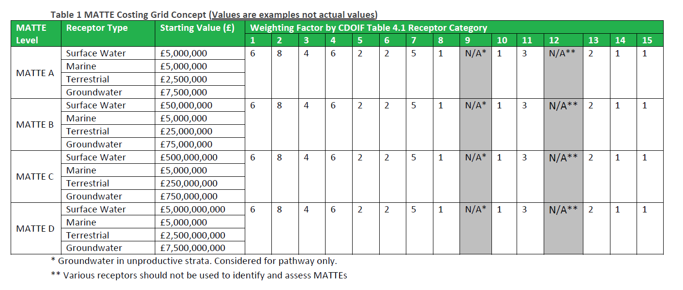
Notes:
Just wanted to briefly show this slide. Don’t take any notice of the values in the table, it is for illustration. This is the sort of thing that we hope to come up with at the end of it all. So you’ve got starting values for each MATTE level and receptor type (whether it is surface water, marine etc) and then a bunch of weighting factors based on what the category of receptor is (if you remember that table from the CDOIF guidance I flashed up earlier).
Now then, let’s have a quick look at the database.

Slide 8
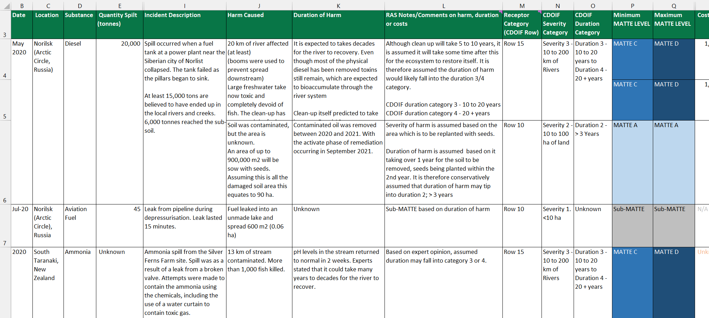
Notes:
So this is really intended as a taster of what it looks like and the sort of information we’ve included in here.
I’ve just taken a random selection of rows from the main table in the database.
There’s quite a few columns due to how we’ve decided to categorise the information about each incident.
So I’ll show you this and then the next slide will be the same examples as here, but just scrolled across to reveal the remaining columns.
What’ve we got then? A handful of columns to describe the incident.
That includes when it occurred, where, what substance, how much, and then a high-level description of what happened, the harm caused and then any information on how long lived that harm was.
Within all of that alone, there are plenty of cans of worms to be opened, with questions such as whether the consequences are unmitigated or not, whether enough time has gone by to even conclude that it has recovered and a bunch of other factors.
Then, in column L, this is where we, RAS, have added our own notes to inform what duration of harm category to class the incident as.
So if you remember, I was saying that most of the time, especially when the incident is outside the UK, it isn’t reported as a MATTE A, B, C or D. Instead, the consequences are just described. Hence us having to sort of retrospectively predict the MATTE level based on the description.
Remember too that the MATTE level is dictated by two factors; the severity of harm (of which there are 4 levels. They were the yellow columns in the CDOIF table on an earlier slide) and the duration of harm (again, 4 levels). The severity and duration are what are combined to determine whether it’s a MATTE A, B, C or D.
Right, so that’s designed to explain why, for now at least, in some cases we’ve got two different duration of harm estimates and consequently a minimum and maximum MATTE estimate. Going forward, I think the only way we can deal with these cases is likely to have to be conservative and assume the higher of the two.
So that gets us to the point where we’ve got a load of past incidents, we know what the relevant receptor categories are and we have best estimates of what the MATTE levels are.
Note: In some cases, for example incidents in the UK, the MATTE level is known and we’ve not had to fill in the blanks.

Slide 9
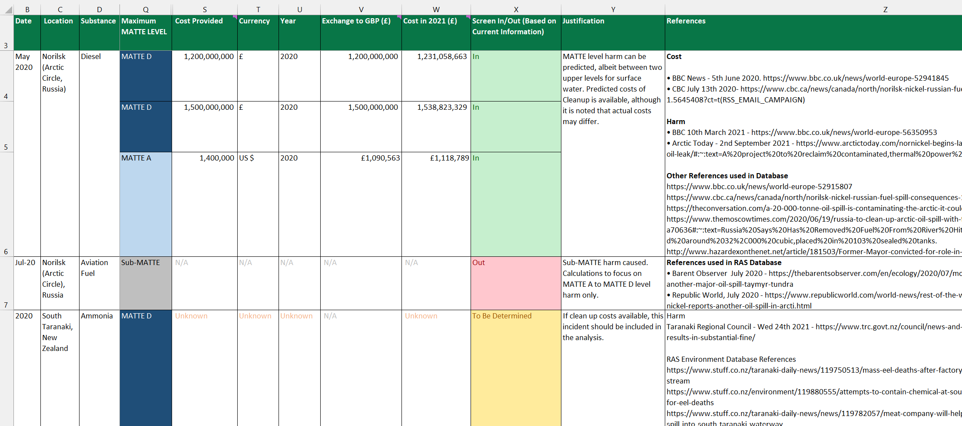
Notes:
Scrolling over, we’ve then got column S which, where available, reports the cost associated with the incident. This is the cost at the time of the incident.
Now, when we originally identified the need for this project, we wrote a paper which explored what sort of contributors or components the cost of environmental harm is made up of. As you might expect, it turns out there’s tonnes of factors that can play a role: clean-up, impacts on other businesses/activities such as fishing, restoration and monitoring programmes, impacts on tourism and recreation, legal costs and so on.
Originally and in an ideal world, we’d want to know the breakdown of all these cost influencing factors. However, in reality, we just do not and cannot have this sort of breakdown and granularity in the cost data. We’re lucky if we get cost data at all, hence the example from New Zealand for which the costs are currently unknown to us. …emphasis on “to us” because that’s where anyone willing to get involved may be able to fill these gaps.
Continuing through the columns, we’ve done some inflation calculations (which we may need to redo before we finalise our figures and guidance since that’s talking about 2021 there).
Then we’ve got a column deciding whether to screen each incident in or out of this project and notes to justify that. So, again, that’s where we want to turn more things green.
Finally, for traceability, we’ve included all the references for the information in the table.

Slide 10
www.ras.ltd.uk
www.energyinst.org
Notes:
So that’s a whistle stop tour of the database.
We’re almost ready to freeze the data set but want one last push for input from anyone willing to get involved.
Following the freeze, we’ll be processing things further and coming up with real figures to go into that example base value table I flashed up a couple of slides ago.
And in summary, we’re getting there. It isn’t easy, hence it not having been done before and we’ve been forced to make simplifications purely based on the data available and the format it is reported in, BUT we believe we’re close to coming up with something useful.
So I’ll finish there and I’m happy to take any questions. …and equally, if you wish to speak with the Energy Institute, then they’re also available.

