Slide 1
NaTech Hazards – What are they? Why should we care? And what can we do?
Aimee Russell

Slide 2
About RAS
Notes:
For those not in the previous presentation, RAS are a risk based consultancy specialising in in risk and hazard management within the process safety industry, with a focus on risk to people, the environment and business.
We believe that managing safety and environmental risk makes good business sense and that these aspects should be integrated to ensure that the wider picture is always understood.
This is especially the case when looking at NaTech management as the risk needs to be understood by all, and from all points of view. It is not just an environmental concern, the consequences of NaTech events can be significant for both safety and business as well. A collaborative approach therefore just makes sense.
This year we are celebrating 30 years.

Slide 3
Why are we here?
Natural Hazard Initiating Technological Events = NaTech
Three Main Questions
  What are NaTech Events?
  Why should we care?
  What can we do about them?
How do we assess this risk?
Notes:
To discuss NaTech Hazards
Gain some understanding and perspective
Outlining a methodology which can be used
In addition, as some of you may have also received climate change questionnaires from the Environment Agency. This approach may be useful in a beginning to address your NaTech hazards.
Before we dive into all of that, we firstly need to understand what we mean by Natural Hazard.

Slide 4
What is a Natural Hazard?
Extreme natural event which poses a risk to society and/or the wider environment.
Categorised based on the risk to:
  People
  Goods
  Social and economic disruption
  Environment
Notes:
There are a number of natural hazards, so lets look at some examples.

Slide 5
What is Natural Hazard?
Climatic, Hydrological
and Meteorological
Hazards
Winter storms e.g. ice storms and blizzards
Heatwave
Flood
Geological and Terrestrial Hazards
Avalanche
Landslide & Rockfall
Volcano
Fog
Tornado
Wildfire & Forest fire
Erosion
Sink holes & Subsidence
Tsunami
Lightning & Thunderstorm
Drought
Hail
Earthquake
Hurricane, Tropical storm, Extra tropical cyclone
Notes:
So, for the purpose of this presentation we are ground natural hazards into two groups, although there are various ways in which they can be grouped.
So you have your starting natural hazard, which may be one listed or could be something else, but that is not all you need to consider with natural hazards, you also need to consider any secondary or associated hazards.

Slide 6
Secondary/Associated Hazards
Result of the primary natural hazard
Need to understand the full picture
Notes:
These hazards occur as a result of the primary hazard.
Most natural hazards are delicately intwined so we must understand the full picture if we are going to be able to look at the risk which is posed.
Hydrological hazards for example

Slide 7
Notes:
Have complex relationships.
But it’s not just meteorological hazards which interact

Slide 8
Notes:
Geological hazards also have complex relationships.
For example, how many of you are aware that the Mount St Helens eruption was a result of a landslide? Or that tsunamis can also be generated as a result of landslides and volcanic eruptions?
You need to fully understand the behaviour of the natural hazards and associated or secondary events before you can think about understanding the impacts.
So now we know about natural hazards, what is a NaTech hazard

Slide 9
What is a NaTech Event
Natural Hazard Event
Operational and safety challenges at an establishment
NaTech Event
Notes:
Essentially, a NaTech hazard is where a natural hazard causes an operations and/or safety challenge at am establishment, for example, an ice storm causing a sites water main to burst, resulting in a loss of cooling water to a reactor which then runaways as the cooling water is not provided when required.
So how do we assess this risk?

Slide 10
Understanding and Assessing the Risk
Step 1
  Identify the Natural Hazard
  (Screening)
Step 2
  Understand the NaTech Hazard
  (Hazard Identification)
Step 3
  Determine the Risk
Step 4
  Mitigation Measures
  Safeguards
  What More Can Be Done
  Emergency Response
Step 5
  Climate Change
Notes:
Most risk assessments loosely follow the 4 same sort of steps
NaTech RA we also have climate change
So how do we screen natural hazards?

Slide 11
Step 1 – Identify the Natural Hazard
What are the natural hazards of concern?
Are there any secondary or associated hazards?
Are there any natural hazards which can be ruled out?
For example;
  Extinct volcanoes
  Coastal flood risk to inland areas or landlocked countries
Be careful not to rule out things on the basis it hasn’t occurred in decades
Notes:
Be careful when screening out hazards not to exclude anything on the basis that it hasn’t occurred in a few decades, because there is still a risk of recurrence. Remember, some of these events are on a geological time scale, which means 100 years ago in a geological sense is less than a second ago.

Slide 12
Step 2 – Understand the NaTech Hazards
How will my site be impacted by a natural hazard?
  What are the direct impacts?
  What are the indirect impacts?
Let’s look at some direct impacts
Notes:
Lets look at some examples, now disclaimer, I am a geographer and hazards girl by training, and there is nothing we love more than a colour picture to help.

Slide 13

Generic Site Layout
Ocean
s
Estuary
Diesel Tank
20,000 m³
Diesel Tank
20,000 m³
Diesel Tank
10,000 m³
Import Pipework
Diesel Tank
20,000 m³
Diesel Tank
20,000 m³
Diesel Tank
10,000 m³
Gasoline Tank
20,000 m³
Gasoline Tank
20,000 m³
Bund 1 m wall height
Bund 1 m
wall height
Sunken Pump Raft
Sunken Pump Raft
Export Pipework
Road Tanker
Control room
Mess room
Switch room 1
Emergency Generator
Site Boundary

Slide 14
Hazard : Lightning
Ocean
s
Estuary
Escalation Risk?
Diesel Tank
20,000 m³
Diesel Tank
20,000 m³
Diesel Tank
10,000 m³
Import Pipework
Fire (major accident hazard)
Risk to people
Diesel Tank
20,000 m³
Diesel Tank
20,000 m³
Diesel Tank
10,000 m³
Gasoline Tank
20,000 m³
Gasoline Tank
20,000 m³
Bund 1 m wall height
Bund 1 m
wall height
Sunken Pump Raft
Sunken Pump Raft
Export Pipework
Road Tanker
Control room
Mess room
Switch room 1
Emergency Generator
Site Boundary
Notes:
The first hazard is a lightning strike, so what happens if lightning hits a gasoline tank?
Likely a fire, and/or explosion. This introduces a risk to people. It may be argued that this is unlikely due to the lightning protection on the tank, but this is a safeguard.
You need to understand, assess and plan for the ultimate consequence of that Natech event
Consideration also needs to be given to the risk of escalation

Slide 15
Hazard : Flood
Ocean
s
Estuary
Diesel Tank
20,000 m³
Diesel Tank
20,000 m³
Diesel Tank
10,000 m³
Import Pipework
Loss of site operability for the diesel tanks
Potential loss of containment if the pipework is damaged
Loss of site access from the West
Diesel Tank
20,000 m³
Diesel Tank
20,000 m³
Diesel Tank
10,000 m³
Gasoline Tank
20,000 m³
Gasoline Tank
20,000 m³
Minor flood
Minor flood
Bund 1 m wall height
Bund 1 m
wall height
Sunken Pump Raft
Sunken Pump Raft
Export Pipework
Road Tanker
Control room
Mess room
Switch room 1
Emergency Generator
Site Boundary
Notes:
So the next hazard is flood
The impact of the flood may be dependent on the size and source of the flood.
Lets firstly look at a minor flood from the estuary, which may also be similar to localised surface water flooding.
In this case, the damage to the site is loss of the diesel export pumps and switch room. This may also result in the loss of containment of diesel if a release occurs at the pumps or pipework connections, especially if the tank side valves are not isolated.
In addition, there is also some loss of the site access from the west of the plant.
So what if we had a larger flood?

Slide 16
Hazard : Flood
Ocean
s
Major Flood
Major Flood
Debris Risk?
Estuary
Diesel Tank
20,000 m³
Diesel Tank
20,000 m³
Diesel Tank
10,000 m³
Loss of all 6 diesel tanks (major accident)
Loss of import and export pumps
Loss of electricity
Loss of site access
Loss of road tanker
Import Pipework
Diesel Tank
20,000 m³
Diesel Tank
20,000 m³
Diesel Tank
10,000 m³
Gasoline Tank
20,000 m³
Gasoline Tank
20,000 m³
Bund 1 m wall height
Bund 1 m
wall height
Sunken Pump Raft
Sunken Pump Raft
Export Pipework
Road Tanker
Control room
Mess room
Switch room 1
Emergency Generator
Site Boundary
Notes:
In this case, the consequences would be more severe.
All 6 diesel tanks are flooded, import and export pumps are lost, loss of both the switch room and backup generator, and the road tanker is flooded.
Now this may seem like an odd thing to consider for flooding, but fire engines can float in 1 m of still water, which that depth reducing with velocity. So depending on the depth of flood waters, vehicles may become buoyant.
Additionally, you have also completely loss access to the site.
Understanding the source of the flood is also key due to the potential for debris in the flood waters which pose a risk to people, but may also damage equipment.
Speaking of people, do not let personnel walk through flood waters. This is extremely dangerous and there are a number of underwater hazards.
That’s a couple of examples about direct hazards, so what about indirect hazards?

Slide 17
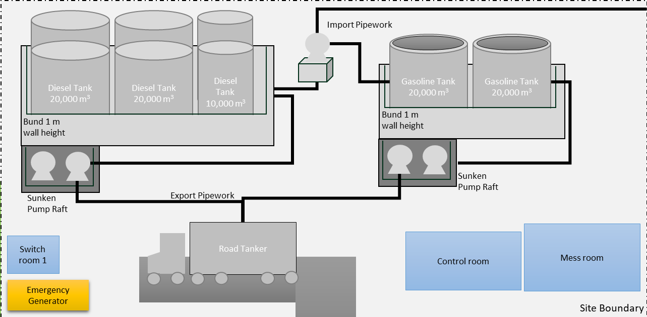

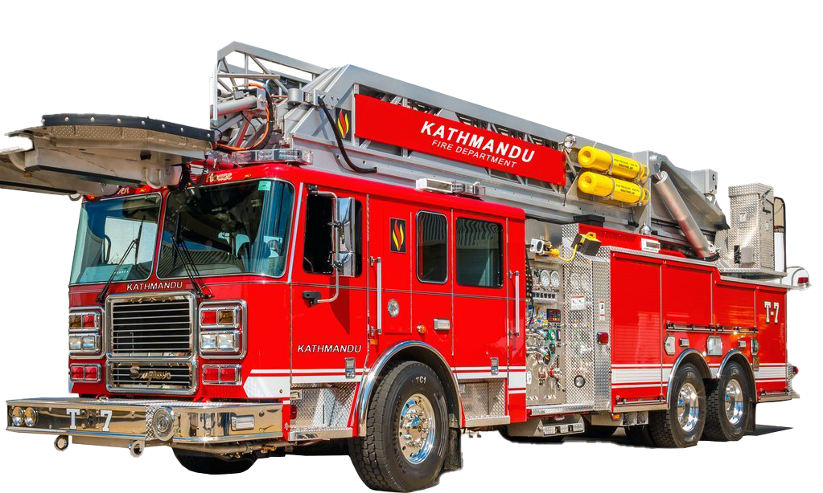
Generic Area Layout
Ocean
Estuary
Major Motorway
High Hazard site
Electricity pylons
Bridge 1
Bridge 2
Fire Station
Notes:
So again we have a generic layout showing areas around our high hazard site, including electricity pylons, presenting site utilities, a fire station and some offsite populations which may include site workers.

Slide 18
Hazard: Earthquake
Ocean
Estuary
Major Motorway
High Hazard site
Electricity pylons
Bridge 1
Bridge 2
Fire Station
Notes:
The hazard for this case is an earthquake. Now the purpose is to identify the potential impacts on the site from damages caused external to the site . (CLICK!)

Slide 19

Hazard: Earthquake
Ocean
Estuary
Loss of Site Electricity
Major Motorway
High Hazard site
Electricity pylons
Bridge 1
Loss of Site Access
Bridge 2
Fire Station
Loss of Emergency Response Capability
Notes:
In this case there is damage to the electricity pylons, causing loss of site electricity and damage to both of the bridges.
Now the damage to the bridges has an additional consequence of cutting the site off from the local fire station, in additional to removing access for workers.
So now there are two problems, workers cannot get into or out of the area, and if there is a problem at the site, the fire department cannot assist.
Its important to remember that in a Natech scenario more than one thing can go wrong.

Slide 20
Secondary Hazard: Tsunami
Ocean
Estuary
Major Motorway
High Hazard site
Electric pylons
Bridge 1
Loss of Site Access
Bridge 2
Fire Station
Loss of Emergency Response Capability
Notes:
Also don’t forget your secondary hazard, which for an earthquake may be a tsunami.
In this case the added complication of loss of site assess may mean that anyone on site has nowhere safe to escape from the tsunami (which is get inland and high up

Slide 21
NaTech HAZID Example
Cause | Consequence | Major Accident Potential? | Safeguards
Coastal Flooding – 1.5 m in depth
Flotation of diesel storage tank due to flooding of the bund | Loss of containment from diesel bund Worst-case 6 tanks, total inventory 100,000 m3 Potential harm to aquatic and terrestrial animals | Yes, potential for a major accident to the environment. | Tanks are anchored to avoid flotation
Flooding of the electrical supply including the back-up generators | Loss of electricity and site electrical heating. Loss of active safeguards for safety critical equipment. | Loss of barrier rather than direct release. Increased likelihood of a major accident | Site ESD (Emergency shutdown) Fail safe isolation valves on loss of electrical power UPS (Uninterruptible power Supply) backups for alarms and safety critical equipment Flood preparedness procedures
Wind Storm
Damage to the outer shell of the anhydrous ammonia storage tank due to debris within winds (e.g. branches) | Loss of containment of anhydrous ammonia, which is highly toxic. Potentially harmful to any personnel within the vicinity and downwind of the tank. Also potential for harm to birds and other terrestrial animals. | Yes, potential for major accident to both people and the environment. | Site toxic alarms Emergency response procedures Breathing apparatus and PPE (Personal Protective Equipment)
Notes:
So once you’ve captured all your risks you can then present them in a table, or a report, or really however you present your hazard studies

Slide 22
Human Factors
Natural disasters are traumatic events
Two key human factors consideration:
  Personnel may not perform as expected in a natural hazard event
  There may be a longer lasting effect on personnel, which could result in altered performance
Notes:
A key aspect to consider is the human aspect
Personnel may not perform as it is expected for them to in a natural hazard event. Therefore, if you are relying on them for making the site safe/emergency response, care considerations are needed. It should be ensured that plans are available and provide clear instructions and decision making tools.
There may be a longer lasting effect on personnel post incident. This may result in altered performance of personnel, so for manual sites with a high reliance on people performance for tasks, this needs to be captured and considered in assessments.
Natural hazards are traumatic events, and have been linked to PTSD and increased rates of substance abuse, depression and anxiety.
So lets look at some real world examples.

Slide 23
Learning from Examples
Ongoing
Bacton, UK
Coastal Erosion
2022
Matanzas, Cuba
Lightning
2022
Alaska, USA
Snow Loading
2022
La Pampilla, Peru
Tsunami
2021
Matanzas, Cuba
Lightning
2020
Salt Lake City, Utah
Earthquake
2019
Omachi, Saga Prefecture
Japan
Flood
2019
France
Extreme Heat
2020
Iran
Landside
2020
Louisiana
Hurricane Laura
2020
Midland, Michigan
Flood
2020
Amazon, Ecuador
Landside
2019
Bahamas,
Hurricane
2018
Somme, France
Extreme Heat
2018
Iowa, USA
Flood
2018
California, USA
Wildfire
2017
Arkema, Texas
Hurricane
2016
France
Flood
2004
Gulf of Mexico
Hurricane (& landslide)
2005
Louisiana, USA
Hurricane Katrina
2006
Kolin, Czech Republic
Low Temperature
2011
Feyzin, France
Lightning
2011
Chiba, Sendai Hirono
Japan
Earthquake & Tsunami
2015
Shenzhen, China
Landside
2002
Mohammedia, Morrocco
Flood
2002
Czech Republic
Flood
2000
Sandhurst
Flood
1998
Esmeraldas
Landslide
1994
Milford Haven, UK
Lightning
1972
Donges, France
Lightning

Slide 24
Learning from Examples – Fukushima Daiichi
11th March 2011
14 m Tsunami Wave Overtops Sea Wall
Tsunami Triggered
9 Mag Earthquake
Nuclear Reactors Shut down
Emergency Generators Kick In for Cooling
Emergency Generators Flood and Fail
Nuclear Meltdown
Radioactive Material Leaked
Safety Features
NaTech Impact
NaTech Consequence
Notes:
Fukushima Daiichi is a nuclear power plant located in Fukushima.
On March 11th 2011, a magnitude 9 earthquake occur off the coast of Japan.
Due to the location and magnitude of the earthquake a tsunami was also triggered. The tsunami is a secondary hazard of an earthquake.
The earthquake was detected at the plant, and the nuclear reactors automatically shut down.
The emergency diesel generator then turned on to pump coolant around the nuclear cores
It is important to that that there if often a lag time between the earthquake and the first tsunami wave.
The site is then hit by a 14 m tsunami wave
This overtops the sea wall flooding the plant and causing the emergency generator to fail. Workers rush to try and restore power, but ultimately the reactors overheat.
Resulting in a nuclear meltdown.
The plant suffered a number of chemical explosions which badly damaged the plant.
Radio active material then began to leak.
So here, the earthquake was the primary hazard, and measures we in place to ensure the safe shutdown of the plant. These were successful in protecting the nuclear cores from the initial event.
However, it was the secondary hazard, a tsunami, that resulted in the NaTech impact and consequence.

Slide 25
Step 3 – Determine the Risk
Which approach
Semi-quantified?
Qualitative?
Why?
Notes:
Semi- quantified
LOPA style
Rapid-N – JRC approach for Earthquakes
Issues with suitably reliable data
Qualitative
Severity rankings
Identification of potential major accident hazards
Essentially. Need to understand the reason for conducting the risk assessment, what is trying to be achieved?

Slide 26
Step 4 – Mitigation Measures, Safeguards, What More Can Be Done and Emergency Response
ALARP
NaTech specific safeguards
NaTech emergency response plans are key
Notes:
ALARP Principals:
Inherent Safety -> Prevent -> Control -> Mitigate
NaTech specific safeguards
Consider the specific impact of the natural hazard
For non NaTech specific safeguards potential for multiple failures
NaTech emergency response plans are key and should be exercised.

Slide 27
Step 4 – What More Can Be Done?
What more can be done?
Not a simple task
Look to other industries for inspiration
Limitations
Notes:
e.g.
Building codes for earthquakes, useful for buildings where people may be
Flood defences and flood resilience for property
Having electrical equipment at height
Temporary flood barriers
Pyroclastic - tens to hundreds of kilometres per hour (typically more than 110 kmph) and at extremely hot temperatures (>800 deg. C)

Slide 28
Step 5 – Climate Change
Increase in severity and frequency of events
Life expectancy and function of the plant
Regulators may set these goals
Need a good baseline assessment
Likely to be a creeping change
Notes:
Increase in severity and frequency of events
Life expectancy and function of the plant may need to play a role in the climate change scenario considered
Regulators may set these goals
England: 2 deg. C by 2050 and 4 deg.C by 2100
Need a good baseline assessment
Likely to be a creeping change Ensure assessments are kept up to date with the changing data

Slide 29
Conclusion
What are NaTech Events?
  Where a natural hazard challenges the safety and operation of a high hazard site
Why should we care?
  Legal and moral duty manage risk to an accepted level
  These risk are real, and will only increase with climate change
What can we do about them?
  Firstly, understand your site-specific risk
  Then targeted risk management can be applied

Slide 30
Natural hazards by their nature are difficult and unpredictable, but how we as a society prepare, react and respond can make all the difference.

Slide 31

Questions?
Email: aimee.russell@ras.ltd.uk
Website: https://www.ras.ltd.uk/

