Slide 1

Advances in the Digitalisation of the Process Industries Conference
16–17 October 2025, Manchester, UK
Hybrid Modelling and Optimisation Framework for Plant-Wide Real-Time Applications
Dario Ferraro
Shabroz Gill
Doug Nicholson
Dr Patrick Thorpe*
* Presenter

Slide 2

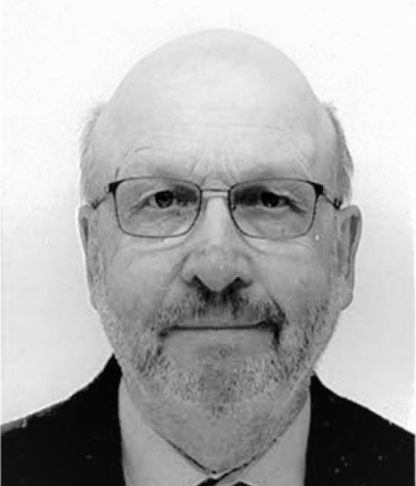


The Spiro Team
The Managing Director and founder of Spiro, with 35 years of experience in APC and optimisation, has led over 40 APC projects and developed several commercial software products, including APC, model identification, PID tuning, and RTO.
Senior Consultant with five decades of experience in industrial process control and optimisation, and a recognised authority in ethylene process APC. Along with Dr Thorpe, Doug was a co-founder of Aptitude, a technology startup sold to IPCOS.
Dr Patrick Thorpe
Doug Nicholson
Process modelling and control specialist with extensive commercial software development expertise and a deep understanding of linear algebra and control theory. Shabroz is an IIT graduate and is the principal architect behind Spiro’s products.
Chemical Engineer with 20 years of experience in APC and optimisation across refining and petrochemicals, including more than 10 dynamic optimisation projects.
Shabroz Gill
Dario Ferraro

Slide 3
Real Time Optimisation (RTO) Requirements
Definition: Real-Time Optimisation (RTO) combines a calibrated process model with an optimiser to continuously drive a process to the best feasible operating point. A well-designed and well-maintained RTO can achieve significant benefits.*
For an RTO project to justify the investment, it should:
Increase operating margins and achieve a quick return on investment.
Deliver capabilities beyond what linear model predictive control can achieve.
But RTO can be:
Complex and costly to build, implement, and maintain.*
Vulnerable to downtime and low availability.
Requirement – to develop an RTO solution that achieves the same benefits but with:
Reduced cost.
Simplified maintenance.
High availability.
Support for multiple use cases (open-loop and closed-loop RTO, ad-hoc optimisation and what-if studies).
*Reference: Darby et al., 2011

Slide 4
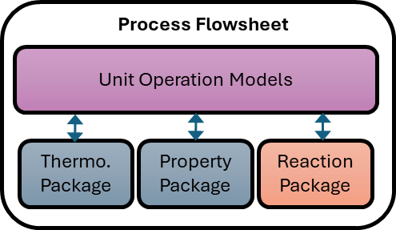
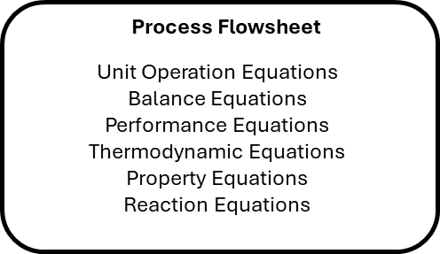
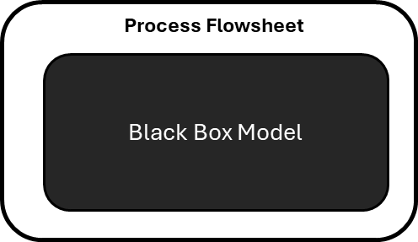
Modelling Methods for Real-Time Optimisation
Sequential Modular Simulation
Solves each flowsheet block in sequence. Flowsheets can be prototyped and run relatively quickly. Good diagnostics, easy to isolate errors. | The model input-output structure is fixed by the design and use case. Optimisation solutions may take a long time to converge. Recycle streams and design specifications are solved iteratively.
Equation Oriented Simulation
Collects all model equations and solves them simultaneously. The model input-output structure can be easily modified according to context. Optimisation solutions can run quickly on a converged model. | Higher model-building effort and skills needed. Diagnostics and debugging can be difficult. Solutions are sensitive to initial conditions and scaling. Requires a robust nonlinear solver.
AI Surrogate Models
Fast execution once the model is trained. Captures complex non-linearities. Models can be differentiable and support gradient-based optimisation. | Poor extrapolation outside the training set. Hard to enforce balance constraints. Explainability and validation are challenging. Extensive data required for training. Require high maintenance (frequent re-training) due to data drift.

Slide 5
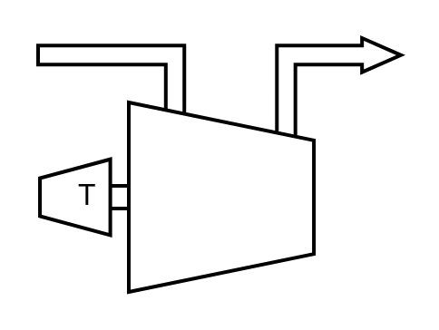
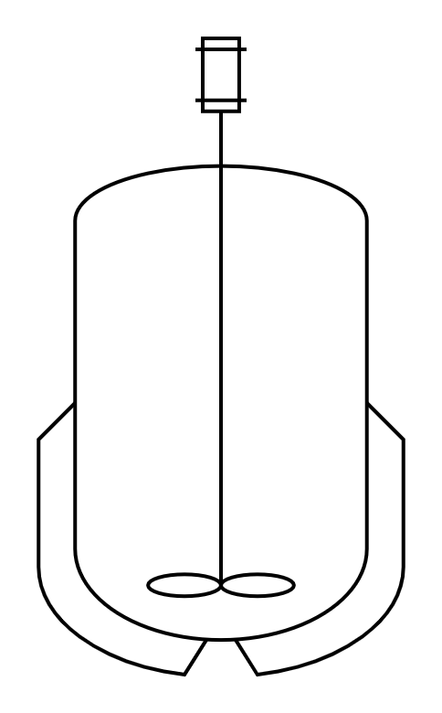


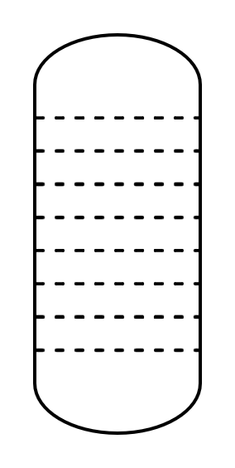
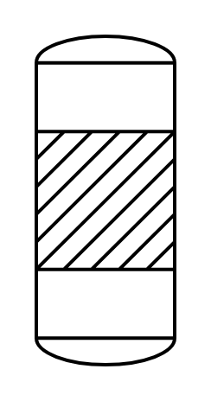


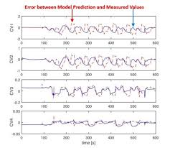
Hybrid Modelling and Optimisation Framework
Unit Operation Library Models
Simulated Data + Machine Learning
Flowsheet Equation Generation
+
Hybrid Model
Mass & Energy Balances
Unit Operation Models
Flowsheet Constraints
Thermodynamic Equations
Physical Property Methods
Reaction Equations
Custom Models
Process Data + Machine Learning
+
Modelling and Optimisation Framework
+

Slide 6
The RTO Execution Cycle
Each solution step utilises the same Equation-Oriented model, but with a different set of constraint conditions and degrees of freedom.
Open-Loop Optimisation
Calibrated & Reconciled Model
What-If Analysis & Ad Hoc Optimisation
*Data reconciliation (measurement bias adjustment) and model parameter estimation.
Closed-Loop Optimisation
Equation-Oriented Model
Model Adaption*
Advanced Process Control (APC)
Process

Slide 7
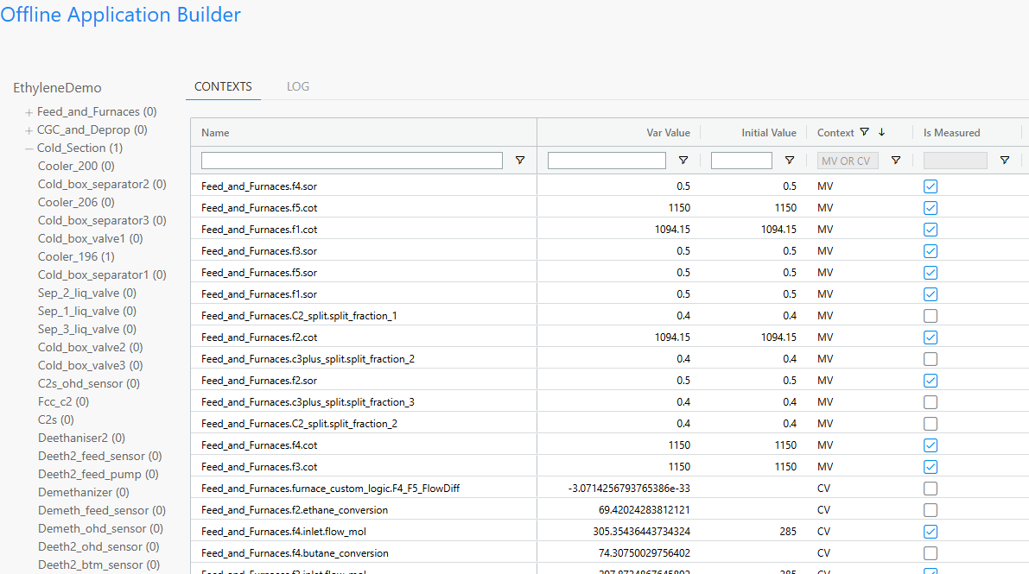
Degrees of Freedom, Context & Model Validation
Degrees of freedom are calculated at the flowsheet and unit operation level to facilitate model diagnostics.
Contexts are used to manage the degrees of freedom for each solution step (initialise, simulate, estimate, optimise, etc.).

Slide 8





Steady State vs Dynamic vs Hybrid RTO
Steady State RTO
Dynamic RTO
Hybrid RTO
Steady State Optimisation
Dynamic Optimisation
Steady State Optimisation
$$\hat{θ}$$
$$\hat{θ}$$
$$\hat{θ}$$
$$u^{RTO}$$
Steady State Model Adaption
$$u^{RTO}$$
Dynamic Model Adaption
$$u^{RTO}$$
Dynamic Model Adaption
SS?
Process
$$y_{m}$$
Process
$$y_{m}$$
Process
$$y_{m}$$
Steady state model adaption with steady state optimisation.
Dynamic model adaption with dynamic optimisation.
Dynamic model adaption with steady state optimisation.
Reference: Krishnamoorthy, Foss and Skogestad, 2018

Slide 9
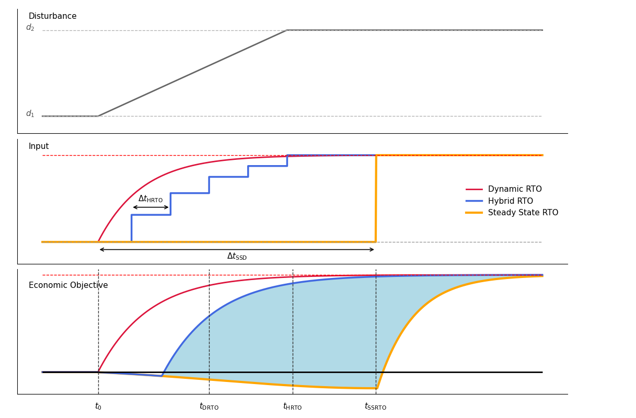
Steady State vs Dynamic vs Hybrid RTO
Ramp Disturbance
RTO Closed Loop Response
Additional Economic Benefit
Process Response (Objective Function)

Slide 10
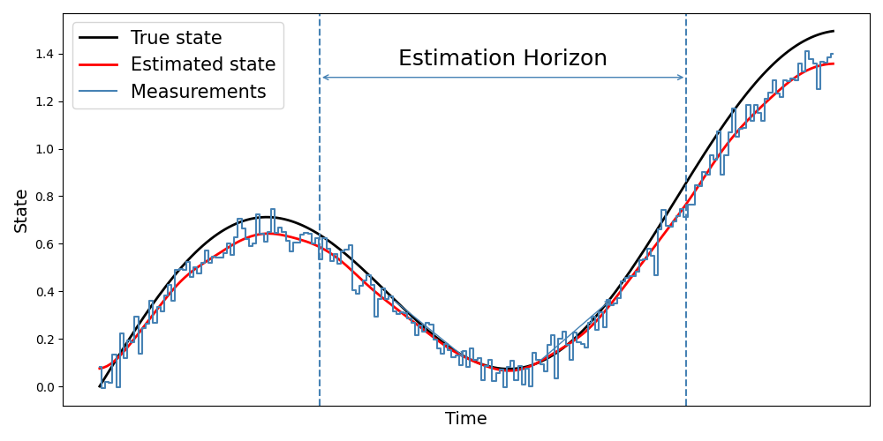


Dynamic Model Adaption
Moving Horizon Estimation
Reference: Hedengren and Eaton, 2017
Solves a dynamic optimisation problem at each sampling instant.
Includes constraints.
Computationally intensive.
Arrival cost estimation adds additional complexity.
Differential–algebraic (DAE) or discrete state space dynamic model.
Nonlinear Kalman Filter
Reference: Krishnamoorthy, Foss and Skogestad, 2018
Simple to implement and computationally fast.
Does not need to solve a nonlinear optimisation problem online.
Tuning can be complex.
Doesn’t handle constraints directly.
Discrete state-space dynamic model.
Initial Estimate
Prediction & Time Update
Measurement Update
Hammerstein Dynamic Model
Reference: Delou et al, 2021
Combines a non-linear steady state model with identified plant dynamics.
Uses a modified Kalman filter formulation, denoted Hammerstein EKF.
Ensures consistency between APC and RTO dynamics.
ARX dynamic model.
Non-linear steady state model
Linear dynamic model
$$u_{t}$$
$$y_{t}$$

Slide 11
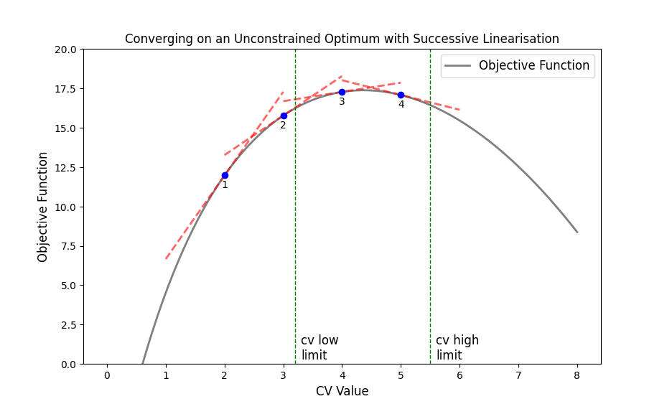
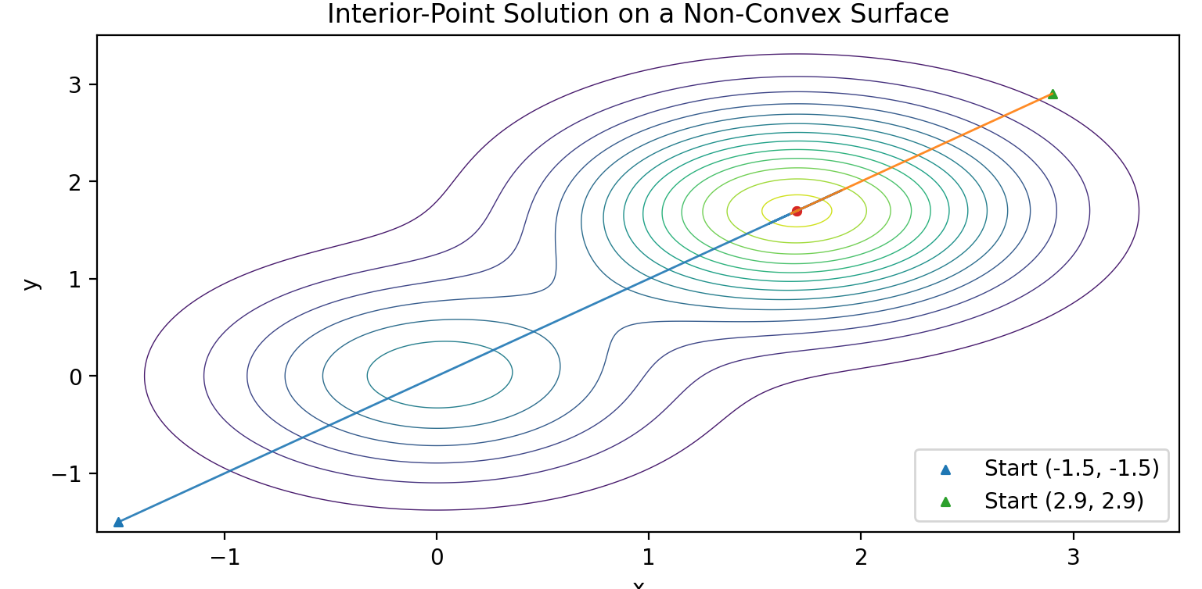
Steady State Optimisation with a Nonlinear Model
Successive Linearisation
Non-linear Optimisation
Effective for convex or mildly nonlinear problems.
Quadratic objective function – deterministic and fast solution.
Can be deployed as closed-loop RTO (hill climbing).
Linearised models can be reused for planning and APC.
Requires a carefully defined trust region.
The open-loop solution is valid only near the linearisation point – makes commissioning difficult.
Not suitable for what-if studies and ad-hoc optimisation.
Applicable to convex and non-convex optimisation problems.
Supports closed-loop and open-loop RTO, as well as what-if analysis and ad-hoc optimisation.
Global optimum solution if properly initialised & constrained.
Two-stage commissioning (open-loop → closed-loop) builds confidence & acceptance before closing the loop.
Can be prone to infeasibility if not correctly designed.
Requires a robust nonlinear solver.

Slide 12
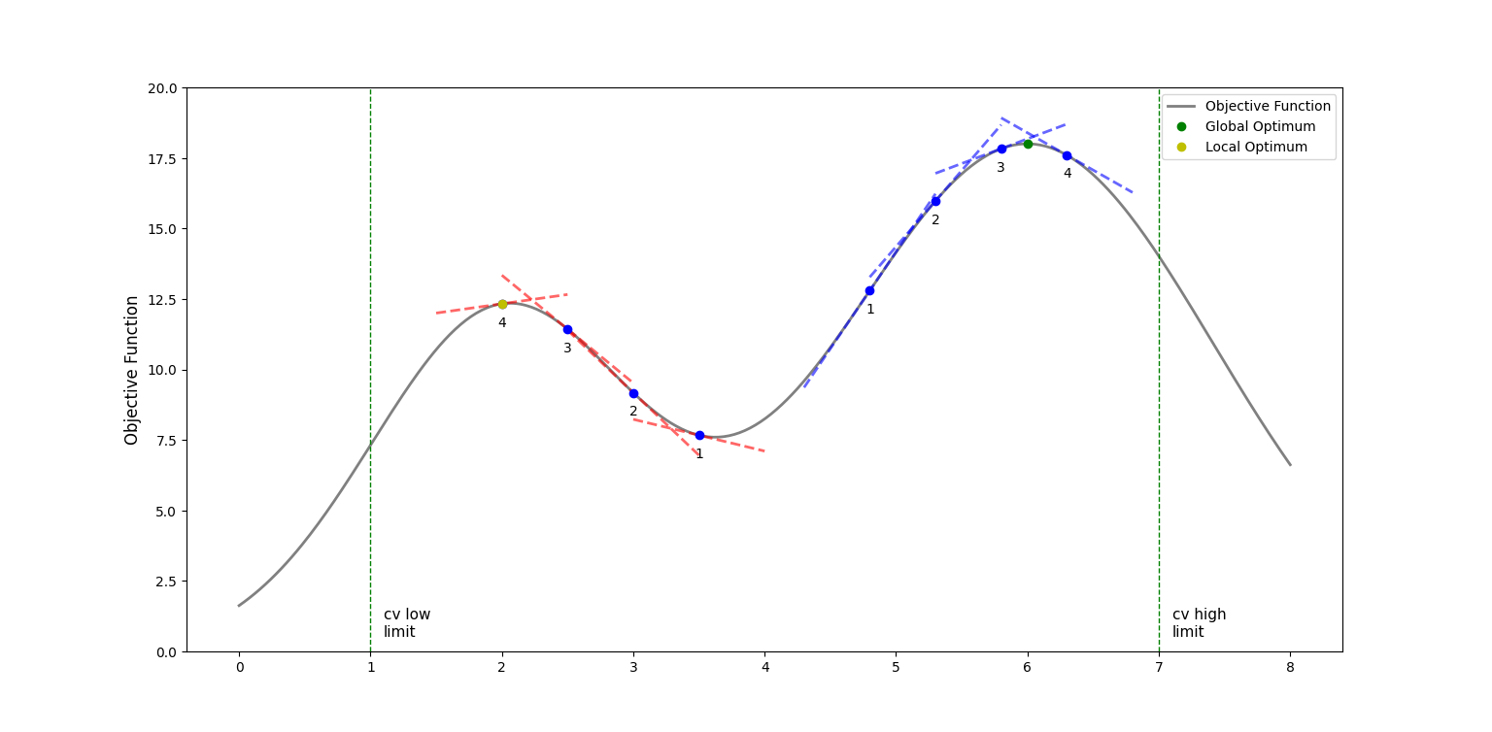
Limitations of Successive Linearisation (Hill Climbing)
1. At each execution cycle, a single linearised optimisation problem is solved using the local gradient.
3. Some oscillation around the optimum point.
4. The approximate solution is only usable inside the trust region.
5. The correct choice of step size is essential.
6. A fast update cycle helps to maintain process alignment.
2. A poor starting point leads to a local optimum.

Slide 13
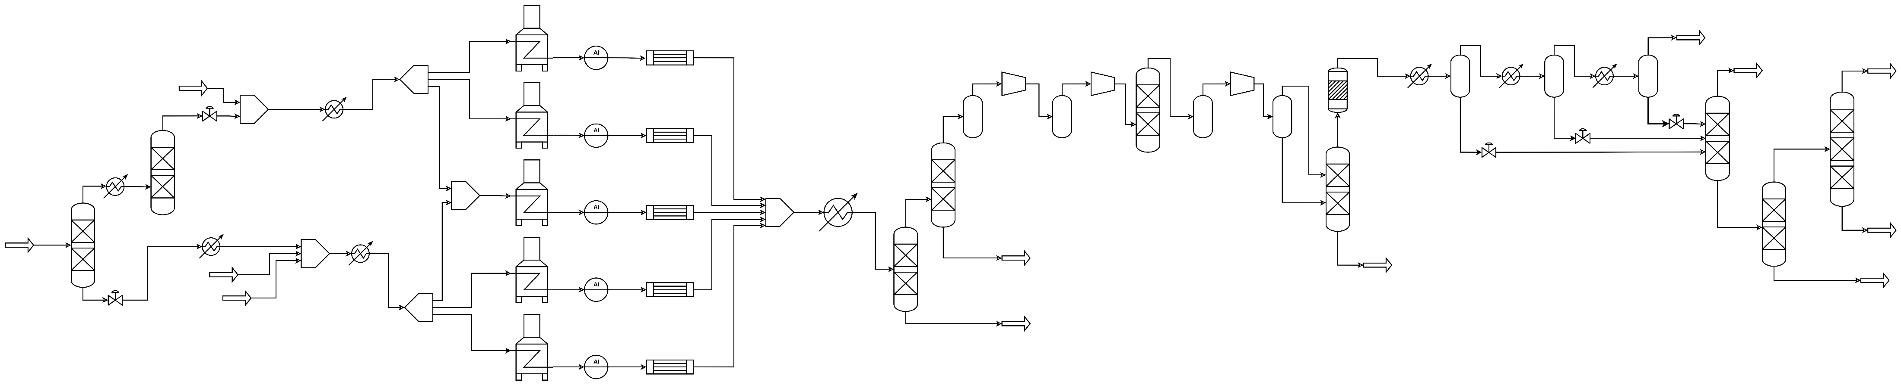
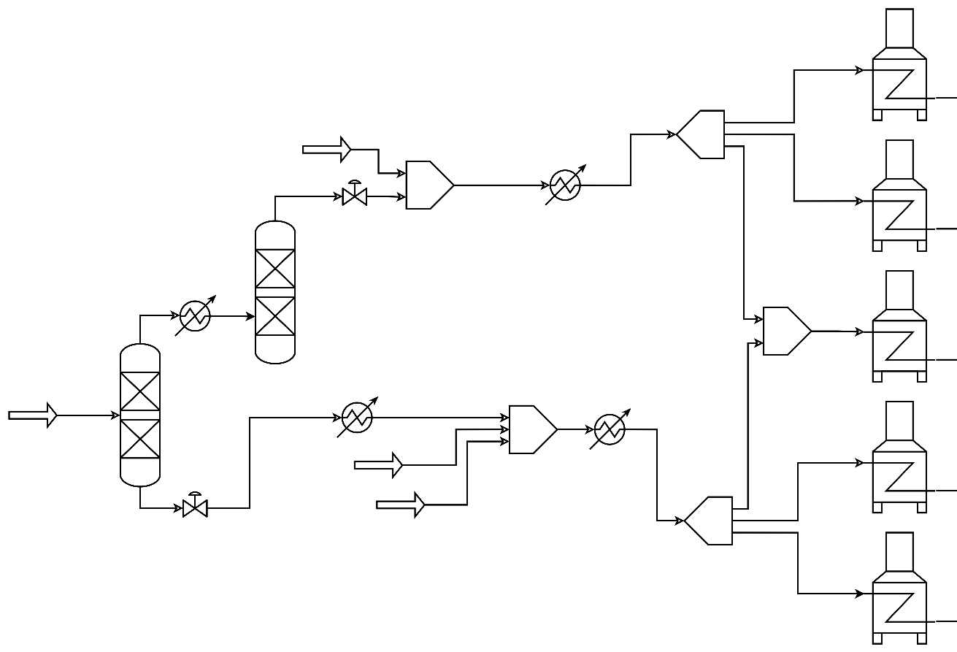
Example – Ethylene Process RTO
C2 Recycle
NGL
Feed
C2 Recycle
Feed Section
Recovery Section
Furnaces
Ethylene Process Model
Detailed feed section and furnace* models.
Simplified separation section model (shortcut distillation, compressors, flash separation, heaters/coolers, etc.).
18 chemical components.
Optimisation Case
Determine the optimal feed allocation, furnace conditions, and downstream operation to maximise ethylene production.
Co-cracking (mixed C2 & C3+) is sub-optimal and should be avoided.
Real-time Optimisation Performance
5065 Variables, 2-minute execution cycle.
Nonlinear, global optimisation.
*In an ethylene process, the cracking reaction takes place in the furnace coils.
Furnace Feed Allocation
Ethane Recycle
Ethane Furnaces
Mixed Feed Furnace
NGL
Feed
C3+ Recycle & LPG Feed
C3+ Furnaces

Slide 14
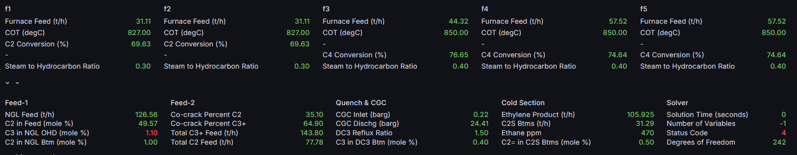
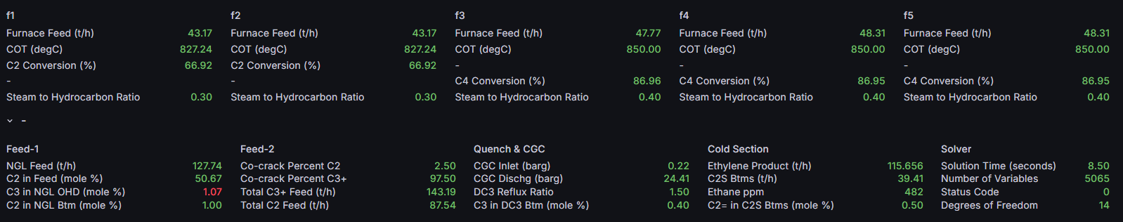
Example – Ethylene Process RTO
Base Case
3. Increased Ethylene production.
4. Increased Ethane recycle up to the furnace feed limit for improved yield.
Optimised Case
2. Ethane to the mixed furnace is reduced to the low limit.
1. Increased Ethane furnace feed and lower conversion.

Slide 15



Contact us
www.spirocontrol.com
+44 7796 147746
info@spirocontrol.com
LinkedIn/SpiroControl
Thornton Science Park
Pool Lane
Chester, UK
CH2 4NU

Slide 16
References
M Darby, M Nikolaou, J Jones, D Nicholson. RTO: an overview and assessment of current practice. J. Process Control 21 (6), (2011).
P. Delou, R. Curvelo, M.B. de Souza, A.R. Secchi. Steady-state real-time optimization using transient measurements in the absence of a dynamic mechanistic model: A framework of HRTO integrated with adaptive self-optimizing IHMPC. J. Process Control 106 (2021).
P. Delou, J. Matias, J Jäschke , M.B. de Souza. Steady-state real-time optimization using transient measurements and approximated Hammerstein dynamic model: A proof of concept in an experimental rig. J. Process Control 132 (2023).
J. Hedengren, A. Eaton. Overview of estimation methods for industrial dynamic systems. Optimization and Engineering 18 (1), (2017).
D. Krishnamoorthy, B. Foss, S. Skogestad. Steady-state real-time optimization using transient measurements. Comput. Chem. Eng. 115 (2018).

