Slide 1
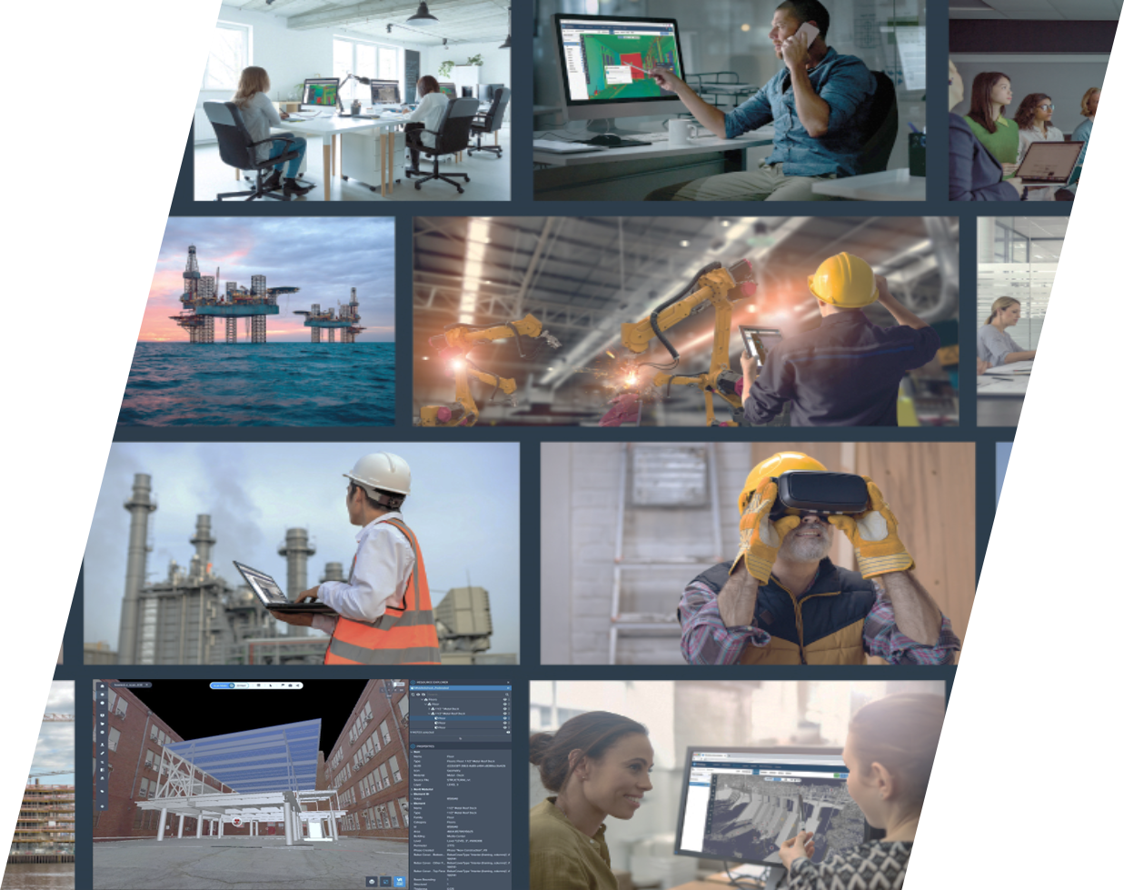


Calibri heading 40 pt one line max
Calibri body 28pt one max - subtitle can be deleted
Reality Capture and digitizing our assets

Slide 2
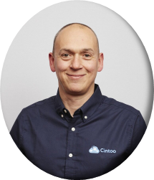
Todays speaker
Ryan Goggin
Strategic Account Manager
Ryan.goggin@cintoo.com
Notes:
I’m Ryan Goggin, Strategic Account Manager at Cintoo
Thank you very much for having me speak at the conference today.
In my presentation, I am going to talk about surveying reality capture data or scan data and how this not only benefits discrete engineering activities (which is often as far as it goes) but can also serve to benefit a much wider community over a much greater period of time.
If a picture paints a thousand words, is it safe to assume a thousand pictures give us a million words? And then, if each picture comprises of a million discrete points, does that give us almost limitless visual understanding and quantifiable, referenceable context? Quite possibly, but if all that rich data requires incredibly high-performance supercomputers to visualise it and then relies on couriers moving harddrives around - perhaps its true value is rarely truly unlocked.

Slide 3


Todays session
Todays session
Reality Capture - Digitizing The Asset:
A New Era In Site Intelligence from engineering to operations and abandonment
Asset Visualisation Platforms
Coordination Across Stakeholders
Design Intent to Operations
Accelerated Engineering
Scan First - A Smart Foundation
The Path Forward
Early Design Validation
Q & A
Notes:
And that’s the scale of the challenge — enabling companies to host, share and collaborate their rich quantifiable data sets across all stages of their assets life.
They key is shifting our mindset or perspective from locally hosted, hardware constrained data overload to cloud hosted, contextualised, actionable intelligence.
Using Cintoo’s Twin Edition with AI-enabled asset tagging, we transform reality capture data into dynamic intelligence.
What this means for engineering projects as well as operations — we reducing cost, we reduce risk, reduce site exposure and deliver efficiency.
The path forward: how our recommended scan-first approach then builds to supports continuous asset intelligence and long-term digital twin value.
And of course, we’ll leave time for Q&A.
It’s not about one scan, one project, or one moment — it’s about creating an evergreen source of truth that lives with the asset itself.

Slide 4

Project lifecycle
Field Development
Technology Assessment
Pre-FEED
APPRIASE
SELECT
FEED
Detailed cost estimating
Execution planning
As-Is / As-Built Reality
Quantifiable Site Data
Satellite View to mm Resolution
DEFINE
Detailed Engineering
Commissioning
Delivery
Progress Monitoring
Supply Chain Collaboration
Single source of truth for all parties
EXECUTE
Long-term Operations
Safe, Reliable
Profitable, Auditable
Re-utilisation of Data
Quantifiable and Contextual
Integrated with AMS, CMMS,ERP
SUSTAIN
Notes:
Now, it’s important to remember: that operations across the process and chemicals industries aren’t just one-off events. They evolve through a structured lifecycle — from concepts, to construction, to commissioning, to operations & abandonment.
And whether we’re talking about a greenfield build, brownfield retrofit or operations, reality capture delivered through Cintoo provides measurable value at every stage.
In the early phases, its in the form of a quantifiable record of existing conditions — helping teams reduce uncertainty, make more accurate cost estimates, and develop clearer strategies before capital is committed.
As projects move into Define and Execute, that same data becomes a single source of truth across stakeholders — supporting design validation, progress tracking, and QA/QC.
And in Sustain, the benefits only increase. Ongoing scanning creates a living record of the facility, supporting operations, inspections, and even abandonment planning when assets eventually reach end of life.
But, unlocking all of that value across the lifecycle requires one critical thing: a reliable, collaborative Asset Visualisation Platform. And that’s exactly what Cintoo provides

Slide 5

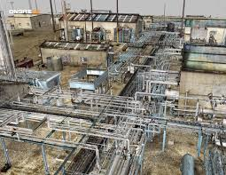
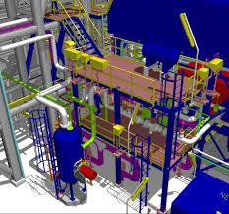
Scan first – A smart foundation
Surveyors
Scope Definition
Prefabrication
Engineering
Design Validation
EPC Contractors
Project Management
Maintenance
Regulators
QA/QC
QA/QC Teams
Handover Documentation
Constructability
Operations
Clash Detection
Digital Twin Enablement
Visual Twin Foundation
REALITY DATA
= AS-BUILT
3D MODEL
= AS-DESIGNED
One foundation, many workflows & users – aligned from day one.
Notes:
Cintoo provides a smarter, firmer foundation for asset heavy industries. – for all stakeholders and parties throughout the ecosystem and supply chain.
Making visibility of verified site or asset conditions available in a unified, collaborative platform.
In the first instance, Cintoo provides the “visual twin” of your site reality.
We support the entire supply chain or ecosystem - EPCs, contractors, surveyors, and end clients - all work from the same digital truth.
Design proposals can be overlaid against actual conditions for scoping and validation.
QA/QC workflows become traceable and auditable.
So, what if every stakeholder could see the same truth on day one?
The answer: fewer surprises, stronger confidence, and faster project execution.

Slide 6
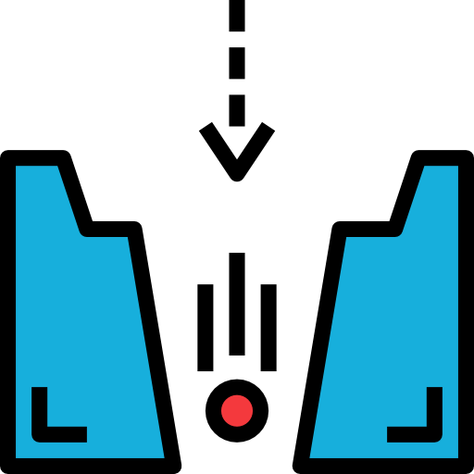
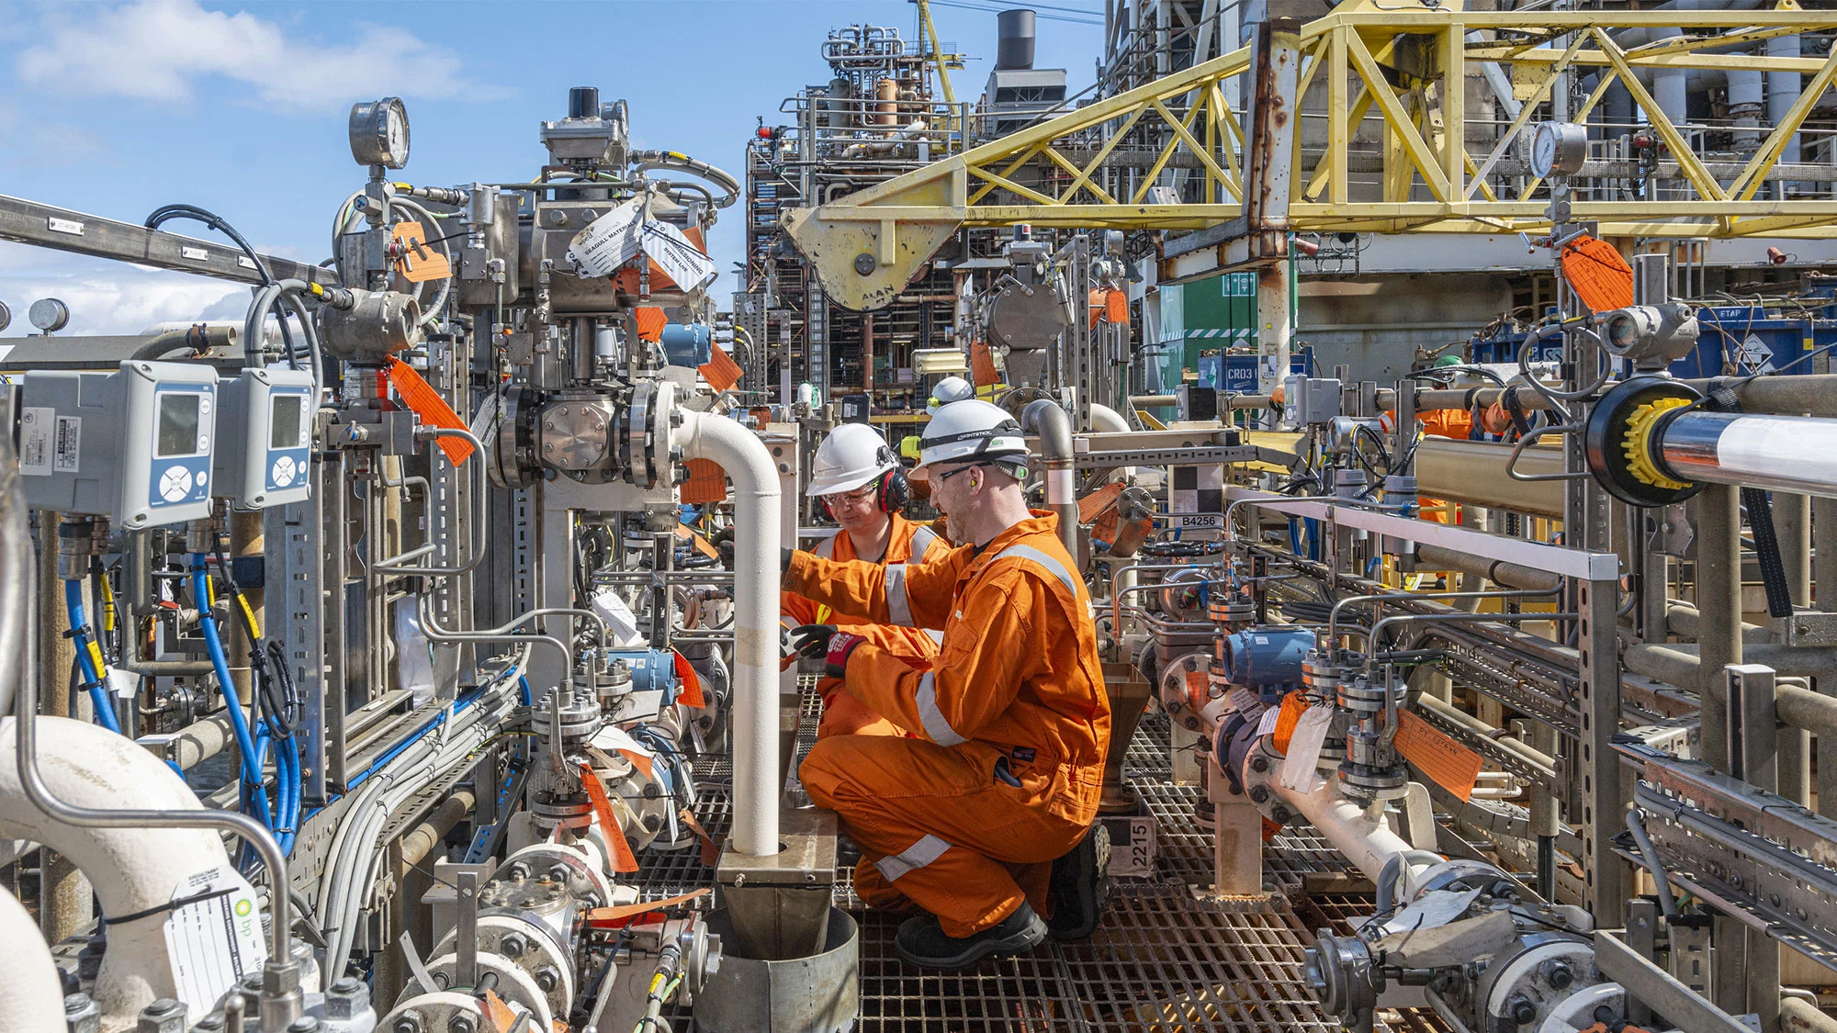


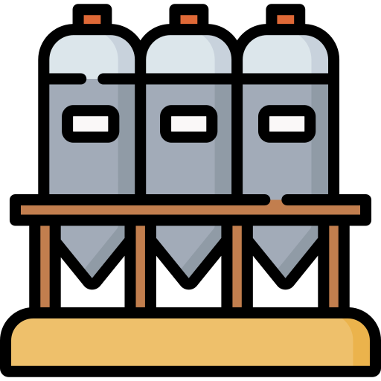





Project challenges
The Stakes – Why Projects Fail
Data Gaps
Multiple EPCs & Contractors
Schedule Pressures
Discipline Silos
Change Orders
Brownfield Retrofits = Higher Risk
Budget Overruns
Early Errors Snowball
Early Errors Multiply As Projects Progress
Design Assumptions
Misalignment
Field Clash
Rework
Delay
Cost Overrun
Notes:
We all understand that projects are complex from the outset:
Multiple parties, such as EPCs, subcontractors, surveyors, and internal stakeholders.
Immense pressure to hit budget and schedule targets.
And in brownfield work, we add retrofits in congested, live facilities often relying on decades-old documentation.
The reality is that early errors snowball. A small misalignment in design or outdated site data can cascade into clashes, redesigns, and expensive field modifications. Fixing those errors in the field costs 5 to 10 times more than catching them upfront.
So the challenge is clear: how do we lock in clarity and alignment before the first boots hit the ground?

Slide 7
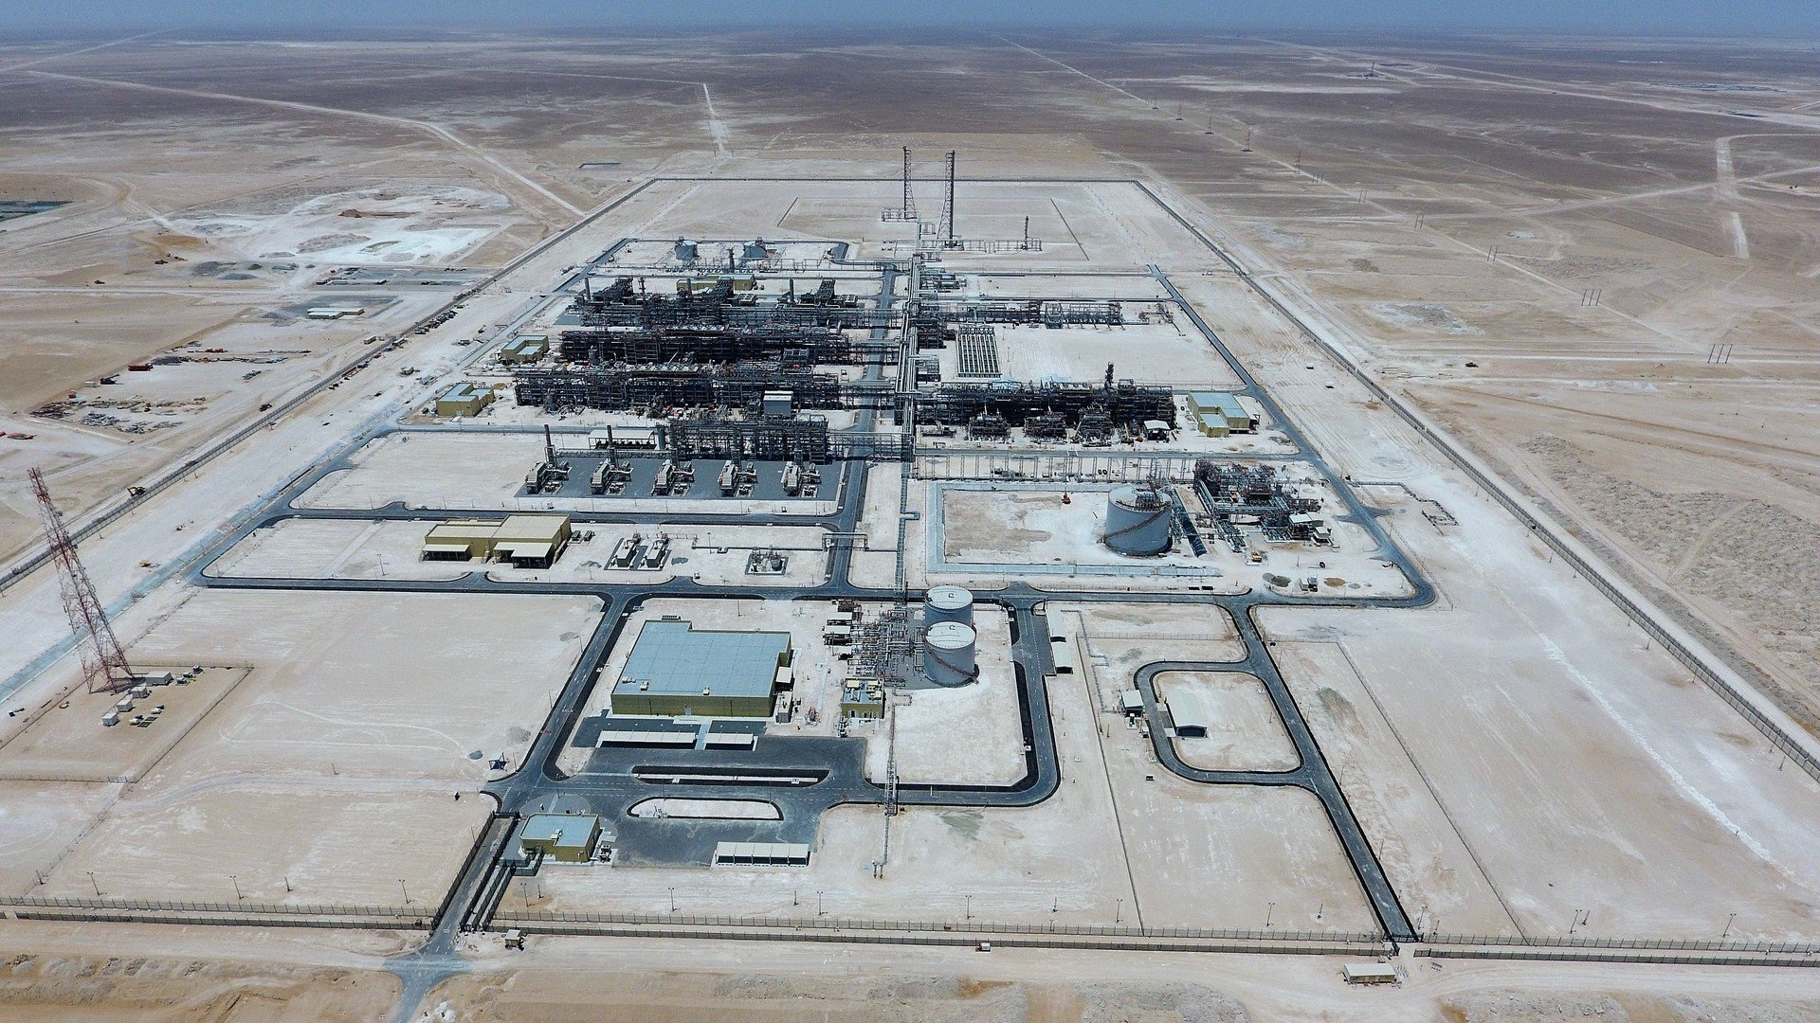
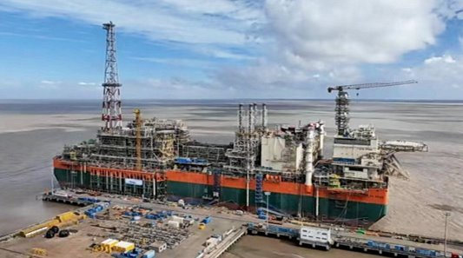
Data Overload > Actionable Intelligence
From Desing Intent to Reality
Onshore
Offshore
One Set of Scans -
Multiple Layers of Value
Brownfield Expansion
Greenfield Development
Notes:
Now, when we talk about design intent versus reality, it’s not just a single type of project we’re referring to.
Whether it’s an onshore facility, an offshore platform, a greenfield build, or a brownfield retrofit, the same challenges apply: keeping design intent aligned with evolving site conditions.
Reality capture provides that common, quantifiable record of truth — a data baseline that can be trusted and shared across every stakeholder, in every type of project.
But its value goes beyond traditional engineering workflows. With Cintoo, that same data supports site familiarisation, logistics planning, hazard identification, and HAZID/HAZOP studies.
In other words: one set of scans, multiple layers of value.
It’s about giving clients the confidence that design intent and site reality stay aligned — regardless of where the project is, or how complex the environment.

Slide 8


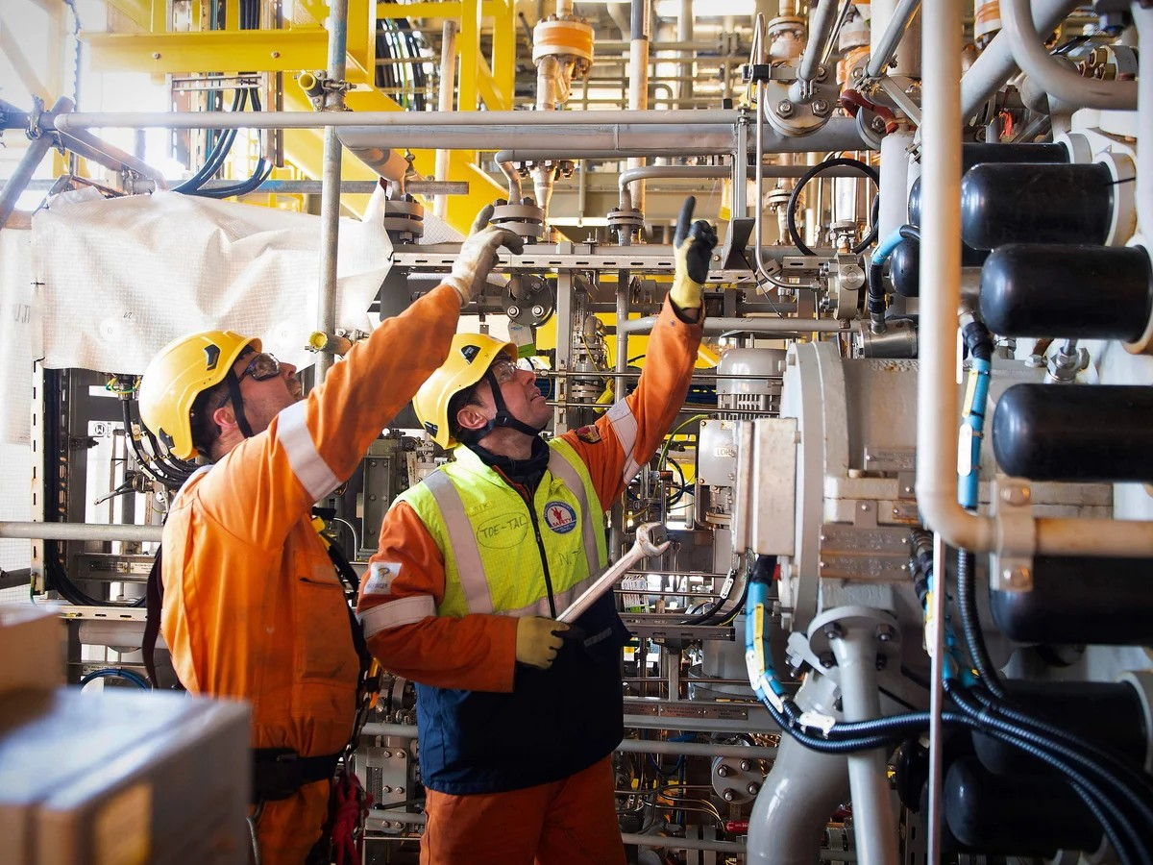
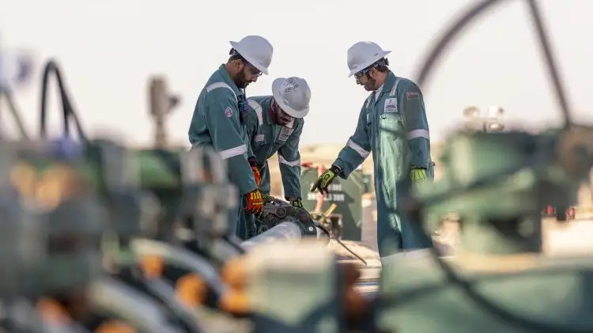
Data Overload > Actionable Intelligence
Data Overload > Actionable Intelligence
Digitization of assets and increasing complexity across the tech-stack
Complex and often hazardous process equipment
Complex transmission and storage of materials
Continual focus on process safety with evolving legislation
Notes:
And as we transition from project to operations
Many companies operate a complex portfolio: processing facilities, complex logistics and storage
Against a landscape of various digitization strategies or programs while expected to maintain profits, meet sustainability goals and comply with evolving legislation
Now multiply that across multiple regions, joint ventures, and decades of operation and legacy data — and you see the scale of information management required. A high potential for data overload.
And within each site lies additional layers of complexity.
Think about an upstream offshore platform, for example. It’s not just one structure — it’s thousands of components, generations of modifications, different contractors and operators, all leaving behind drawings, documents, and sometimes conflicting records.
Over decades, the data mountain grows, but clarity can actually shrink. And when clarity shrinks, risk grows.

Slide 9
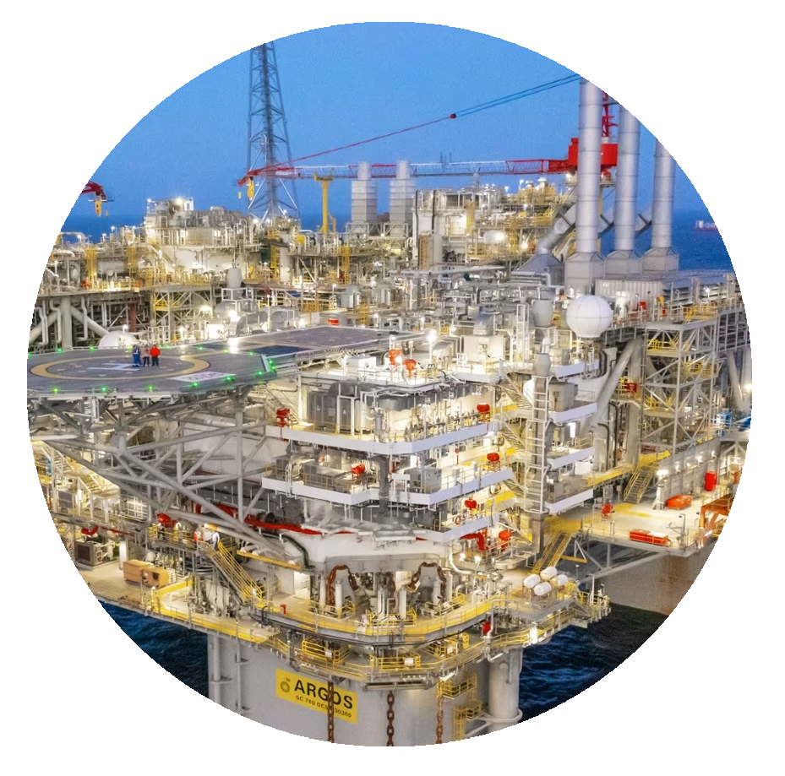
Data Overload > Actionable Intelligence
1 Typical Refinery
= 500,000+
Asset Components
1 Typical FPSO
= 1,000,000 + Scanned Objects
The challenge isn’t collecting scan data — it’s transforming its scale into trusted, actionable intelligence.
Notes:
Zoom into a single platform, terminal, or pipeline system: you’re not managing “an asset,” but millions of components — valves, pumps, exchangers, tie-in points, structures — each with its own lifecycle and inspection needs.
Too often, data is fragmented, outdated, or locked in silos. This slows decision making, unnecessarily complicates approval processes, and adds cost.
The challenge is clear: how do we transform overwhelming data into actionable intelligence — at scale, across the portfolio?
And this is where we need to make a mental shift. It’s not always about collecting more data — we often already have plenty.
The challenge is about curating, connecting, and activating that data so it becomes accessible intelligence. Because only readily accessible intelligence drives better decisions.

Slide 10
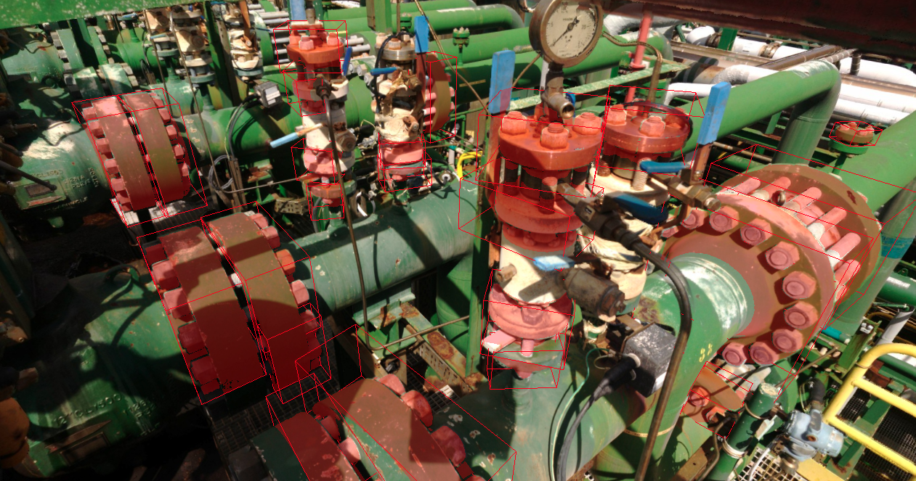


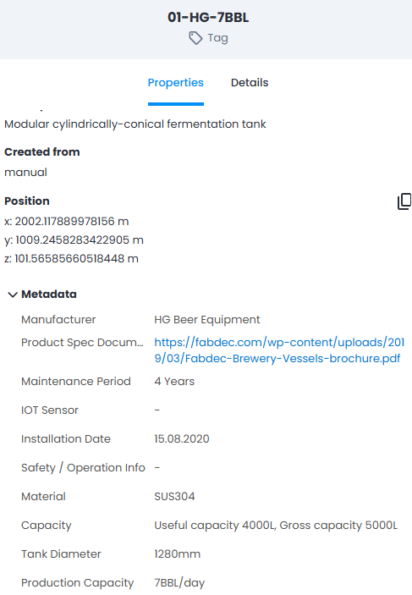


From Scan to Asset Intelligence
Point Cloud Data
Tagged, Searchable, Connected Assets
Meshed Visual-Twin
Notes:
Reality capture is powerful, but scans alone are just static data.
We maximise value realization when scans are structured, contextualized, and connected. (ARCGIS advisory document)
With Cintoo, this quantifiable data become a trusted source of truth:
Organized in the cloud for global access.
Unlimited users with customisable permissions and access logs
Aligned with as-built reality, not outdated drawings.
And integrated with enterprise systems and updated with live metadata
This transforms static scans into dynamic intelligence — usable daily by engineering, operations, and maintenance teams.
So instead of scans being treated as a snapshot that gets stored on a hard drive somewhere, they become part of a living, breathing information system.
Engineers can pull them up to validate tie-ins, operations teams can check equipment conditions, and maintenance can scope jobs without physically mobilizing first. That’s a step change from how scans have traditionally been used.

Slide 11

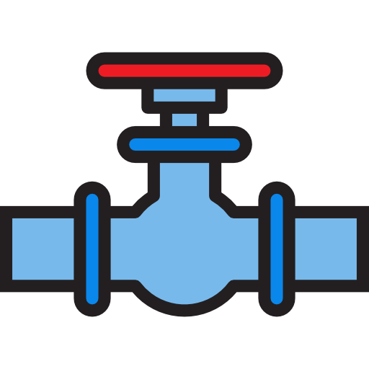




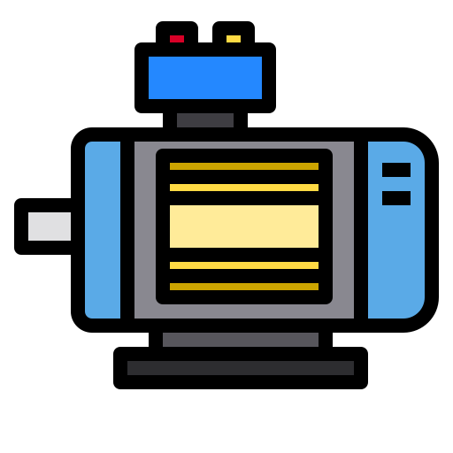
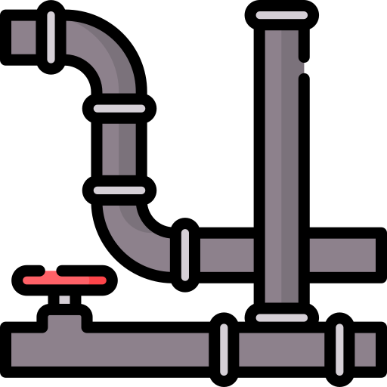
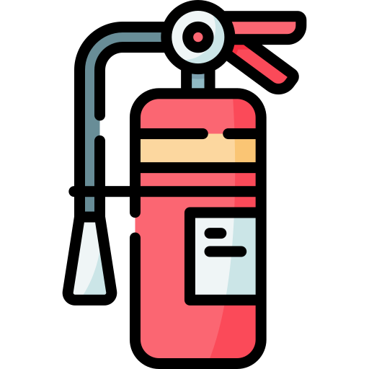
AI Enabled Asset Tagging with
Manual
Asset Tag
.CSV Imported Asset Tag
Create
Visual Asset Tag
AI Enabled Asset Identification
Select from 34* Asset Categories
valve (handwheel)
pressure
gauges
flanges
valve
(handle)
control
boxes
electric motor
pipes
fire equipment
AI Auto-Detection
Notes:
Here’s where things accelerate.
Cintoo doesn’t just store scans — Our Twin Edition transforms them into intelligent, visual asset libraries.
Assets can be tagged in three ways:
Manually in the scan,
Imported from an existing register in .CSV format,
Or automatically identified, with our AI machine learning tagging inside the scan data.
Our AI is trained currently to detect 34 critical asset categories — piping, valves, control boxes, flanges, motors, fire safety equipment, and more.
Every tag is verified against reality, showing its true condition, context, and connections — again all globally accessible in the cloud.
This means what was once just a 3D point cloud becomes something entirely different: a searchable, structured, and intelligent map of your facility. Imagine a safety inspector needing to check every fire sign location — instead of searching through PDFs, drawings, or making a trip to site, they can query the digital asset directly. That’s the power of structured tagging.

Slide 12


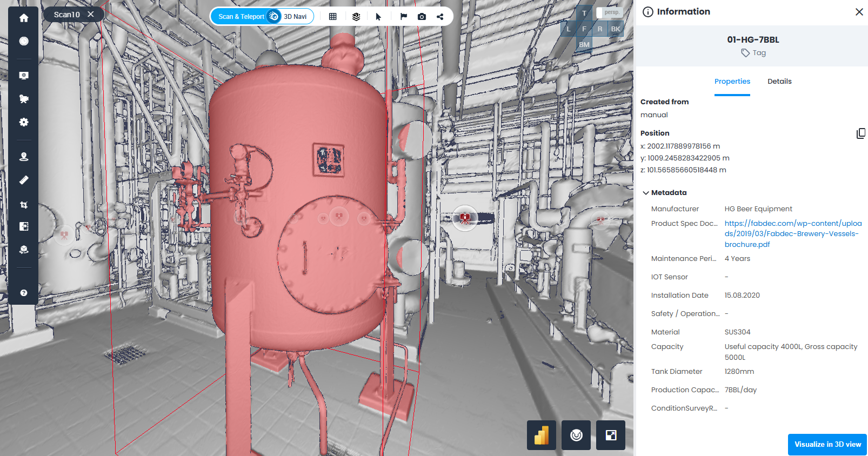
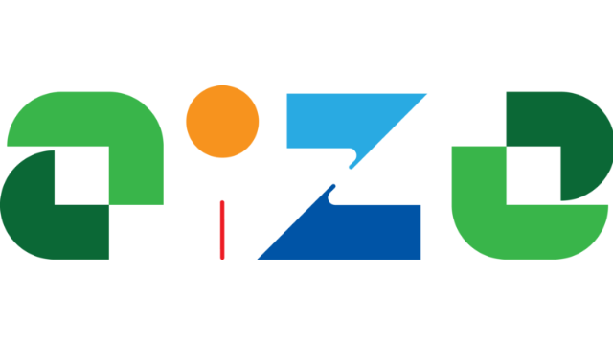
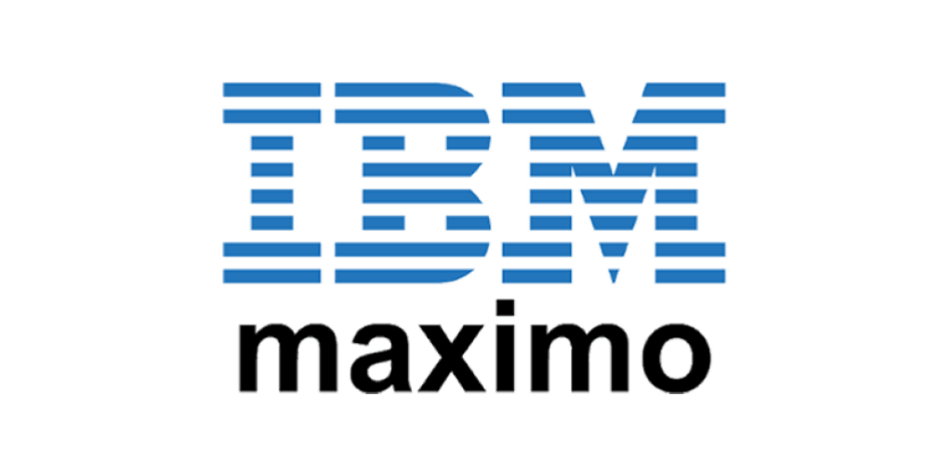



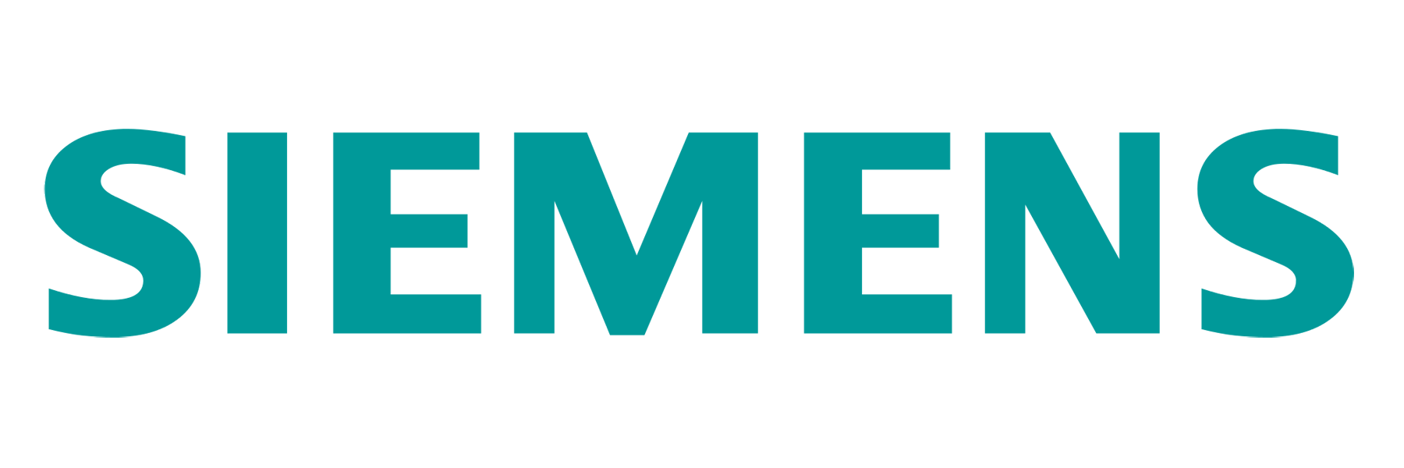

AI Enabled Asset Tagging with
Manual Edit Asset Info
Download Tag List > Edit > Import
Input, Sync & Connect Asset Info
Connect Unique Tag Via URL with EAM (others)
Notes:
The next step is linking those visual tags to intelligence.
Each tagged asset can be enriched with:
Manually entered details,
Synced records from an asset management system,
Or live links from various enterprise platforms.
Now each tag carries the latest operational data alongside its as-found condition.
This is where the digital twin takes shape — a continuously updated, visual foundation seamlessly connected to the systems that help run it.
And importantly — this isn’t about replacing existing systems. It’s about connecting them. Cintoo becomes the visual layer that brings all those databases and registers together in one place, in context, in reality.
That’s where the concept of a true digital twin becomes real — when you can see both the data and the actual condition, side by side.

Slide 13


Organisational Confidence
Lower Safety Risk
Reduced Travel
Trusted As-Built Conditions
Smarter Planning
Faster Compliance
Streamlined Audits
Collaborate Globally
Remote Monitoring
Traceable Asset Record
Reduced Downtime
Reality Data > Insight > Confidence > Action
Notes:
So what does this mean in practice?
Projects, commissioning, inspections, audits, and maintenance are resource-heavy. Teams travel, mobilize, and face risk — sometimes just to confirm existing conditions often taking copious notes and photos on the phones
With Cintoo, scan data allows many of these tasks to happen remotely:
Project Manager can visually check progress
Commissioners can be familiarised prior to stepping foot on site
Inspectors can review equipment from anywhere.
Audits can be supported with visual, measurable evidence.
Maintenance planners can validate access before scoping and mobilizing crews.
The result: fewer site visits, lower risk, faster compliance — with everyone working from the same reality.
Let’s take an example. An inspection team preparing to check valves at a site no longer has to drive to site just to confirm whether scaffolding will be needed. They can check in Cintoo, confirm clearances, and scope the job before mobilizing. That saves cost, reduces travel, and most importantly, cuts exposure hours in potentially hazardous environments.

Slide 14
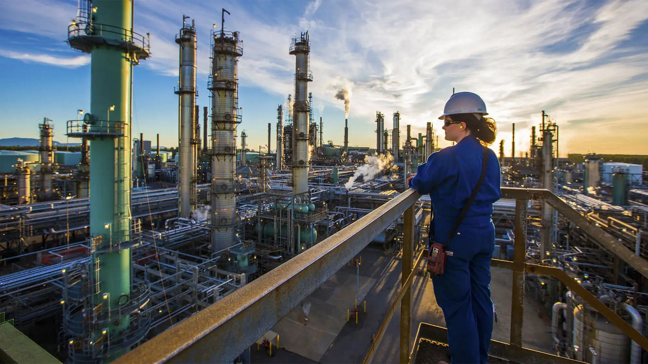



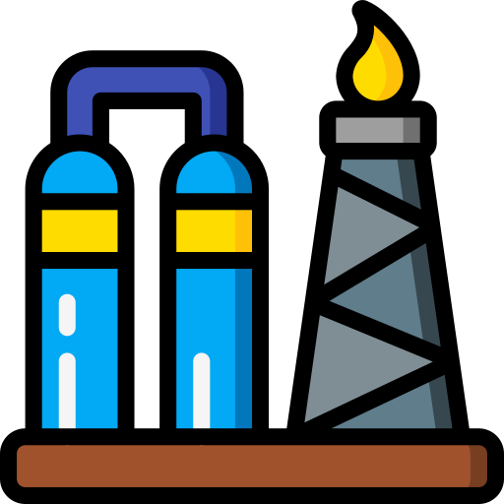

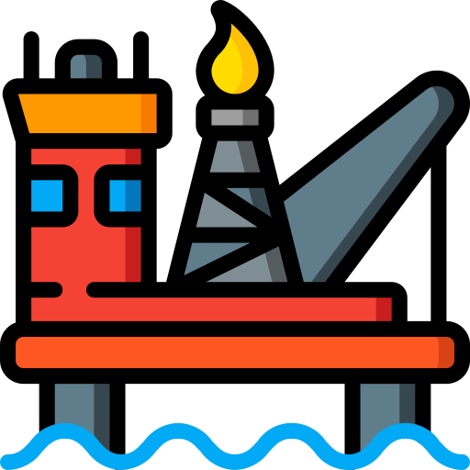
The path forward
DIGITAL TWIN
UNIFIED ASSET LIBRARY
PREDICTIVE INSIGHTS
The Backbone of Asset Clarity for Smarter, Safer Operations.
TODAY
CONNECTED ASSETS
Notes:
Digitization isn’t about one-off surveys and ad-hoc scans — it’s about continuous intelligence.
Cintoo project structures allow each new set of scans to strengthen the unified asset library, keeping operators aligned with the current status of their asset portfolio and even tracking legacy issues by comparing scan to scan
And no need to rip out existing IT: Cintoo’s API is designed to integrate with CMMS ERP’s and asset management databases so the digital twin stays live, current, and trusted.
So a path forward could be to:
Consolidate into a unified asset library.
Enable cross-team collaboration with connected assets.
Unlock predictive insights through rapidly developing AI.
And ultimately, build a full visual & digital twin — delivering clarity and confidence for decades.
And this is where the vision gets exciting: every new scan doesn’t just give you another snapshot, it enriches the intelligence. Over time, you build not just a picture of “what is,” but a record of “what has been” — a foundation for operational issues such as compliance, predictive maintenance, trend analysis, and truly proactive asset management.
This is how clarity scales

Slide 15
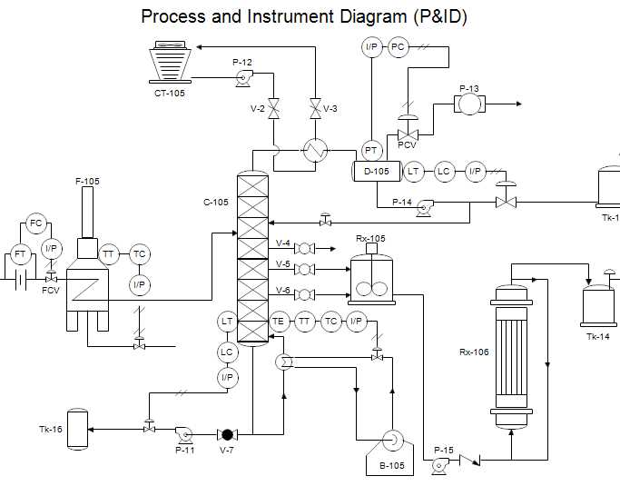
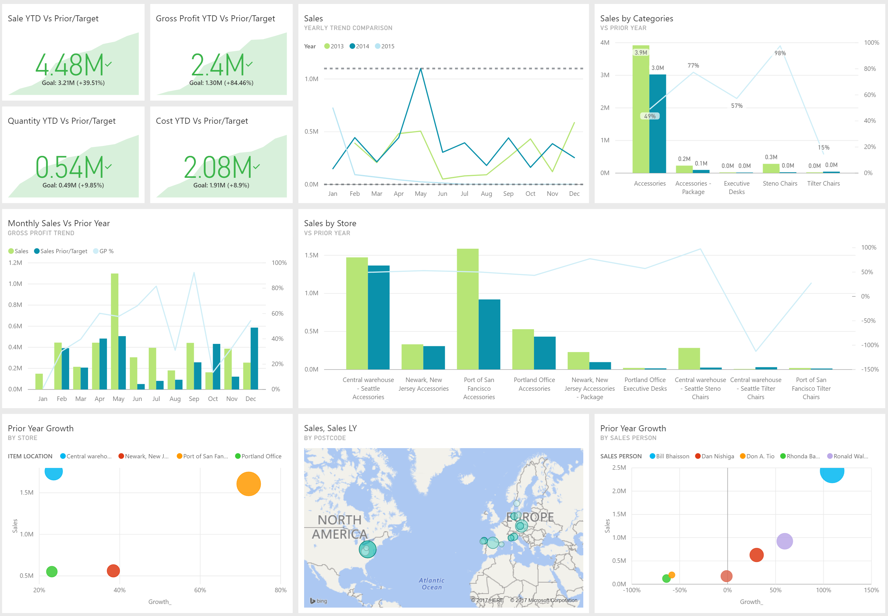

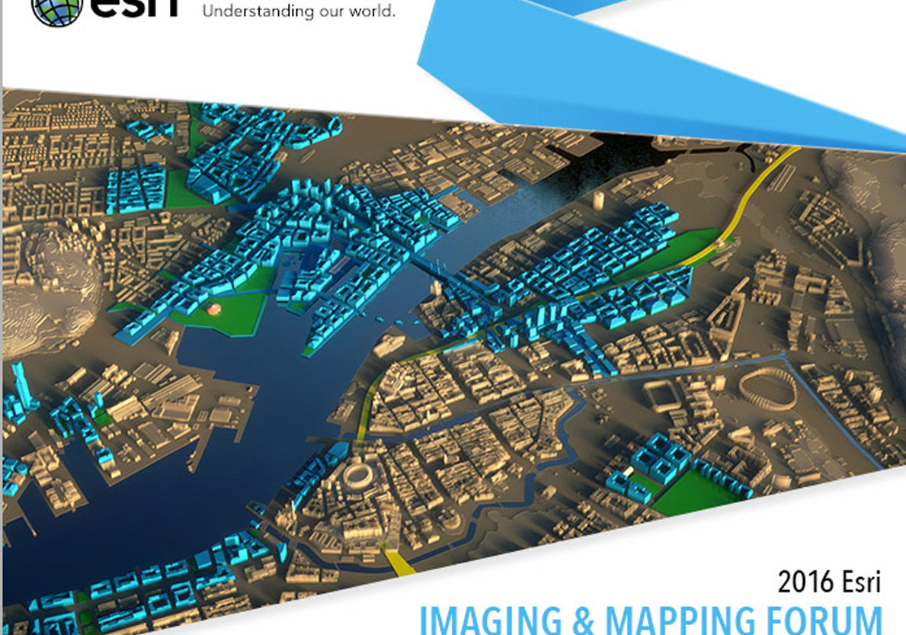
What next?
Notes:
And yes, what next, you might ask…
We already have the ability the visualise published PowerBI dashboards in the Cintoo platform with corresponding tagged coordinates.
Last week we formally released our ability to seamlessly integrate with Esri ArcGIS – allowing clients to visualise from satellite to 2mm resolution in single experience.
And in the next few weeks we will also be able to visualise 2d documents and schematics in the Cintoo platform alongside corresponding tag scan data
We are also training our AI algorithm to automatically detect cracks

Slide 16


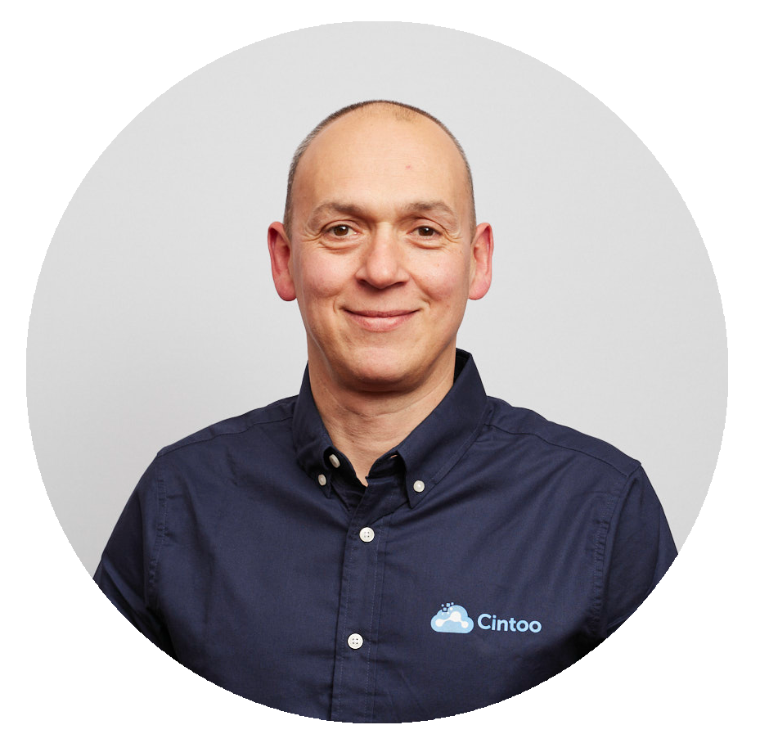
Thank you
Q & A
Ryan Goggin
Account Manager
ryan.goggin@cintoo.com
Notes:
So, what should you take away?
Assets live for decades, but clarity depends on knowing their condition and keeping data current and connected.
Cintoo’s Twin Edition turns static scans into dynamic intelligence — structured, tagged, searchable, and globally accessible.
The outcome: deeper knowledge based on quantifiable data that is integrated into the wider digital strategy, a foundational piece of digital twin strategies.
Now, let’s open the floor for your questions.

