Slide 1

Artificial Intelligence (AI) and human-centered Skills in Modern Engineering
By
A. Kayode Coker
Notes:
3:00–4:00
Relate AI to your model plots. Explain how production, purity, and sensitivity plots guide decision-making.

Slide 2

Presentation Flow (Summary)
Meaning of “Artificial” → Human brain
Cognitive functions → Neurons
ArtIficial intelligence (AI) → Machine learning (ML)→ Artificial neural Network (ANN)→ Generative ArtifIcial intelligence (GAI)
Human – Centered Skills
AN Example with Python script/program
A practical framework/Conclusion

Slide 3


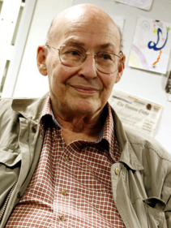
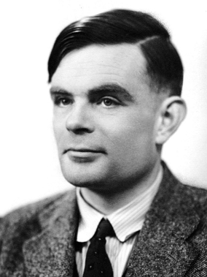
What is Artificial ?
Definition: Artificial means human‑made, engineered, constructed, something that does not arise naturally but is created through human ingenuity.
Artificial Intelligence, we are not referring to biological intelligence. We are referring to engineered intelligence systems designed to
simulate human cognitive functions such as learning, reasoning, pattern recognition, and decision‑making. It uses computer science and data to enable problem solving in machines
John McCarthy
American Mathematician and computer scientist, 1955
Marvin Minsky
Alan Turin, 1931
Notes:
John McCarthy (MIT), American mathematician and computer scientist coined the term “Artificial Intelligence” with Marvin Minsky (MIT) at a workshop conference for the Dartmouth Summer Research Project on Artificial Intelligence, Dartmouth College in Hanover, New Hampshire, USA.
Alan Turin studied at Cambridge, U.K., - Theoretical Foundations of Machine Intelligence, 1950. Turin is recognized as a pioneer in Computer Science and Artificial Intelligence.
The term “Artificial Intelligence” was coined in 1955 by the American mathematician and computer scientist John McCarthy. He introduced it in a written proposal for the Dartmouth Summer Research Project on Artificial Intelligence, which became the founding event of the field.
McCarthy chose the phrase deliberately to unify scattered research efforts under a single discipline. Before this, researchers used terms like automata theory, complex information processing, or cybernetics. By naming the field “Artificial Intelligence,” McCarthy and colleagues Marvin Minsky, Nathaniel Rochester, and Claude Shannon established a clear identity for the scientific study of machine intelligence.

Slide 4

AI, ML, and ANN: Tools for the Engineer
Artificial Intelligence, Machine Learning, and Artificial Neural Networks are powerful tools that can accelerate engineering analysis, improve decision-making, enhance process safety, and optimize plant performance.
They are not replacements for engineering fundamentals, engineering judgment, or human responsibility.
Notes:
AI tools include a range of technologies that work together to enable advanced analytics to perform various functions. Deep learning techniques utilize neural networks with many layers to analyze various forms of data, such as images, sound, and text. For example, natural language processing (NLP) extracts information from human-generated text, and computer vision interprets images and videos to perform tasks.
Advanced analytics uses artificial intelligence (AI) to simulate a human level of intelligence. With AI, you can process more data, work on more complex modeling, and incorporate increasingly abstract algorithms.

Slide 5
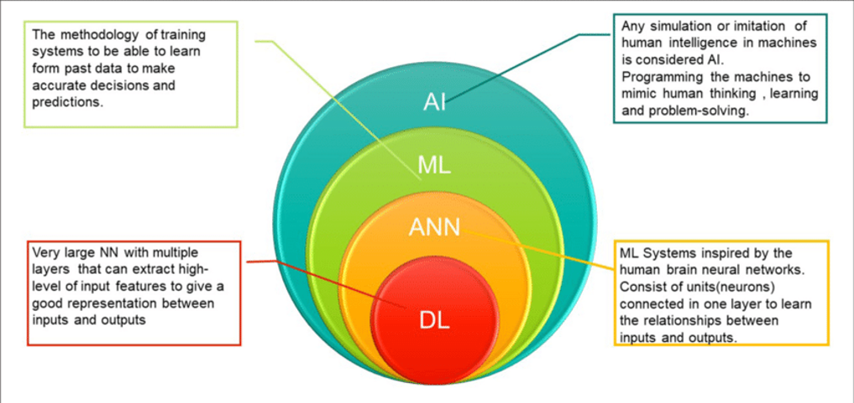
Generative AI within the AI hierarchy
The modern AI stack is typically structured like nested boxes:
• Artificial Intelligence (AI) Broadest category — any system that
mimics human intelligence.
• Machine Learning (ML) Subset of AI — systems that learn
patterns from data.
• Deep Learning (DL) Subset of ML — neural networks with many
layers.
• Generative AI (GenAI) Subset of DL — models that create new
content (text, images, audio, code, Fortran, C/C++, Java, MATLAB, Python, R-statistical and data analysis, SQL-database queries) based on learned patterns. It can translate code between languages Fortran-> C++→ Python
Notes:
AI and ML tools: are software systems, platforms, and frameworks that enable engineers, data scientists, and organizations to:
Build intelligent applications
Analyze large datasets
Train machine learning models
Automate decision‑making
Deploy predictive and optimization solutions
They provide the algorithms, computing power, data pipelines, and interfaces needed to turn raw data into actionable intelligence.

Slide 6
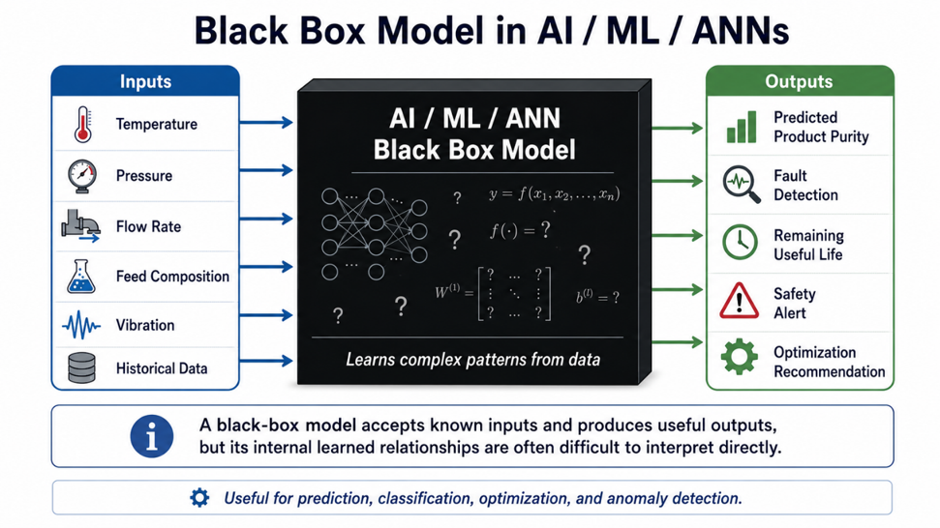

Slide 7

Artificial Intelligence allows for computers and machines to do things that would normally require human intelligence:
Automation
Prediction
Decision Support
Perception
Language Understanding and Generation
Creativity and Content Generation
Simulation and Optimization
Personalized Experiences
Notes:
AI can perform repetitive and complex tasks automatically (e., Adjust reactor temperature, feed rates, valve positions to keep a process within operating limits without constant intervention)
AI can identify patterns in data and forecast likely outcomes (e.g, equipment failure prediction, when a heat exchanger foul, when a catalyst will lose activity or when a pump is likely to fail based on historical process data ).
AI can analyze large amounts of information and suggest actions. (e.g., During an upset condition, AI recommends actions such as reducing feed rate, changing reflux ratio, or switching operating models to maintain product quality)
AI can analyze camera feeds to detect leaks, corrosion, flame abnormalities, unsafe worker behavior and so on.)
AI can work with human language (e.g., translation, summarization, Question answering, Conversational assistants, such as “Why did reactor conversion drop yesterday?” and AI can summarize process trends, alarms histories and operating reports.)
Generative AI can create new content, (e.g., AI generates operating procedures, maintenance instructions, P&ID documentation drafts, control narratives, HAZOP preparation notes, or simulation code (such as Python)
AI works with process simulations to optimize energy consumption, maximize yield, minimize emissions, or identify the most profitable operating point.
AI adapts dashboards and alerts to specific roles. (e.g., Operators, maintenance engineers, process engineers, and plant managers each receive information tailored to their responsibilities).

Slide 8
8
Table 1. Application of AI/ML Data Processing in CPI
Performance | AI/ML/ANNs Description
Classify | Assign data into categories (e.g., fault types, product grades)
Detect | Identify anomalies, events, or patterns in real times
Recognize | Interpret images, signals, speech or sensor data
Estimate | Approximate unknown values or parameters.
Forecast | Predict future trends or time-series behavior
Infer | Draw conclusions from incomplete or noisy data
Recommend | Suggest best actions, settings or decisions.
Control | Adjust processes dynamically (e.g., RL –based control)
Simulate | Generate synthetic scenarios or process behavior
Learn | Improve performance from data or experience
Adapt | Modify behavior when conditions change
Notes:
RL-based control stands for Reinforcement Learning-Based Control, an artificial intelligence (AI) approach in which a control system learns to make decisions and adjust process operating conditions dynamically through interactions with its environment.Unlike conventional controllers, such as PID controllers, which operate according to predefined control laws, an RL-based controller learns a control policy by receiving rewards or penalties based on the consequences of its actions.

Slide 9
Engineering Perspective
It is equally important to emphasize what AI/ML/ANN do not do. They do not:
Replace engineering judgment.
Replace first-principles engineering.
Replace ethics or professional responsibility.
Replace human creativity.
Replace leadership and communication.
Replace accountability for engineering decisions.
They work alongside engineers, making them more capable by adding to, assisting, speeding up, supporting, and improving their skills.

Slide 10

Characteristics of Deterministic Models
They are:
Physics-based
Explainable
Repeatable
Accurate when assumptions are correct
Used for engineering design
Examples include:
Heat exchanger sizing
Distillation design
Pump sizing
Reactor design
Pipe hydraulics
The calculations are based upon:
• Mass balances
• Energy balances
• Momentum balances
• Thermodynamics
• Heat transfer
• Fluid flow
• Phase equilibrium
These equations are called First-Principles Models.

Slide 11
Instead of solving
Mass Balance
↓
Energy Balance
↓
Vapor Liquid Equilibrium (VLE)
↓
Tray-by-Tray Calculations
↓
Product Purity
AI Learns Patterns
Processes involving randomness, probability, statistical elements, and uncertainty are described as stochastic in AI, ML, and ANNs.
Deterministic processes in simulators like Aspen HYSYS, ChemCAD, and Honeywell UniSim Design involve calculations that are set and predictable, adhering strictly to physical principles.
AI simply learns
Inputs
↓
Patterns
↓
Predicted Output
AI/ML/ANNs = probabilistic learning Process simulators = deterministic physics
stochastic = statistical + probabilistic + randomised behavior.
Notes:
The three terms are related but are not identical:
• Artificial intelligence (AI) is the broad field concerned with computer systems that perform prediction, reasoning, optimization, diagnosis, or decision-support functions.
• Machine learning (ML) is a branch of AI in which algorithms learn relationships from historical or real-time data.
• Artificial neural networks (ANNs) are a family of ML models inspired loosely by biological neural structures. Deep neural networks, convolutional neural networks, recurrent neural networks, and long short-term memory networks are specialized ANN architectures.

Slide 12


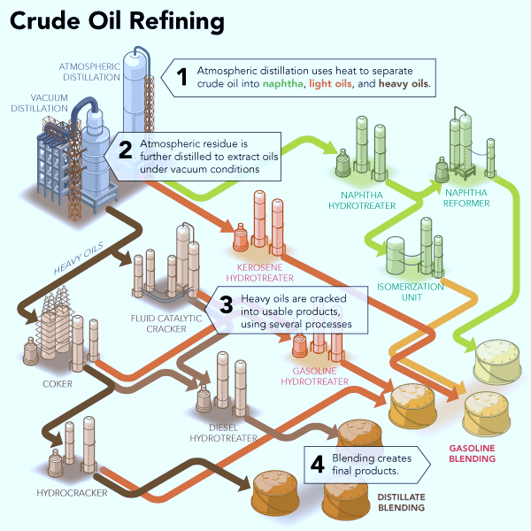
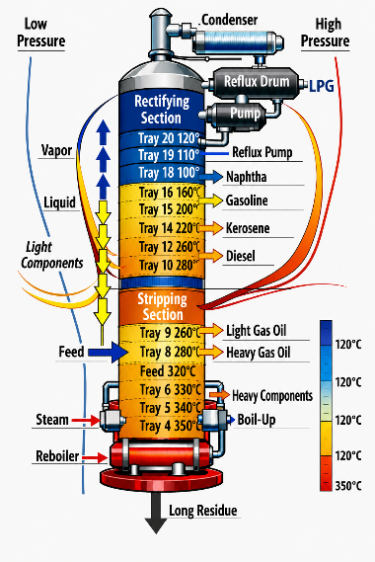


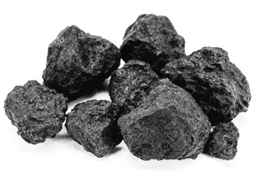
Raw Materials
Separation
Process
Chemical
Process
Separation
Process
Products
Qg > Qr
By Product
C₁-C₂ – Refinery fuel gas
C₃-C₄
C₅-C₇
C₈
C₁₀-C₁₆
C₁₂-C₂₂
C₁₂–C₂₀
C₂₀–C₃₀
Coke
C₃₀ – C₇₀₊
Figure 1. Petroleum crude oil refining
Notes:
AI/ML/ANNs tools are now employed in modern petroleum refineries for process monitoring, prediction maintenance, energy management, product quality prediction, process safety and refining planning. Increasingly, these
Data driven models are integrated with first principles process models, digital twins, process historians and advanced control system rather being used as stand alone black box models.
AI, ML, and ANN technologies are powerful data-driven tools used to analyze, predict, optimize, and solve complex problems in chemical and petroleum refining processes. Many ANN and deep learning models are often referred to as "black-box" tools because they learn process behavior from historical data without explicitly revealing the underlying physical relationships. Consequently, modern industrial practice increasingly combines AI with first-principles engineering models to improve accuracy, interpretability, safety, and operational reliability.

Slide 13

Table 2. Application of AI/ML/ANN in Petroleum Refining
Process Unit | Primary Function | Applications of AI/ML/ANNs
Crude Distillation Unit (CDU) | Separates crude oil into fractions based on boiling point. | Predict crude assay behavior, optimize furnace outlet temperature, predict product yields, monitor tray efficiencies, detect fouling, optimize reflux ratios, estimate energy consumption.
Vacuum Distillation Unit (VDU) | Separates atmospheric residue into vacuum gas oils and vacuum residue under reduced pressure. | Predict vacuum gas oil quality, optimize vacuum pressure, detect heater fouling, estimate coke formation, monitor vacuum system performance.
Delayed Coker | Thermally cracks heavy residues into lighter products and petroleum coke. | Predict coke yield and quality, optimize drum switching, predict drum fouling, monitor heater tube coking, detect abnormal temperature profiles.
Fluid Catalytic Cracking (FCC) | Converts heavy gas oils into gasoline, LPG, and light olefins. | Predict gasoline yield and octane, optimize catalyst circulation, monitor regenerator temperature, predict slide valve degradation, detect catalyst deactivation, optimize air distribution.

Slide 14

AI/ML/ANN‑Enabled Linear Regression Models for Crude‑Oil Refining Applications
Model | Description | Crude‑Oil Refining Example
Simple Linear Regression | One predictor → one response; assumes a straight‑line relationship. | Predicting crude density from API gravity for quick tank‑farm blending estimates.
Multiple Linear Regression | Several predictors contribute independently to the output. | Estimating distillation column top temperature using reflux ratio, feed temperature, and tray efficiency.
Polynomial Regression | Captures curved relationships using squared or cubic terms. | Modelling viscosity–temperature behaviour of vacuum residue for heater design.
Ridge Regression (L2) | Penalizes large coefficients; stabilizes models with correlated variables. | Predicting sulfur content in diesel using correlated feed properties (crude sulfur, HDS reactor temperature, space velocity).
Lasso Regression (L1) | Shrinks some coefficients to zero → automatic variable selection. | Identifying key factors affecting coker furnace tube fouling from dozens of operational parameters.
Elastic Net Regression | Mix of L1 + L2 penalties; ideal for correlated refinery variables. | Modelling FCC gasoline yield using feed Conradson carbon, riser temperature, catalyst activity, and steam injection.
Bayesian Linear Regression | Produces probability distributions for predictions → uncertainty quantification. | Estimating remaining catalyst activity in hydrotreaters with confidence intervals for shutdown planning.
Principal Component Regression (PCR) | Uses PCA to reduce dimensionality before regression. | Predicting crude assay properties (e.g., TBP curve) from multivariate spectroscopic data.
Partial Least Squares Regression (PLS) | Finds latent variables that maximize covariance with the target. Widely used in chemometrics. | Building soft sensors for FCC riser outlet composition using NIR/FTIR measurements.

Slide 15

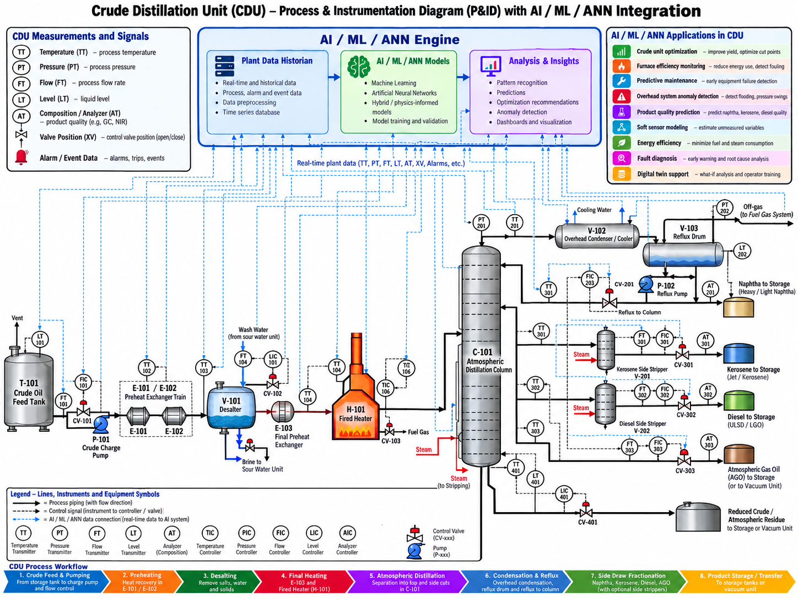
Crude Distillation Unit (CDU) Process and Instrumentation Diagram (P&ID) Integrated with AI, Machine Learning, and Artificial Neural Networks for Intelligent Monitoring, Control, and Optimization
AI/ML models – identify abnormal operating conditions, ANNs models can predict equipment performance, detect faults, provide early warning of potential process upsets.
Notes:
For example, AI/ML models can use pressure, temperature, flow, and composition data associated with instruments shown on a P&ID to identify abnormal operating conditions, while ANNs can predict equipment performance, detect developing faults, and provide early warning of potential process upsets. When integrated with digital twins and plant historians, P&IDs can therefore serve as an important visual framework for applying intelligent monitoring and decision-support systems

Slide 16

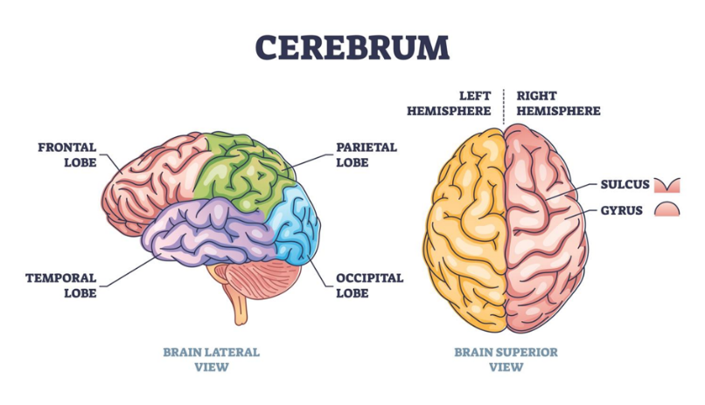
Human Brain
Figure 2. The Cerebrum (The Largest Part of the Brain) The Cerebrum occupies the upper and front portions of the brain and accounts for approximately 85% of the brain's mass. The Corpus Callosum connects the two hemispheres, which enables them to communicate with one another without any difficulty.
Notes:
The Cerebrum is the largest region of the brain, and is responsible for higher processes such as thoughts, action and processing of sensory information. The Corpus callosum connects the two hemispheres, which enables them to communicate with one another without any difficulty

Slide 17

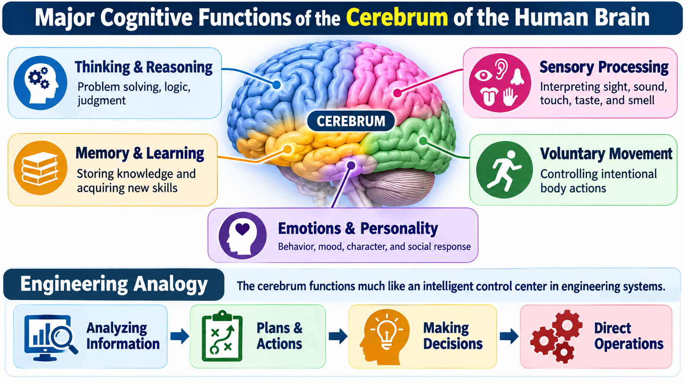
The cerebrum acts like the brain’s intelligent control centre: it receives information, analyzes it, develops plans, makes decisions, and directs appropriate actions
Notes:
The cerebrum acts like the brain’s intelligent control centre: it receives information, analyzes it, develops plans, makes decisions, and directs appropriate actions.
The cerebrum is the largest part of the human brain and is responsible for higher-level cognitive activities, conscious thought, interpretation of sensory information, voluntary actions, and aspects of personality and emotion.
1. Thinking & Reasoning
The cerebrum supports logical thinking, problem-solving, judgment, planning, and decision-making. It enables humans to analyze situations and select appropriate responses.
2. Memory & Learning
It plays a major role in storing information, recalling past experiences, acquiring knowledge, and developing new skills through learning.
3. Sensory Processing
The cerebrum receives and interprets information from the senses, including sight, hearing, touch, taste, and smell, allowing the brain to understand and respond to the surrounding environment.
4. Voluntary Movement
It initiates and controls intentional movements such as walking, writing, speaking, operating equipment, and other purposeful physical actions.
5. Emotions & Personality
The cerebrum contributes to emotional responses, behaviour, motivation, social interaction, judgment, and personality characteristics.
Engineering Analogy
In engineering terms, the cerebrum can be compared with an intelligent supervisory control and decision-making system. It performs a sequence similar to:
Analyzing Information → Plans & Actions → Making Decisions → Direct Operations

Slide 18
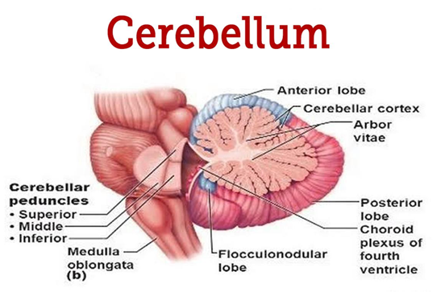
Figure 3. The Cerebellum is located at the lower rear portion of the brain, beneath the cerebrum. Although much smaller than the cerebrum, it contains more than half of the brain's neurons. It is responsible for coordinating movement and balance, and ensures that activities are smooth and accurate.

Slide 19
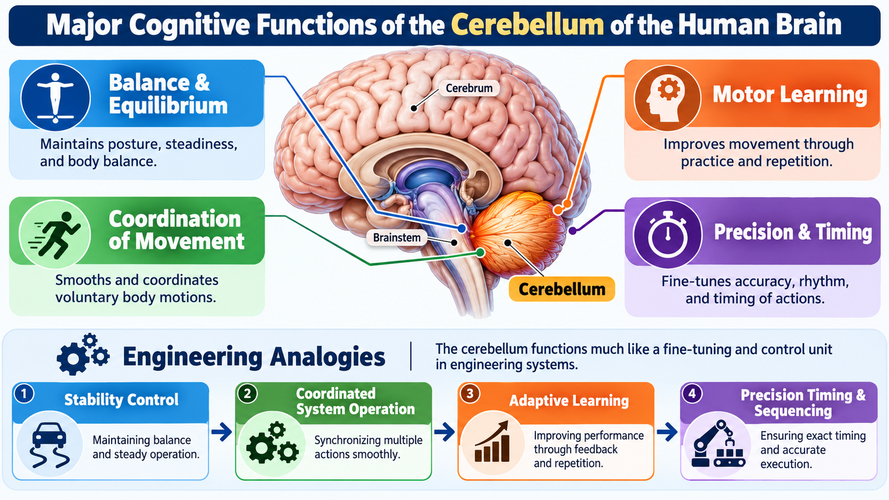
The cerebellum acts like the brain’s fine-tuning and feedback controller, maintaining stability, coordinating actions, learning from experience, and ensuring precise timing and execution.
Notes:
The cerebellum acts like the brain’s fine-tuning and feedback controller, maintaining stability, coordinating actions, learning from experience, and ensuring precise timing and execution.
The cerebellum is located at the back of the brain and plays a major role in maintaining balance, coordinating movement, refining motor skills, and ensuring precise timing of physical actions.

Slide 20

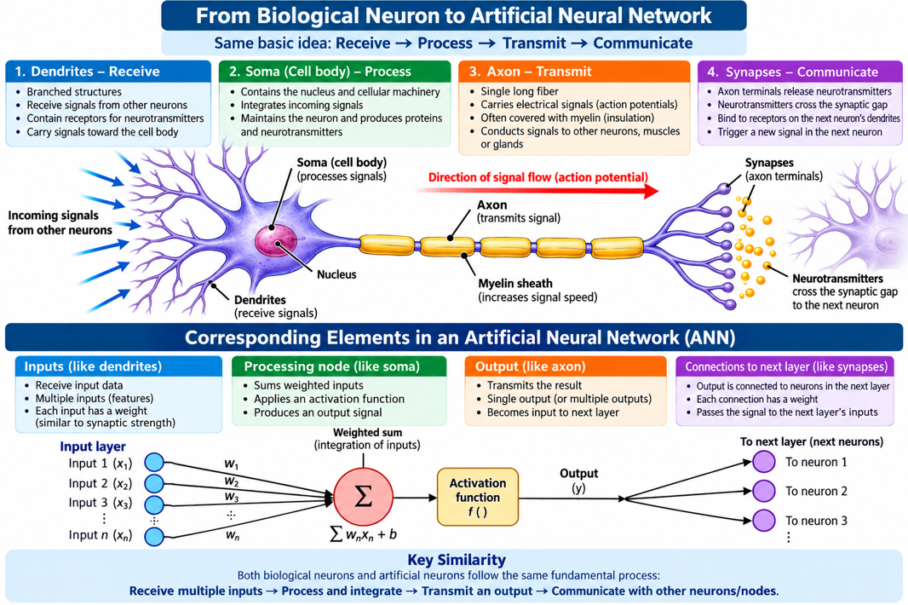
From Biological Neurons to Artificial Neural Networks: Structure, Signal Flow, and Functional Correspondence
The image illustrates the functional correspondence between a biological neuron and an artificial neural network (ANN). It emphasizes that both systems follow the same basic sequence:
Receive → Process → Transmit → Communicate
Notes:
Neurotransmitters travel across the synapse to the dendrites of the subsequent cell. The procedure is repeated an infinite number of times, resulting in a communication network that is both dynamic and constantly developing.
Principal is Glutamate: Responsible for increasing the firing of neurons and plays an importance in the process of learning and memory
Dopamine: Plays a role in the process of reward and motivation.
Serotonin: Influences mood, hunger and sleep.
The major structural component of a neuron: Dendrites, Axon and Synapses
Together, these components form the neural circuitry of the brain — a dynamic network that processes, transmits, and refines information, much like a distributed control system in process engineering. Neurons that are coupled to one another and work
Synapses are the connections that allow neurons to communicate with one another, and neurotransmitters are the chemical messengers that are responsible for transporting impulses across these gaps. Consider synapses to be locations at which performers in an orchestra pass on their melodies to one another and neurotransmitters to be the notes that are played by their instruments.
Glutamine is the principal excitatory neurotransmitter in the brain. It is responsible for increasing the firing of neurons and plays an important part in the processes of learning and memory.

Slide 21

For chemical and process engineers, cognitive functions are fundamental in areas such as:
Process design
Plant operation
Hazard analysis
Process control
Optimization
Troubleshooting
Safety management
Project leadership
First-Principles Models from process simulation platforms + Plant Data + AI/ML/ANN + Process Control-→ Predictive, prescriptive and real- time optimization capabilities across petroleum and chemical process operations.

Slide 22
Table 3. The principal AI/ML/ANN tools in Refining & CPI
AI/ML/ANN Tool or Technique | Typical CPI Application | Examples of Vendors/Platforms
Artificial Neural Networks (ANNs) | Nonlinear process modeling, soft sensors, product-quality prediction, equipment-performance estimation | AspenTech, AVEVA, Honeywell, Siemens
Deep Neural Networks / Deep Learning | Complex nonlinear prediction, inferential quality estimation, pattern recognition, equipment diagnostics | Aspen DMC3, Aspen Inferential Qualities, industrial AI platforms
Supervised Machine Learning | Prediction of yield, temperature, pressure, product properties, emissions and equipment condition | AspenTech, Honeywell Forge, AVEVA, Siemens
Unsupervised Learning | Anomaly detection, clustering of operating states, abnormal-condition identification | Honeywell, AspenTech, Emerson, Siemens
Regression Models | Soft sensing, property prediction, energy-consumption prediction and process correlations | Most process-simulation and analytics platforms
The important distinction is that AI does not replace conventional chemical-engineering simulation. The most powerful industrial architecture is increasingly:
First-Principles Models + Plant Data + AI/ML/ANN + Process Control
Notes:
Simulation and automation companies serving the petroleum, refining, petrochemical, and chemical process industries increasingly combine conventional first-principles process simulation with Artificial Intelligence (AI), Machine Learning (ML), Artificial Neural Networks (ANNs), advanced analytics, and digital-twin technologies. The principal tools can be grouped as follows.

Slide 23
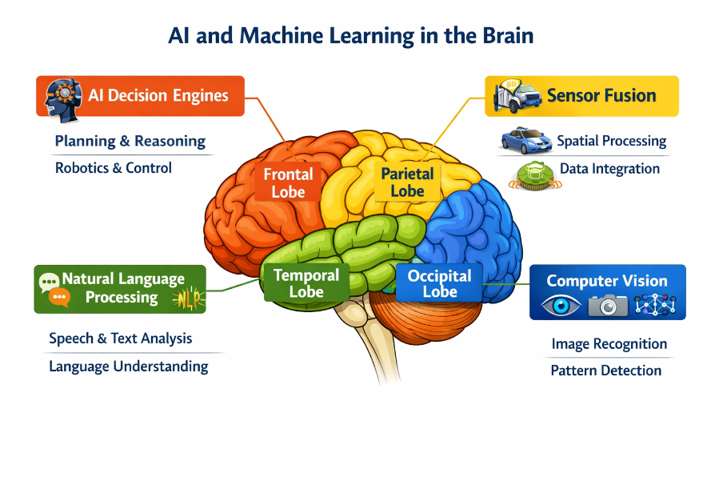
Figure 4. AI and Machine Learning in the Human Brain
NLP (Natural Language Processing) is the field of AI/ML/ANNs that enables machines to understand, interpret, generate, and interact with human language. It is the bridge between human communication and machine intelligence.
Notes:
Machine Learning allows systems to learn from data. Generative AI allows systems to create new possibilities — new designs, new solutions, new pathways.
Models such as:
VAEs (Variational Autoencoders)
GANs (Generative Adversarial Networks)
Transformers
extend our ability to simulate, predict, and generate engineering solutions.”

Slide 24
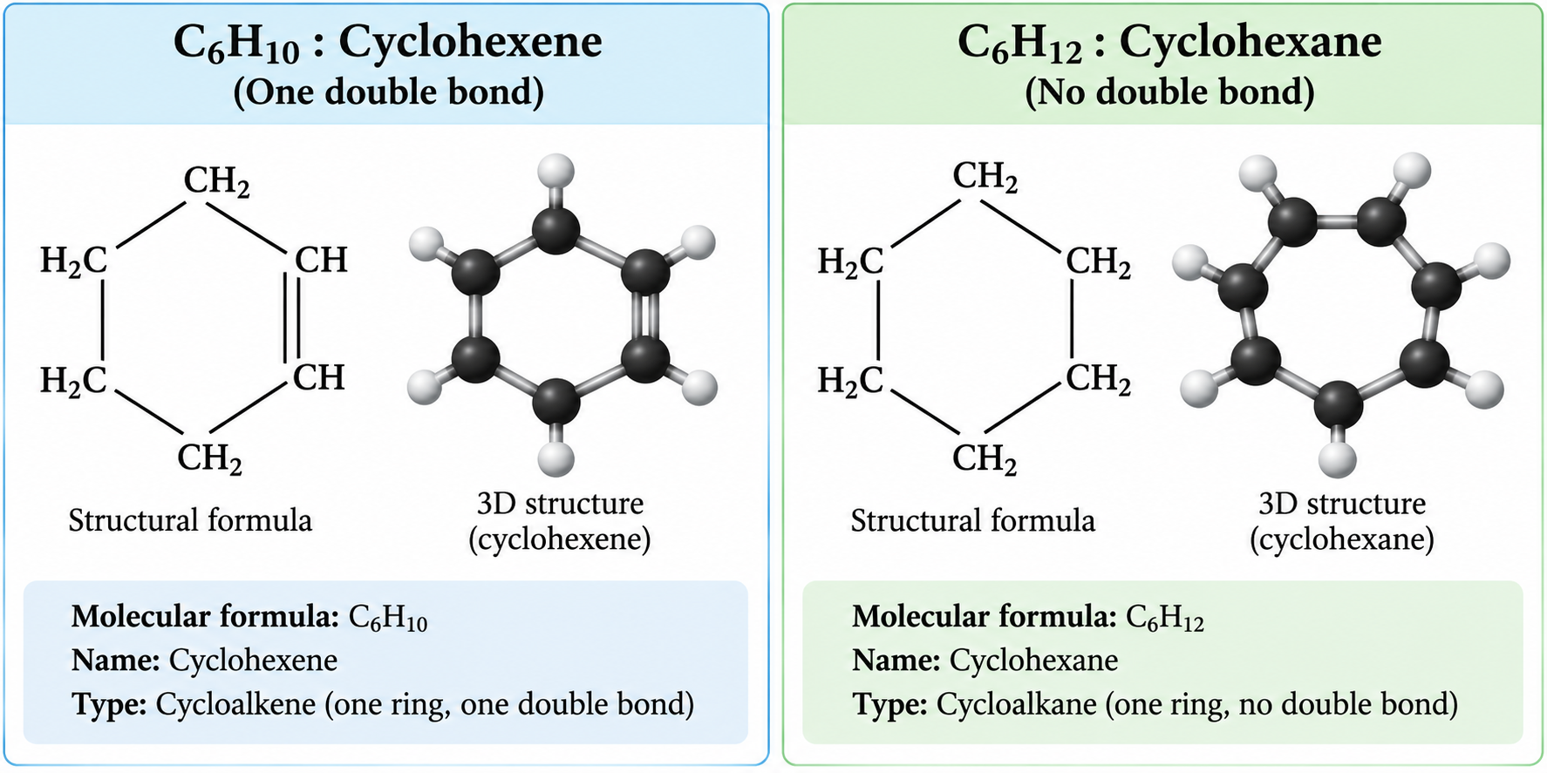


Example: Optimizing Catalyst Design.
Generative AI can assist engineers by predicting the performance of various catalyst compositions before they are synthesized in the laboratory
For a cycloalkene containing one C=C double bond:
$$\boxed{C_{n}H_{2n−2}+H_{2}→C_{n}H_{2n}}$$
Thus:
$$\boxed{\text{Cycloalkene}+H_{2}\underset{→}{\text{Catalyst}}\text{Cycloalkane (Cycloparaffin)}}$$
Sample data
(C₆ H₁₀ +H₂→C₆ H₁₂ )
Parameter | Input Content
Reaction Type | Hydrogenation of alkenes
Desired Product | Cycloalkanes
Temperature Range | 50-100ºC
Pressure Range | 1 – 10 atm
Material Costs | Low-cost materials performed
Performance Metrics | Conversion rate, selectively and stability
$$\boxed{\text{Cyclohexene}+H_{2}\underset{→}{Ni, Pt, Pd}\text{Cyclohexane}}$$
Generate a list of potential catalyst formulation and their expected performance metrics.
Notes:
Cyclohexane (C₆H₁₂) and cyclohexene (C₆H₁₀) are both important in the chemical process industries (CPI), but cyclohexane is produced and consumed on a much larger industrial scale. Their principal commercial production is generally associated with the petrochemical industry, although cyclohexane can also occur in refinery streams. Compound Major CPI uses Typical industrial source cyclohexane, C₆H₁₂ Nylon intermediates, solvents, chemical synthesis. Mainly petrochemical production by benzene hydrogenation Cyclohexene, C₆H₁₀ Intermediate for cyclohexanol, cyclohexanone and specialty chemicals Petrochemical/chemical synthesis, often from partial hydrogenation or dehydration routes

Slide 25
Coker\Documents\Python_Folder\GENERATIVE AI-ASSISTED CATALYST FORMULATION AND OPTIMIZATION-akc1.py
Results
Highest-ranked generated catalyst formulation:
13.2 wt% Ni/Activated Carbon + Mg promoter
Operating temperature = 93.5 º C
Operating pressure = 9.36 atm
Predicted conversion = 87.28 %
Predicted selectivity = 92.63 %
Predicted stability = 86.09 %
AI Design Score = 86.62
Nickel-containing formulations rank strongly because nickel provides good hydrogenation activity while maintaining relatively low material cost.
The support, promoter, metal loading, temperature and pressure influence catalyst conversion, selectivity and stability.

Slide 26
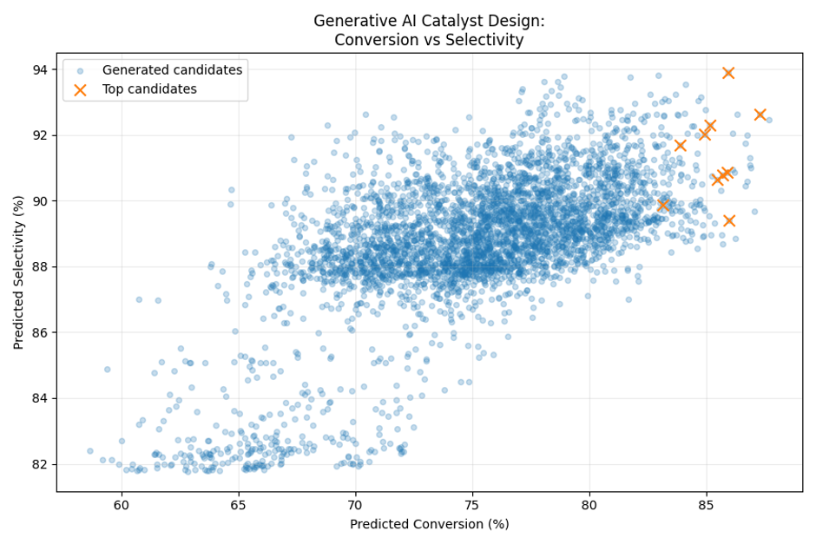
Figure 6. Generative AI Catalyst Design: Conversion vs. Selectivity

Slide 27
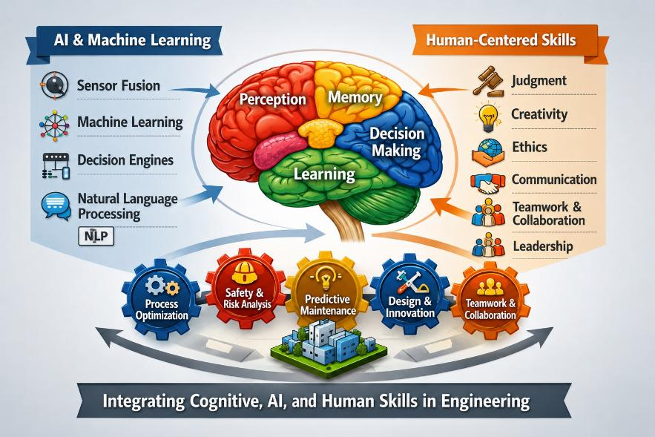
Figure 5. Integrating Cognitive, AI, and Human Skills in Engineering
Notes:
The infographic illustrates a closed-loop interaction between Artificial Intelligence & Machine Learning (AI/ML) and Human-Centered Skills, with the human brain (cognition) serving as the integration hub. Rather than showing AI replacing engineers, it demonstrates that AI augments human intelligence while human skills guide AI toward safe, ethical, and effective engineering decisions.
AI provides computational intelligence, while human-centered skills provide wisdom, ethics, creativity, and leadership. Engineering excellence is achieved when AI, human cognition, and professional skills work together—not when one replaces the other.

Slide 28

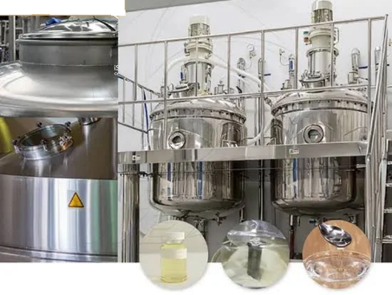
In a chemical reactor, AI-based process safety monitoring may continuously analyze
Reactor Temperature
Pressure
Feed Flow Rate
Cooling Water Performance
Reaction Conversion
T2 Laboratory Inc. Reactive Chemical Explosion
https://youtu.be/C561PCq5E1g
Notes:
Role of AI and ML in Process Safety Monitoring
Artificial Intelligence (AI) and Machine Learning (ML) significantly improve process safety monitoring by enabling systems to:
• Detect abnormal patterns automatically
• Predict unsafe conditions before incidents occur
• Analyze large volumes of plant data rapidly
• Identify hidden operational relationships
• Reduce false alarms
• Improve operator decision-making
• Support predictive safety management

Slide 29

Table 4. Summary Table
AI/ML/ANN Tool | Preventive Function | T2 Failure Addressed
Predictive maintenance | Detect cooling degradation early | Cooling system failure
ANN runaway predictor | Forecast temperature/pressure acceleration | Runaway reaction onset
Digital twin | Compare expected vs. actual reactor behavior | Undetected deviation
AI alarm management | Early, prioritized warnings | Late operator response
Automated intervention | Trigger quench/shutdown | Human delay
AI‑enhanced PHA | Identify reactive hazards | Inadequate hazard recognition
Generative AI support | Real‑time decision guidance | Lack of situational awareness
A Digital Twin is a dynamic AI‑enhanced model that behaves like the real equipment, learns from real data, and allows engineers to test, predict, and optimise without touching the physical plant.
Notes:
GANs use two competing neural networks—a generator and a discriminator—to learn the distribution of process data. In process safety applications, they can generate representative examples of rare faults, cooling failures, runaway trajectories, sensor malfunctions, and other hazardous scenarios for which historical plant data may be limited. They can also support anomaly detection, data augmentation, operator-training simulations, and model stress-testing.
A digital twin provides a dynamic virtual representation of a physical refinery process. Through its integration with AI, machine learning, and artificial neural networks, it uses historical and real-time operating data for continuous monitoring, process-state estimation, anomaly detection, prediction, simulation, optimization, and operational decision support.

Slide 30

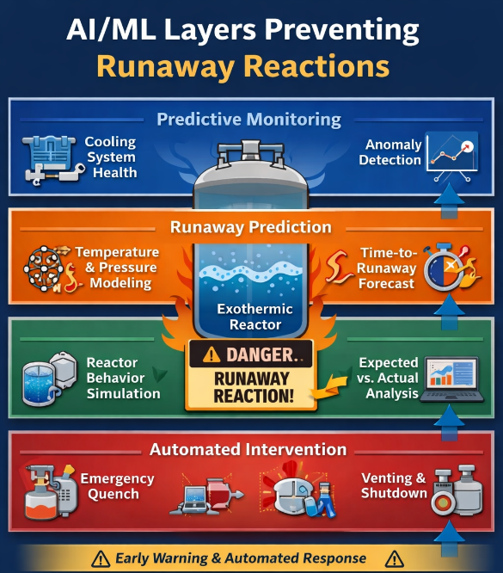
Figure 6. AI/ML layers in preventing runaway reactions

Slide 31
A Practical Framework
Future chemical/process engineer | AI/ML/ANNs
Must Know | Applications of AI/ML/ANN Strengths and limitations Data quality requirements Interpretations of outputs.
Should Know | Basic model structure Training concepts Accuracy and validation methods Python fundamentals
Nice to Know | Neural network mathematics Model development from scratch. Advanced AI architectures.
AI/ML/ANN tools should be viewed as engineers view process simulators. They should understand what these tools do, where they can be applied, their assumptions, and limitations. Not every engineer must become an AI-developer, but should possess sufficient knowledge to evaluate AI-generated recommendations, verify their engineering validity and apply professional judgment before implementation.

Slide 32

Concluding Perspective
The future of chemical and process engineering will likely involve a close integration between:
Human cognitive capabilities
Engineering fundamentals
AI-assisted systems
ML-based predictive tools
Digital engineering environments

Slide 33

Concluding Perspective
Engineers who combine technical expertise
with cognitive skills, communication abilities,
ethical reasoning, and digital intelligence will
be better positioned to lead modern engineering
organizations and solve increasingly complex
industrial challenges.

Slide 34

IChemE Webinar Files Available on AKC Technology.com
Website:
https://www.akctechnology.com
On the website, navigate to the Training Menu and then click on IChemE –Webinar Folder.
Access the files by clicking on the IChemE menu/folder.
PowerPoint Slides
Example
Python programs/scripts
Glossary on Artificial Intelligence and Human Cognition

Slide 35


New Book published by Tellwell Publishing Company
https://www.akctechnology.com
Notes:
If today's workshop has convinced you that the future engineer needs more than technical expertise—that we must combine Human Intelligence, Artificial Intelligence, and Human-Centered Skills—then I invite you to continue that journey. This philosophy is explored in much greater depth in my recently published book, The Soft Skills Edge – Engineering Your Path to Professional Success. It was written to help engineers develop the professional capabilities that AI cannot replace

